Slide 1
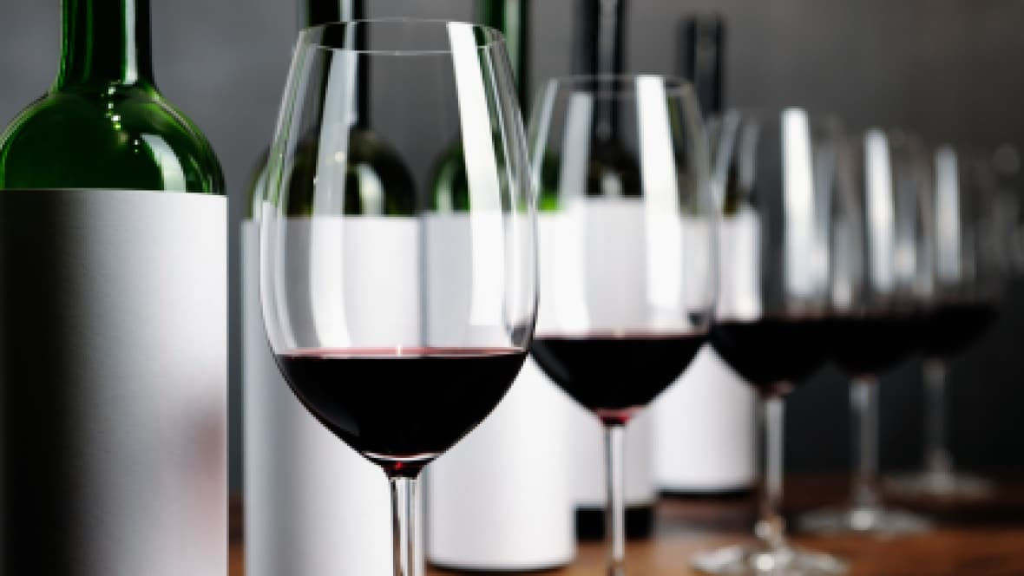
How do
you know that glass of wine
is good?
by Tate Kennedy
July 22,
2018

Slide 2
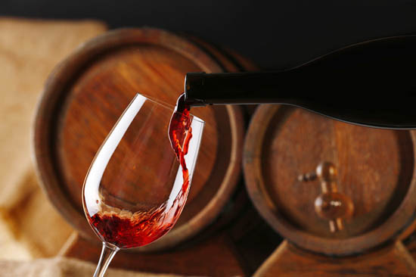
Wine Statistics in the United States
The United States continues to be the largest wine consuming nation since 2010 (Wine Institute, 2015).
In 2015, the total amount of wine consumed in the U.S. was 2.83 gallons per resident, roughly 14 bottles of wine per year (pales in comparison to France, at 11.7 gallons).
According to the website Statista, the United States became the 4th largest producer nation (following Italy, France and Spain) with 23.9 million hectoliters in 2016.
It’s also a $38 billion industry in the U.S. (GordOn, 2016).
There are many statistics available that showcase wine’s growing popularity and those contributing factors, but in the end there’s really only one thing that matters … how wine tastes!

Slide 3
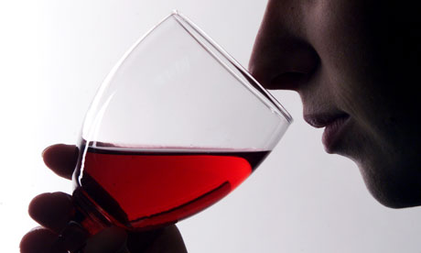
Use Case
Wine quality is mostly assessed by physicochemical tests and the more widely accepted, sensory tests.
Sensory tests depend on human experts to sample the wine and qualify the wine according to taste.
This subjective method is challenged in keeping up with the demands of mass production created from the increasing popularity of wine.
The physicochemical tests can be conducted on a larger scale and have the advantage of being objective.
This leads us to our research question:
Through classification, can we accurately measure the quality of wine based on physicochemical compounds?

Slide 4
Data Source
Sensory test data (the outcome variable) and physicochemical test data (the input variables) were collected for red and white variants of the Portugese “Vindho Verde” wine with the aim to explore the relationship between the two types of test results.
Datasets are available from the UCI Machine Learning repository https://archive.ics.uci.edu/ml/datasets/wine+quality (P. Cortez, A. Cerdeira, F. Almeida, T. Matos and J. Reis. Modeling wine preferences by data mining from physicochemical properties. In Decision Support Systems, Elsevier, 47(4):547-553, 2009).
Due to privacy concerns, data about grape types, brand and price were omitted.
The data was collected between May 2004 and February 2007.
Sensory tests were conducted by experts in the field, evaluating each wine sample three times through a blind taste test. Scores were assigned from a range of zero to ten, with ten representing the highest quality of wine. The median of the three scores was recorded for each sample.
Physicochemical tests were performed on eleven of the most common compounds, including fixed acidity, volatile acidity, citric acid, residual sugar, chlorides, free sulfur dioxide, total sulfur dioxide, density, pH, sulphates and alcohol.

Slide 5
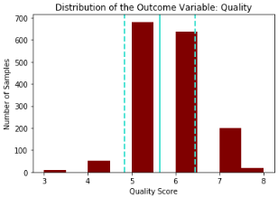
Classification
Within supervised learning, we can use classification models to categorize the outcome of interest (quality of wine) between discrete values such as good (quality of 7 or higher), average (quality of 5 or 6) and poor (quality less than 5).
There were two sets of data available, one for red wine and the other for white wine. The dataset for red wine was selected, which included 1,599 samples.
The dependent variable, quality, is normally distributed.
The data is not centered but clusters around the mean and the majority of the results are within one standard deviation of the mean.

Slide 6
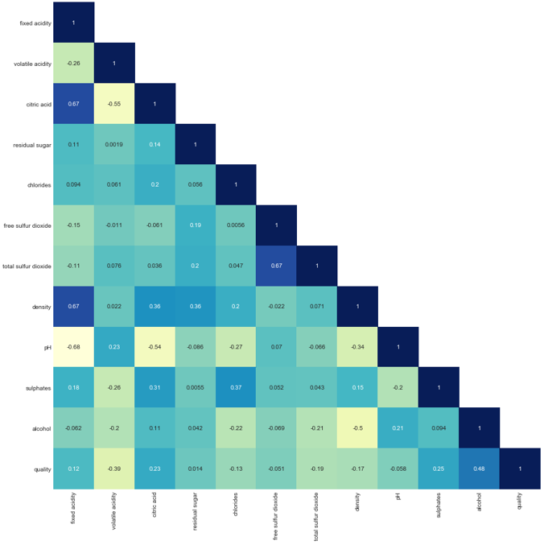
Features
The quality of red wine, the dependent variable, is most correlated with alcohol, followed by sulphates and citric acid.
Volatile acidity has the most significant inverse relationship with quality.
Free sulfur dioxide, pH and residual sugar have the lowest relationships with quality.
Some signs of collinearity exist between fixed acidity, citric acid and density as well as between free sulfur dioxide and total sulfur dioxide.
Principal Components Analysis confirms 95% of the total variance in quality is explained by eight components.
Features were reduced accordingly.

Slide 7
Best Model
Random Forest Classifier produced the highest accuracy rate at 89.3%, but only when we increased the number of estimators to 250.
Earlier iterations with estimators at 25, 100 and 150 produced lower scores and additional iterations above 250, such as 500 and 1,000 produced either the same or lower accuracy rates.
Cross-validation scores (cv=10) were consistent, eliminating concerns of overfitting in the model. Mean of 84.2%.
Test set validation, with the number of estimators at 250, produced an accuracy rate of 88.5%.

Slide 8
Models Considered
Gaussian Naïve Bayes Classifier | K-Nearest Neighbors Classifier | Support Vector Machine Classifier
Produced an 81.0% accuracy rate. With 20% holdout, accuracy rate was 81.5%. Test on sample produced an 81.6% accuracy rate. Cross-validation scores (cv=10) were relatively consistent, with the exception of two scores. Mean of 81.4%. Test set validation produced an accuracy rate of 81.5%. | Produced it’s highest accuracy rate of 84.8% with neighbors increased to 10. Earlier iterations of 5 and 1 neighbors produced lower accuracy scores. Cross-validation scores (cv=10) were relatively consistent. Mean of 83.4%. Test set validation produced a similar accuracy rate, 84.8%. | Both the linear and RBF kernels produced the same 85.8% accuracy rates. Cross-validation scores (cv=10) within the linear model were more consistent than those of the RBF model. Linear mean of 82.5%, RBF mean of 83.2%. Test set validation of the linear model produced an accuracy rate of 83.8%.

Slide 9
Model Applications
From a production standpoint:
Within the wine industry as a whole, certification and quality assessment are critical concerns. An unambiguous standard is needed to regulate the market.
The model will shed light on how physicochemical compounds affect the sensory preferences of consumers. This is an area today, where that relationship is not clearly understood.
As noted earlier, the understanding of human preferences in sensory testing is subjective and is not enough to ensure quality wine is produced at a larger scale, in keeping with demand.
From a purveyor standpoint:
Inventory and pricing. Know the quality of wine your serving and applying a complimentary pricing model.
From a consumption standpoint:
Avoid poor quality wines by seeing beyond the label or relying on chance.

Slide 10
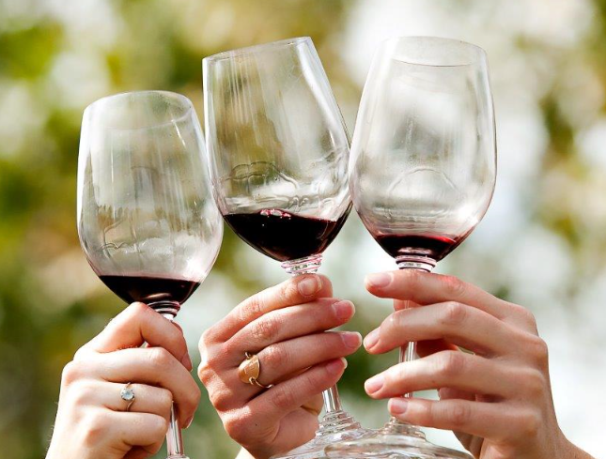
Model Improvements
Additional models could have been considered, such as Gradient Boosting Classifier, Decision Tree or Logistic Regression.
There could be additional physicochemical compounds/tests that explain a high level of variance in the quality of wine.
The model retained some variables with relatively small relationship to the dependent variable. The model could easily go down to seven features and have those still explain 90% of the total variance.
Lack of a continuous variable.
Underlying data held bias towards what’s considered normal or average wines.
There could be more fine tuning of the parameters.
Cheers!

