Slide 1


CONNECT
32
LESSON 32 · WĀHANGA 3 · DAYS, MONTHS AND THE CLASSROOM
Ngā marama: months of the year + Minutes, morning and afternoon
Ko te aha tēnei marama?
Te Reo Māori · Combined class
COMBINED CLASS · N1.5 · N2.6 · N3.7
Notes:
CONNECT
Whole class. Karakia tīmatanga led by an Ara 3 student. Retrieval (Lesson 31, Ngā rā o te wiki: days of the week): days of the week chant. Hook: “marama” means both month and moon. Why might that be?

Slide 2
WHAT WE ARE LEARNING · THREE PATHS
CONNECT
Ara 1 · Novice 1
Ara 2 · Novice 2
Ara 3 · Novice 3
We are learning the months of the year and to ask what month it is.
We are learning to tell the time with minutes past and to, and parts of the day.
We are learning to describe the weather using verbs.
I can say the twelve months
I can ask and answer “Ko te aha tēnei marama?”
I can spot the sound changes in loan-word months
I can say minutes past with “i”
I can say minutes to with “ki”
I can add i te ata / i te ahiahi / i te pō
I can ask about the weather
I can describe weather with a verb (the rain is falling)
I can describe today’s weather
Waiheke High School · Te Reo Māori · Combined class · Lesson 32 · 2
Notes:
CONNECT
Whole class. Karakia tīmatanga led by an Ara 3 student. Retrieval (Lesson 31, Ngā rā o te wiki: days of the week): days of the week chant. Hook: “marama” means both month and moon. Why might that be?

Slide 3
CONNECT
Marama means both “month” and “moon”. Why?
Waiheke High School · Te Reo Māori · Combined class · Lesson 32 · 3
Notes:
CONNECT
Whole class. Karakia tīmatanga led by an Ara 3 student. Retrieval (Lesson 31, Ngā rā o te wiki: days of the week): days of the week chant. Hook: “marama” means both month and moon. Why might that be?

Slide 4
Ngā marama
I DO
Hānuere
January
Pēpuere
February
Māehe
March
Āperira
April
Mei
May
Hune
June
Hūrae
July
Ākuhata
August
Hepetema
September
Oketopa
October
Noema
November
Tīhema
December
Waiheke High School · Te Reo Māori · Combined class · Lesson 32 · 4
Notes:
I DO
Whole class: Teach the months and look for loan-word patterns (J → H, F → P, s dropped, vowels added). Model Ko te aha tēnei marama? / Ko (te) Noema tēnei marama. Then Ara 2 at the front with the teacher (Ara 2 slides): Model minutes past (i) and to (ki), including the number rules (e before 2–9; tekau without e). Teach parts of the day. Meanwhile Ara 1 starts the worksheet or the kēmu, and Ara 3 works through the Novice 3 lesson “Kei te pēhea te huarere?” on a device.
Watch for: Missing macrons on Hānuere, Pēpuere, Māehe, Āperira, Hūrae, Ākuhata, Tīhema. Ask: “Which months have a long vowel?”

Slide 5
Sound detectives
I DO
January →
H
ānuere (no j)
February →
P
ēpuere (no f, no b)
March → Māeh
e
(every word ends in a vowel)
Watch the
tohutō
Waiheke High School · Te Reo Māori · Combined class · Lesson 32 · 5
Notes:
I DO
Whole class: Teach the months and look for loan-word patterns (J → H, F → P, s dropped, vowels added). Model Ko te aha tēnei marama? / Ko (te) Noema tēnei marama. Then Ara 2 at the front with the teacher (Ara 2 slides): Model minutes past (i) and to (ki), including the number rules (e before 2–9; tekau without e). Teach parts of the day. Meanwhile Ara 1 starts the worksheet or the kēmu, and Ara 3 works through the Novice 3 lesson “Kei te pēhea te huarere?” on a device.
Watch for: Missing macrons on Hānuere, Pēpuere, Māehe, Āperira, Hūrae, Ākuhata, Tīhema. Ask: “Which months have a long vowel?”

Slide 6
I DO
ARA 2 · NOVICE 2
Minutes, morning and afternoon
We are learning to tell the time with minutes past and to, and parts of the day.
Ara 2 group with the teacher. Ara 1: start the worksheet or the kēmu. Ara 3: your own lesson on a device.
Waiheke High School · Te Reo Māori · Combined class · Lesson 32 · 6
Notes:
I DO
Whole class: Teach the months and look for loan-word patterns (J → H, F → P, s dropped, vowels added). Model Ko te aha tēnei marama? / Ko (te) Noema tēnei marama. Then Ara 2 at the front with the teacher (Ara 2 slides): Model minutes past (i) and to (ki), including the number rules (e before 2–9; tekau without e). Teach parts of the day. Meanwhile Ara 1 starts the worksheet or the kēmu, and Ara 3 works through the Novice 3 lesson “Kei te pēhea te huarere?” on a device.
Slide note: Ara 2 group with the teacher. Ara 1: start the worksheet or the kēmu. Ara 3: your own lesson on a device.
Watch for: Missing macrons on Hānuere, Pēpuere, Māehe, Āperira, Hūrae, Ākuhata, Tīhema. Ask: “Which months have a long vowel?”

Slide 7
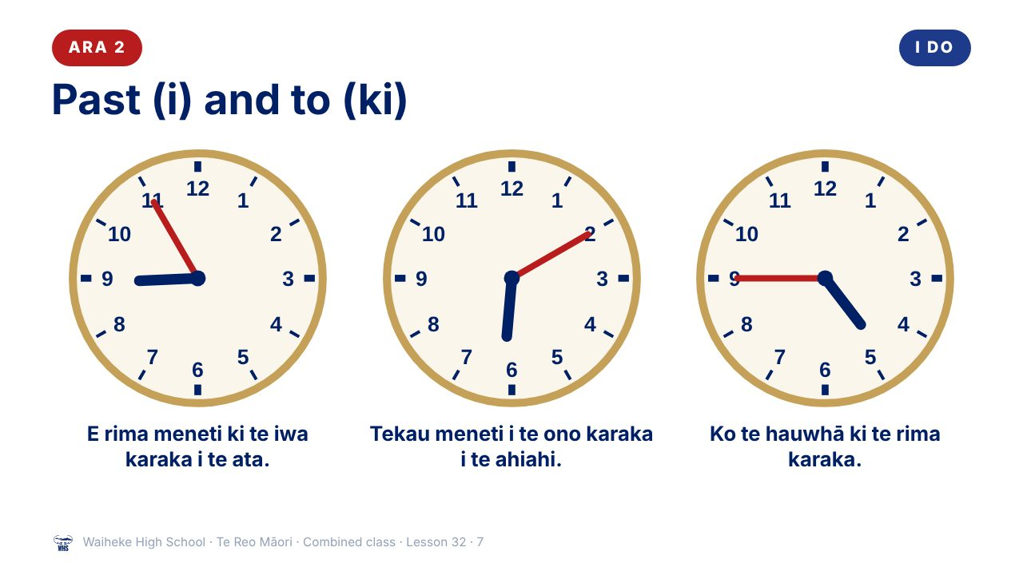
Notes:
I DO
Whole class: Teach the months and look for loan-word patterns (J → H, F → P, s dropped, vowels added). Model Ko te aha tēnei marama? / Ko (te) Noema tēnei marama. Then Ara 2 at the front with the teacher (Ara 2 slides): Model minutes past (i) and to (ki), including the number rules (e before 2–9; tekau without e). Teach parts of the day. Meanwhile Ara 1 starts the worksheet or the kēmu, and Ara 3 works through the Novice 3 lesson “Kei te pēhea te huarere?” on a device.
Watch for: Missing macrons on Hānuere, Pēpuere, Māehe, Āperira, Hūrae, Ākuhata, Tīhema. Ask: “Which months have a long vowel?”
(This slide is a picture. Edit the title in the notes or rebuild it if you need to change it.)

Slide 8
ARA 2
I DO
i or ki?
i = past
ki = to
Tekau meneti
i
te ono karaka
10 past 6
E rima meneti
ki
te iwa karaka
5 to 9
Waiheke High School · Te Reo Māori · Combined class · Lesson 32 · 8
Notes:
I DO
Whole class: Teach the months and look for loan-word patterns (J → H, F → P, s dropped, vowels added). Model Ko te aha tēnei marama? / Ko (te) Noema tēnei marama. Then Ara 2 at the front with the teacher (Ara 2 slides): Model minutes past (i) and to (ki), including the number rules (e before 2–9; tekau without e). Teach parts of the day. Meanwhile Ara 1 starts the worksheet or the kēmu, and Ara 3 works through the Novice 3 lesson “Kei te pēhea te huarere?” on a device.
Watch for: Missing macrons on Hānuere, Pēpuere, Māehe, Āperira, Hūrae, Ākuhata, Tīhema. Ask: “Which months have a long vowel?”

Slide 9
ARA 2
I DO
Parts of the day
i te ata
in the morning
i te poutūmārō
at midday
i te ahiahi
in the afternoon / evening
i te pō
at night
Waiheke High School · Te Reo Māori · Combined class · Lesson 32 · 9
Notes:
I DO
Whole class: Teach the months and look for loan-word patterns (J → H, F → P, s dropped, vowels added). Model Ko te aha tēnei marama? / Ko (te) Noema tēnei marama. Then Ara 2 at the front with the teacher (Ara 2 slides): Model minutes past (i) and to (ki), including the number rules (e before 2–9; tekau without e). Teach parts of the day. Meanwhile Ara 1 starts the worksheet or the kēmu, and Ara 3 works through the Novice 3 lesson “Kei te pēhea te huarere?” on a device.
Watch for: Missing macrons on Hānuere, Pēpuere, Māehe, Āperira, Hūrae, Ākuhata, Tīhema. Ask: “Which months have a long vowel?”

Slide 10
Ko te aha tēnei marama?
WE DO
PĀTAI
Ko te aha tēnei marama?
What month is it?
WHAKAUTU
Ko (te) Noema tēnei marama.
It is November.
Waiheke High School · Te Reo Māori · Combined class · Lesson 32 · 10
Notes:
WE DO
Birthday line-up by month (Ko ___ taku marama huritau… keep simple: students just say their month). Ara 2 version: Class reads times from the school bell timetable. Mixed-path pairs: Ara 2 or 3 students partner Ara 1 students as tuakana.

Slide 11
ARA 2
WE DO
Our bell times
Read them in te reo
1
Period 1 starts
2
Morning tea
3
Lunch
4
Home time
Waiheke High School · Te Reo Māori · Combined class · Lesson 32 · 11
Notes:
WE DO
Birthday line-up by month (Ko ___ taku marama huritau… keep simple: students just say their month). Ara 2 version: Class reads times from the school bell timetable. Mixed-path pairs: Ara 2 or 3 students partner Ara 1 students as tuakana.

Slide 12
WE DO
ARA 3 · NOVICE 3
Kei te pēhea te huarere?
We are learning to describe the weather using verbs.
Ara 3 works independently from the Novice 3 slides, then partners an Ara 1 student for the kōrero task (tuakana–teina).
Waiheke High School · Te Reo Māori · Combined class · Lesson 32 · 12
Notes:
WE DO
Birthday line-up by month (Ko ___ taku marama huritau… keep simple: students just say their month). Ara 2 version: Class reads times from the school bell timetable. Mixed-path pairs: Ara 2 or 3 students partner Ara 1 students as tuakana.
Slide note: Ara 3 works independently from the Novice 3 slides, then partners an Ara 1 student for the kōrero task (tuakana–teina).

Slide 13
Your task
YOU DO
Ara 1
Ara 2
Ara 3
KŌRERO
Month bingo with your group.
KŌRERO
“My day”: tell your partner three times.
KŌRERO
Weather forecast role-play.
WORKSHEET
Q1 Write the months in order.
WORKSHEET
Q1 Read the clocks.
WORKSHEET
Q1 Match.
WORKSHEET
Q2 Sound detective.
WORKSHEET
Q2 Write our school timetable.
WORKSHEET
Q2 Describe the pictures.
WORKSHEET
Q3 Make a calendar of four events.
WORKSHEET
Q3 Match.
WORKSHEET
Q3 Weather diary.
Waiheke High School · Te Reo Māori · Combined class · Lesson 32 · 13
Notes:
YOU DO
Three worksheets (see “Worksheets by path”). Ara 1: Kōrero: “month bingo”. Worksheet: months in order, sound-change detective, a calendar of four events. Ara 2: Kōrero: “My day” timetable dialogue. Worksheet: read clocks, write a timetable, match times. Ara 3: Kōrero: weather forecast role-play. Worksheet: match, describe pictures, a week’s weather diary.

Slide 14
REVIEW
↻ REVIEW
Ko te aha tēnei marama?
Answer in a full sentence.
Which month is your birthday?
Ara 2: When does lunch start? Answer in te reo.
Waiheke High School · Te Reo Māori · Combined class · Lesson 32 · 14
Notes:
REVIEW
Whole class: Exit: Ko te aha tēnei marama? Name the month of your birthday. Ara 2 also: Exit: When does lunch start? Answer in te reo. Karakia whakamutunga led by an Ara 3 student.

