Slide 1


CONNECT
3
LESSON 3 · WĀHANGA 1 · KIA ORA! SOUNDS, GREETINGS AND WHO I AM
Tricky sounds and dialects
ng · r · t · wh
Te Reo Māori · Novice 1
NOVICE 1 · N1.1
Notes:
CONNECT
Karakia tīmatanga (opening karakia) led by the teacher, then a student once taught in Lesson 7. Retrieval (Lesson 2, Te arapū Māori: vowels and macrons): vowels short and long. Hook: play or say “ngā” and ask where students have heard “ng” at the start of a word in English (they haven’t; only in the middle, as in singer).

Slide 2
CONNECT
WHAT WE ARE LEARNING
We are learning to pronounce ng, r, t and wh, and to notice how dialects differ between iwi and regions.
SUCCESS CRITERIA
✓ I can say ng, a tapped r, soft and aspirated t, and wh
✓ I can read syllable drills aloud
✓ I can give one example of a dialect difference
Waiheke High School · Te Reo Māori · Novice 1 · Lesson 3 · 2
Notes:
CONNECT
Karakia tīmatanga (opening karakia) led by the teacher, then a student once taught in Lesson 7. Retrieval (Lesson 2, Te arapū Māori: vowels and macrons): vowels short and long. Hook: play or say “ngā” and ask where students have heard “ng” at the start of a word in English (they haven’t; only in the middle, as in singer).

Slide 3
CONNECT
Where do you hear “ng” in English?
singer · bringing · Singapore
Can you start a word with it?
Waiheke High School · Te Reo Māori · Novice 1 · Lesson 3 · 3
Notes:
CONNECT
Karakia tīmatanga (opening karakia) led by the teacher, then a student once taught in Lesson 7. Retrieval (Lesson 2, Te arapū Māori: vowels and macrons): vowels short and long. Hook: play or say “ngā” and ask where students have heard “ng” at the start of a word in English (they haven’t; only in the middle, as in singer).

Slide 4
Four tricky sounds
I DO
ng
as in singer: ngā, ngeru
r
tapped, not rolled: rangi
t
soft before a e o · aspirated before i u
wh
usually like English “f”: whare
Waiheke High School · Te Reo Māori · Novice 1 · Lesson 3 · 4
Notes:
I DO
Model each sound with the English anchors: ng in singer/bringing/Singapore; tapped r (tongue taps the roof of the mouth); t soft before a e o and aspirated before i u; wh like f. Introduce mita (dialect) with the four curriculum examples on a map.
Watch for: Students rolling the r like Spanish, or saying “n-g” as two sounds. Ask: “Where does your tongue go when you tap the r?”

Slide 5
Syllable drills
WE DO
 | a | e | i | o | u
r | ra | re | ri | ro | ru
t | ta | te | ti | to | tu
ng | nga | nge | ngi | ngo | ngu
wh | wha | whe | whi | who | whu
Waiheke High School · Te Reo Māori · Novice 1 · Lesson 3 · 5
Notes:
WE DO
Syllable drills as a class: ra re ri ro ru / ta te ti to tu / nga nge ngi ngo ngu / wha whe whi who whu. Then pairs read greetings from Lesson 1 to each other with feedback.

Slide 6
Mita: dialects differ
I DO
Iwi or region | Feature | Example
Ngāi Tahu | k replaces ng | Kāi Tahu · kāika
Tūhoe | ng becomes n | nā (for ngā)
Taranaki | h often dropped | Whanganui → “Wanganui”
Ngāpuhi | w often dropped | whakarongo → “hakarongo”
Waiheke High School · Te Reo Māori · Novice 1 · Lesson 3 · 6
Notes:
I DO
Model each sound with the English anchors: ng in singer/bringing/Singapore; tapped r (tongue taps the roof of the mouth); t soft before a e o and aspirated before i u; wh like f. Introduce mita (dialect) with the four curriculum examples on a map.
Slide note: Not every speaker with whakapapa to an iwi uses its dialect features.
Watch for: Students rolling the r like Spanish, or saying “n-g” as two sounds. Ask: “Where does your tongue go when you tap the r?”

Slide 7
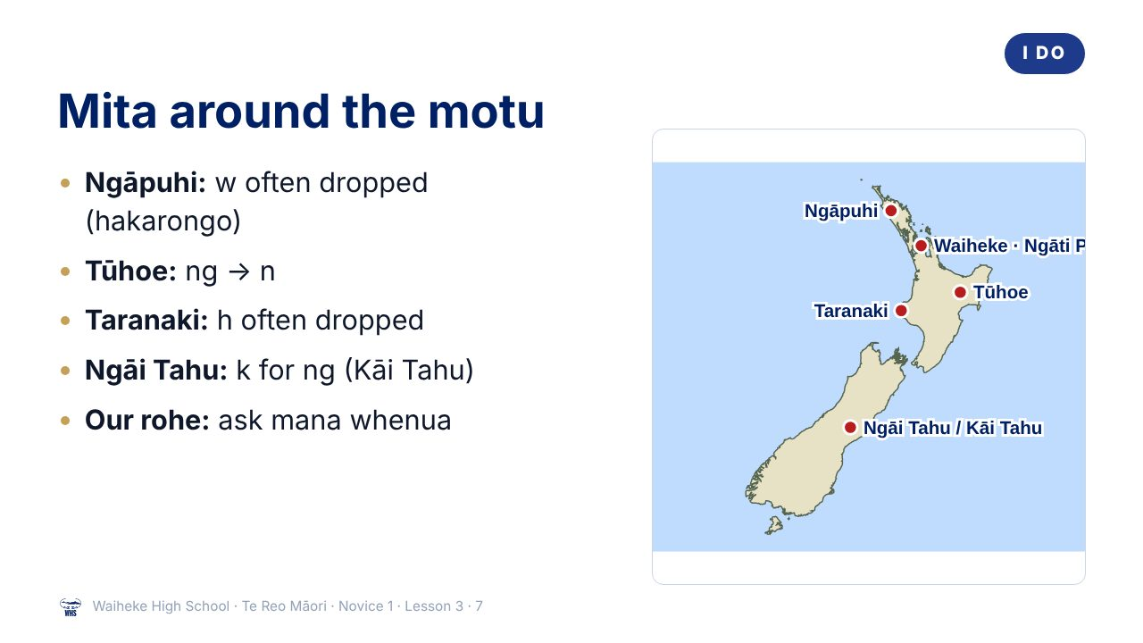
Notes:
I DO
Model each sound with the English anchors: ng in singer/bringing/Singapore; tapped r (tongue taps the roof of the mouth); t soft before a e o and aspirated before i u; wh like f. Introduce mita (dialect) with the four curriculum examples on a map.
Watch for: Students rolling the r like Spanish, or saying “n-g” as two sounds. Ask: “Where does your tongue go when you tap the r?”
(This slide is a picture. Edit the title in the notes or rebuild it if you need to change it.)

Slide 8
Our rohe
I DO
Which iwi and hapū are mana whenua here?
What features does their mita have?
Teacher: add local examples here
Waiheke High School · Te Reo Māori · Novice 1 · Lesson 3 · 8
Notes:
I DO
Model each sound with the English anchors: ng in singer/bringing/Singapore; tapped r (tongue taps the roof of the mouth); t soft before a e o and aspirated before i u; wh like f. Introduce mita (dialect) with the four curriculum examples on a map.
Watch for: Students rolling the r like Spanish, or saying “n-g” as two sounds. Ask: “Where does your tongue go when you tap the r?”

Slide 9
Your task
YOU DO
KŌRERO
With a partner, read the four drill lines. Give feedback on r and ng.
WORKSHEET
Q1 Sort the words by sound.
WORKSHEET
Q2 Match each dialect feature to its iwi.
WORKSHEET
Q3 Write two sentences about mita.
Waiheke High School · Te Reo Māori · Novice 1 · Lesson 3 · 9
Notes:
YOU DO
Kōrero: pairs record or perform the four drill lines. Worksheet: sort words by sound, match dialect examples to iwi, write about mita.

Slide 10
REVIEW
↻ REVIEW
Whakarongo!
Say whakarongo with a tapped r.
Now say it the Ngāpuhi way.
Waiheke High School · Te Reo Māori · Novice 1 · Lesson 3 · 10
Notes:
REVIEW
Exit: say “whakarongo” three ways: standard, Ngāpuhi (hakarongo) and with a tapped r.

