Slide 1
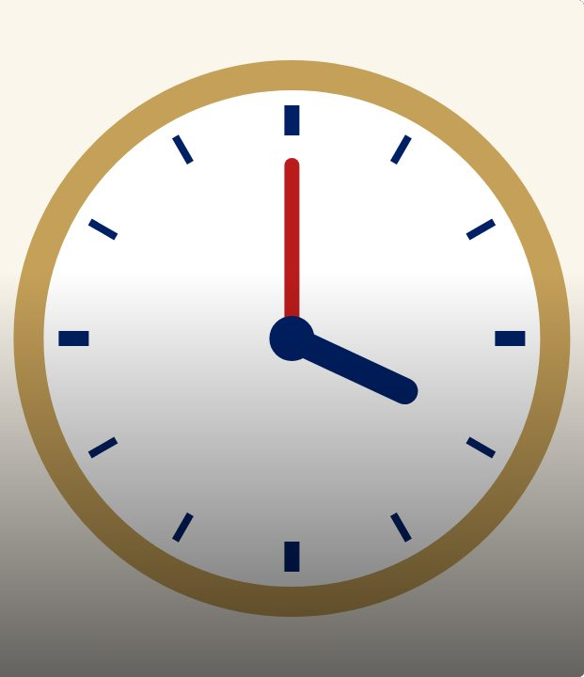

CONNECT
41
LESSON 41 · WĀHANGA 3 · DATES, ORIGINS AND TIME
Ko te aha te wā? Telling the time
Ko te aha te wā?
Te Reo Māori · Novice 2
NOVICE 2 · N2.6
Notes:
CONNECT
Karakia tīmatanga led by a student. Retrieval: numbers 1–12. Hook: “He aha te wā?” Why might a speaker smile at this question? (It asks “What is time?”)

Slide 2
CONNECT
WHAT WE ARE LEARNING
We are learning to ask and tell the time on the hour, half past and quarter past.
SUCCESS CRITERIA
✓ I can ask “Ko te aha te wā?” correctly
✓ I can say o’clock times
✓ I can say half past and quarter past
Waiheke High School · Te Reo Māori · Novice 2 · Lesson 41 · 2
Notes:
CONNECT
Karakia tīmatanga led by a student. Retrieval: numbers 1–12. Hook: “He aha te wā?” Why might a speaker smile at this question? (It asks “What is time?”)

Slide 3
CONNECT
“He aha te wā?”
Why might a speaker smile at this?
It means “What is time?”
Waiheke High School · Te Reo Māori · Novice 2 · Lesson 41 · 3
Notes:
CONNECT
Karakia tīmatanga led by a student. Retrieval: numbers 1–12. Hook: “He aha te wā?” Why might a speaker smile at this question? (It asks “What is time?”)

Slide 4
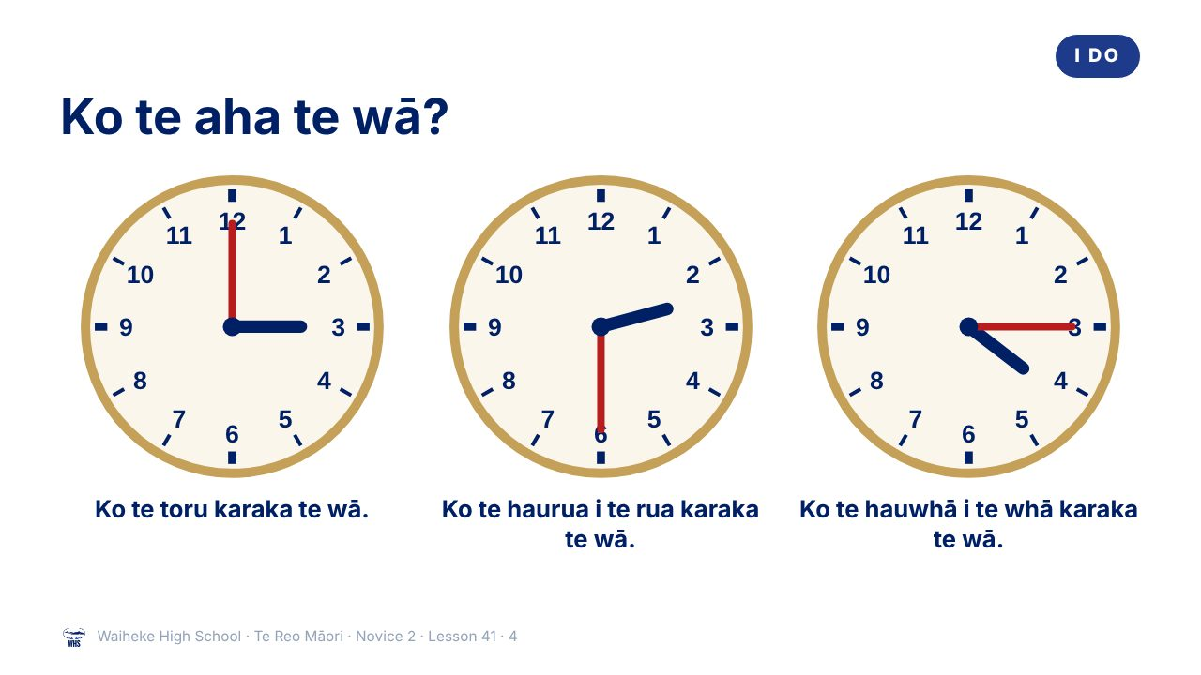
Notes:
I DO
Model Ko te aha te wā? with a clock. Teach karaka, haurua i te, hauwhā i te.
Watch for: Students asking “He aha te wā?” Ask: “Is that asking the time, or what time is?”
(This slide is a picture. Edit the title in the notes or rebuild it if you need to change it.)

Slide 5
Ask it the right way
I DO
✓
Ko te aha te wā?
What is the time?
✗ He aha te wā? What is time?
Two words for time:
wā
and
tāima
Waiheke High School · Te Reo Māori · Novice 2 · Lesson 41 · 5
Notes:
I DO
Model Ko te aha te wā? with a clock. Teach karaka, haurua i te, hauwhā i te.
Watch for: Students asking “He aha te wā?” Ask: “Is that asking the time, or what time is?”

Slide 6
Clock words
I DO
karaka
o’clock
haurua
half
hauwhā
quarter
i
past
ki
to
Waiheke High School · Te Reo Māori · Novice 2 · Lesson 41 · 6
Notes:
I DO
Model Ko te aha te wā? with a clock. Teach karaka, haurua i te, hauwhā i te.
Watch for: Students asking “He aha te wā?” Ask: “Is that asking the time, or what time is?”

Slide 7
Read the clock
WE DO
Your teacher moves the hands
1
Ko te ___ karaka te wā.
2
Ko te haurua i te ___ karaka te wā.
3
Ko te hauwhā i te ___ karaka te wā.
Waiheke High School · Te Reo Māori · Novice 2 · Lesson 41 · 7
Notes:
WE DO
Teacher moves the clock hands; class says the time.

Slide 8
Your task
YOU DO
KŌRERO
Set a time on your clock; your partner says it.
WORKSHEET
Q1 Read the clocks.
WORKSHEET
Q2 Draw the hands.
WORKSHEET
Q3 Fix the question.
Waiheke High School · Te Reo Māori · Novice 2 · Lesson 41 · 8
Notes:
YOU DO
Kōrero: pairs with clock faces. Worksheet: read clocks, draw hands, correct the question.

Slide 9
REVIEW
↻ REVIEW
Ko te aha te wā ināianei?
Say the time now.
Waiheke High School · Te Reo Māori · Novice 2 · Lesson 41 · 9
Notes:
REVIEW
Exit: say the time now.

