Slide 1
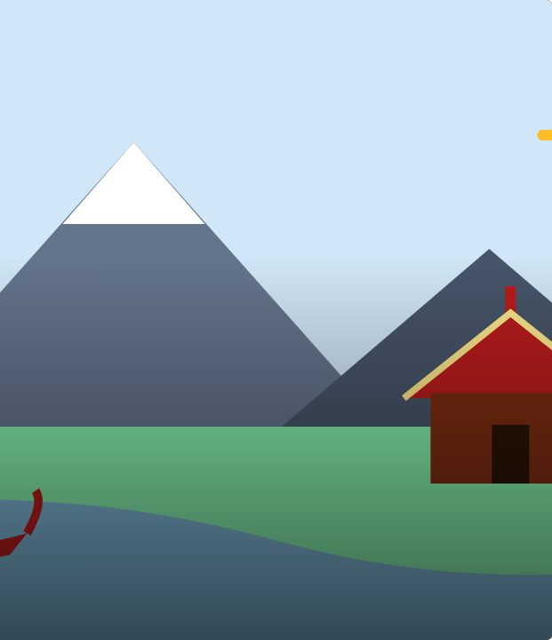

BRIEF
10
Project · 1 of 4
Tōku mihi · Research
Tōku mihi
Te Reo Māori · Novice 3
NOVICE 3 · N3.1
Notes:
BRIEF
Karakia tīmatanga. Model questions to ask whānau.

Slide 2
BRIEF
WHAT WE ARE LEARNING
We are researching our connections for our mihi.
SUCCESS CRITERIA
✓ I can gather information about my connections
✓ I can choose pepeha or kōrero tuakiri
Waiheke High School · Te Reo Māori · Novice 3 · Lesson 10 · 2
Notes:
BRIEF
Karakia tīmatanga. Model questions to ask whānau.

Slide 3
Tōku mihi: the project
BRIEF
Prepare and present a mihi with pepeha or kōrero tuakiri, plus kōrero about what matters to you.
1
Research ← today
2
Draft
3
Rehearse
4
Present
Waiheke High School · Te Reo Māori · Novice 3 · Lesson 10 · 3
Notes:
BRIEF
Karakia tīmatanga. Model questions to ask whānau.

Slide 4
Today
MAKE
Choose pepeha or kōrero tuakiri
Plan questions for whānau
Waiheke High School · Te Reo Māori · Novice 3 · Lesson 10 · 4
Notes:
MAKE
Plan questions; start research.

Slide 5
Language for the project
MAKE
Tēnā koutou katoa
Greetings to all
Ko ___ te maunga
___ is the mountain
Nō ___ aku tīpuna
My ancestors are from ___
Nō reira
And so
Waiheke High School · Te Reo Māori · Novice 3 · Lesson 10 · 5
Notes:
MAKE
Plan questions; start research.

Slide 6
Your task
MAKE
BOOK
Research plan.
Waiheke High School · Te Reo Māori · Novice 3 · Lesson 10 · 6
Notes:
MAKE
Plan questions; start research.

Slide 7
REFLECT
↻ REVIEW
Whakaaro
Who will you ask?
Waiheke High School · Te Reo Māori · Novice 3 · Lesson 10 · 7
Notes:
REFLECT
What do you still need to find out? Karakia whakamutunga.

