Slide 1
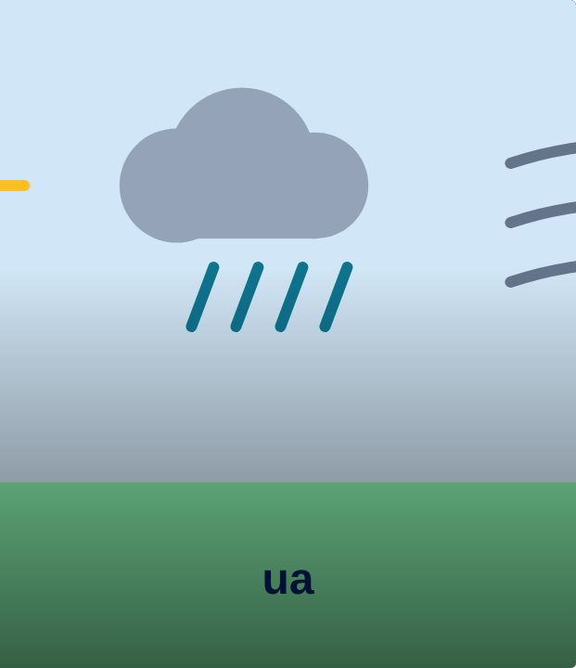

CONNECT
35
LESSON 35 · WĀHANGA 3 · KAI, WEATHER AND THE MARAMATAKA
Kei te pēhea te huarere?
Te huarere
Te Reo Māori · Novice 3
NOVICE 3 · N3.7
Notes:
CONNECT
Karakia tīmatanga led by a student. Retrieval (Lesson 32): koha. Hook: look out the window. Describe it in English. Now: what is the rain doing?

Slide 2
CONNECT
WHAT WE ARE LEARNING
We are learning to describe the weather using verbs.
SUCCESS CRITERIA
✓ I can ask about the weather
✓ I can describe weather with a verb (the rain is falling)
✓ I can describe today’s weather
Waiheke High School · Te Reo Māori · Novice 3 · Lesson 35 · 2
Notes:
CONNECT
Karakia tīmatanga led by a student. Retrieval (Lesson 32): koha. Hook: look out the window. Describe it in English. Now: what is the rain doing?

Slide 3
CONNECT
Look outside. What is the rain doing?
Waiheke High School · Te Reo Māori · Novice 3 · Lesson 35 · 3
Notes:
CONNECT
Karakia tīmatanga led by a student. Retrieval (Lesson 32): koha. Hook: look out the window. Describe it in English. Now: what is the rain doing?

Slide 4
Te huarere
I DO
Kei te heke te ua.
🌧️ The rain is falling.
Kei te whiti te rā.
☀️ The sun is shining.
Kei te pupuhi te hau.
💨 The wind is blowing.
Kei te wera tēnei rā.
🔥 It’s hot today.
Kei te makariri.
🥶 It’s cold.
Kei te kōmaru te rangi.
☁️ It’s overcast.
Waiheke High School · Te Reo Māori · Novice 3 · Lesson 35 · 4
Notes:
I DO
Model Kei te pēhea te huarere? and verb-based weather. Teach the phrases.
Watch for: Translating “it is raining” word for word. Ask: “What is the rain doing?”

Slide 5
Weather needs a verb
I DO
English: “It is raining.”
Te reo: “The rain is
falling
.”
Kei te heke te ua.
Ask with
pēhea
: Kei te pēhea te huarere?
Waiheke High School · Te Reo Māori · Novice 3 · Lesson 35 · 5
Notes:
I DO
Model Kei te pēhea te huarere? and verb-based weather. Teach the phrases.
Watch for: Translating “it is raining” word for word. Ask: “What is the rain doing?”

Slide 6
Weather charades
WE DO
Act it, the class says it
1
Kei te heke te ua
2
Kei te pupuhi te hau
3
Kei te makariri
Waiheke High School · Te Reo Māori · Novice 3 · Lesson 35 · 6
Notes:
WE DO
Weather charades; then describe the weather now.

Slide 7
Your task
YOU DO
KŌRERO
Weather forecast role-play.
WORKSHEET
Q1 Match.
WORKSHEET
Q2 Describe the pictures.
WORKSHEET
Q3 Weather diary.
Waiheke High School · Te Reo Māori · Novice 3 · Lesson 35 · 7
Notes:
YOU DO
Kōrero: weather forecast role-play. Worksheet: match, describe pictures, a week’s weather diary.

Slide 8
REVIEW
↻ REVIEW
Kei te pēhea te huarere?
Describe the weather now.
Waiheke High School · Te Reo Māori · Novice 3 · Lesson 35 · 8
Notes:
REVIEW
Exit: Kei te pēhea te huarere ināianei?

