Slide 1
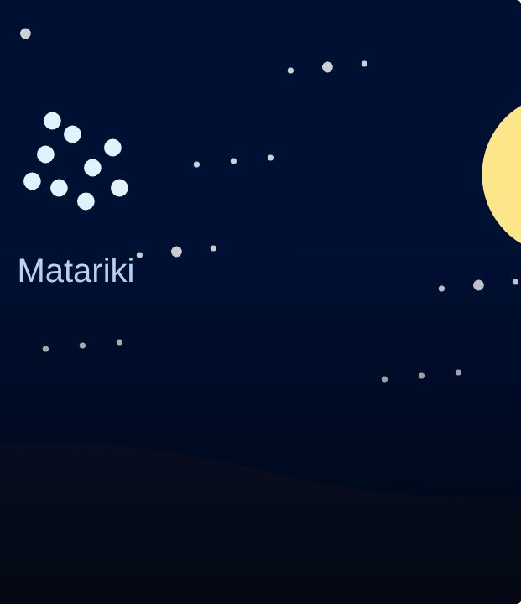

CONNECT
36
LESSON 36 · WĀHANGA 3 · KAI, WEATHER AND THE MARAMATAKA
Seasons and the maramataka
Maramataka
Te Reo Māori · Novice 3
NOVICE 3 · N3.7
Notes:
CONNECT
Karakia tīmatanga led by a student. Retrieval (Lesson 35): today’s weather. Hook: before calendars on phones, how might people know when to plant or fish?

Slide 2
CONNECT
WHAT WE ARE LEARNING
We are learning the seasons and how the maramataka guides activities.
SUCCESS CRITERIA
✓ I can name the four seasons
✓ I can ask what season it is
✓ I can explain what the maramataka is and how it guides planting, fishing and harvesting
Waiheke High School · Te Reo Māori · Novice 3 · Lesson 36 · 2
Notes:
CONNECT
Karakia tīmatanga led by a student. Retrieval (Lesson 35): today’s weather. Hook: before calendars on phones, how might people know when to plant or fish?

Slide 3
CONNECT
Without a phone calendar, how would you know when to plant or fish?
Waiheke High School · Te Reo Māori · Novice 3 · Lesson 36 · 3
Notes:
CONNECT
Karakia tīmatanga led by a student. Retrieval (Lesson 35): today’s weather. Hook: before calendars on phones, how might people know when to plant or fish?

Slide 4
Ngā wāhanga o te tau
I DO
Ko te aha tēnei wāhanga o te tau? · Ko te ngahuru.
raumati
summer · Tīhema–Pēpuere (Dec–Feb)
ngahuru
autumn · Māehe–Mei (Mar–May)
takurua
winter · Hune–Ākuhata (Jun–Aug)
kōanga
spring · Hepetema–Noema (Sep–Nov)
Waiheke High School · Te Reo Māori · Novice 3 · Lesson 36 · 4
Notes:
I DO
Teach the four seasons and the question. Explain the maramataka: moon phases (e.g. Whiro, Rākaunui), the stars (Matariki, Puanga), and how they guide planting, fishing and harvesting. Note iwi differences.
Watch for: Northern hemisphere seasons (Christmas in winter). Ask: “Which months are summer in Aotearoa?”

Slide 5
Te maramataka
I DO
A traditional calendar tracking the
moon
,
sun
and
stars
Guides
planting
,
fishing
and
harvesting
Phases include
Whiro
(new moon) and
Rākaunui
(full moon)
Maramataka
differ
between iwi and rohe
Waiheke High School · Te Reo Māori · Novice 3 · Lesson 36 · 5
Notes:
I DO
Teach the four seasons and the question. Explain the maramataka: moon phases (e.g. Whiro, Rākaunui), the stars (Matariki, Puanga), and how they guide planting, fishing and harvesting. Note iwi differences.
Watch for: Northern hemisphere seasons (Christmas in winter). Ask: “Which months are summer in Aotearoa?”

Slide 6
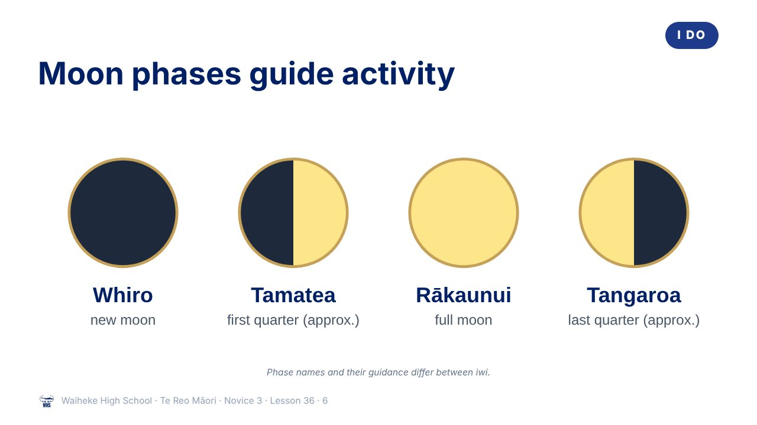
Notes:
I DO
Teach the four seasons and the question. Explain the maramataka: moon phases (e.g. Whiro, Rākaunui), the stars (Matariki, Puanga), and how they guide planting, fishing and harvesting. Note iwi differences.
Slide note: Phase names and their guidance differ between iwi.
Watch for: Northern hemisphere seasons (Christmas in winter). Ask: “Which months are summer in Aotearoa?”
(This slide is a picture. Edit the title in the notes or rebuild it if you need to change it.)

Slide 7
Matariki and Puanga
I DO
Matariki
(the Pleiades) rises in
takurua
(winter)
Marks the Māori New Year for many iwi
Some iwi use
Puanga
(Rigel)
A time to remember, celebrate and plan
Waiheke High School · Te Reo Māori · Novice 3 · Lesson 36 · 7
Notes:
I DO
Teach the four seasons and the question. Explain the maramataka: moon phases (e.g. Whiro, Rākaunui), the stars (Matariki, Puanga), and how they guide planting, fishing and harvesting. Note iwi differences.
Watch for: Northern hemisphere seasons (Christmas in winter). Ask: “Which months are summer in Aotearoa?”

Slide 8
Your task
YOU DO
BOOK
Make a seasons wheel with te reo seasons, months and a maramataka activity.
KŌRERO
Ko te aha tēnei wāhanga o te tau?
Waiheke High School · Te Reo Māori · Novice 3 · Lesson 36 · 8
Notes:
YOU DO
Book: make a seasons wheel with te reo seasons, months and one maramataka activity each. Kōrero: Ko te aha tēnei wāhanga o te tau?

Slide 9
REVIEW
↻ REVIEW
Te maramataka
What is it, and what does it guide?
Waiheke High School · Te Reo Māori · Novice 3 · Lesson 36 · 9
Notes:
REVIEW
Exit: What is the maramataka, and what does it guide?

