Slide 1
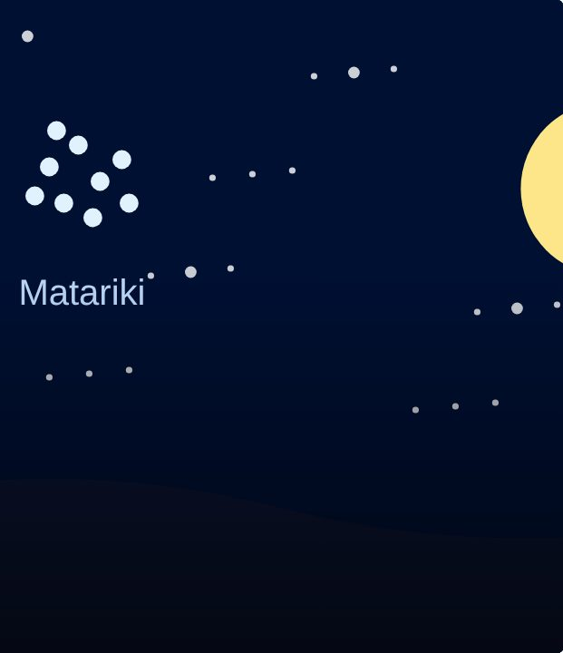

START
1
LESSON 1 · ANY LEVEL
Matariki: the Māori New Year
Matariki
Te Reo Māori · Relief lessons
RELIEF LESSONS · ARA 1–3
Notes:
START
(5 min) Greet the class (Kia ora koutou). Karakia if usual. Show slides 1–3 and read the Matariki introduction together.

Slide 2
START
WHAT WE ARE LEARNING
We are learning about Matariki, the Māori New Year, and the stars of the Matariki cluster.
SUCCESS CRITERIA
✓ I can explain what Matariki is and when it happens.
✓ I can name some stars of Matariki and what each is connected to.
✓ I can write a Matariki wish (Ara 2 and 3 in te reo).
Waiheke High School · Te Reo Māori · Relief lessons · Lesson 1 · 2
Notes:
START
(5 min) Greet the class (Kia ora koutou). Karakia if usual. Show slides 1–3 and read the Matariki introduction together.

Slide 3
What is Matariki?
LEARN
A cluster of stars that rises before dawn in mid-winter (June or July).
It marks
te tau hou Māori
, the Māori New Year.
A public holiday in Aotearoa since 2022.
Remember the past · celebrate the present · plan for the future.
Waiheke High School · Te Reo Māori · Relief lessons · Lesson 1 · 3
Notes:
LEARN
(10 min) Slides 4–5: the nine stars and the three Matariki themes. Students say the star names after a confident student, or read them together.

Slide 4
Ngā whetū o Matariki · the nine stars
LEARN
Matariki
health and wellbeing
Pōhutukawa
those who have died
Tupuānuku
food grown in the ground
Tupuārangi
food from trees and birds
Waitī
fresh water and its food
Waitā
the ocean and its food
Waipunarangi
rain
Ururangi
the winds
Hiwa-i-te-rangi
wishes for the year ahead
Waiheke High School · Te Reo Māori · Relief lessons · Lesson 1 · 4
Notes:
LEARN
(10 min) Slides 4–5: the nine stars and the three Matariki themes. Students say the star names after a confident student, or read them together.

Slide 5
Three ways to celebrate
LEARN
Remember
Celebrate
Look ahead
Matariki Hunga Nui
Remember those who have died since last Matariki.
Matariki Ahunga Nui
Share kai with whānau and friends.
Matariki Manako Nui
Make wishes and plans for the new year.
Waiheke High School · Te Reo Māori · Relief lessons · Lesson 1 · 5
Notes:
LEARN
(10 min) Slides 4–5: the nine stars and the three Matariki themes. Students say the star names after a confident student, or read them together.

Slide 6
Kupu hou · new words
LEARN
whetū
star
tau hou
new year
rangi
sky
kai
food
wai
water
hau
wind
ua
rain
wawata
wish; hope
Waiheke High School · Te Reo Māori · Relief lessons · Lesson 1 · 6
Notes:
LEARN
(10 min) Slides 4–5: the nine stars and the three Matariki themes. Students say the star names after a confident student, or read them together.

Slide 7
Your task
DO
WORKSHEET
Everyone: Parts A and B.
WORKSHEET
Then your Ara section (Ara 1, 2 or 3).
BOOK
Finished? Draw the Matariki cluster and label three stars.
Waiheke High School · Te Reo Māori · Relief lessons · Lesson 1 · 7
Notes:
DO
(35 min) Worksheet: everyone does Parts A–C, then their Ara section, then the drawing. Early finishers choose from the list at the bottom of the sheet.

Slide 8
FINISH
↻ REVIEW
Hiwa-i-te-rangi · make a wish
Share one Matariki wish with the person next to you.
Which star do you think is most important? Why?
Waiheke High School · Te Reo Māori · Relief lessons · Lesson 1 · 8
Notes:
FINISH
(10 min) Pairs share their Matariki wish and their hākari menu. Two or three share with the class. Collect sheets. Ka kite anō!

