Slide 1
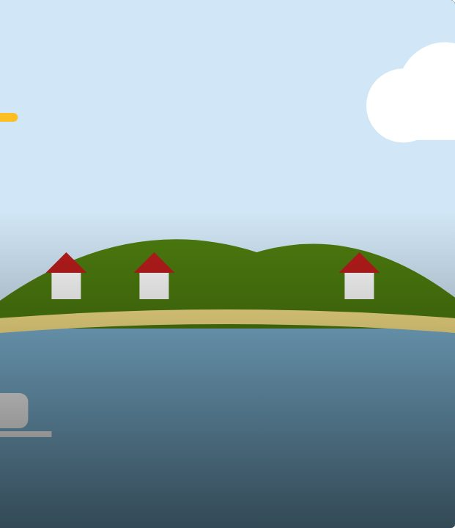

START
2
LESSON 2 · ANY LEVEL
Place-name detectives
Ngā ingoa wāhi
Te Reo Māori · Relief lessons
RELIEF LESSONS · ARA 1–3
Notes:
START
(5 min) Greet the class. Show slide 3: ask who knows what Rotorua or Aotearoa means.

Slide 2
START
WHAT WE ARE LEARNING
We are learning to break Māori place names into parts to work out what they mean.
SUCCESS CRITERIA
✓ I can recognise common parts of place names (wai, roto, maunga, motu, nui, iti).
✓ I can work out the meaning of some place names.
✓ I can create and explain a place name (Ara 3).
Waiheke High School · Te Reo Māori · Relief lessons · Lesson 2 · 2
Notes:
START
(5 min) Greet the class. Show slide 3: ask who knows what Rotorua or Aotearoa means.

Slide 3
LEARN
What does “Rotorua” mean?
roto = lake
rua = two
Rotorua = the second lake
Waiheke High School · Te Reo Māori · Relief lessons · Lesson 2 · 3
Notes:
LEARN
(10 min) Slides 4–5: go through the word parts and decode two names together (Rotorua, Waiwera).

Slide 4
Word parts · ngā wāhanga kupu
LEARN
wai
water
roto
lake
maunga
mountain
motu
island
awa
river
nui
big
iti
small
roa
long
tapu
sacred
wera
hot
one
sand; beach
puke
hill
Waiheke High School · Te Reo Māori · Relief lessons · Lesson 2 · 4
Notes:
LEARN
(10 min) Slides 4–5: go through the word parts and decode two names together (Rotorua, Waiwera).

Slide 5
Let’s decode
LEARN
Name | Parts | Meaning
Waiwera | wai + wera | hot water
Rotoiti | roto + iti | small lake
Oneroa | one + roa | long beach
Aotearoa | ao + tea + roa | long white cloud
Waiheke High School · Te Reo Māori · Relief lessons · Lesson 2 · 5
Notes:
LEARN
(10 min) Slides 4–5: go through the word parts and decode two names together (Rotorua, Waiwera).

Slide 6
Your task
DO
WORKSHEET
Everyone: Part A, decode the names.
WORKSHEET
Then your Ara section.
DEVICE
Finished? Explore the Place Names Map (if devices are allowed).
Waiheke High School · Te Reo Māori · Relief lessons · Lesson 2 · 6
Notes:
DO
(35 min) Worksheet: everyone does Parts A and B, then their Ara section, then the island design. Early finishers choose from the list at the bottom of the sheet (or use the Place Names Map if devices are allowed).

Slide 7
FINISH
↻ REVIEW
Kōrero
Which name did you like most? What does it mean?
Ara 3: share your invented place name.
Waiheke High School · Te Reo Māori · Relief lessons · Lesson 2 · 7
Notes:
FINISH
(10 min) Pairs swap and decode each other’s island names. Share the best ones. Collect sheets.

