Slide 1
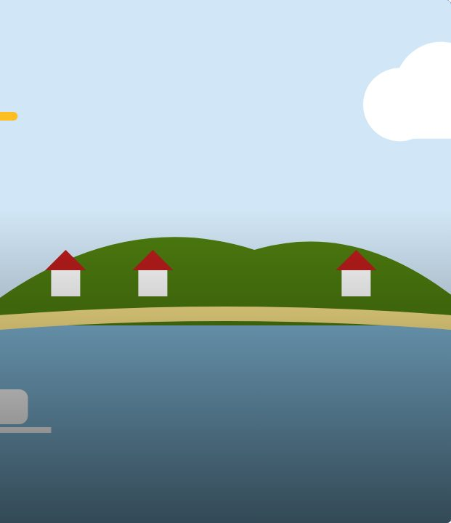

CONNECT
22
LESSON 22 · WĀHANGA 2 · NUMBERS, AGE AND PLACES
Kei hea tō kāinga? Significant places + Nō hea koe? Where are you from?
Kei hea tō kāinga?
Te Reo Māori · Combined class
COMBINED CLASS · N1.4 · N2.5 · N3.6
Notes:
CONNECT
Whole class. Karakia tīmatanga led by an Ara 3 student. Hook: “Where is home?” Is it always where you live? Students think-pair-share.

Slide 2
WHAT WE ARE LEARNING · THREE PATHS
CONNECT
Ara 1 · Novice 1
Ara 2 · Novice 2
Ara 3 · Novice 3
We are learning to communicate about places that are significant to us.
We are learning to talk about where people are from, including whakapapa connections to place.
We are learning to describe quality and quantity, including how many are needed.
I can ask and answer “Kei hea tō kāinga?”
I can use “kei” for where I live now and “ko” for my home
I can name places in Aotearoa with their Māori names
I can ask and answer “Nō hea koe?”
I can explain how “nō” is different from “kei”
I can talk about connections to more than one place
I can describe quality with kei te + adjective
I can ask and answer E hia?
I can ask how many are needed with Kia hia?
Waiheke High School · Te Reo Māori · Combined class · Lesson 22 · 2
Notes:
CONNECT
Whole class. Karakia tīmatanga led by an Ara 3 student. Hook: “Where is home?” Is it always where you live? Students think-pair-share.

Slide 3
CONNECT
Where is home? Is it always where you live?
Think · pair · share
Waiheke High School · Te Reo Māori · Combined class · Lesson 22 · 3
Notes:
CONNECT
Whole class. Karakia tīmatanga led by an Ara 3 student. Hook: “Where is home?” Is it always where you live? Students think-pair-share.

Slide 4
Kei hea tō kāinga?
I DO
PĀTAI
Kei hea tō kāinga?
Where is your home?
WHAKAUTU
Kei Waiheke taku kāinga.
My home is on Waiheke.
PĀTAI
Kei hea tana kāinga?
Where is their home?
WHAKAUTU
Kei Kāpiti tana kāinga.
Their home is at Kāpiti.
Waiheke High School · Te Reo Māori · Combined class · Lesson 22 · 4
Notes:
I DO
Whole class: Model Kei hea tō kāinga? / Kei Waiheke taku kāinga. Contrast with Ko Aotearoa taku kāinga. Teach Māori place names on a map of Aotearoa. Talk about home as belonging. Then Ara 2 at the front with the teacher (Ara 2 slides): Contrast kei (where now) with nō (whakapapa connection). Model Nō hea koe? / Nō Tapuika ahau. Nō Taranaki ia. Nō Airangi a Siobhan. Explain that people connect to many places through different whānau members. Meanwhile Ara 1 starts the worksheet or the kēmu, and Ara 3 works through the Novice 3 lesson “Quality and quantity” on a device.
Watch for: Students saying “Kei hea koe kāinga”. Ask: “Where does “taku” go in the sentence?”

Slide 5
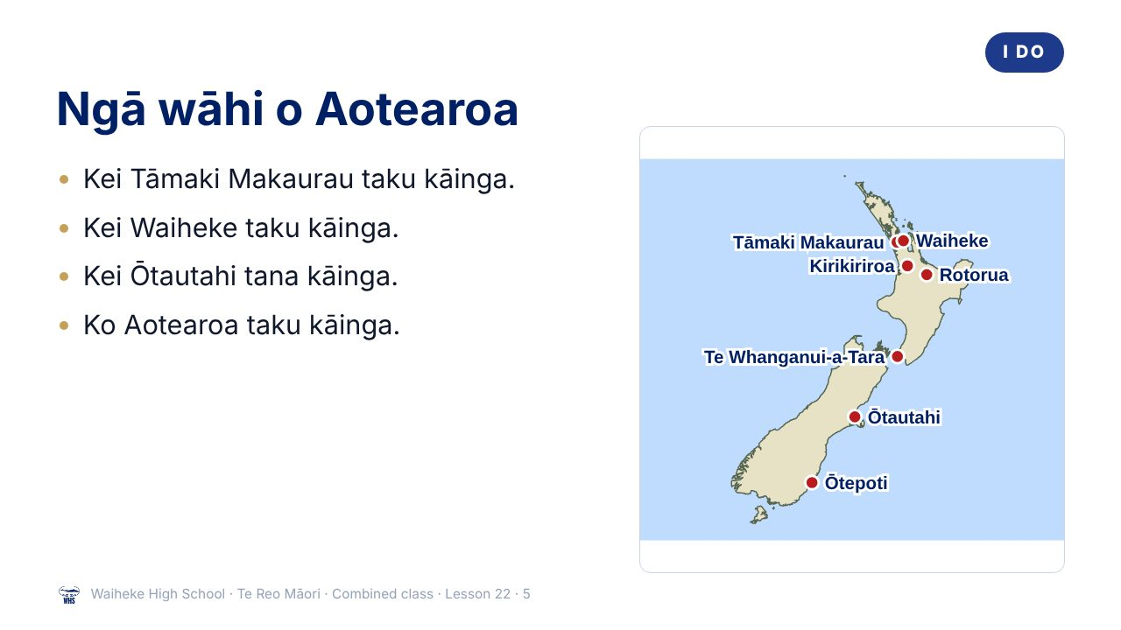
Notes:
I DO
Whole class: Model Kei hea tō kāinga? / Kei Waiheke taku kāinga. Contrast with Ko Aotearoa taku kāinga. Teach Māori place names on a map of Aotearoa. Talk about home as belonging. Then Ara 2 at the front with the teacher (Ara 2 slides): Contrast kei (where now) with nō (whakapapa connection). Model Nō hea koe? / Nō Tapuika ahau. Nō Taranaki ia. Nō Airangi a Siobhan. Explain that people connect to many places through different whānau members. Meanwhile Ara 1 starts the worksheet or the kēmu, and Ara 3 works through the Novice 3 lesson “Quality and quantity” on a device.
Watch for: Students saying “Kei hea koe kāinga”. Ask: “Where does “taku” go in the sentence?”
(This slide is a picture. Edit the title in the notes or rebuild it if you need to change it.)

Slide 6
Kei or ko?
I DO
Kei = where it is now
Ko = names the place
Kei Ōtepoti taku kāinga.
Kei Te Waipounamu te kāinga o Mere.
Ko Aotearoa taku kāinga.
Ko Hāmoa te kāinga o Fred.
Waiheke High School · Te Reo Māori · Combined class · Lesson 22 · 6
Notes:
I DO
Whole class: Model Kei hea tō kāinga? / Kei Waiheke taku kāinga. Contrast with Ko Aotearoa taku kāinga. Teach Māori place names on a map of Aotearoa. Talk about home as belonging. Then Ara 2 at the front with the teacher (Ara 2 slides): Contrast kei (where now) with nō (whakapapa connection). Model Nō hea koe? / Nō Tapuika ahau. Nō Taranaki ia. Nō Airangi a Siobhan. Explain that people connect to many places through different whānau members. Meanwhile Ara 1 starts the worksheet or the kēmu, and Ara 3 works through the Novice 3 lesson “Quality and quantity” on a device.
Watch for: Students saying “Kei hea koe kāinga”. Ask: “Where does “taku” go in the sentence?”

Slide 7
Ngā wāhi · places
I DO
Tāmaki Makaurau
Auckland
Te Whanganui-a-Tara
Wellington
Ōtautahi
Christchurch
Ōtepoti
Dunedin
Kirikiriroa
Hamilton
Te Ika-a-Māui
North Island
Te Waipounamu
South Island
Waiheke
our island
Waiheke High School · Te Reo Māori · Combined class · Lesson 22 · 7
Notes:
I DO
Whole class: Model Kei hea tō kāinga? / Kei Waiheke taku kāinga. Contrast with Ko Aotearoa taku kāinga. Teach Māori place names on a map of Aotearoa. Talk about home as belonging. Then Ara 2 at the front with the teacher (Ara 2 slides): Contrast kei (where now) with nō (whakapapa connection). Model Nō hea koe? / Nō Tapuika ahau. Nō Taranaki ia. Nō Airangi a Siobhan. Explain that people connect to many places through different whānau members. Meanwhile Ara 1 starts the worksheet or the kēmu, and Ara 3 works through the Novice 3 lesson “Quality and quantity” on a device.
Watch for: Students saying “Kei hea koe kāinga”. Ask: “Where does “taku” go in the sentence?”

Slide 8
I DO
ARA 2 · NOVICE 2
Nō hea koe? Where are you from?
We are learning to talk about where people are from, including whakapapa connections to place.
Ara 2 group with the teacher. Ara 1: start the worksheet or the kēmu. Ara 3: your own lesson on a device.
Waiheke High School · Te Reo Māori · Combined class · Lesson 22 · 8
Notes:
I DO
Whole class: Model Kei hea tō kāinga? / Kei Waiheke taku kāinga. Contrast with Ko Aotearoa taku kāinga. Teach Māori place names on a map of Aotearoa. Talk about home as belonging. Then Ara 2 at the front with the teacher (Ara 2 slides): Contrast kei (where now) with nō (whakapapa connection). Model Nō hea koe? / Nō Tapuika ahau. Nō Taranaki ia. Nō Airangi a Siobhan. Explain that people connect to many places through different whānau members. Meanwhile Ara 1 starts the worksheet or the kēmu, and Ara 3 works through the Novice 3 lesson “Quality and quantity” on a device.
Slide note: Ara 2 group with the teacher. Ara 1: start the worksheet or the kēmu. Ara 3: your own lesson on a device.
Watch for: Students saying “Kei hea koe kāinga”. Ask: “Where does “taku” go in the sentence?”

Slide 9
ARA 2
I DO
Kei or nō?
Kei = where now
Nō = whakapapa connection
Kei Waiheke taku kāinga.
My home is on Waiheke.
Nō Taranaki ia.
She is from Taranaki.
Nō Airangi
a
Siobhan.
Waiheke High School · Te Reo Māori · Combined class · Lesson 22 · 9
Notes:
I DO
Whole class: Model Kei hea tō kāinga? / Kei Waiheke taku kāinga. Contrast with Ko Aotearoa taku kāinga. Teach Māori place names on a map of Aotearoa. Talk about home as belonging. Then Ara 2 at the front with the teacher (Ara 2 slides): Contrast kei (where now) with nō (whakapapa connection). Model Nō hea koe? / Nō Tapuika ahau. Nō Taranaki ia. Nō Airangi a Siobhan. Explain that people connect to many places through different whānau members. Meanwhile Ara 1 starts the worksheet or the kēmu, and Ara 3 works through the Novice 3 lesson “Quality and quantity” on a device.
Watch for: Students saying “Kei hea koe kāinga”. Ask: “Where does “taku” go in the sentence?”

Slide 10
ARA 2
I DO
Nō hea koe?
PĀTAI
Nō hea koe?
Where are you from?
WHAKAUTU
Nō Tapuika ahau.
I am from Tapuika (iwi).
PĀTAI
Nō hea a Siobhan?
Where is Siobhan from?
WHAKAUTU
Nō Airangi a Siobhan.
Siobhan is from Ireland.
Waiheke High School · Te Reo Māori · Combined class · Lesson 22 · 10
Notes:
I DO
Whole class: Model Kei hea tō kāinga? / Kei Waiheke taku kāinga. Contrast with Ko Aotearoa taku kāinga. Teach Māori place names on a map of Aotearoa. Talk about home as belonging. Then Ara 2 at the front with the teacher (Ara 2 slides): Contrast kei (where now) with nō (whakapapa connection). Model Nō hea koe? / Nō Tapuika ahau. Nō Taranaki ia. Nō Airangi a Siobhan. Explain that people connect to many places through different whānau members. Meanwhile Ara 1 starts the worksheet or the kēmu, and Ara 3 works through the Novice 3 lesson “Quality and quantity” on a device.
Watch for: Students saying “Kei hea koe kāinga”. Ask: “Where does “taku” go in the sentence?”

Slide 11
ARA 2
I DO
Ngā whenua
Hāmoa
Samoa
Tonga
Tonga
Airangi
Ireland
Ingarangi
England
Haina
China
Inia
India
Waiheke High School · Te Reo Māori · Combined class · Lesson 22 · 11
Notes:
I DO
Whole class: Model Kei hea tō kāinga? / Kei Waiheke taku kāinga. Contrast with Ko Aotearoa taku kāinga. Teach Māori place names on a map of Aotearoa. Talk about home as belonging. Then Ara 2 at the front with the teacher (Ara 2 slides): Contrast kei (where now) with nō (whakapapa connection). Model Nō hea koe? / Nō Tapuika ahau. Nō Taranaki ia. Nō Airangi a Siobhan. Explain that people connect to many places through different whānau members. Meanwhile Ara 1 starts the worksheet or the kēmu, and Ara 3 works through the Novice 3 lesson “Quality and quantity” on a device.
Watch for: Students saying “Kei hea koe kāinga”. Ask: “Where does “taku” go in the sentence?”

Slide 12
ARA 2
WE DO
Many connections
People can connect to several
hapū
,
iwi
and
whenua
through different whānau members
Nō Hāmoa ahau, nō Airangi hoki. I am from Samoa and Ireland too.
Waiheke High School · Te Reo Māori · Combined class · Lesson 22 · 12
Notes:
WE DO
Map game: teacher points to a city, class says “Kei _ te kāinga o _” about imaginary people. Ara 2 version: Teacher models own background. Students say one place their whānau is from (or a fictional character’s). Mixed-path pairs: Ara 2 or 3 students partner Ara 1 students as tuakana.

Slide 13
WE DO
ARA 3 · NOVICE 3
Quality and quantity
We are learning to describe quality and quantity, including how many are needed.
Ara 3 works independently from the Novice 3 slides, then partners an Ara 1 student for the kōrero task (tuakana–teina).
Waiheke High School · Te Reo Māori · Combined class · Lesson 22 · 13
Notes:
WE DO
Map game: teacher points to a city, class says “Kei _ te kāinga o _” about imaginary people. Ara 2 version: Teacher models own background. Students say one place their whānau is from (or a fictional character’s). Mixed-path pairs: Ara 2 or 3 students partner Ara 1 students as tuakana.
Slide note: Ara 3 works independently from the Novice 3 slides, then partners an Ara 1 student for the kōrero task (tuakana–teina).

Slide 14
Your task
YOU DO
Ara 1
Ara 2
Ara 3
KŌRERO
Ask four people “Kei hea tō kāinga?”
KŌRERO
Nō hea koe? mingle.
KŌRERO
Shopping list role-play.
WORKSHEET
Q1 Match the place names.
WORKSHEET
Q1 Kei or nō?
WORKSHEET
Q1 Describe the quality.
WORKSHEET
Q2 Write sentences about three people.
WORKSHEET
Q2 Write sentences.
WORKSHEET
Q2 E hia or kia hia?
WORKSHEET
Q3 Where do you feel at home?
WORKSHEET
Q3 My connections.
WORKSHEET
Q3 Plan a hui.
Waiheke High School · Te Reo Māori · Combined class · Lesson 22 · 14
Notes:
YOU DO
Three worksheets (see “Worksheets by path”). Ara 1: Kōrero: ask four people Kei hea tō kāinga? Worksheet: place names match, sentences about three people, a sentence about where you feel at home. Ara 2: Kōrero: “Nō hea koe?” mingle. Worksheet: kei or nō, sentences, connections map. Ara 3: Kōrero: shopping list role-play. Worksheet: describe quality, quantity questions, plan a hui.

Slide 15
REVIEW
↻ REVIEW
Kei hea tō kāinga?
Answer with kei.
Answer with ko.
Ara 2: Answer with nō.
Waiheke High School · Te Reo Māori · Combined class · Lesson 22 · 15
Notes:
REVIEW
Whole class: Exit: say where you live with kei, and where home is with ko. Ara 2 also: Exit: Nō hea koe? Kei hea tō kāinga? Karakia whakamutunga led by an Ara 3 student.

