Slide 1


CONNECT
31
LESSON 31 · WĀHANGA 3 · DAYS, MONTHS AND THE CLASSROOM
Ngā rā o te wiki: days of the week + Ko te aha te wā? Telling the time
Ko te aha tēnei rā?
Te Reo Māori · Combined class
COMBINED CLASS · N1.5 · N2.6 · N3.6
Notes:
CONNECT
Whole class. Karakia tīmatanga led by an Ara 3 student. Hook: say “pene”, “tēpu”, “mīti”. What do you notice? (They sound like English words.)

Slide 2
WHAT WE ARE LEARNING · THREE PATHS
CONNECT
Ara 1 · Novice 1
Ara 2 · Novice 2
Ara 3 · Novice 3
We are learning the days of the week and how loan words are made.
We are learning to ask and tell the time on the hour, half past and quarter past.
We are learning to talk about cost, and to understand koha and reciprocity.
I can say the days of the week
I can ask and answer “Ko te aha tēnei rā?”
I can explain the difference between a loan word and a transliteration
I can ask “Ko te aha te wā?” correctly
I can say o’clock times
I can say half past and quarter past
I can ask and answer E hia te utu?
I can explain koha
I can explain reciprocity in te ao Māori
Waiheke High School · Te Reo Māori · Combined class · Lesson 31 · 2
Notes:
CONNECT
Whole class. Karakia tīmatanga led by an Ara 3 student. Hook: say “pene”, “tēpu”, “mīti”. What do you notice? (They sound like English words.)

Slide 3
CONNECT
Say these: pene · tēpu · mīti
What do you notice?
Waiheke High School · Te Reo Māori · Combined class · Lesson 31 · 3
Notes:
CONNECT
Whole class. Karakia tīmatanga led by an Ara 3 student. Hook: say “pene”, “tēpu”, “mīti”. What do you notice? (They sound like English words.)

Slide 4
Ngā rā o te wiki
I DO
English | Loan word | Māori-made
Monday | Mane | Rāhina
Tuesday | Tūrei | Rātū
Wednesday | Wenerei | Rāapa
Thursday | Tāite | Rāpare
Friday | Paraire | Rāmere
Saturday | Hātarei | Rāhoroi
Sunday | Hanarei | Rātapu
Waiheke High School · Te Reo Māori · Combined class · Lesson 31 · 4
Notes:
I DO
Whole class: Explain loan words and adapting to Māori sound patterns (every word ends in a vowel, no s, etc.). Teach the loan-word days and the Māori-made names. Contrast loan word and transliteration. Then Ara 2 at the front with the teacher (Ara 2 slides): Model Ko te aha te wā? with a clock. Teach karaka, haurua i te, hauwhā i te. Meanwhile Ara 1 starts the worksheet or the kēmu, and Ara 3 works through the Novice 3 lesson “Utu and koha: cost and reciprocity” on a device.
Watch for: Students thinking loan words are “not real te reo”. Ask: “Does English have loan words from te reo? (kiwi, haka, kai, whānau)”

Slide 5
Loan word or transliteration?
I DO
Loan word
Transliteration
A word
borrowed
and adapted to Māori sounds
pen →
pene
· Tuesday →
Tūrei
Made for
new
concepts
Writing a word in a
different script
寿司 →
sushi
The two are often confused
Waiheke High School · Te Reo Māori · Combined class · Lesson 31 · 5
Notes:
I DO
Whole class: Explain loan words and adapting to Māori sound patterns (every word ends in a vowel, no s, etc.). Teach the loan-word days and the Māori-made names. Contrast loan word and transliteration. Then Ara 2 at the front with the teacher (Ara 2 slides): Model Ko te aha te wā? with a clock. Teach karaka, haurua i te, hauwhā i te. Meanwhile Ara 1 starts the worksheet or the kēmu, and Ara 3 works through the Novice 3 lesson “Utu and koha: cost and reciprocity” on a device.
Watch for: Students thinking loan words are “not real te reo”. Ask: “Does English have loan words from te reo? (kiwi, haka, kai, whānau)”

Slide 6
I DO
ARA 2 · NOVICE 2
Ko te aha te wā? Telling the time
We are learning to ask and tell the time on the hour, half past and quarter past.
Ara 2 group with the teacher. Ara 1: start the worksheet or the kēmu. Ara 3: your own lesson on a device.
Waiheke High School · Te Reo Māori · Combined class · Lesson 31 · 6
Notes:
I DO
Whole class: Explain loan words and adapting to Māori sound patterns (every word ends in a vowel, no s, etc.). Teach the loan-word days and the Māori-made names. Contrast loan word and transliteration. Then Ara 2 at the front with the teacher (Ara 2 slides): Model Ko te aha te wā? with a clock. Teach karaka, haurua i te, hauwhā i te. Meanwhile Ara 1 starts the worksheet or the kēmu, and Ara 3 works through the Novice 3 lesson “Utu and koha: cost and reciprocity” on a device.
Slide note: Ara 2 group with the teacher. Ara 1: start the worksheet or the kēmu. Ara 3: your own lesson on a device.
Watch for: Students thinking loan words are “not real te reo”. Ask: “Does English have loan words from te reo? (kiwi, haka, kai, whānau)”

Slide 7
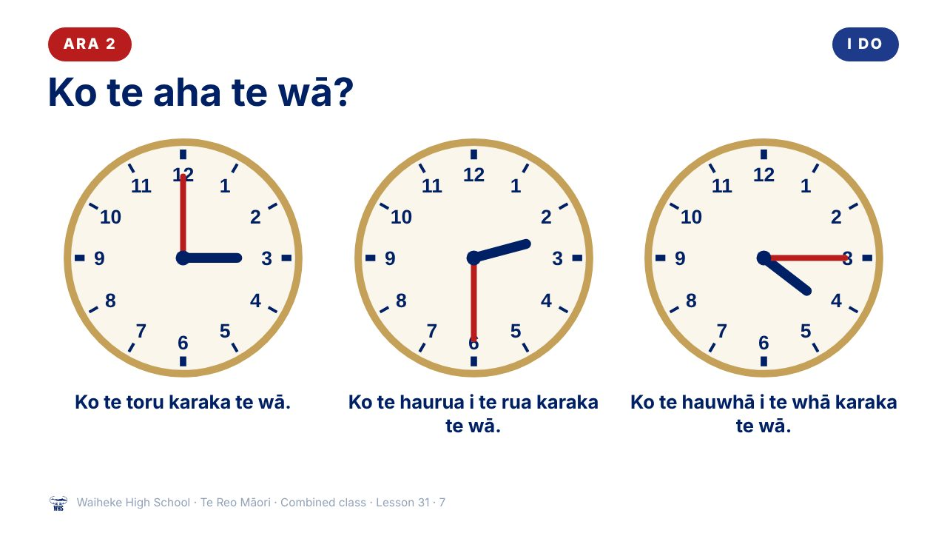
Notes:
I DO
Whole class: Explain loan words and adapting to Māori sound patterns (every word ends in a vowel, no s, etc.). Teach the loan-word days and the Māori-made names. Contrast loan word and transliteration. Then Ara 2 at the front with the teacher (Ara 2 slides): Model Ko te aha te wā? with a clock. Teach karaka, haurua i te, hauwhā i te. Meanwhile Ara 1 starts the worksheet or the kēmu, and Ara 3 works through the Novice 3 lesson “Utu and koha: cost and reciprocity” on a device.
Watch for: Students thinking loan words are “not real te reo”. Ask: “Does English have loan words from te reo? (kiwi, haka, kai, whānau)”
(This slide is a picture. Edit the title in the notes or rebuild it if you need to change it.)

Slide 8
ARA 2
I DO
Ask it the right way
✓
Ko te aha te wā?
What is the time?
✗ He aha te wā? What is time?
Two words for time:
wā
and
tāima
Waiheke High School · Te Reo Māori · Combined class · Lesson 31 · 8
Notes:
I DO
Whole class: Explain loan words and adapting to Māori sound patterns (every word ends in a vowel, no s, etc.). Teach the loan-word days and the Māori-made names. Contrast loan word and transliteration. Then Ara 2 at the front with the teacher (Ara 2 slides): Model Ko te aha te wā? with a clock. Teach karaka, haurua i te, hauwhā i te. Meanwhile Ara 1 starts the worksheet or the kēmu, and Ara 3 works through the Novice 3 lesson “Utu and koha: cost and reciprocity” on a device.
Watch for: Students thinking loan words are “not real te reo”. Ask: “Does English have loan words from te reo? (kiwi, haka, kai, whānau)”

Slide 9
ARA 2
I DO
Clock words
karaka
o’clock
haurua
half
hauwhā
quarter
i
past
ki
to
Waiheke High School · Te Reo Māori · Combined class · Lesson 31 · 9
Notes:
I DO
Whole class: Explain loan words and adapting to Māori sound patterns (every word ends in a vowel, no s, etc.). Teach the loan-word days and the Māori-made names. Contrast loan word and transliteration. Then Ara 2 at the front with the teacher (Ara 2 slides): Model Ko te aha te wā? with a clock. Teach karaka, haurua i te, hauwhā i te. Meanwhile Ara 1 starts the worksheet or the kēmu, and Ara 3 works through the Novice 3 lesson “Utu and koha: cost and reciprocity” on a device.
Watch for: Students thinking loan words are “not real te reo”. Ask: “Does English have loan words from te reo? (kiwi, haka, kai, whānau)”

Slide 10
Ko te aha tēnei rā?
WE DO
PĀTAI
Ko te aha tēnei rā?
What day is it today?
WHAKAUTU
Ko (te) Tūrei tēnei rā.
Today is Tuesday.
PĀTAI
Ko te aha āpōpō?
What is tomorrow?
WHAKAUTU
Ko te Wenerei āpōpō.
Tomorrow is Wednesday.
Waiheke High School · Te Reo Māori · Combined class · Lesson 31 · 10
Notes:
WE DO
Day chant, then “What comes next?”: teacher says a day, class says the next. Ara 2 version: Teacher moves the clock hands; class says the time. Mixed-path pairs: Ara 2 or 3 students partner Ara 1 students as tuakana.

Slide 11
ARA 2
WE DO
Read the clock
Your teacher moves the hands
1
Ko te ___ karaka te wā.
2
Ko te haurua i te ___ karaka te wā.
3
Ko te hauwhā i te ___ karaka te wā.
Waiheke High School · Te Reo Māori · Combined class · Lesson 31 · 11
Notes:
WE DO
Day chant, then “What comes next?”: teacher says a day, class says the next. Ara 2 version: Teacher moves the clock hands; class says the time. Mixed-path pairs: Ara 2 or 3 students partner Ara 1 students as tuakana.

Slide 12
WE DO
ARA 3 · NOVICE 3
Utu and koha: cost and reciprocity
We are learning to talk about cost, and to understand koha and reciprocity.
Ara 3 works independently from the Novice 3 slides, then partners an Ara 1 student for the kōrero task (tuakana–teina).
Waiheke High School · Te Reo Māori · Combined class · Lesson 31 · 12
Notes:
WE DO
Day chant, then “What comes next?”: teacher says a day, class says the next. Ara 2 version: Teacher moves the clock hands; class says the time. Mixed-path pairs: Ara 2 or 3 students partner Ara 1 students as tuakana.
Slide note: Ara 3 works independently from the Novice 3 slides, then partners an Ara 1 student for the kōrero task (tuakana–teina).

Slide 13
Your task
YOU DO
Ara 1
Ara 2
Ara 3
KŌRERO
Ask your partner about today, tomorrow and yesterday.
KŌRERO
Set a time on your clock; your partner says it.
BOOK
Explain koha and reciprocity in your own words.
WORKSHEET
Q1 Put the days in order.
WORKSHEET
Q1 Read the clocks.
BOOK
Write a shop dialogue.
WORKSHEET
Q2 Loan word detective.
WORKSHEET
Q2 Draw the hands.
KŌRERO
Perform your dialogue.
WORKSHEET
Q3 Loan word or transliteration?
WORKSHEET
Q3 Fix the question.
Waiheke High School · Te Reo Māori · Combined class · Lesson 31 · 13
Notes:
YOU DO
Three worksheets (see “Worksheets by path”). Ara 1: Kōrero: ask a partner about their week (Ko te aha tēnei rā? Ko te aha āpōpō?). Worksheet: days in order, loan word detective, transliteration vs loan word. Ara 2: Kōrero: pairs with clock faces. Worksheet: read clocks, draw hands, correct the question. Ara 3: Book: explain koha and reciprocity in your own words; write a shop dialogue. Kōrero: perform it.

Slide 14
REVIEW
↻ REVIEW
Ko te aha tēnei rā?
Answer in a full sentence.
Ko te aha āpōpō?
Ara 2: Say the time now.
Waiheke High School · Te Reo Māori · Combined class · Lesson 31 · 14
Notes:
REVIEW
Whole class: Exit: Ko te aha tēnei rā? Ko te aha āpōpō? Ara 2 also: Exit: say the time now. Karakia whakamutunga led by an Ara 3 student.

