Slide 1
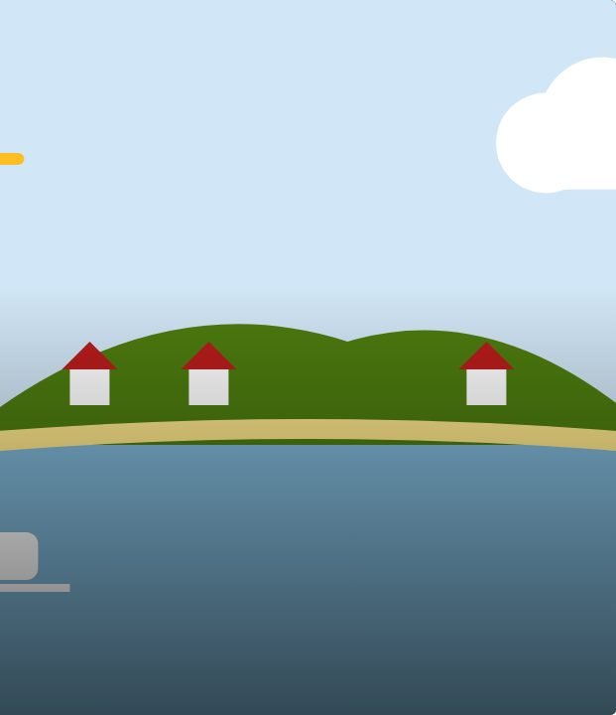

CONNECT
22
LESSON 22 · WĀHANGA 2 · NUMBERS, AGE AND PLACES
Kei hea tō kāinga? Significant places
Tōku kāinga
Te Reo Māori · Novice 1
NOVICE 1 · N1.4
Notes:
CONNECT
Karakia tīmatanga (opening karakia) led by the teacher, then a student once taught in Lesson 7. Hook: “Where is home?” Is it always where you live? Students think-pair-share.

Slide 2
CONNECT
WHAT WE ARE LEARNING
We are learning to communicate about places that are significant to us.
SUCCESS CRITERIA
✓ I can ask and answer “Kei hea tō kāinga?”
✓ I can use “kei” for where I live now and “ko” for my home
✓ I can name places in Aotearoa with their Māori names
Waiheke High School · Te Reo Māori · Novice 1 · Lesson 22 · 2
Notes:
CONNECT
Karakia tīmatanga (opening karakia) led by the teacher, then a student once taught in Lesson 7. Hook: “Where is home?” Is it always where you live? Students think-pair-share.

Slide 3
CONNECT
Where is home? Is it always where you live?
Think · pair · share
Waiheke High School · Te Reo Māori · Novice 1 · Lesson 22 · 3
Notes:
CONNECT
Karakia tīmatanga (opening karakia) led by the teacher, then a student once taught in Lesson 7. Hook: “Where is home?” Is it always where you live? Students think-pair-share.

Slide 4
Kei hea tō kāinga?
I DO
PĀTAI
Kei hea tō kāinga?
Where is your home?
WHAKAUTU
Kei Waiheke taku kāinga.
My home is on Waiheke.
PĀTAI
Kei hea tana kāinga?
Where is their home?
WHAKAUTU
Kei Kāpiti tana kāinga.
Their home is at Kāpiti.
Waiheke High School · Te Reo Māori · Novice 1 · Lesson 22 · 4
Notes:
I DO
Model Kei hea tō kāinga? / Kei Waiheke taku kāinga. Contrast with Ko Aotearoa taku kāinga. Teach Māori place names on a map of Aotearoa. Talk about home as belonging.
Watch for: Students saying “Kei hea koe kāinga”. Ask: “Where does “taku” go in the sentence?”

Slide 5
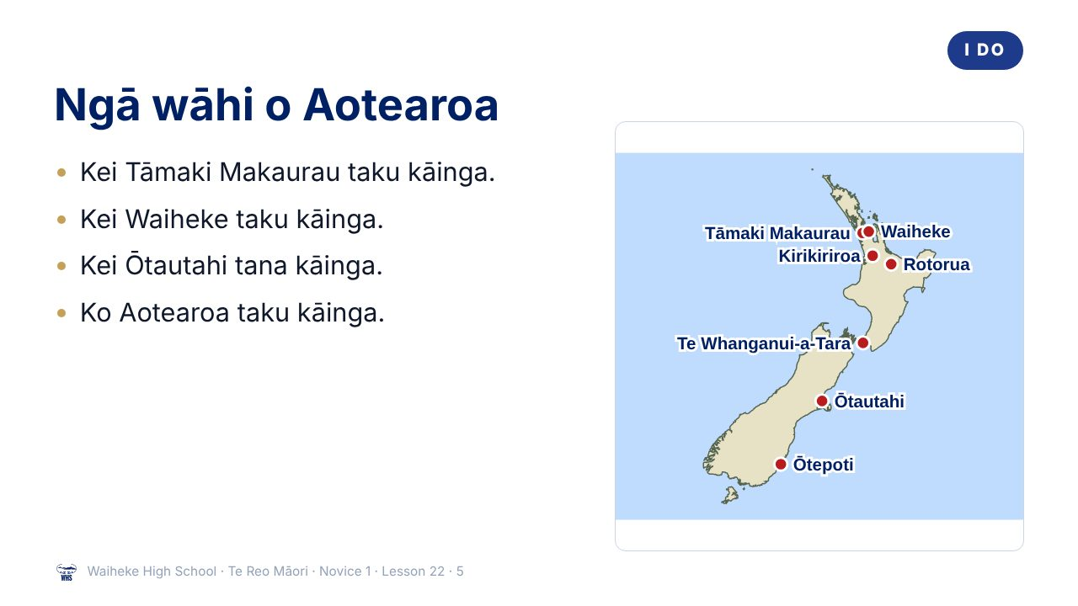
Notes:
I DO
Model Kei hea tō kāinga? / Kei Waiheke taku kāinga. Contrast with Ko Aotearoa taku kāinga. Teach Māori place names on a map of Aotearoa. Talk about home as belonging.
Watch for: Students saying “Kei hea koe kāinga”. Ask: “Where does “taku” go in the sentence?”
(This slide is a picture. Edit the title in the notes or rebuild it if you need to change it.)

Slide 6
Kei or ko?
I DO
Kei = where it is now
Ko = names the place
Kei Ōtepoti taku kāinga.
Kei Te Waipounamu te kāinga o Mere.
Ko Aotearoa taku kāinga.
Ko Hāmoa te kāinga o Fred.
Waiheke High School · Te Reo Māori · Novice 1 · Lesson 22 · 6
Notes:
I DO
Model Kei hea tō kāinga? / Kei Waiheke taku kāinga. Contrast with Ko Aotearoa taku kāinga. Teach Māori place names on a map of Aotearoa. Talk about home as belonging.
Watch for: Students saying “Kei hea koe kāinga”. Ask: “Where does “taku” go in the sentence?”

Slide 7
Ngā wāhi · places
I DO
Tāmaki Makaurau
Auckland
Te Whanganui-a-Tara
Wellington
Ōtautahi
Christchurch
Ōtepoti
Dunedin
Kirikiriroa
Hamilton
Te Ika-a-Māui
North Island
Te Waipounamu
South Island
Waiheke
our island
Waiheke High School · Te Reo Māori · Novice 1 · Lesson 22 · 7
Notes:
I DO
Model Kei hea tō kāinga? / Kei Waiheke taku kāinga. Contrast with Ko Aotearoa taku kāinga. Teach Māori place names on a map of Aotearoa. Talk about home as belonging.
Watch for: Students saying “Kei hea koe kāinga”. Ask: “Where does “taku” go in the sentence?”

Slide 8
Your task
YOU DO
KŌRERO
Ask four people “Kei hea tō kāinga?”
WORKSHEET
Q1 Match the place names.
WORKSHEET
Q2 Write sentences about three people.
WORKSHEET
Q3 Where do you feel at home?
Waiheke High School · Te Reo Māori · Novice 1 · Lesson 22 · 8
Notes:
YOU DO
Kōrero: ask four people Kei hea tō kāinga? Worksheet: place names match, sentences about three people, a sentence about where you feel at home.

Slide 9
REVIEW
↻ REVIEW
Kei hea tō kāinga?
Answer with kei.
Answer with ko.
Waiheke High School · Te Reo Māori · Novice 1 · Lesson 22 · 9
Notes:
REVIEW
Exit: say where you live with kei, and where home is with ko.

