Slide 1
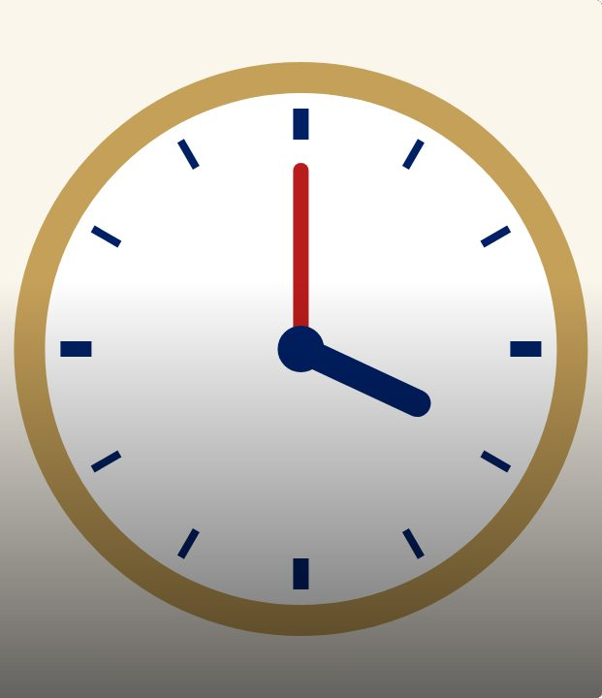

SET UP
43
LESSON 43 · WĀHANGA 3 · DATES, ORIGINS AND TIME
Time stations race
Ko te aha te wā?
Te Reo Māori · Novice 2
NOVICE 2 · N2.6
Notes:
SET UP
Karakia tīmatanga. Eight stations with clock faces set to different times.

Slide 2
SET UP
WHAT WE ARE LEARNING
We are practising telling the time quickly and accurately.
SUCCESS CRITERIA
✓ I can read analogue clocks in te reo
✓ I can use i and ki correctly
✓ I can add parts of the day
Waiheke High School · Te Reo Māori · Novice 2 · Lesson 43 · 2
Notes:
SET UP
Karakia tīmatanga. Eight stations with clock faces set to different times.

Slide 3
Language for today
SET UP
Ko te aha te wā?
What is the time?
Karaka
O’clock
Haurua
Half
Hauwhā
Quarter
Meneti
Minutes
I te ata
In the morning
Waiheke High School · Te Reo Māori · Novice 2 · Lesson 43 · 3
Notes:
SET UP
Karakia tīmatanga. Eight stations with clock faces set to different times.

Slide 4
How it works
SESSION
Follow the steps
1
Read the clock
2
Write the time in te reo
3
Next station
4
Make a TV guide
Waiheke High School · Te Reo Māori · Novice 2 · Lesson 43 · 4
Notes:
SESSION
Pairs race around stations writing the time in te reo. Then a “TV guide” task: write a timetable for an evening.

Slide 5
Your task
SESSION
KŌRERO
Station race.
WORKSHEET
Times and TV guide.
Waiheke High School · Te Reo Māori · Novice 2 · Lesson 43 · 5
Notes:
SESSION
Pairs race around stations writing the time in te reo. Then a “TV guide” task: write a timetable for an evening.

Slide 6
REFLECT
↻ REVIEW
Whakaaro
Which times were hardest?
Waiheke High School · Te Reo Māori · Novice 2 · Lesson 43 · 6
Notes:
REFLECT
Mark answers together. Karakia whakamutunga.

