Slide 1
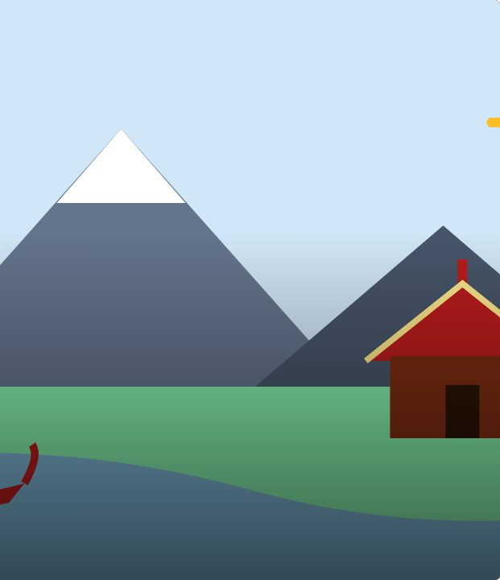

CONNECT
1
LESSON 1 · WĀHANGA 1 · MIHI, IDENTITY AND RELATIONSHIPS
Mihi and mihimihi
Mihi
Te Reo Māori · Novice 3
NOVICE 3 · N3.1
Notes:
CONNECT
Karakia tīmatanga led by a student. Retrieval (Novice 2): greet people with titles (e te, e ngā). Hook: watch or describe a mihimihi at the start of a hui. Why do people share where they come from before the business starts?

Slide 2
CONNECT
WHAT WE ARE LEARNING
We are learning what a mihi is and how to give a short mihi to acknowledge people and place.
SUCCESS CRITERIA
✓ I can explain mihi and mihimihi
✓ I can open and close a mihi correctly
✓ I can give a four-line mihi
Waiheke High School · Te Reo Māori · Novice 3 · Lesson 1 · 2
Notes:
CONNECT
Karakia tīmatanga led by a student. Retrieval (Novice 2): greet people with titles (e te, e ngā). Hook: watch or describe a mihimihi at the start of a hui. Why do people share where they come from before the business starts?

Slide 3
CONNECT
Why share where you come from before a hui starts?
Watch or listen to a mihimihi
Waiheke High School · Te Reo Māori · Novice 3 · Lesson 1 · 3
Notes:
CONNECT
Karakia tīmatanga led by a student. Retrieval (Novice 2): greet people with titles (e te, e ngā). Hook: watch or describe a mihimihi at the start of a hui. Why do people share where they come from before the business starts?

Slide 4
Mihi
I DO
A
greeting
,
acknowledgement
or
introduction
Acknowledges
places
,
people
and
space
Formal and informal contexts
Upholds
manaakitanga
and
whanaungatanga
Waiheke High School · Te Reo Māori · Novice 3 · Lesson 1 · 4
Notes:
I DO
Explain mihi and mihimihi and the values they uphold. Model a short mihi: opening (Tēnā koutou katoa), name, where you live, closing (Nō reira, tēnā koutou, tēnā koutou, tēnā koutou katoa). Show dialect variations.
Watch for: Students rushing the closing. Ask: “Why do we repeat “tēnā koutou” three times?”

Slide 5
A short mihi
I DO
Tēnā koutou katoa.
Greetings to you all.
Ko Sione taku ingoa.
My name is Sione.
Kei Rotorua ahau e noho ana.
I live in Rotorua.
Nō reira, tēnā koutou, tēnā koutou, tēnā koutou katoa.
So, greetings, greetings, greetings to you all.
Waiheke High School · Te Reo Māori · Novice 3 · Lesson 1 · 5
Notes:
I DO
Explain mihi and mihimihi and the values they uphold. Model a short mihi: opening (Tēnā koutou katoa), name, where you live, closing (Nō reira, tēnā koutou, tēnā koutou, tēnā koutou katoa). Show dialect variations.
Watch for: Students rushing the closing. Ask: “Why do we repeat “tēnā koutou” three times?”

Slide 6
Dialect in mihi
I DO
Standard | Variation
ahau | au · awau
tīpuna | tūpuna
kāinga | kāika (Kāi Tahu)
Waiheke High School · Te Reo Māori · Novice 3 · Lesson 1 · 6
Notes:
I DO
Explain mihi and mihimihi and the values they uphold. Model a short mihi: opening (Tēnā koutou katoa), name, where you live, closing (Nō reira, tēnā koutou, tēnā koutou, tēnā koutou katoa). Show dialect variations.
Watch for: Students rushing the closing. Ask: “Why do we repeat “tēnā koutou” three times?”

Slide 7
Mihimihi
WE DO
Several people share
mihi
in turn
Builds
connections
between people
Everyone listens while each person speaks
Waiheke High School · Te Reo Māori · Novice 3 · Lesson 1 · 7
Notes:
WE DO
Class builds a model mihi on the board line by line. Choral practice of the opening and closing.

Slide 8
Your task
YOU DO
BOOK
Write your four-line mihi.
KŌRERO
Practise with a partner.
KŌRERO
Share in a small mihimihi circle.
Waiheke High School · Te Reo Māori · Novice 3 · Lesson 1 · 8
Notes:
YOU DO
Book: write your four-line mihi. Kōrero: practise in pairs, then a small-group mihimihi circle.

Slide 9
REVIEW
↻ REVIEW
Nō reira…
Name one value a mihi upholds.
Why does it matter?
Waiheke High School · Te Reo Māori · Novice 3 · Lesson 1 · 9
Notes:
REVIEW
Exit: one value a mihi upholds, and why.

