Slide 1
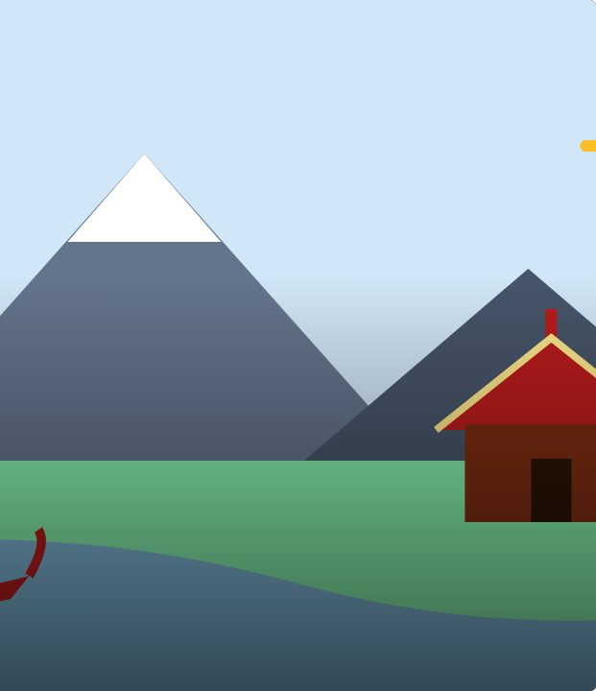

SET UP
5
LESSON 5 · WĀHANGA 1 · MIHI, IDENTITY AND RELATIONSHIPS
Mihimihi circle
Mihimihi
Te Reo Māori · Novice 3
NOVICE 3 · N3.1
Notes:
SET UP
Karakia tīmatanga. Chairs in a circle. Agree the order (follow your school’s tikanga).

Slide 2
SET UP
WHAT WE ARE LEARNING
We are sharing mihi in a mihimihi circle to build connections.
SUCCESS CRITERIA
✓ I can give my mihi without notes
✓ I can listen respectfully
✓ I can respond with a closing acknowledgement
Waiheke High School · Te Reo Māori · Novice 3 · Lesson 5 · 2
Notes:
SET UP
Karakia tīmatanga. Chairs in a circle. Agree the order (follow your school’s tikanga).

Slide 3
Language for today
SET UP
Mihimihi
Sharing mihi
Tēnā koutou katoa
Greetings to all
Nō reira
And so
Kia ora
Thank you
Waiheke High School · Te Reo Māori · Novice 3 · Lesson 5 · 3
Notes:
SET UP
Karakia tīmatanga. Chairs in a circle. Agree the order (follow your school’s tikanga).

Slide 4
How it works
SESSION
Follow the steps
1
Sit in a circle
2
Share mihi in turn
3
Listen without interrupting
4
Close with a waiata
Waiheke High School · Te Reo Māori · Novice 3 · Lesson 5 · 4
Notes:
SESSION
Each student shares their mihi. After everyone, a student closes with an acknowledgement and the class sings a waiata.

Slide 5
Your task
SESSION
KŌRERO
Share your mihi.
KŌRERO
Close with waiata.
Waiheke High School · Te Reo Māori · Novice 3 · Lesson 5 · 5
Notes:
SESSION
Each student shares their mihi. After everyone, a student closes with an acknowledgement and the class sings a waiata.

Slide 6
REFLECT
↻ REVIEW
Whakaaro
What connections did you notice?
Waiheke High School · Te Reo Māori · Novice 3 · Lesson 5 · 6
Notes:
REFLECT
What did you learn about your classmates? Karakia whakamutunga.

