Slide 1
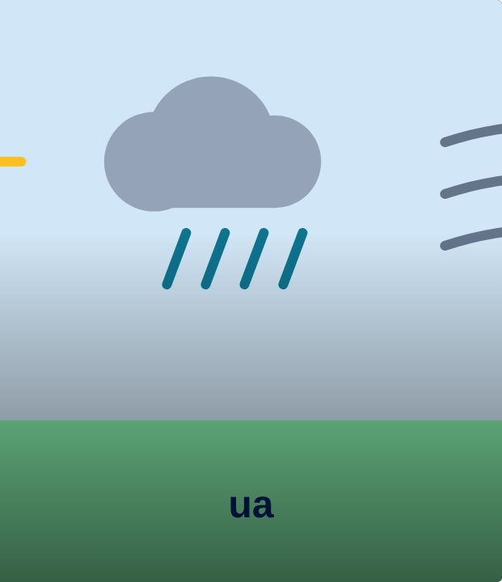

SET UP
37
LESSON 37 · WĀHANGA 3 · KAI, WEATHER AND THE MARAMATAKA
Weather report
Te matapae huarere
Te Reo Māori · Novice 3
NOVICE 3 · N3.7
Notes:
SET UP
Karakia tīmatanga. Devices; a map of Aotearoa or Waiheke.

Slide 2
SET UP
WHAT WE ARE LEARNING
We are recording a weather report in te reo.
SUCCESS CRITERIA
✓ I can describe weather with verbs
✓ I can use the four seasons
✓ I can speak clearly and confidently on camera
Waiheke High School · Te Reo Māori · Novice 3 · Lesson 37 · 2
Notes:
SET UP
Karakia tīmatanga. Devices; a map of Aotearoa or Waiheke.

Slide 3
Language for today
SET UP
Matapae huarere
Weather forecast
Āpōpō
Tomorrow
Ka heke te ua
It will rain
Ka whiti te rā
The sun will shine
Waiheke High School · Te Reo Māori · Novice 3 · Lesson 37 · 3
Notes:
SET UP
Karakia tīmatanga. Devices; a map of Aotearoa or Waiheke.

Slide 4
How it works
SESSION
Follow the steps
1
Choose three places
2
Script weather now and tomorrow
3
Record
4
Peer review
Waiheke High School · Te Reo Māori · Novice 3 · Lesson 37 · 4
Notes:
SESSION
Groups script and record a 60-second weather report for three places, including tomorrow’s forecast.

Slide 5
Your task
SESSION
BOOK
Script.
DEVICE
Record.
Waiheke High School · Te Reo Māori · Novice 3 · Lesson 37 · 5
Notes:
SESSION
Groups script and record a 60-second weather report for three places, including tomorrow’s forecast.

Slide 6
REFLECT
↻ REVIEW
Whakaaro
Which forecast phrase was most useful?
Waiheke High School · Te Reo Māori · Novice 3 · Lesson 37 · 6
Notes:
REFLECT
Peer review. Karakia whakamutunga.

