Slide 1


CONNECT
3
LESSON 3 · WĀHANGA 1 · KIA ORA! SOUNDS, GREETINGS AND WHO I AM
Tricky sounds and dialects + Terms of address and titles
Ng, r, t, wh
Te Reo Māori · Combined class
COMBINED CLASS · N1.1 · N2.1 · N3.1
Notes:
CONNECT
Whole class. Karakia tīmatanga led by an Ara 3 student. Retrieval (Lesson 2, Te arapū Māori: vowels and macrons): vowels short and long. Hook: play or say “ngā” and ask where students have heard “ng” at the start of a word in English (they haven’t; only in the middle, as in singer).

Slide 2
WHAT WE ARE LEARNING · THREE PATHS
CONNECT
Ara 1 · Novice 1
Ara 2 · Novice 2
Ara 3 · Novice 3
We are learning to pronounce ng, r, t and wh, and to notice how dialects differ between iwi and regions.
We are learning to use terms of address and titles in greetings, for one person or a group.
We are learning what whakataukī and whakatauākī are, and how metaphorical language carries values.
I can say ng, a tapped r, soft and aspirated t, and wh
I can read syllable drills aloud
I can give one example of a dialect difference
I can greet someone with a term of address (e hoa, e hine)
I can make a term of address plural with “mā”
I can greet groups and people with titles using “e te” and “e ngā”
I can explain the difference between whakataukī and whakatauākī
I can explain the meaning of two whakataukī
I can link a whakataukī to a value
Waiheke High School · Te Reo Māori · Combined class · Lesson 3 · 2
Notes:
CONNECT
Whole class. Karakia tīmatanga led by an Ara 3 student. Retrieval (Lesson 2, Te arapū Māori: vowels and macrons): vowels short and long. Hook: play or say “ngā” and ask where students have heard “ng” at the start of a word in English (they haven’t; only in the middle, as in singer).

Slide 3
CONNECT
Where do you hear “ng” in English?
singer · bringing · Singapore
Can you start a word with it?
Waiheke High School · Te Reo Māori · Combined class · Lesson 3 · 3
Notes:
CONNECT
Whole class. Karakia tīmatanga led by an Ara 3 student. Retrieval (Lesson 2, Te arapū Māori: vowels and macrons): vowels short and long. Hook: play or say “ngā” and ask where students have heard “ng” at the start of a word in English (they haven’t; only in the middle, as in singer).

Slide 4
Four tricky sounds
I DO
ng
as in singer: ngā, ngeru
r
tapped, not rolled: rangi
t
soft before a e o · aspirated before i u
wh
usually like English “f”: whare
Waiheke High School · Te Reo Māori · Combined class · Lesson 3 · 4
Notes:
I DO
Whole class: Model each sound with the English anchors: ng in singer/bringing/Singapore; tapped r (tongue taps the roof of the mouth); t soft before a e o and aspirated before i u; wh like f. Introduce mita (dialect) with the four curriculum examples on a map. Then Ara 2 at the front with the teacher (Ara 2 slides): Teach terms of address with “e”. Teach “mā” for plural. Teach “e te” and “e ngā” with titles and groups. Link to manaakitanga: choosing a respectful address. Meanwhile Ara 1 starts the worksheet or the kēmu, and Ara 3 works through the Novice 3 lesson “Whakataukī and whakatauākī” on a device.
Watch for: Students rolling the r like Spanish, or saying “n-g” as two sounds. Ask: “Where does your tongue go when you tap the r?”

Slide 5
Mita: dialects differ
I DO
Iwi or region | Feature | Example
Ngāi Tahu | k replaces ng | Kāi Tahu · kāika
Tūhoe | ng becomes n | nā (for ngā)
Taranaki | h often dropped | Whanganui → “Wanganui”
Ngāpuhi | w often dropped | whakarongo → “hakarongo”
Waiheke High School · Te Reo Māori · Combined class · Lesson 3 · 5
Notes:
I DO
Whole class: Model each sound with the English anchors: ng in singer/bringing/Singapore; tapped r (tongue taps the roof of the mouth); t soft before a e o and aspirated before i u; wh like f. Introduce mita (dialect) with the four curriculum examples on a map. Then Ara 2 at the front with the teacher (Ara 2 slides): Teach terms of address with “e”. Teach “mā” for plural. Teach “e te” and “e ngā” with titles and groups. Link to manaakitanga: choosing a respectful address. Meanwhile Ara 1 starts the worksheet or the kēmu, and Ara 3 works through the Novice 3 lesson “Whakataukī and whakatauākī” on a device.
Slide note: Not every speaker with whakapapa to an iwi uses its dialect features.
Watch for: Students rolling the r like Spanish, or saying “n-g” as two sounds. Ask: “Where does your tongue go when you tap the r?”

Slide 6
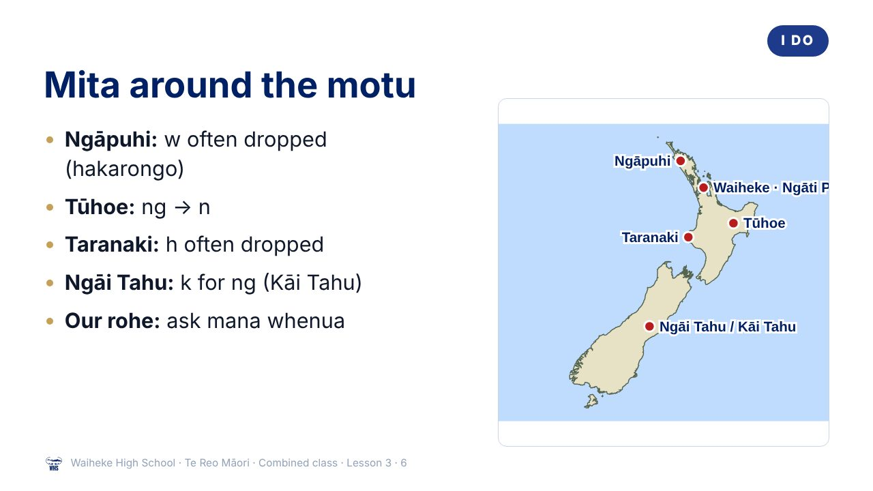
Notes:
I DO
Whole class: Model each sound with the English anchors: ng in singer/bringing/Singapore; tapped r (tongue taps the roof of the mouth); t soft before a e o and aspirated before i u; wh like f. Introduce mita (dialect) with the four curriculum examples on a map. Then Ara 2 at the front with the teacher (Ara 2 slides): Teach terms of address with “e”. Teach “mā” for plural. Teach “e te” and “e ngā” with titles and groups. Link to manaakitanga: choosing a respectful address. Meanwhile Ara 1 starts the worksheet or the kēmu, and Ara 3 works through the Novice 3 lesson “Whakataukī and whakatauākī” on a device.
Watch for: Students rolling the r like Spanish, or saying “n-g” as two sounds. Ask: “Where does your tongue go when you tap the r?”
(This slide is a picture. Edit the title in the notes or rebuild it if you need to change it.)

Slide 7
Our rohe
I DO
Which iwi and hapū are mana whenua here?
What features does their mita have?
Teacher: add local examples here
Waiheke High School · Te Reo Māori · Combined class · Lesson 3 · 7
Notes:
I DO
Whole class: Model each sound with the English anchors: ng in singer/bringing/Singapore; tapped r (tongue taps the roof of the mouth); t soft before a e o and aspirated before i u; wh like f. Introduce mita (dialect) with the four curriculum examples on a map. Then Ara 2 at the front with the teacher (Ara 2 slides): Teach terms of address with “e”. Teach “mā” for plural. Teach “e te” and “e ngā” with titles and groups. Link to manaakitanga: choosing a respectful address. Meanwhile Ara 1 starts the worksheet or the kēmu, and Ara 3 works through the Novice 3 lesson “Whakataukī and whakatauākī” on a device.
Watch for: Students rolling the r like Spanish, or saying “n-g” as two sounds. Ask: “Where does your tongue go when you tap the r?”

Slide 8
I DO
ARA 2 · NOVICE 2
Terms of address and titles
We are learning to use terms of address and titles in greetings, for one person or a group.
Ara 2 group with the teacher. Ara 1: start the worksheet or the kēmu. Ara 3: your own lesson on a device.
Waiheke High School · Te Reo Māori · Combined class · Lesson 3 · 8
Notes:
I DO
Whole class: Model each sound with the English anchors: ng in singer/bringing/Singapore; tapped r (tongue taps the roof of the mouth); t soft before a e o and aspirated before i u; wh like f. Introduce mita (dialect) with the four curriculum examples on a map. Then Ara 2 at the front with the teacher (Ara 2 slides): Teach terms of address with “e”. Teach “mā” for plural. Teach “e te” and “e ngā” with titles and groups. Link to manaakitanga: choosing a respectful address. Meanwhile Ara 1 starts the worksheet or the kēmu, and Ara 3 works through the Novice 3 lesson “Whakataukī and whakatauākī” on a device.
Slide note: Ara 2 group with the teacher. Ara 1: start the worksheet or the kēmu. Ara 3: your own lesson on a device.
Watch for: Students rolling the r like Spanish, or saying “n-g” as two sounds. Ask: “Where does your tongue go when you tap the r?”

Slide 9
ARA 2
I DO
Terms of address
e + term (fewer than 3 vowels) · mā after = plural
e hoa
friend
e tama
boy
e hine
girl
e kui
elderly woman
e koro
elderly man
e tama mā
boys
e hine mā
girls
ākonga mā
students
Waiheke High School · Te Reo Māori · Combined class · Lesson 3 · 9
Notes:
I DO
Whole class: Model each sound with the English anchors: ng in singer/bringing/Singapore; tapped r (tongue taps the roof of the mouth); t soft before a e o and aspirated before i u; wh like f. Introduce mita (dialect) with the four curriculum examples on a map. Then Ara 2 at the front with the teacher (Ara 2 slides): Teach terms of address with “e”. Teach “mā” for plural. Teach “e te” and “e ngā” with titles and groups. Link to manaakitanga: choosing a respectful address. Meanwhile Ara 1 starts the worksheet or the kēmu, and Ara 3 works through the Novice 3 lesson “Whakataukī and whakatauākī” on a device.
Watch for: Students rolling the r like Spanish, or saying “n-g” as two sounds. Ask: “Where does your tongue go when you tap the r?”

Slide 10
ARA 2
I DO
Titles and groups: e te / e ngā
One | More than one
Kia ora, e te whānau | Tēnā koutou, e ngā manuhiri
E te tumuaki, tēnā koe | E ngā kaiako, tēnā koutou
Waiheke High School · Te Reo Māori · Combined class · Lesson 3 · 10
Notes:
I DO
Whole class: Model each sound with the English anchors: ng in singer/bringing/Singapore; tapped r (tongue taps the roof of the mouth); t soft before a e o and aspirated before i u; wh like f. Introduce mita (dialect) with the four curriculum examples on a map. Then Ara 2 at the front with the teacher (Ara 2 slides): Teach terms of address with “e”. Teach “mā” for plural. Teach “e te” and “e ngā” with titles and groups. Link to manaakitanga: choosing a respectful address. Meanwhile Ara 1 starts the worksheet or the kēmu, and Ara 3 works through the Novice 3 lesson “Whakataukī and whakatauākī” on a device.
Watch for: Students rolling the r like Spanish, or saying “n-g” as two sounds. Ask: “Where does your tongue go when you tap the r?”

Slide 11
ARA 2
I DO
Hoa is for everyone
Calling someone
hoa
does not mean they must be your close friend
It is a widely used, friendly term in te ao Māori
Calling someone
kui
or
koro
is respectful, not rude
Waiheke High School · Te Reo Māori · Combined class · Lesson 3 · 11
Notes:
I DO
Whole class: Model each sound with the English anchors: ng in singer/bringing/Singapore; tapped r (tongue taps the roof of the mouth); t soft before a e o and aspirated before i u; wh like f. Introduce mita (dialect) with the four curriculum examples on a map. Then Ara 2 at the front with the teacher (Ara 2 slides): Teach terms of address with “e”. Teach “mā” for plural. Teach “e te” and “e ngā” with titles and groups. Link to manaakitanga: choosing a respectful address. Meanwhile Ara 1 starts the worksheet or the kēmu, and Ara 3 works through the Novice 3 lesson “Whakataukī and whakatauākī” on a device.
Watch for: Students rolling the r like Spanish, or saying “n-g” as two sounds. Ask: “Where does your tongue go when you tap the r?”

Slide 12
Syllable drills
WE DO
 | a | e | i | o | u
r | ra | re | ri | ro | ru
t | ta | te | ti | to | tu
ng | nga | nge | ngi | ngo | ngu
wh | wha | whe | whi | who | whu
Waiheke High School · Te Reo Māori · Combined class · Lesson 3 · 12
Notes:
WE DO
Syllable drills as a class: ra re ri ro ru / ta te ti to tu / nga nge ngi ngo ngu / wha whe whi who whu. Then pairs read greetings from Lesson 1 to each other with feedback. Ara 2 version: Teacher shows pictures (a group of girls, the principal, visitors, the class); students call out the greeting. Mixed-path pairs: Ara 2 or 3 students partner Ara 1 students as tuakana.

Slide 13
ARA 2
WE DO
Welcoming manuhiri
ĀKONGA
Tēnā koutou, e ngā manuhiri!
Greetings, visitors!
MANUHIRI
Tēnā koutou, ākonga mā.
Greetings, students.
ĀKONGA
E te tumuaki, tēnā koe.
Principal, greetings.
Waiheke High School · Te Reo Māori · Combined class · Lesson 3 · 13
Notes:
WE DO
Syllable drills as a class: ra re ri ro ru / ta te ti to tu / nga nge ngi ngo ngu / wha whe whi who whu. Then pairs read greetings from Lesson 1 to each other with feedback. Ara 2 version: Teacher shows pictures (a group of girls, the principal, visitors, the class); students call out the greeting. Mixed-path pairs: Ara 2 or 3 students partner Ara 1 students as tuakana.

Slide 14
WE DO
ARA 3 · NOVICE 3
Whakataukī and whakatauākī
We are learning what whakataukī and whakatauākī are, and how metaphorical language carries values.
Ara 3 works independently from the Novice 3 slides, then partners an Ara 1 student for the kōrero task (tuakana–teina).
Waiheke High School · Te Reo Māori · Combined class · Lesson 3 · 14
Notes:
WE DO
Syllable drills as a class: ra re ri ro ru / ta te ti to tu / nga nge ngi ngo ngu / wha whe whi who whu. Then pairs read greetings from Lesson 1 to each other with feedback. Ara 2 version: Teacher shows pictures (a group of girls, the principal, visitors, the class); students call out the greeting. Mixed-path pairs: Ara 2 or 3 students partner Ara 1 students as tuakana.
Slide note: Ara 3 works independently from the Novice 3 slides, then partners an Ara 1 student for the kōrero task (tuakana–teina).

Slide 15
Your task
YOU DO
Ara 1
Ara 2
Ara 3
KŌRERO
With a partner, read the four drill lines. Give feedback on r and ng.
KŌRERO
Role-play welcoming guests to our class.
BOOK
Write one saying, its meaning and when you would use it.
WORKSHEET
Q1 Sort the words by sound.
WORKSHEET
Q1 Complete the greetings.
KŌRERO
Say it from memory to your partner.
WORKSHEET
Q2 Match each dialect feature to its iwi.
WORKSHEET
Q2 Make them plural.
WORKSHEET
Q3 Write two sentences about mita.
WORKSHEET
Q3 Write a welcome for assembly.
Waiheke High School · Te Reo Māori · Combined class · Lesson 3 · 15
Notes:
YOU DO
Three worksheets (see “Worksheets by path”). Ara 1: Kōrero: pairs record or perform the four drill lines. Worksheet: sort words by sound, match dialect examples to iwi, write about mita. Ara 2: Kōrero: role-play welcoming guests to class. Worksheet: complete greetings, make plural, write a welcome for a school assembly. Ara 3: Book: choose one, write it, its meaning, and when you could use it in a mihi. Kōrero: say it from memory.

Slide 16
REVIEW
↻ REVIEW
Whakarongo!
Say whakarongo with a tapped r.
Now say it the Ngāpuhi way.
Ara 2: Greet the class as the teacher would.
Waiheke High School · Te Reo Māori · Combined class · Lesson 3 · 16
Notes:
REVIEW
Whole class: Exit: say “whakarongo” three ways: standard, Ngāpuhi (hakarongo) and with a tapped r. Ara 2 also: Exit: greet the class as their teacher would (Tēnā koutou, ākonga mā). Karakia whakamutunga led by an Ara 3 student.

