Slide 1
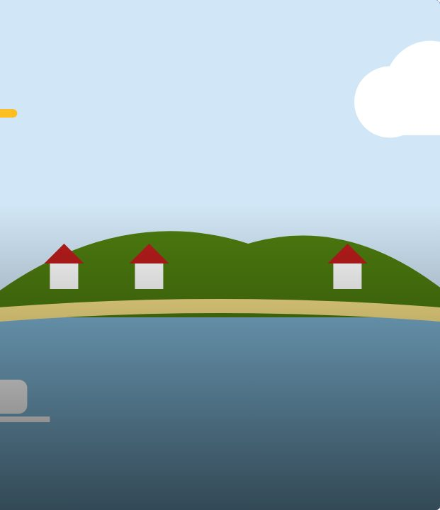

SET UP
23
LESSON 23 · WĀHANGA 2 · NUMBERS, AGE AND PLACES
Place-name hīkoi
Ngā ingoa wāhi
Te Reo Māori · Combined class
COMBINED CLASS · N1.4
Notes:
SET UP
Karakia tīmatanga. Plan a short hīkoi around the school (or use a projected map if a walk is not possible). Prepare cards with local place names. Ara 3 students lead the set-up as session leaders; brief them with the leader plan sheet.

Slide 2
SET UP
WHAT WE ARE LEARNING
We are learning the Māori names of significant places around our school and island, and practising kei and ko sentences.
SUCCESS CRITERIA
✓ I can say the Māori names of local places
✓ I can say where my home is
✓ I can explain why place names matter
Waiheke High School · Te Reo Māori · Combined class · Lesson 23 · 2
Notes:
SET UP
Karakia tīmatanga. Plan a short hīkoi around the school (or use a projected map if a walk is not possible). Prepare cards with local place names. Ara 3 students lead the set-up as session leaders; brief them with the leader plan sheet.

Slide 3
Language for today
SET UP
Wāhi
Place
Ingoa
Name
Kāinga
Home
Maunga
Mountain; hill
Moana
Sea
Awa
River; stream
Kei hea?
Where?
Ko ___ taku kāinga
___ is my home
Waiheke High School · Te Reo Māori · Combined class · Lesson 23 · 3
Notes:
SET UP
Karakia tīmatanga. Plan a short hīkoi around the school (or use a projected map if a walk is not possible). Prepare cards with local place names. Ara 3 students lead the set-up as session leaders; brief them with the leader plan sheet.

Slide 4
How it works
SESSION
Follow the steps
1
Walk to each stop
2
Learn the place name and its story
3
Say: Kei ___ tātou
4
Back in class: mark your home and write sentences
Waiheke High School · Te Reo Māori · Combined class · Lesson 23 · 4
Notes:
SESSION
At each stop, the teacher shares a place name and its meaning or story (from mana whenua sources). Students say: Kei _ tātou. (We are at _.) Back in class: students mark their home on a map and write sentences.

Slide 5
Your task
SESSION
KŌRERO
At each stop: Kei ___ tātou.
WORKSHEET
Record names and meanings.
WORKSHEET
Write about your home.
Waiheke High School · Te Reo Māori · Combined class · Lesson 23 · 5
Notes:
SESSION
At each stop, the teacher shares a place name and its meaning or story (from mana whenua sources). Students say: Kei _ tātou. (We are at _.) Back in class: students mark their home on a map and write sentences.

Slide 6
Roles today
SESSION
Ara 1
Ara 2
Ara 3
KŌRERO
Take part using the Novice 1 language on the sheet.
KŌRERO
Take part and add Novice 2 language (descriptions, names and address, tokohia, nō, time).
KŌRERO
Leaders: run a station or group, model the language, keep everyone in te reo, and use Novice 3 language yourself.
Waiheke High School · Te Reo Māori · Combined class · Lesson 23 · 6
Notes:
SESSION
At each stop, the teacher shares a place name and its meaning or story (from mana whenua sources). Students say: Kei _ tātou. (We are at _.) Back in class: students mark their home on a map and write sentences.

Slide 7
REFLECT
↻ REVIEW
Whakaaro
Which place name story stuck with you?
Why do names matter?
Waiheke High School · Te Reo Māori · Combined class · Lesson 23 · 7
Notes:
REFLECT
Why do place names matter? Students write one sentence in English and one in te reo. Karakia whakamutunga.

