Slide 1
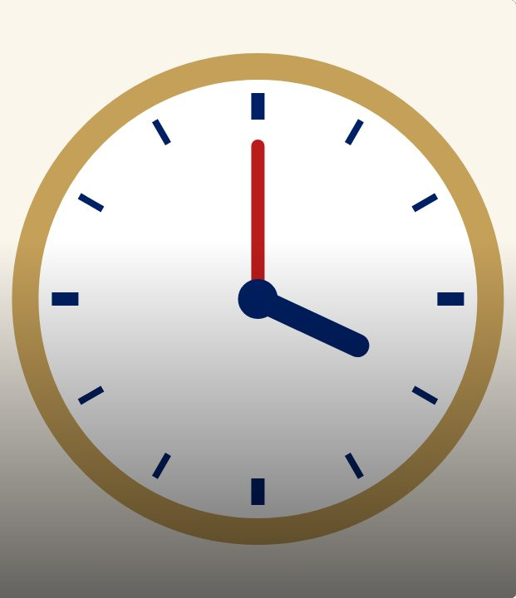

CONNECT
42
LESSON 42 · WĀHANGA 3 · DATES, ORIGINS AND TIME
Minutes, morning and afternoon
Meneti
Te Reo Māori · Novice 2
NOVICE 2 · N2.6
Notes:
CONNECT
Karakia tīmatanga led by a student. Retrieval: o’clock, half and quarter past. Hook: your school timetable: when does period 1 start?

Slide 2
CONNECT
WHAT WE ARE LEARNING
We are learning to tell the time with minutes past and to, and parts of the day.
SUCCESS CRITERIA
✓ I can say minutes past with “i”
✓ I can say minutes to with “ki”
✓ I can add i te ata / i te ahiahi / i te pō
Waiheke High School · Te Reo Māori · Novice 2 · Lesson 42 · 2
Notes:
CONNECT
Karakia tīmatanga led by a student. Retrieval: o’clock, half and quarter past. Hook: your school timetable: when does period 1 start?

Slide 3
CONNECT
When does period 1 start?
Say it in te reo if you can
Waiheke High School · Te Reo Māori · Novice 2 · Lesson 42 · 3
Notes:
CONNECT
Karakia tīmatanga led by a student. Retrieval: o’clock, half and quarter past. Hook: your school timetable: when does period 1 start?

Slide 4
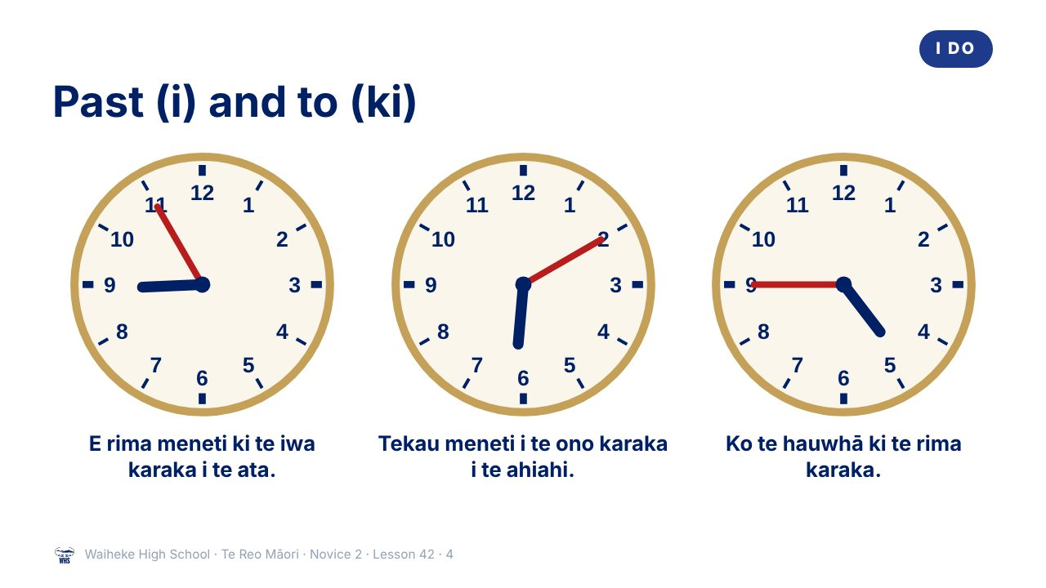
Notes:
I DO
Model minutes past (i) and to (ki), including the number rules (e before 2–9; tekau without e). Teach parts of the day.
Watch for: Mixing i and ki. Ask: “Is the minute hand before or after the hour?”
(This slide is a picture. Edit the title in the notes or rebuild it if you need to change it.)

Slide 5
i or ki?
I DO
i = past
ki = to
Tekau meneti
i
te ono karaka
10 past 6
E rima meneti
ki
te iwa karaka
5 to 9
Waiheke High School · Te Reo Māori · Novice 2 · Lesson 42 · 5
Notes:
I DO
Model minutes past (i) and to (ki), including the number rules (e before 2–9; tekau without e). Teach parts of the day.
Watch for: Mixing i and ki. Ask: “Is the minute hand before or after the hour?”

Slide 6
Parts of the day
I DO
i te ata
in the morning
i te poutūmārō
at midday
i te ahiahi
in the afternoon / evening
i te pō
at night
Waiheke High School · Te Reo Māori · Novice 2 · Lesson 42 · 6
Notes:
I DO
Model minutes past (i) and to (ki), including the number rules (e before 2–9; tekau without e). Teach parts of the day.
Watch for: Mixing i and ki. Ask: “Is the minute hand before or after the hour?”

Slide 7
Our bell times
WE DO
Read them in te reo
1
Period 1 starts
2
Morning tea
3
Lunch
4
Home time
Waiheke High School · Te Reo Māori · Novice 2 · Lesson 42 · 7
Notes:
WE DO
Class reads times from the school bell timetable.

Slide 8
Your task
YOU DO
KŌRERO
“My day”: tell your partner three times.
WORKSHEET
Q1 Read the clocks.
WORKSHEET
Q2 Write our school timetable.
WORKSHEET
Q3 Match.
Waiheke High School · Te Reo Māori · Novice 2 · Lesson 42 · 8
Notes:
YOU DO
Kōrero: “My day” timetable dialogue. Worksheet: read clocks, write a timetable, match times.

Slide 9
REVIEW
↻ REVIEW
Lunchtime
When does lunch start? Answer in te reo.
Waiheke High School · Te Reo Māori · Novice 2 · Lesson 42 · 9
Notes:
REVIEW
Exit: When does lunch start? Answer in te reo.

