Slide 1
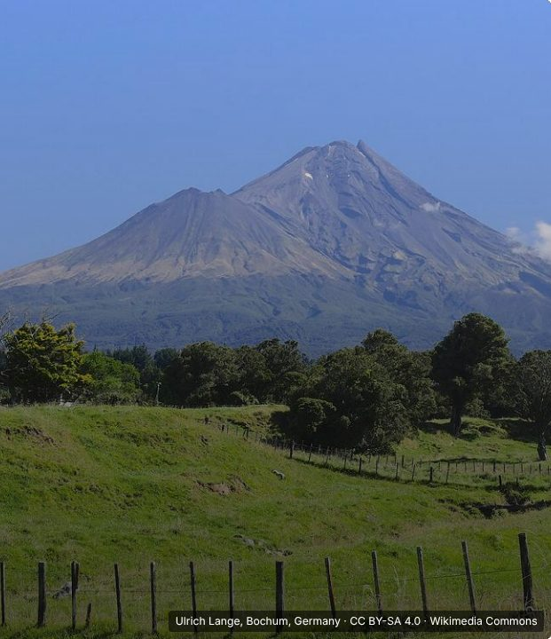

CONNECT
2
LESSON 2 · WĀHANGA 1 · MIHI, IDENTITY AND RELATIONSHIPS
Pepeha and kōrero tuakiri
Pepeha
Te Reo Māori · Novice 3
NOVICE 3 · N3.1
Notes:
CONNECT
Karakia tīmatanga led by a student. Retrieval (Lesson 1): open and close a mihi. Hook: show a photo of a maunga and an awa. How can a mountain be part of who someone is?

Slide 2
CONNECT
WHAT WE ARE LEARNING
We are learning about pepeha and kōrero tuakiri, and how to express our identity and connection to place.
SUCCESS CRITERIA
✓ I can explain what a pepeha is and why it is a taonga
✓ I can use the pepeha pattern Ko ___ te maunga
✓ I can choose between pepeha and kōrero tuakiri for myself
Waiheke High School · Te Reo Māori · Novice 3 · Lesson 2 · 2
Notes:
CONNECT
Karakia tīmatanga led by a student. Retrieval (Lesson 1): open and close a mihi. Hook: show a photo of a maunga and an awa. How can a mountain be part of who someone is?

Slide 3
CONNECT
How can a mountain be part of who someone is?
Waiheke High School · Te Reo Māori · Novice 3 · Lesson 2 · 3
Notes:
CONNECT
Karakia tīmatanga led by a student. Retrieval (Lesson 1): open and close a mihi. Hook: show a photo of a maunga and an awa. How can a mountain be part of who someone is?

Slide 4
A pepeha (curriculum example)
I DO
Ko Tūhua taku/te maunga.
Tūhua is my/the mountain.
Ko Arahura taku/te awa.
Arahura is my/the river.
Ko Uruao taku/te waka.
Uruao is my/the waka.
Ko Poutini Ngāi Tahu te iwi.
Poutini Ngāi Tahu is the iwi.
Ko Ngāti Waewae taku/te hapū.
Ngāti Waewae is my/the hapū.
Ko Arahura taku/te marae.
Arahura is my/the marae.
Waiheke High School · Te Reo Māori · Novice 3 · Lesson 2 · 4
Notes:
I DO
Model a pepeha with the curriculum example (Tūhua, Arahura, Uruao …), then a kōrero tuakiri example. Explain te/taku shows relationship, not ownership. Explain that pepeha are a taonga from tīpuna and that non-Māori use kōrero tuakiri, acknowledging the whenua they stand on.
Watch for: Non-Māori students claiming a maunga or iwi they have no whakapapa to. Ask: “Is this a whakapapa connection, or a place you live?”

Slide 5
Relationship, not possession
I DO
te / taku
and
ngā / aku
are often interchangeable
They show
relationship
, not ownership
Pepeha are a
taonga
handed down by
tīpuna
Several: Ko Tūhua, ko Aoraki
ngā
maunga.
Waiheke High School · Te Reo Māori · Novice 3 · Lesson 2 · 5
Notes:
I DO
Model a pepeha with the curriculum example (Tūhua, Arahura, Uruao …), then a kōrero tuakiri example. Explain te/taku shows relationship, not ownership. Explain that pepeha are a taonga from tīpuna and that non-Māori use kōrero tuakiri, acknowledging the whenua they stand on.
Watch for: Non-Māori students claiming a maunga or iwi they have no whakapapa to. Ask: “Is this a whakapapa connection, or a place you live?”

Slide 6
Kōrero tuakiri: statements of identity
I DO
I whānau mai au i China.
I was born in China.
I tipu ake ahau i Timaru.
I grew up in Timaru.
Nō Tonga aku tīpuna.
My ancestors are from Tonga.
Ko Sāmoa taku kāinga.
Samoa is my home.
Kei Waiheke ahau e noho ana.
I live on Waiheke.
Waiheke High School · Te Reo Māori · Novice 3 · Lesson 2 · 6
Notes:
I DO
Model a pepeha with the curriculum example (Tūhua, Arahura, Uruao …), then a kōrero tuakiri example. Explain te/taku shows relationship, not ownership. Explain that pepeha are a taonga from tīpuna and that non-Māori use kōrero tuakiri, acknowledging the whenua they stand on.
Watch for: Non-Māori students claiming a maunga or iwi they have no whakapapa to. Ask: “Is this a whakapapa connection, or a place you live?”

Slide 7
Which is right for me?
WE DO
Pepeha
Kōrero tuakiri
For people with
whakapapa
to the maunga, awa, waka, iwi
A taonga from tīpuna
Share
your
ancestral connections
Acknowledge
the whenua you stand on
Waiheke High School · Te Reo Māori · Novice 3 · Lesson 2 · 7
Notes:
WE DO
Build a kōrero tuakiri for a fictional student as a class. Practise multiple elements: Ko Tūhua, ko Aoraki ngā maunga.

Slide 8
Your task
YOU DO
BOOK
Draft your pepeha or kōrero tuakiri.
KŌRERO
Share with a partner if you are comfortable.
Waiheke High School · Te Reo Māori · Novice 3 · Lesson 2 · 8
Notes:
YOU DO
Book: draft your own pepeha or kōrero tuakiri (students choose; whānau can help at home). Kōrero: share with a partner if comfortable.

Slide 9
REVIEW
↻ REVIEW
Te or taku?
What do te and taku show in a pepeha?
Waiheke High School · Te Reo Māori · Novice 3 · Lesson 2 · 9
Notes:
REVIEW
Exit: Why do pepeha use “te” or “taku”, and what relationship do they show?

