Slide 1
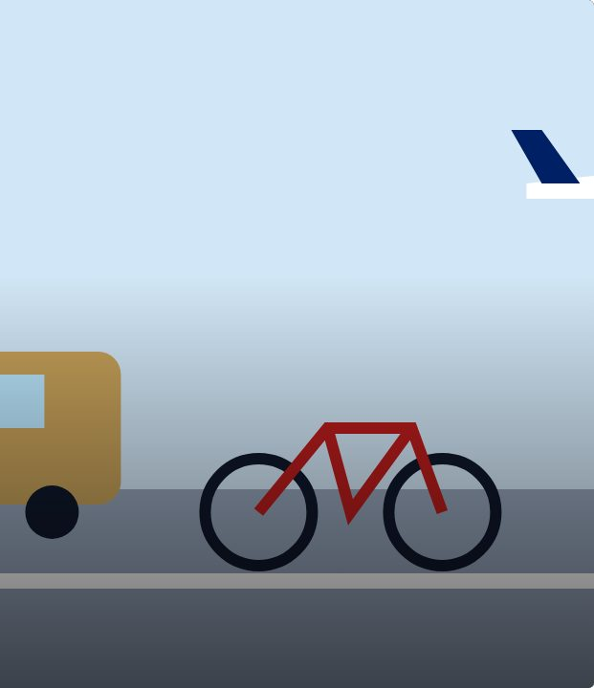

CONNECT
19
LESSON 19 · WĀHANGA 2 · TIME, TRAVEL AND OPINIONS
Mā runga, mā raro: travel
Mā runga pahi
Te Reo Māori · Novice 3
NOVICE 3 · N3.4
Notes:
CONNECT
Karakia tīmatanga led by a student. Retrieval (Lesson 17): i and ka. Hook: how did you get to school today? On Waiheke, how do people get to Tāmaki Makaurau?

Slide 2
CONNECT
WHAT WE ARE LEARNING
We are learning to talk about travelling to and from places and how we travel.
SUCCESS CRITERIA
✓ I can ask and answer “Kei te haere koe ki hea?”
✓ I can say how I travel with mā runga / mā raro
✓ I can use ki for “to” a place
Waiheke High School · Te Reo Māori · Novice 3 · Lesson 19 · 2
Notes:
CONNECT
Karakia tīmatanga led by a student. Retrieval (Lesson 17): i and ka. Hook: how did you get to school today? On Waiheke, how do people get to Tāmaki Makaurau?

Slide 3
CONNECT
How did you get to school today?
How do people get from Waiheke to Tāmaki Makaurau?
Waiheke High School · Te Reo Māori · Novice 3 · Lesson 19 · 3
Notes:
CONNECT
Karakia tīmatanga led by a student. Retrieval (Lesson 17): i and ka. Hook: how did you get to school today? On Waiheke, how do people get to Tāmaki Makaurau?

Slide 4
Kei te haere koe ki hea?
I DO
PĀTAI
Kei te haere koe ki hea?
Where are you going?
WHAKAUTU
Kei te haere ahau ki te wharepaku.
I’m going to the toilet.
PĀTAI
Kei te haere koe mā runga aha?
How are you travelling?
WHAKAUTU
Kei te haere au mā runga paihikara.
I’m going by bike.
Waiheke High School · Te Reo Māori · Novice 3 · Lesson 19 · 4
Notes:
I DO
Model Kei te haere koe ki hea? / Kei te haere ahau ki te wharepaku. Teach mā runga + vehicle and mā raro. Explain waka. Combine with tenses: I hīkoi māua i Ōamaru. Ka taraiwa mai a Freddie.
Watch for: “Mā runga raro” (mixing the fixed expression). Ask: “Is walking a vehicle?”

Slide 5
Ngā waka · transport
I DO
mā runga + vehicle · mā raro = on foot
pahi
bus
tereina
train
paihikara
bicycle
waka
car; vehicle; boat
waka rererangi
plane
mā raro
on foot
Waiheke High School · Te Reo Māori · Novice 3 · Lesson 19 · 5
Notes:
I DO
Model Kei te haere koe ki hea? / Kei te haere ahau ki te wharepaku. Teach mā runga + vehicle and mā raro. Explain waka. Combine with tenses: I hīkoi māua i Ōamaru. Ka taraiwa mai a Freddie.
Watch for: “Mā runga raro” (mixing the fixed expression). Ask: “Is walking a vehicle?”

Slide 6
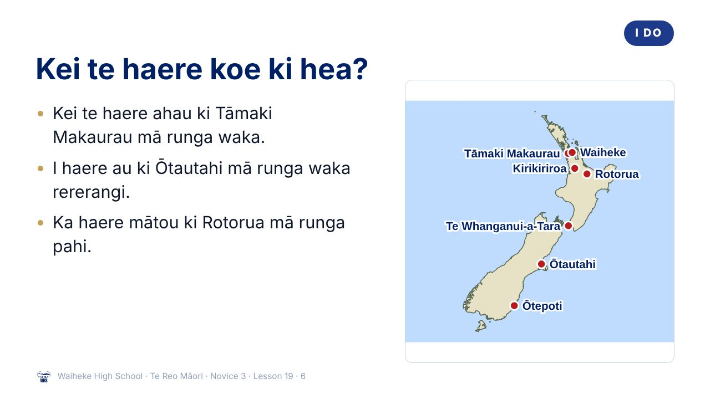
Notes:
I DO
Model Kei te haere koe ki hea? / Kei te haere ahau ki te wharepaku. Teach mā runga + vehicle and mā raro. Explain waka. Combine with tenses: I hīkoi māua i Ōamaru. Ka taraiwa mai a Freddie.
Watch for: “Mā runga raro” (mixing the fixed expression). Ask: “Is walking a vehicle?”
(This slide is a picture. Edit the title in the notes or rebuild it if you need to change it.)

Slide 7
Waka
I DO
Traditional
voyaging vessels
Now also used for
cars and vehicles
Kei te hoki atu te whānau mā runga waka rererangi.
Waiheke High School · Te Reo Māori · Novice 3 · Lesson 19 · 7
Notes:
I DO
Model Kei te haere koe ki hea? / Kei te haere ahau ki te wharepaku. Teach mā runga + vehicle and mā raro. Explain waka. Combine with tenses: I hīkoi māua i Ōamaru. Ka taraiwa mai a Freddie.
Watch for: “Mā runga raro” (mixing the fixed expression). Ask: “Is walking a vehicle?”

Slide 8
Travel survey
WE DO
Ask the class
1
I haere mai koe ki te kura mā runga aha?
2
Mā runga pahi? Mā runga waka? Mā raro?
Waiheke High School · Te Reo Māori · Novice 3 · Lesson 19 · 8
Notes:
WE DO
Class travel survey on the board.

Slide 9
Your task
YOU DO
KŌRERO
Travel survey: ask six people.
WORKSHEET
Q1 Answer.
WORKSHEET
Q2 Translate.
WORKSHEET
Q3 Plan a trip.
Waiheke High School · Te Reo Māori · Novice 3 · Lesson 19 · 9
Notes:
YOU DO
Kōrero: travel survey in te reo. Worksheet: questions, translate, write a trip plan.

Slide 10
REVIEW
↻ REVIEW
Mā runga aha?
How did you come to school?
Waiheke High School · Te Reo Māori · Novice 3 · Lesson 19 · 10
Notes:
REVIEW
Exit: I haere mai koe ki te kura mā runga aha?

