Slide 1
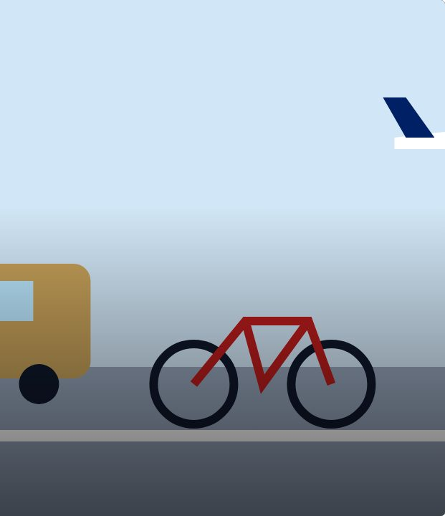

SET UP
20
LESSON 20 · WĀHANGA 2 · TIME, TRAVEL AND OPINIONS
Travel survey and map
Mā runga aha?
Te Reo Māori · Novice 3
NOVICE 3 · N3.4
Notes:
SET UP
Karakia tīmatanga. Survey sheets; map of Waiheke.

Slide 2
SET UP
WHAT WE ARE LEARNING
We are surveying how people travel and mapping it in te reo.
SUCCESS CRITERIA
✓ I can ask and answer about travel
✓ I can use past and future travel sentences
✓ I can present survey results
Waiheke High School · Te Reo Māori · Novice 3 · Lesson 20 · 2
Notes:
SET UP
Karakia tīmatanga. Survey sheets; map of Waiheke.

Slide 3
Language for today
SET UP
Mā runga aha?
By what?
Mā raro
On foot
Ki hea?
Where to?
Tokohia?
How many people?
Waiheke High School · Te Reo Māori · Novice 3 · Lesson 20 · 3
Notes:
SET UP
Karakia tīmatanga. Survey sheets; map of Waiheke.

Slide 4
How it works
SESSION
Follow the steps
1
Survey
2
Tally
3
Graph
4
Present in te reo
Waiheke High School · Te Reo Māori · Novice 3 · Lesson 20 · 4
Notes:
SESSION
Survey the class (and another class) about travel to school and to the city. Graph results; present with Tokohia … mā runga …?

Slide 5
Your task
SESSION
KŌRERO
Survey.
WORKSHEET
Tally and graph.
KŌRERO
Present.
Waiheke High School · Te Reo Māori · Novice 3 · Lesson 20 · 5
Notes:
SESSION
Survey the class (and another class) about travel to school and to the city. Graph results; present with Tokohia … mā runga …?

Slide 6
REFLECT
↻ REVIEW
Whakaaro
What is the most common way?
Waiheke High School · Te Reo Māori · Novice 3 · Lesson 20 · 6
Notes:
REFLECT
What does our data show? Karakia whakamutunga.

