Slide 1
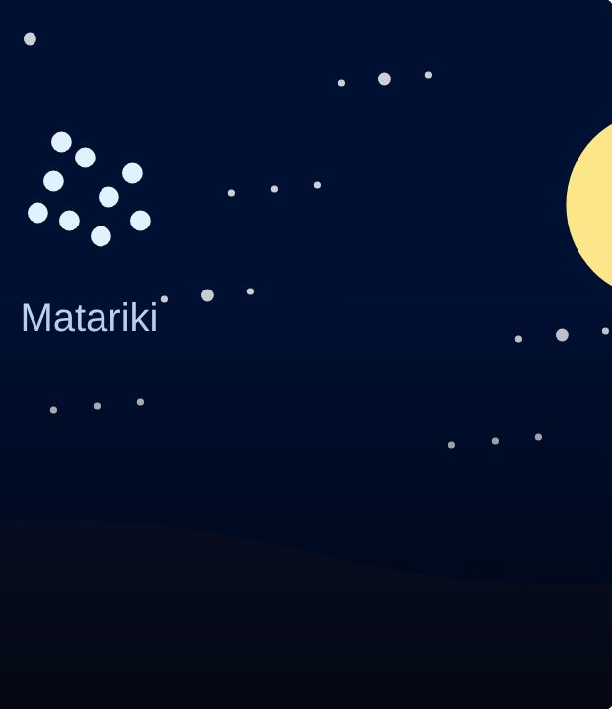

SET UP
38
LESSON 38 · WĀHANGA 3 · KAI, WEATHER AND THE MARAMATAKA
Maramataka moon diary
Te maramataka
Te Reo Māori · Novice 3
NOVICE 3 · N3.7
Notes:
SET UP
Karakia tīmatanga. Moon diary sheets; a published maramataka for your rohe if available.

Slide 2
SET UP
WHAT WE ARE LEARNING
We are observing the moon and linking it to the maramataka.
SUCCESS CRITERIA
✓ I can record moon phases
✓ I can link a phase to an activity
✓ I can respect iwi differences in the maramataka
Waiheke High School · Te Reo Māori · Novice 3 · Lesson 38 · 2
Notes:
SET UP
Karakia tīmatanga. Moon diary sheets; a published maramataka for your rohe if available.

Slide 3
Language for today
SET UP
Marama
Moon
Whiro
New moon
Rākaunui
Full moon
Whakatō
Plant
Hī ika
Fish
Hauhake
Harvest
Waiheke High School · Te Reo Māori · Novice 3 · Lesson 38 · 3
Notes:
SET UP
Karakia tīmatanga. Moon diary sheets; a published maramataka for your rohe if available.

Slide 4
How it works
SESSION
Follow the steps
1
Look at the moon each night
2
Draw the phase
3
Check the maramataka
4
Plan an activity
Waiheke High School · Te Reo Māori · Novice 3 · Lesson 38 · 4
Notes:
SESSION
Introduce the diary; students record the moon each night for two weeks. In class: compare with the maramataka and plan a garden or fishing day.

Slide 5
Your task
SESSION
BOOK
Moon diary.
KŌRERO
Share observations.
Waiheke High School · Te Reo Māori · Novice 3 · Lesson 38 · 5
Notes:
SESSION
Introduce the diary; students record the moon each night for two weeks. In class: compare with the maramataka and plan a garden or fishing day.

Slide 6
REFLECT
↻ REVIEW
Whakaaro
What did you notice about the moon?
Waiheke High School · Te Reo Māori · Novice 3 · Lesson 38 · 6
Notes:
REFLECT
What did you notice? Karakia whakamutunga.

