Slide 1

Buying and Renting Out Properties in Major Texas Cities
Gabe Cweigenberg, Daniel Anguiano, Kennedy Knowlton

Slide 2

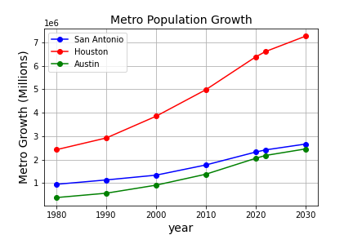

Slide 3

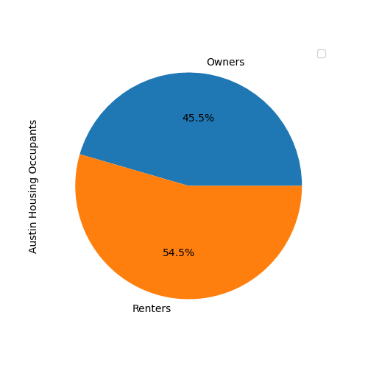
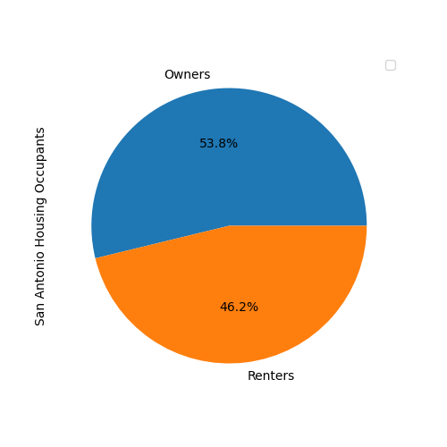
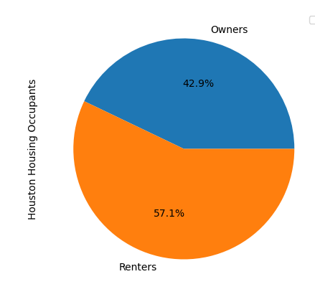

Slide 4

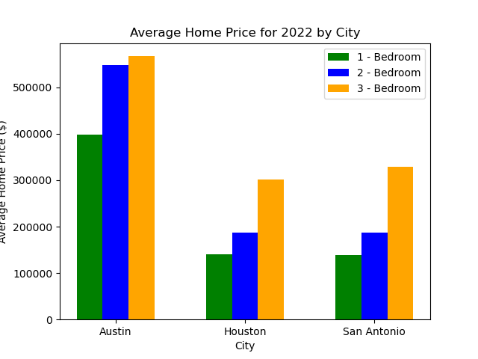

Slide 5

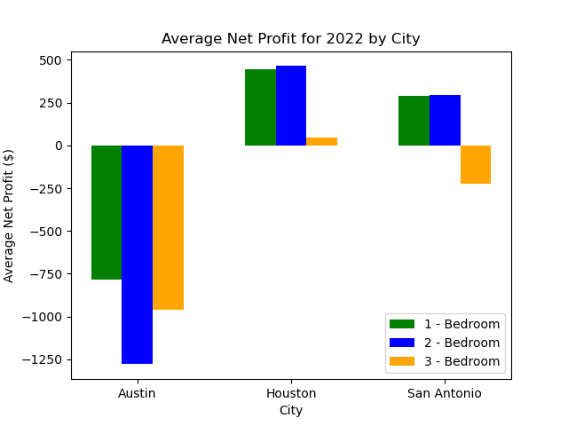

Slide 6
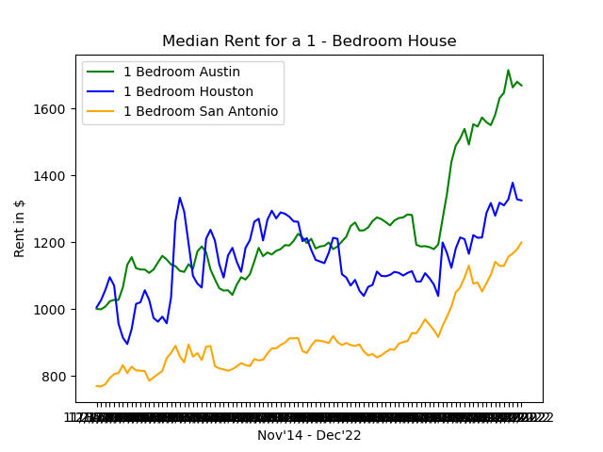
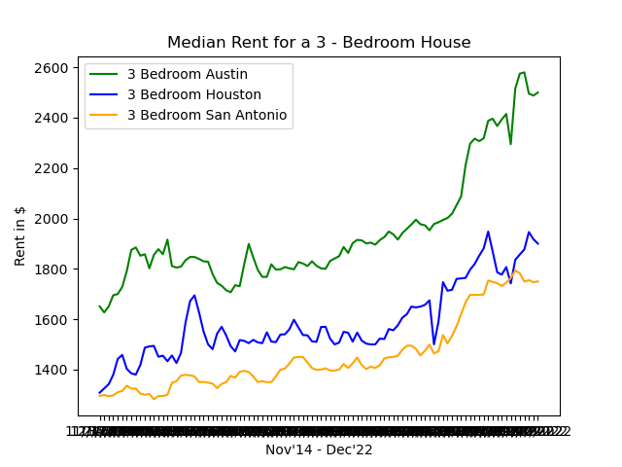

Slide 7

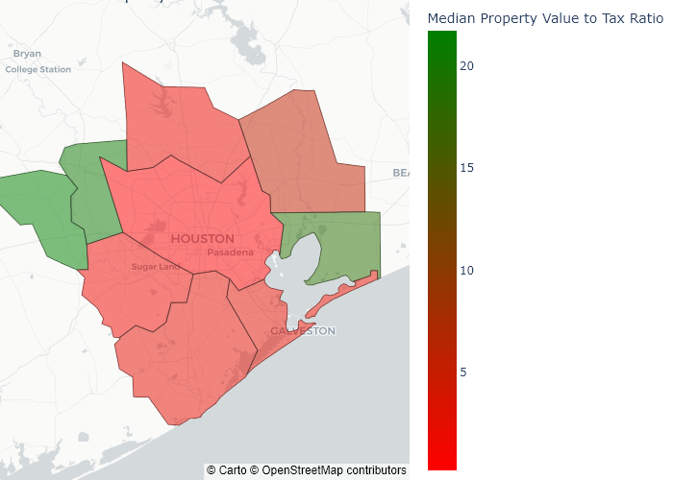

Slide 8

Concluding Factors
The rental cost in Houston is higher than San Antonio.
Houston1 bedroom =$1283.31
Houston 2 bedroom =$1589.62
Houston 3 bedroom =$1857.15
While the average housing cost is cheaper, yielding a lower mortgage cost.
Houston1 bedroom =$139953.7
Houston 2 bedroom =$187785.5
Houston 3 bedroom =$301823.7
Which allows Sally to yield the greatest profit across the board.
Houston1 bedroom = $444.22
Houston 2 bedroom = $463.75
Houston 3 bedroom = $47.56

