Slide 1
IC-CAD Project
Sessions 1&2 -- 2026

Slide 2
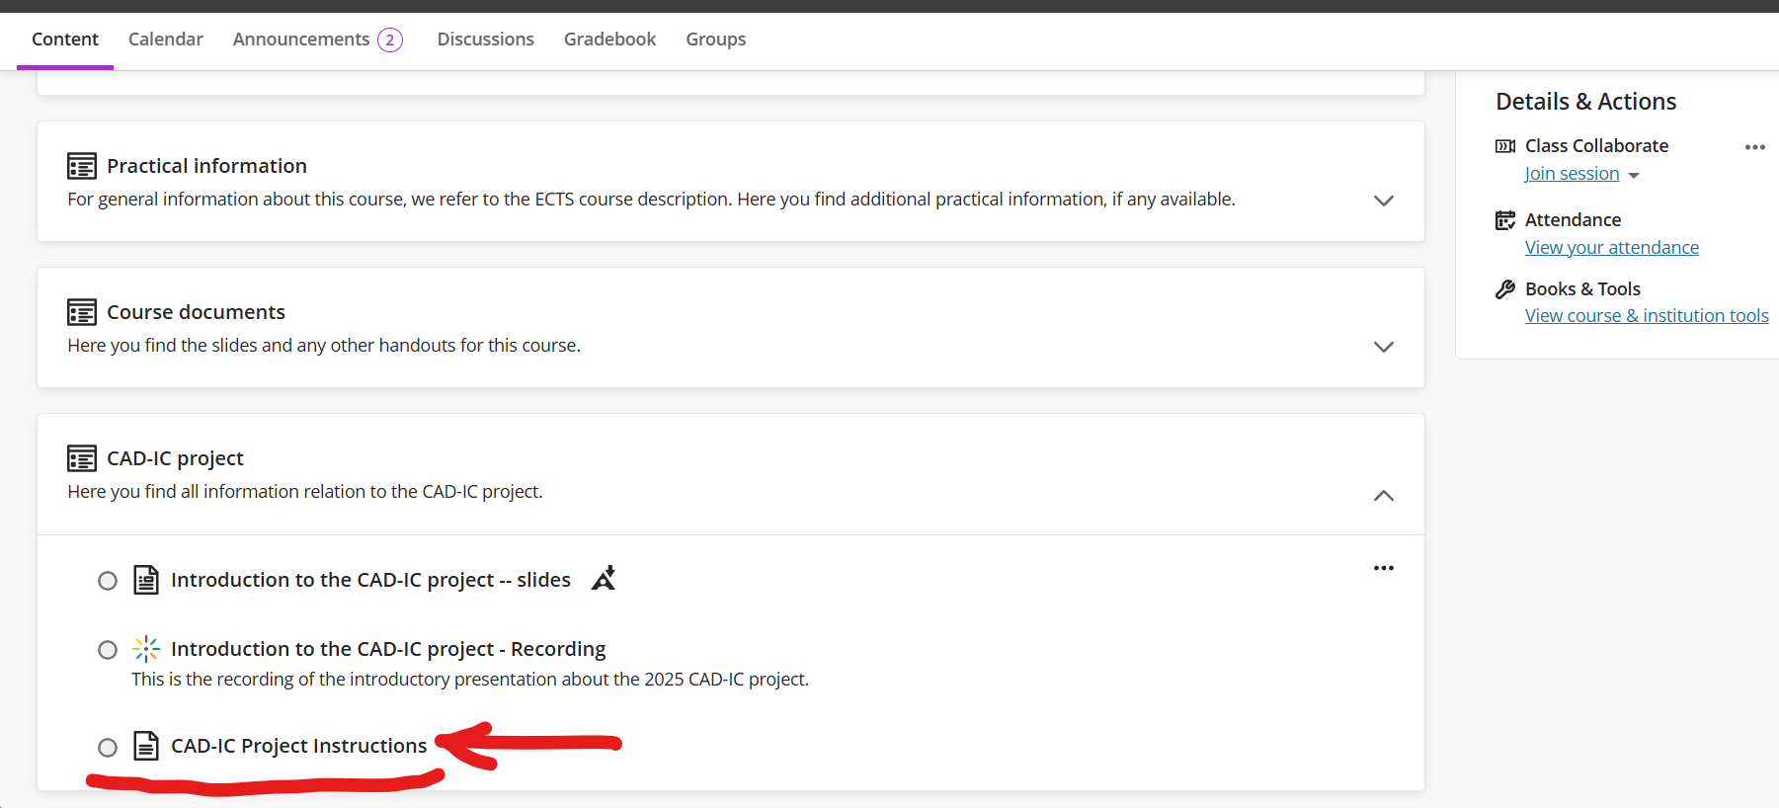
Download the Instructions PDF
Go to the course page in Toledo/Ultra, and download the following file:

Slide 3
Terminal command to access the code
From your own terminal, run the following command. You can decide the destination path … .
cp –r /users/micas/mahmadza/public/bin/CAD ~/your/own/path

Slide 4
Python Environment – Student server
Python 3.9.21 is the only available python on the student server.
The environment for the course should have the following Python packages:
numpy, scipy, matplotlib, pyyaml, pandas, gymnasium, torch (PyTorch), mcp[cli], pydantic, python-dotenv, and ipykernel (for notebooks).
Antigravity CLI should be installed separately.
The following python environment is available to use in VSCode:
/users/micas/mahmadza/public/bin/cad_env/bin/python

Slide 5
Python Environment – your own computer
Use uv for the course environment. Commands shown: Linux/macOS.
1 Install uv
curl -LsSf https://astral.sh/uv/install.sh | sh
Reopen your terminal after installing uv.
2 Create the environment in your project folder
uv venv --python 3.12
source .venv/bin/activate
uv pip install numpy scipy matplotlib pyyaml pandas gymnasium torch
uv pip install "mcp[cli]" pydantic python-dotenv ipykernel
Windows activation:
.venv\Scripts\Activate.ps1
uv installation guide
MCP Python SDK
Notes:
CAD course environment setup, November 2026. Example commands use Linux/macOS with bash or zsh. Run the environment commands from the project directory. Reactivate the environment whenever a new terminal is opened. uv can download Python 3.12 if needed. torch is PyTorch. mcp[cli] supplies the MCP Python SDK and its development commands. ipykernel supports notebook kernels; select the project environment in your notebook editor. pydantic and python-dotenv are retained as explicit course dependencies even though MCP can install them transitively.
Windows: install uv using the Windows instructions at the link. Use .venv\Scripts\Activate.ps1 in PowerShell instead of source .venv/bin/activate. The uv venv and uv pip install commands are the same on Windows.
Sources accessed November 3, 2026:
https://docs.astral.sh/uv/getting-started/installation/
https://docs.astral.sh/uv/pip/environments/
https://py.sdk.modelcontextprotocol.io/get-started/installation/

Slide 6
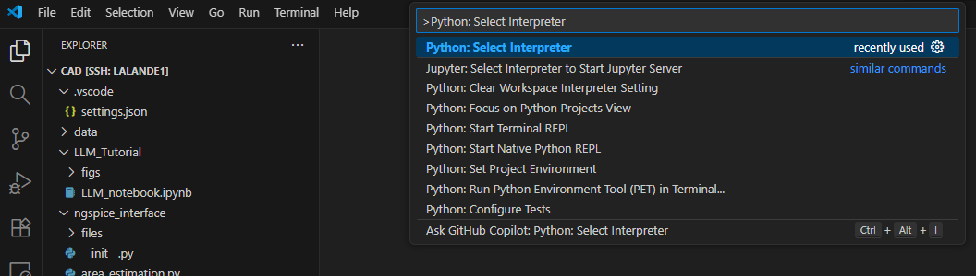
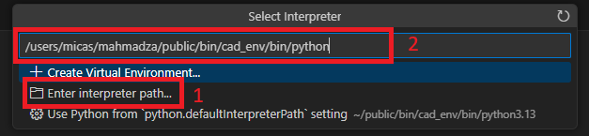
Setting the environment in VSCode
Open the CAD/ folder as the source directory in VSCode.
Press Ctrl+Shift+P to open the command palate.
First, Enter the Python: Clear Workspace Interpreter Setting for resetting.
Open command palate again, Enter command Python: Select Intrepreter
Write the path to the interpreter and press Enter:
  /users/micas/mahmadza/public/bin/cad_env/bin/python
The cad_env will become the default python environment in that project.

Slide 7
How to use ngspice
ngspice is already installed and available through the following path:
The above command calls ngspice on the netlist.cir file to run it!
You can make an alias in your .bashrc if you don’t want to write the full path to the ngspice simulator every time (up to you!).
You can also define a task in VSCode (with or without using the code runner extension) to make .cir files automatically runnable with the above ngspice path every time you press the run button on them in VSCode. (If you want!)
/users/micas/mahmadza/public/bin/ngspice path/to/netlist.cir

Slide 8
Making unittest files
First, you must know that the DUT class (located in the dut_testbench.py file) inherits from the NgspiceWrapper class (located in the ngspice_wrapper.py file).
This means that all attributes, variables, and functions available in NgspiceWrapper are also available in DUT: including the create_new_netlist and simulate functions.
To make a unittest, it is better if you make a .py file directly in the CAD/ source directory and create an instance of DUT there.
Otherwise, if you want to run dut_testbench.py directly, you will have to add a main block to it (be careful of the relative import statements in that case !)

Slide 9
Reference Designs
Your measurement functions in the dut_testbench.py should give you similar results as in a reference_designs.csv file that will be given to you later.
Each row of that file contains a set of sizing parameters for which all the specs are measured by us! So, your measurements should be as close as possible to those!
Your unittest file should confirm that your measurements are correct for each of the reference designs.
You will also find the calculated reward for each design in that file. So, you can see if your calculations in the circuit_env.py file are correct … .

Slide 10
Working at Home & Questions
If you want to work on your own laptop (outside of ESAT student server), you should setup your own python environment as well as install ngspice on your computer.
If you want to ask questions, we are only available during the lab sessions!
Please only ask important questions (!), not any python-VSCode bug related to poor programming... . Embrace the trial-and-error learning!
Use Toledo Discussions.

