Slide 1
R and R Markdown
Week 2

Slide 2
What is R Markdown and why should I use it?
R Markdown is an R library that lets you embed your R code in a Markdown document
Markdown is a markup language (a system for annotating a document) similar to LaTeX. In fact, it relies on many functions from LaTeX
You write a script (a computer program) that generates a document
Advantages over Word and Excel
Formatting is more consistent and easily reproducible, esp. in large documents
Changes in your data, analysis, or graphs can be easily carried over to your documents

Slide 3
What is R Markdown and why should I use it?
Advantages over Word and Excel (cont…)
Let’s you embed your R code
LaTeX features:
Extensive libraries
Easier mathematical formulas
Format is a standard in academia
Output formats: LaTeX scripts, PDF, HTML, Word documents
Can also include bibliographic references with BibTeX (bibliography for LaTeX)
In fact, you’re gonna be doing a bit of all these functions today!

Slide 4
The basics of R Markdown
Setup and Installation
from: https://bookdown.org/yihui/rmarkdown/installation.html
From your R Studio console:
install.packages('rmarkdown')
This will also install Pandoc, necessary for Word document output, but for PDF outputs, you’ll need to install LaTeX. TinyTeX is recommended. From your console again:
install.packages("tinytex")
and after the installation:
tinytex::install_tinytex()

Slide 5
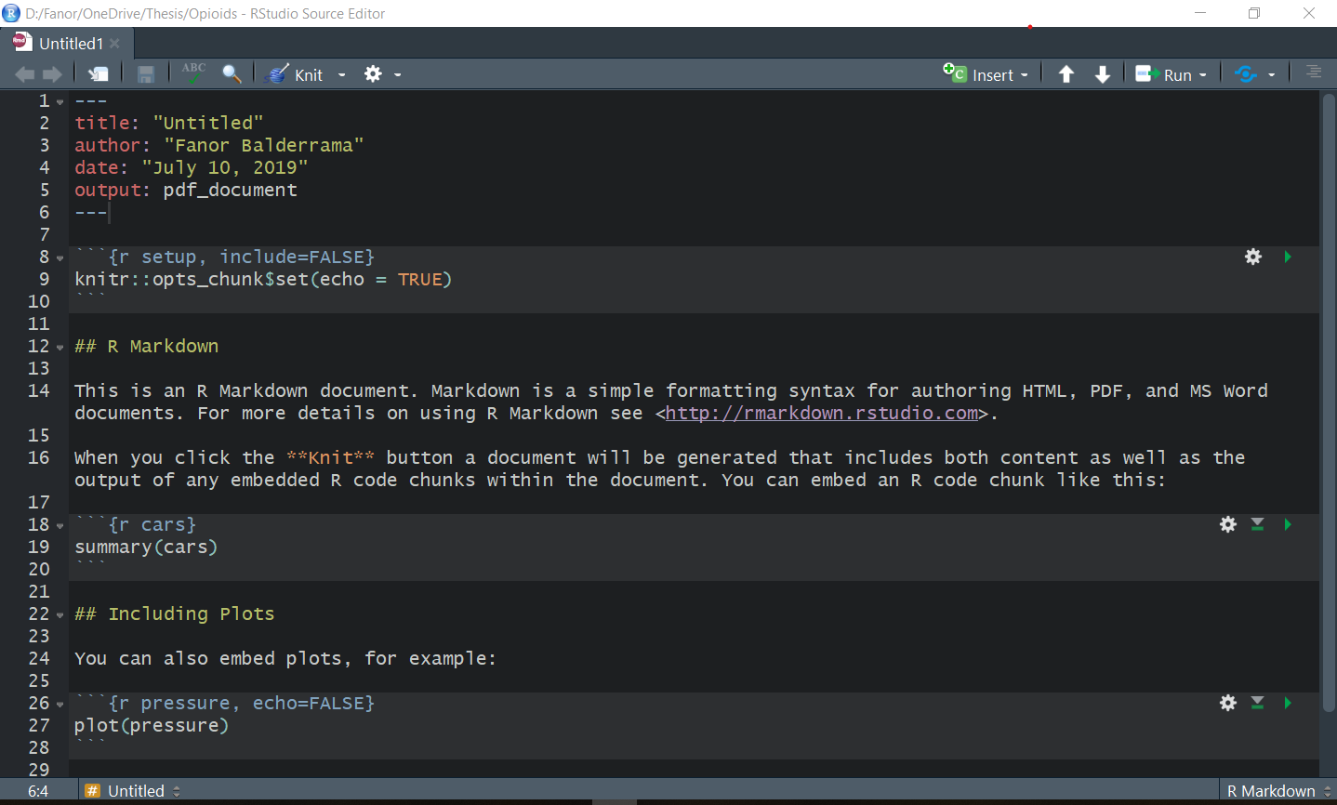
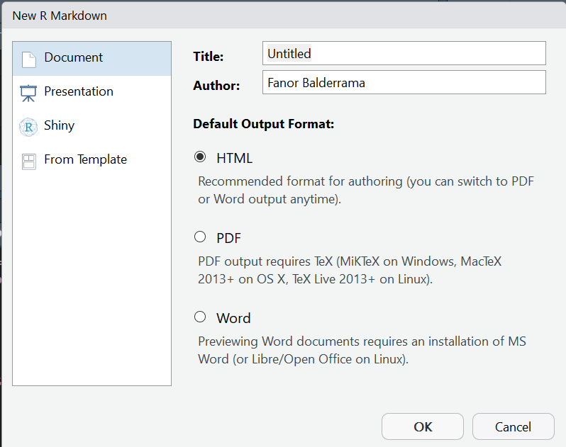
The basics of R Markdown
In your project in R Studio, click on
File → New File → R Markdown
Choose a title (this is not the file name and can be easily changed)
Choose a format, PDF for now → OK
Take a quick look at the code and click on “Knit”. Then, save the script.

Slide 6
The basics of R Markdown
The first part is the YAML metadata
Information about your document that will be generated as a header
Information about the output (e.g. PDF, folder location)
Call to LaTeX libraries and its options (e.g. BibTeX)
R code can be embedded in two ways:
Chunks: Blocks delimited by
Inline code: delimited by `r single printed output R code here`
Everything outside will Markdown-formatted script
# for headings and sub-headings
* text * for bold, underlined blocks of text
Help → Cheatsheets → R Markdown Reference Guide
```{r chunk_name, display_options}
R Code block here
```

Slide 7
How to find answers about R
Tutorials, including video tutorials
StackOverflow and similar Q&A type of forums
Cheat sheets
Read the documentation if you look for how to use a specific function or library:
Web
Help in the R Studio Console with “?” (e.g. ?lm )
Books

Slide 8


Slide 9
Activity
Common tasks (all groups)
Load the contents of the RDA file
Read the survey code book
What are the variables we’re interested in?
Having tried a cigarette
Health rating
Gender
Age (just to know the characteristics of the subgroup)
Has been treated for mood disorders
Subset the data frame

Slide 10
Activity
Common tasks (cont.)
Formatting of variables:
What class of variables are they?
Text (character), numeric, categorical (factor)?
What type of variables should they be?
Coding of variables
Take a look at the codebook
Tip: The names of the data frame and the variables are a bit unwieldly. Consider renaming them.

Slide 11
ANOVA group tasks
Do you know what an one-way ANOVA does and how it works statistically?
What function in R can do the one-way ANOVA test for you?
Find the documentation for such function
What arguments does the function take?
How do you think you should write the function in R?
You may want to look at examples online

Slide 12
Sample demographics group tasks
What variables are you interested in describing?
What are good ways of describing them? (mean, standard deviation, mode, median, proportion?)
Create a data frame that looks like the table you want to create
Look online how to create tables online in R

Slide 13
Mean plot group tasks
What kind of graph do you need to make?
What groups or categories will be included?
What data about those groups will be shown?
Create a data frame with all the information you will need
Create a plot with ggplot
Look for examples online

Slide 14




