Slide 1
AMES Housing sale price prediction
DSI 8 Project 2

Slide 2
Problem statement
To predict the price of homes at sale for the Aimes Iowa Housing dataset using data from Ames Assessor’s Office for sales from 2006 to 2010.

Slide 3
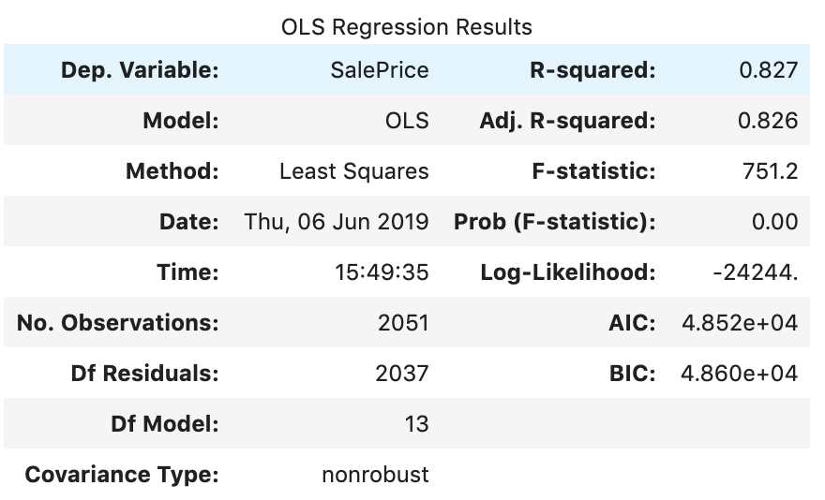
Narrowed down to 13 features to predict sale price based to their P-value in a ridge regression
Adjusted R-squared score at 0.826
RMSE score of 28842.84

Slide 4
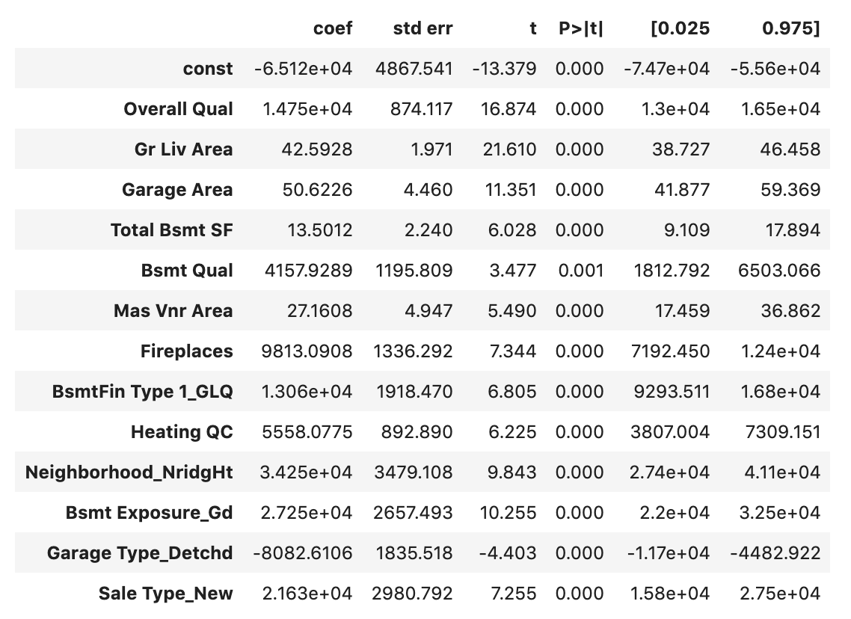
Final 13 features
Northridge Heights is the best neighborhood!
Having an additional fireplace can increase your property’s sale price

