Slide 1
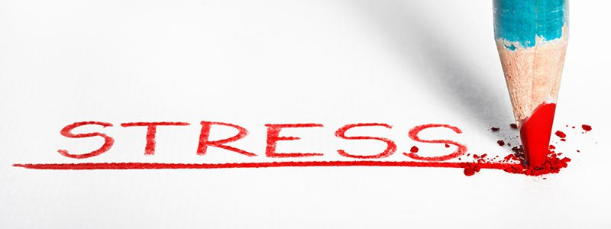
Increasing Stress and Its Impact
Team members:
Prachit Patil (8418) Nitesh Prasad (8420)
Kenneth Rebello (8422) Shaleel Rodrigues (8423)
Valiant Rodrigues (8424) Isaac Sanctis (8426)
Nidhi Sharma (8430) Aditya Shrotriya (8432)
TE INFORMATION TECHNOLOGY

Slide 2
Increasing Stress and Its Impact
Stress is...
Why did we stress ourselves?
Why do we stress ourselves?
Can we glorify stress?
Should we condemn stress?

Slide 3
Types of Stress
Stress
Acute Stress
Episodic Acute Stress
Chronic Stress

Slide 4
Types OF STRESS ACCORDING TO DR. ALBRECHT
Stress
Time Stress
Situational Stress
Anticipatory Stress
Encounter Stress

Slide 5
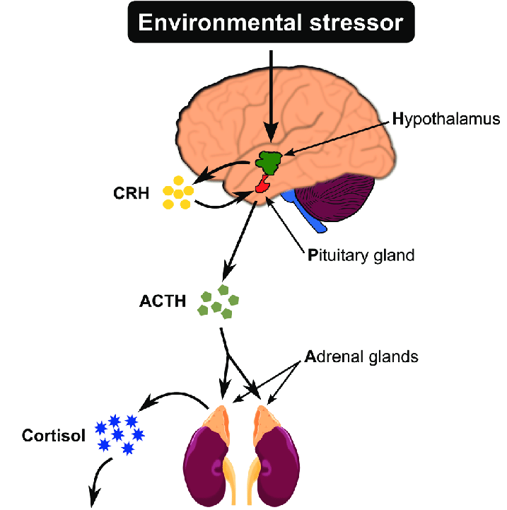
The Biology Of Stress
First Phase - Sympathomedullary (SAM) Pathway
Amygdala sends the distress signal to the hypothalamus
Hypothalmus stimulates the Adrenal Medulla via the SAM Pathway
Adrenal medulla produces Adrenaline
Adrenaline provides the body with a surge in energy.
The fight or flight response is activated

Slide 6
Second Phase - Hypothalamus Pituitary Adrenal (HPA) Axis
Hypothalamus sends a signal to the Pituitary Gland.
It releases ACTH. This causes release of CRH.
CRH stimulates the Adrenal Cortex.
The Adrenal Cortex releases the steroid hormone Cortisol.
Cortisol maintains the steady supplies of blood sugar.
The body is helped to cope with prolonged stress.
The parasympathetic nervous systems stops the production of Cortisol.

Slide 7
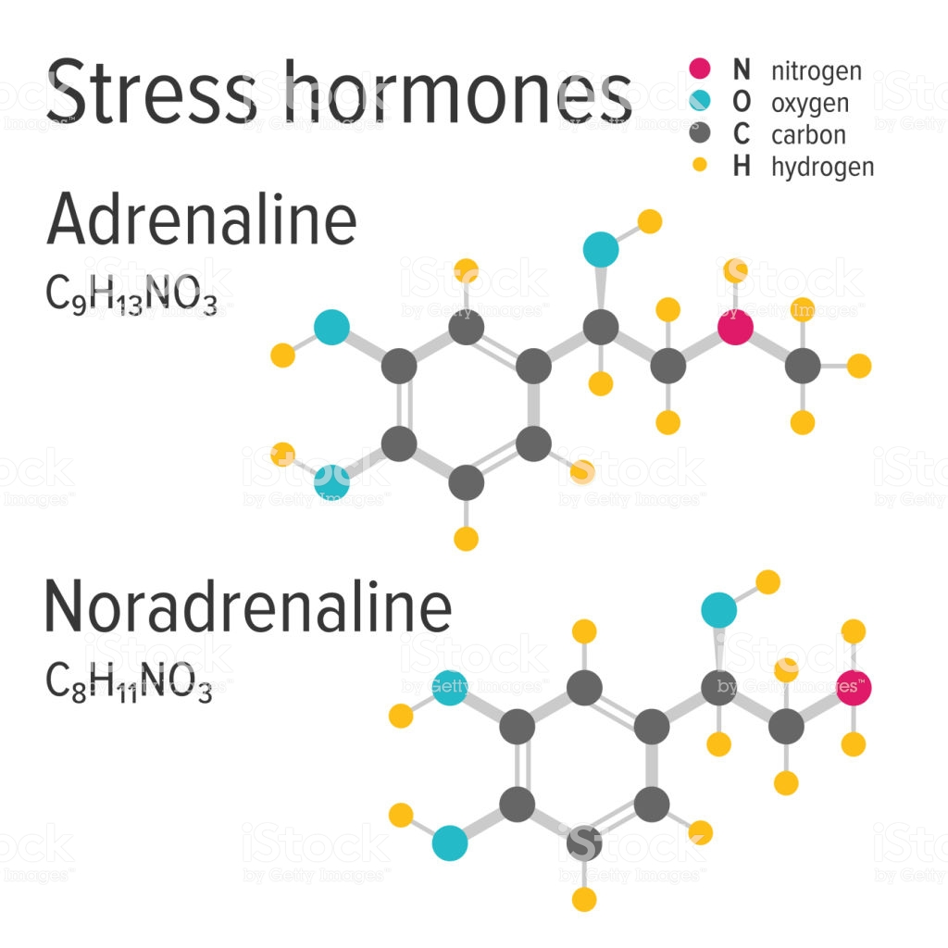
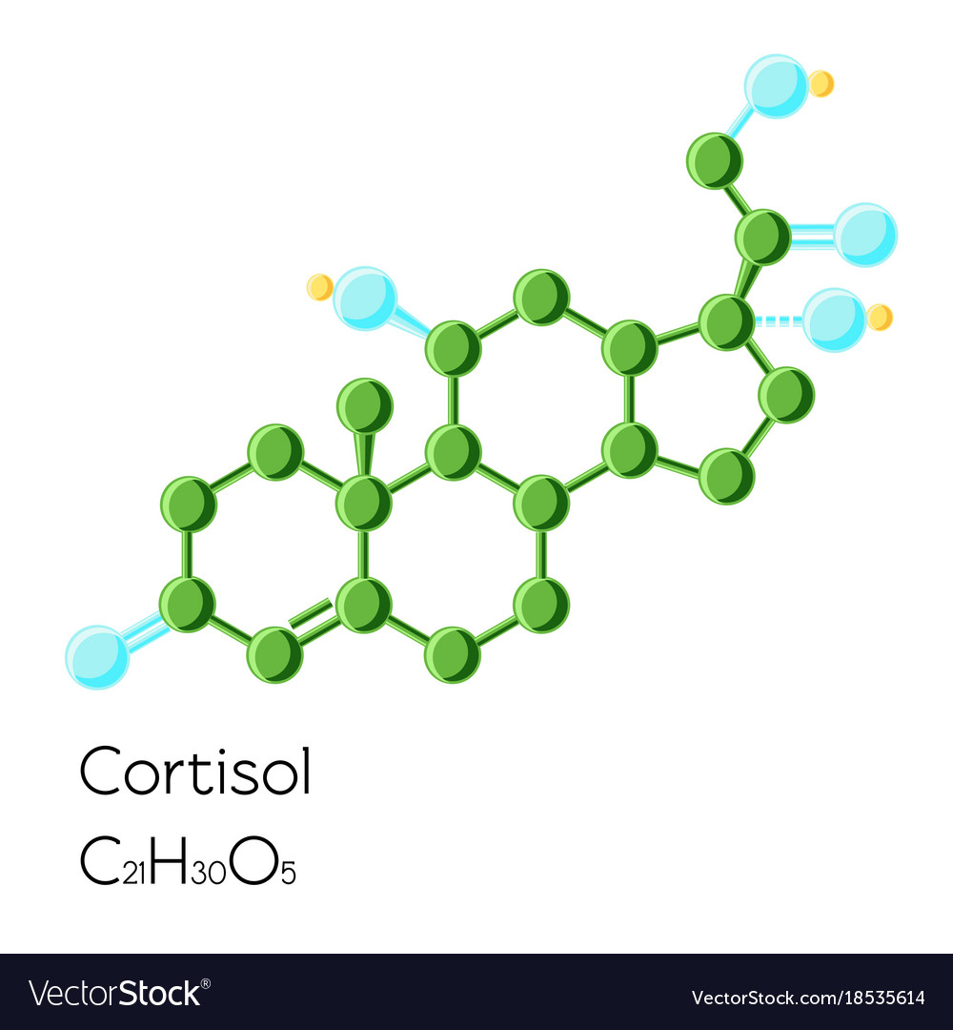
DISADVANTagES
All energy is redirected to the muscles.
Increase in blood pressure.
Stress-induced DNA damage leads to prematue aging and also tumor growth.
Impaired cognitive performance.
Suppressed thyroid function.
Decreased bone density.
Higher blood pressure
Increased abdominal fat

Slide 8

Causes of Stress

Slide 9
Stressors
A stressor is anything that causes the release of stress hormones. There are two broad categories of stressors: Physiological (or physical) stressors and Psychological Stressors.
Physiological (or physical) stressors
These are stressors that put strain on our body?(i.e.: very cold/hot temperatures, injury, chronic illness, or pain).
Psychological Stressors
These are events, situations, individuals, comments, or anything we interpret as negative or threatening

Slide 10
It is our perception of stressor that determines if it becomes stress
Stress has always been the part of our civilisation.Historically stress was physical, we needed to survive physical attacks.
Our cultural evolution has been faster than our physiological evolution.
As a result in stressful condition our body reacts the same as the person who was getting chased by wild animals 100 years back.

Slide 11
Causes of Stress in adoloscence
Peer Pressure
Pressure to succeed academically
Uncertainty about the future
Parental Pressure
Social Media and Technology
Poor Time Management
Unhealthy Competition

Slide 12
EFFECTS of Stress

Slide 13
On your mood | On your behavior | On your body
Anxiety | Overeating or undereating | Headache
Restlessness | Angry outbursts | Muscle pain or tension
Lack of motivation or focus | Drug or alcohol misuse | Fatigue
Feeling overwhelmed | Tobacco use | Affects Respiratory System
Irritability or anger | Social withdrawal | Affects Digestive System
Sadness or depression | Exercising less often | Affects Immuns System

Slide 14
Positive Effects Of Stress
It boosts brainpower
It can increase short-term immunity
It can make you stronger
Makes you creative
It motivates you to succeed
It can enhance child development

Slide 15
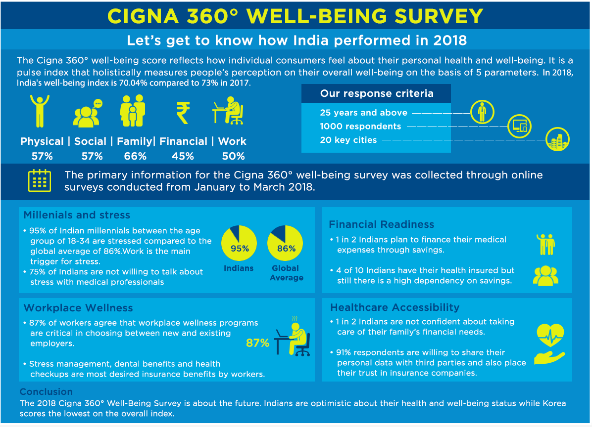
STATISTICS ON STRESS
Stress levels seem to be high in India compared to other countries, both developed and emerging, says a survey conducted by Cigna TTK Health Insurance. About 89% of the population in India say they are suffering from stress compared to the global average of 86%.
According to Moneycontrol, the survey further revealed that 95 per cent of Indian millennials between the age group of 18-34 are stressed compared to the global average of 86 per cent.

Slide 17
This survey was launched in 2018 with the goal of exploring well-being perceptions and concerns across five key areas of well-being - physical, family, social, financial and work.
All in all, despite the issues flagged off above, India ranked highest in overall well-being in the survey at 70.4 compared to a global average of 61.2. However, the pulse index reveals the second largest year-on-year drop among nations surveyed - India was at 73 in the 2017 survey.

Slide 18
STRESS MANAGEMENT
BELIEVE IN YOURSELF
Most important point to avoid stress is to have faith in yourself, you need to believe in your abilities , remember stress comes only when we overthink.
IF STRESS CAN COME IT CAN GO
When someone asked SIR KRISHNAMURTHY how he always overcame Stress very easily in life, He replied, “NEVER TAKE ANYTHING SERIOUSLY”
This principle has helped me live a stressfree life.
SHARPEN THE SAW
This Principle was given by Dr Stephen Covey in his book ‘Seven habits of highlyEffective People’, The principle states that we have to stop fretting over the things which are not going as per our expectation Instead we should be rejuvenating our life by focusing on sharpening the skills that we possess.

Slide 19
INFLOW OF NEW THOUGHTS CAN REMAKE YOU
Affirm these always “I don’t believe in stress”, continue to affirm that until the idea dominates your subconscious mind.
Think only positive thoughts and you will see only positive reality.
STOP FUMING AND FRETTING
Instead of stressing out any problem, Step aside and do something about the thing that is bothering you, Use all your strength to overcome the road-blocks in your life.
TRY PRAYER POWER
A Beautiful Prayer- I believe I am always divinely guided. I believe I will always take the right turn on the road, I believe god will always make a way where there is no way.

Slide 20
WHEN VITALITY SAGS TRY THIS
A famous statesman who made seven speeches in one day was still boundless in energy . “Why are you not tired after making seven speeches?” someone asked him. “Because,” he said “I believe absolutely in everything I said in those speeches. I am enthusiastic about my convictions.”
That’s the secret. He was on fire for something. He was pouring himself out, and you never lose energy and vitality in so doing.
NOTHING IS IMPOSSIBLE
Throughout the bible the truth is emphasized again and again that, “If you have faith as a grain of mustard seed…..nothing shall be impossible unto you.
Always remember in life that stress comes to only to those who struggle with the complexities and avoid the simplicities.

Slide 21
The conclusion we would like the reader to infer from this report is that stress is on the rise and its dangers are something we can not ignore anymore. It would be wise to learn how to tackle this toxic feeling and turn it into something productive.
THANK YOU FOR YOUR ATTENTION.

