Slide 1
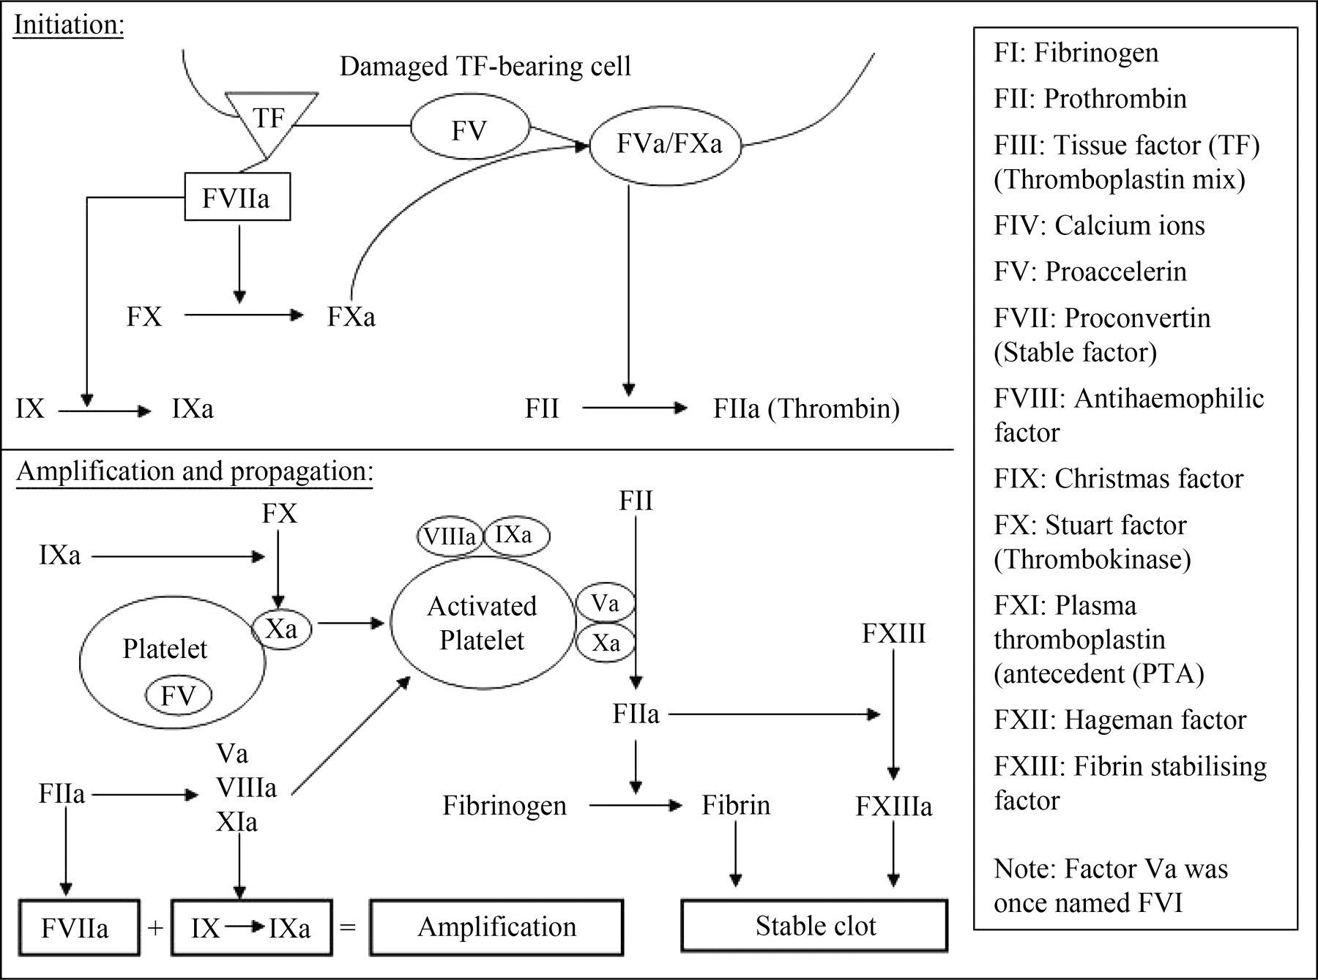

An overview of the cell-based model of coagulation
Curry, A. N. et al. Contin Educ Anaesth Crit Care Pain 2007 7:45-50; doi:10.1093/bjaceaccp/mkm002
Copyright restrictions may apply.

Slide 2
Prothrombin
(factor II)
Va
Activated platelet
Xa
Thrombin
(IIa)
Fibrinogen
(I)
Fibrin
(Ia)
VIIIa
VIII
Stable clot

