Slide 1
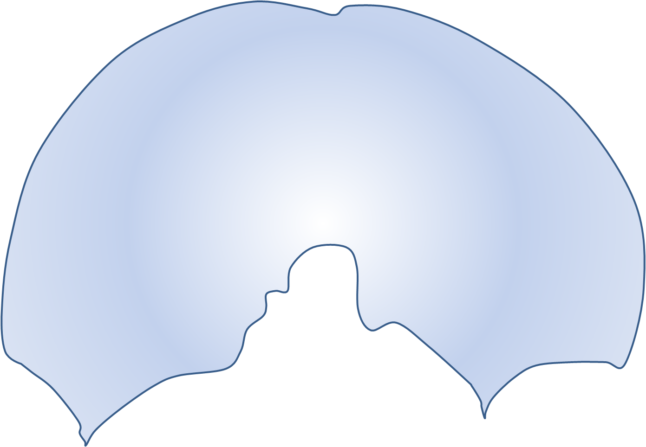
C o s t a l
C a r t I l a g e
Vena caval foramen (T8)
Right phrenic nerve
Oesophageal hiatus (T10)
Vagus nerve
Aortic hiatus (T12)
Thoracic duct
Azygous vein
L1
Left crus
L2
Right crus
L3
Lumbosacral fascia
Lumbosacral fascia

