Slide 1

😁 Emoji Predictor
😉 Han Lai

Slide 2
Why Emoji ?🤔 😕

Slide 3

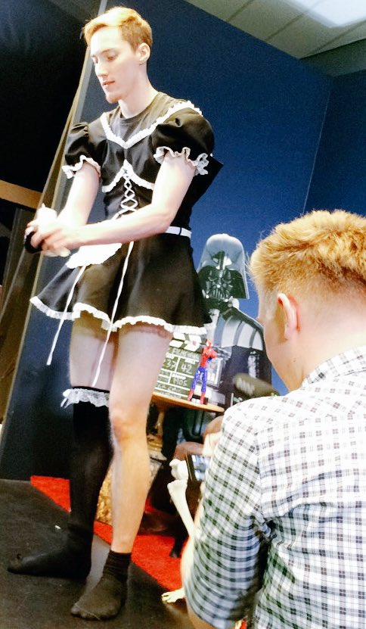
Emoji is universal language! 🙆
💛❤
すっごくたのしかったです
→ It was soooo fun
Warum geschehen diese Dinge?
😅

Slide 4
Why Predictors than? 😕

Slide 5
Why predictor

Slide 6
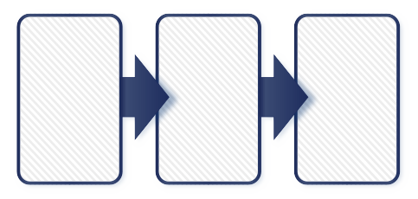
Data Pipeline 📊

Slide 7
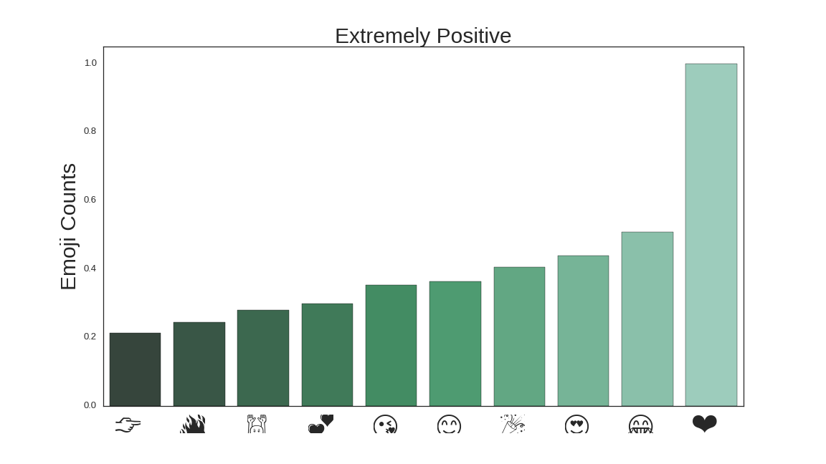
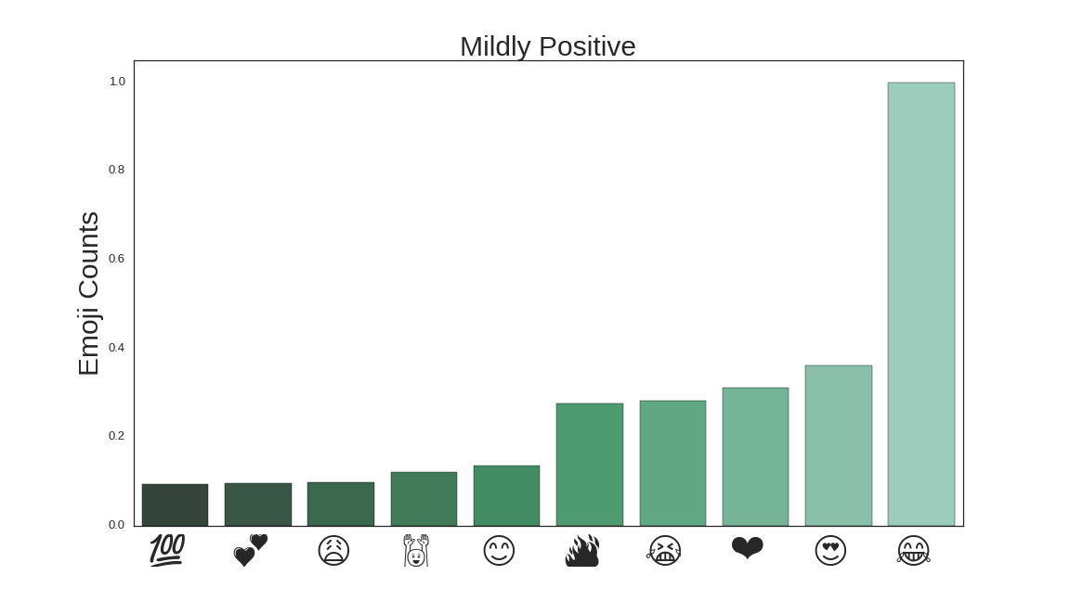
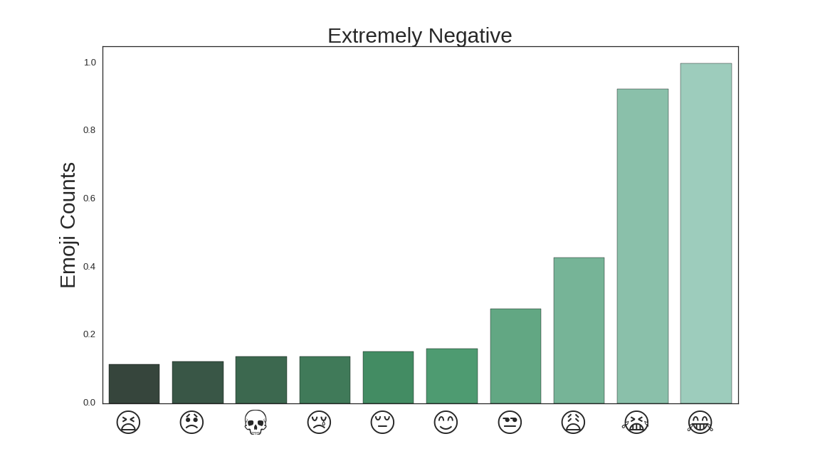
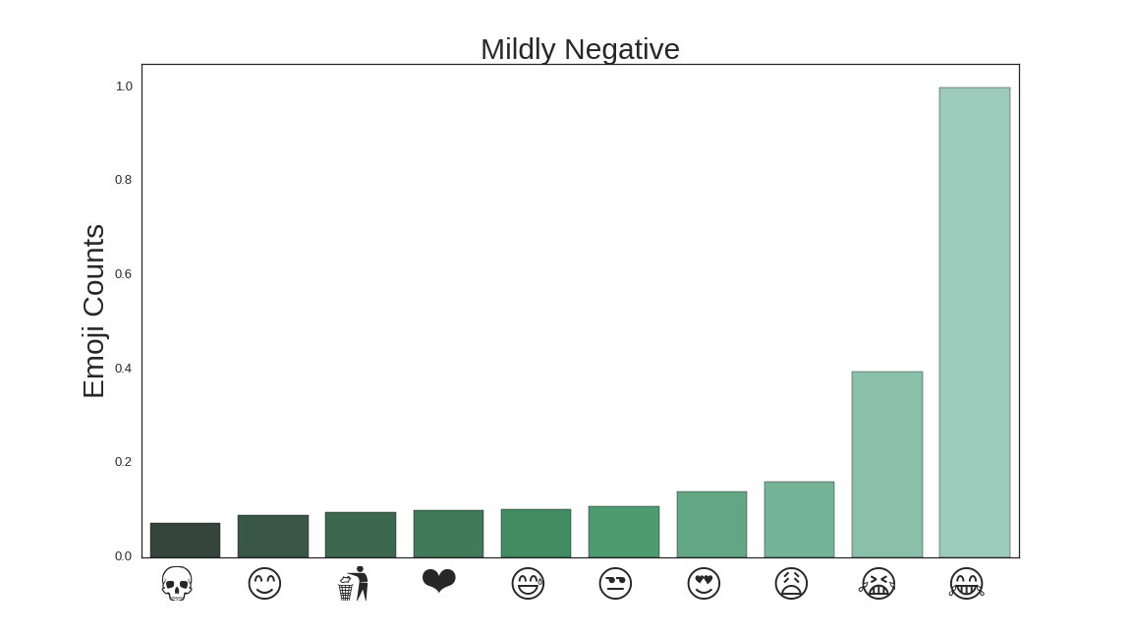
Sentiment Analysis on Emoji

Slide 8
Web 🕸 apps!

