Slide 1



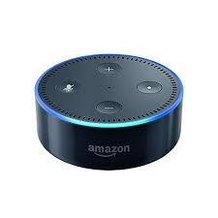

alexa.agilesalt.com
5. Input my sites
4. email, name
6. Save my sites
by user’s email
3. login
1. Link Account @ Alexa app
2. email, name
7. Ask to check my sites
8. Retrieve my sites
by user’s email
9. Alexa tells whether your sites are up or not
Alexa Web Check

