Slide 1
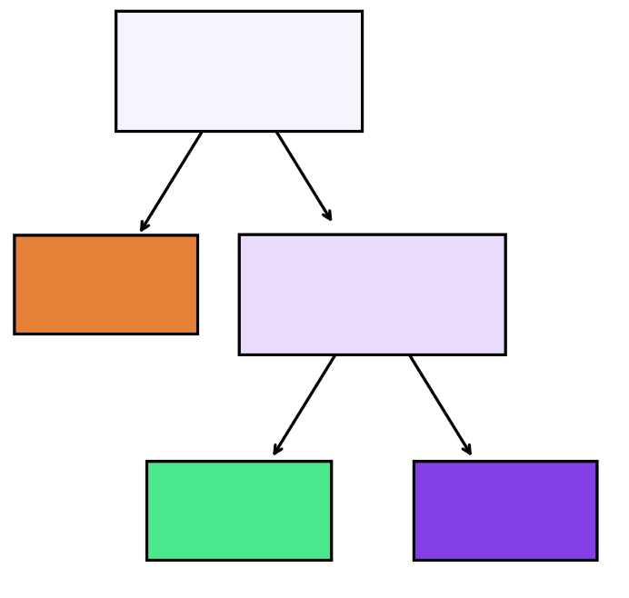
Bagging
Boosting
Bootstrapped Sample 1
Bootstrapped Sample 2
Bootstrapped Sample 3
Dataset
Prediction
Prediction

