Slide 1
Fall 2012
Team TEAM
Kenneth Lombardi – Tech lead
Steven Peng – Design lead

Slide 2

Since Engine Proof
Abandoned ship
  No more fluids
More MOAI understanding
New game idea!

Slide 3
Game
First-person “free-fall” while collecting/avoiding objects
Two modes
  Level based
    Player is scored on time to complete level and items collected
  Infinite
    See how high the player can score before hitting an object

Slide 4
Game... part 2
Player can move in any direction as well as dive to descend at a faster speed
Falling into certain objects will have adverse effects
  Repel, slow, distort vision, etc.
Player is graded on time it takes to complete level as well as how many collectibles
Still aiming for mobile platform

Slide 5
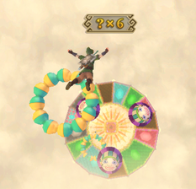
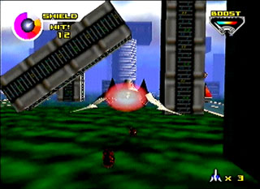
Skyward Sword
Dive through rings
Avoid balloons
Land on a target
StarFox64
Restricted on-rails
Avoid/destroy obstacles
Barrel Rolls

Slide 6
Tech, Tools, and Text
Tools
  ZeroBrane Studio, Visual Studio 2010, Eclipse
Mobile
  Print out errors
  Shaders
Tech
  Persistence, Serialization, Factory, Managers (window, layer, etc.)

Slide 7
Factory
layer1 = Factory:createFromFile("Layer", "level1.lua");
local function initialize()
  Factory:register("PropPrototype", PropPrototypeCreator:new());
  Factory:register("Prop", MOAIPropCreator:new());
  Factory:register("PropContainer", PropContainerCreator:new());
  Factory:register("Layer", MOAILayerCreator:new());
  Factory:register("MOAIPropPrototype", MOAIPropPrototypeCreator:new());
  Factory:register("MOAIPropCube", MOAIPropCubeCreator:new());
end

Slide 8
deserialize ("Layer",
{
{--Entry Number: {1}
["visible"]="true",
["type"]="Layer",
["name"]="Layer1",
["propContainer"]={2},
["position"]={3},
},
{--Entry Number: {2}
[1]={4},
},
{--Entry Number: {3}
["y"]=42,
["x"]=24,
["z"]=0,
},
{--Entry Number: {4}
["type"]="MOAIPropCube",
["name"]="Prop1",
["position"]={5},
},
{--Entry Number: {5}
["y"]=1077.0828605541,
["x"]=691.58695151122,
["z"]=86,
},
})

Slide 9
Risks and Mitigations
New game idea, huge set back
  Simpler idea, should be back on our feet shortly
3D in primarily-2D engine
  Use non-complex shapes/polygons that we can generate ourselves

Slide 10
It's showtime!

