Slide 1
Who Are We?
Steven Peng – R.T.I.S. - Producer
Kenneth Lombardi – R.T.I.S. - Technical Director

Slide 2


High Concept
Theme
  Rubber duckies
  Boats
  Floaties
Technology
Physics
  Fluid
  Buoyancy
Gyroscope
Android and Windows
Genre
  Puzzle
  Infinite Runner

Slide 3
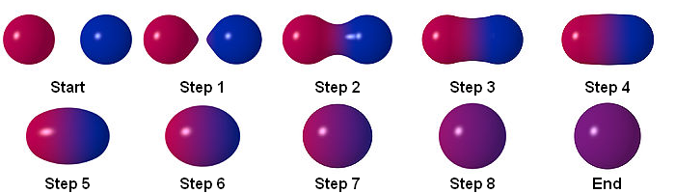
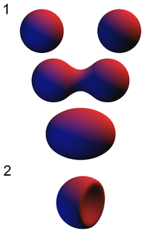
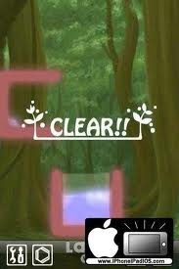
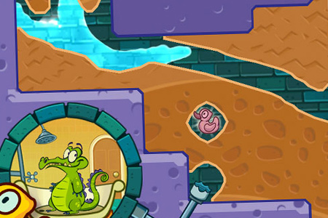
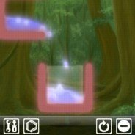

Slide 4
The Big Idea
Prototype
  Get the mechanic in
First Playable
  Iterate on the mechanic until fun happens

Slide 5
Engine Proof to Prototype
Fluid physics
  Buoyancy
Spicy Metaballs
Editor

Slide 6
Roles and Responsibilities
Kenneth | Steven
Editor – The graphical interface to the static state and persistent state of objects. | Fluid Simulation – The basic feel and physics of the fluid.
Engine Extension – The integration of Steven's high performance fluid simulation. | Metaballs – Making the fluid look organic.

Slide 7
Prototype to First Playable
User Interface
A single level
Win and lose conditions

Slide 8
Roles and Responsibilities
Kenneth | Steven
Editor Continued – Extend editor to encompass new features emerging as needed by the design iteration. | Fluid Simulation Continued – Optimization of fluid physics.
User Interface – The basic flow of the game such as menus and level switching. | User Interface – Physical interactions between various objects that can be created in the editor.
Win / Lose Conditions – An aspect of the design to denote progress with a definite begin and end.

Slide 9
Risks and Mitigations
One man team after this semester
  Simple idea. Second semester does not rely on Kenneth
Mobile SDK that is new to both team members
  Focus technology to what we know we can do
Mobile hardware restrictions
  Optimizations for physics on mobile device
ASC hours take a lot of time. 16 hours = 30 hours
  Become time lords

Slide 10
Why Moai?
Mobile
  Both team members were interested in using a mobile framework.
  Mobile market is growing.
Open Source
  We can extend the framework in any way we feel comfortable.
Multiple Platforms
  Runs on Windows, Mac, PC, Android, iOS, and Chrome.

Slide 11
Moai != Unity
Bare bones framework
Requires pipeline to be built on top
Fully open source
No editor or other tools

Slide 12
Rubric
Architecture
Graphics and Art Pipeline
Game Concepts
Debugging
Physics
System Integration
Team and Presentation

Slide 13
Architecture + 0
Configuration and tweaking data is not data-driven | -5%
Architecture is component based (or better) | +1%
Archetype system for game objects | +1%
Reflection/property viewing system | +1%
Function binding or delegates | +1%
Scripting language integration | +1%

Slide 14
Graphics and Art Pipeline + 0
Game Concepts + 2
No negatives. No positives. All required. | +0%
Multiple concepts are likely feasible | +1%
Multiple concepts are interesting | +1%
Debugging + 0
No negatives. No positives. All required. | +0%

Slide 15
Physics + 6
System Integration + 0
Basic static collision response | +1%
Basic dynamic collision response | +1%
Advanced collision detection | +1%
Advanced simulation of forces | +1%
Advanced collision response | +1%
No need for AI or Networking | +0%
No negatives. No positives. All required. | +0%

Slide 16
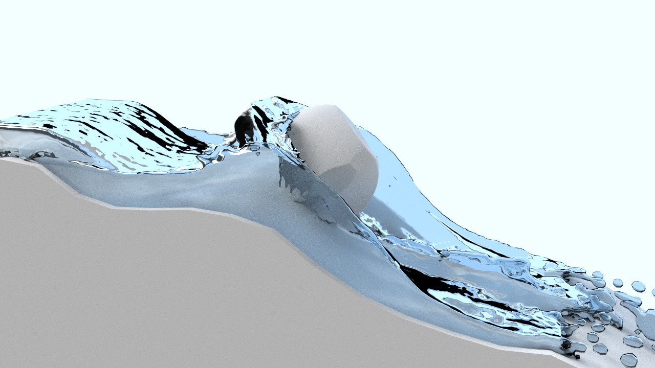
Team and Presentation + 2
Has accounted for all major risks | +1%
Has already solved many major risks | +1%

Slide 17
Rubric Totals + 10
+0 Architecture
+0 Graphics and Art Pipeline
+2 Game Concepts
+0 Debugging
+6 Physics
+0 System Integration
+2 Team and Presentation

Slide 18
And now the technology demo...

