Slide 1

Big Data, Big Displays, and
Cluster-Driven Interactive Visualization
Sunday, October 27, 2002
Kenneth Moreland
Sandia National Laboratories
kmorel@sandia.gov
Sandia is a multiprogram laboratory operated by Sandia Corporation, a Lockheed Martin Company,
for the United States Department of Energy under contract DE-AC04-94AL85000.

Slide 2
Visualization Platforms
Most tasks involve a massive amount of data and calculations.
  Requires specialized 3D hardware.
Hardware of yesteryear.
  Specialized “big iron” graphics workstations.
  $1+ million SGI machines.
Hardware of today.
  PC graphics cards.
    $200 card competitive with graphics workstation.
  Not designed for large visualization jobs.

Slide 3
Scalable Parallel Rendering
High end PC with graphics card: ~$3.5K.
  At such a bargain, we can buy lots!
Connect commodity computers with high speed interconnect.
  Viola, massively powerful graphics.
Challenge: harness aggregate rendering power.
  Render faster.
  Make larger images.

Slide 4
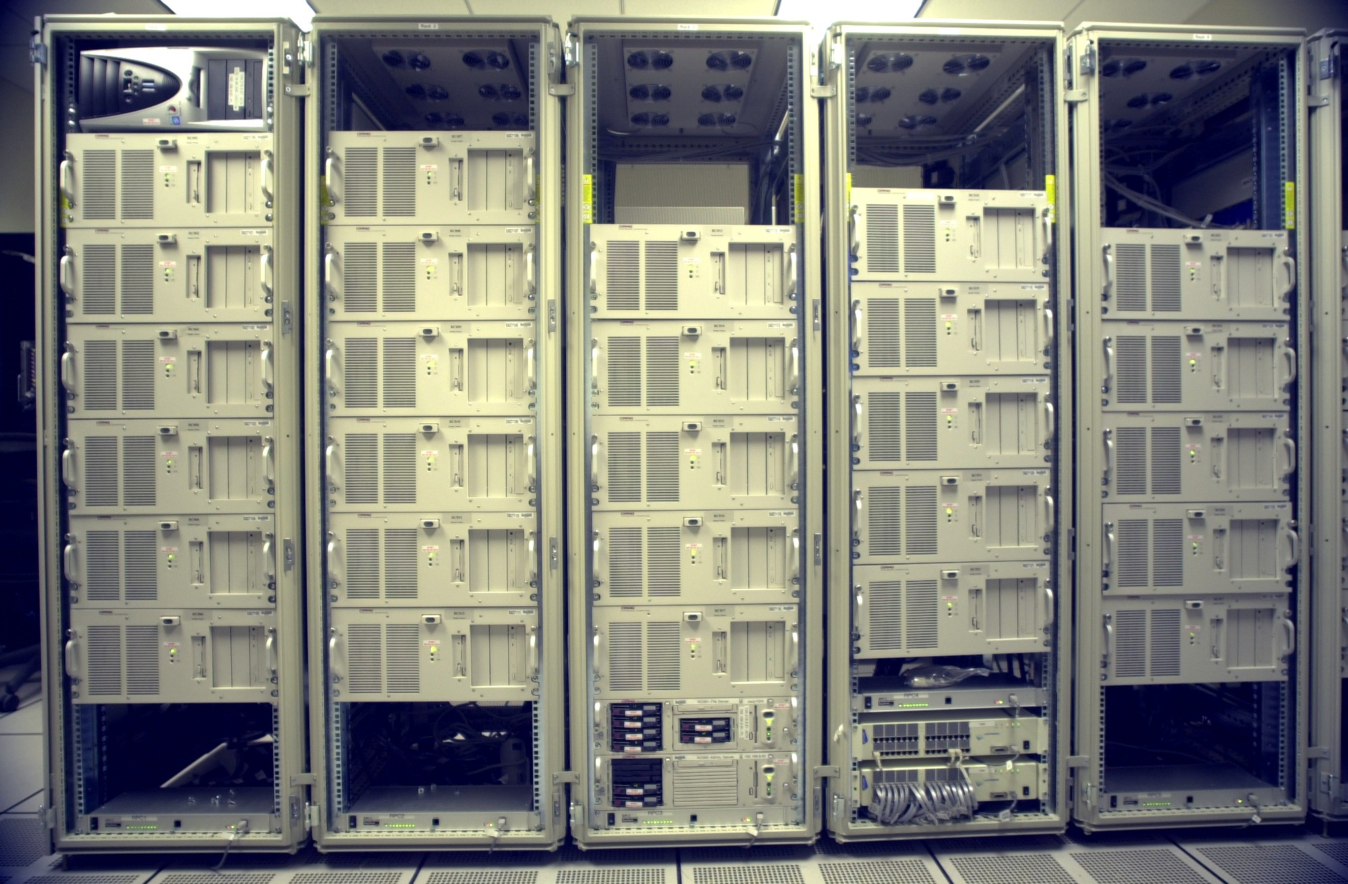
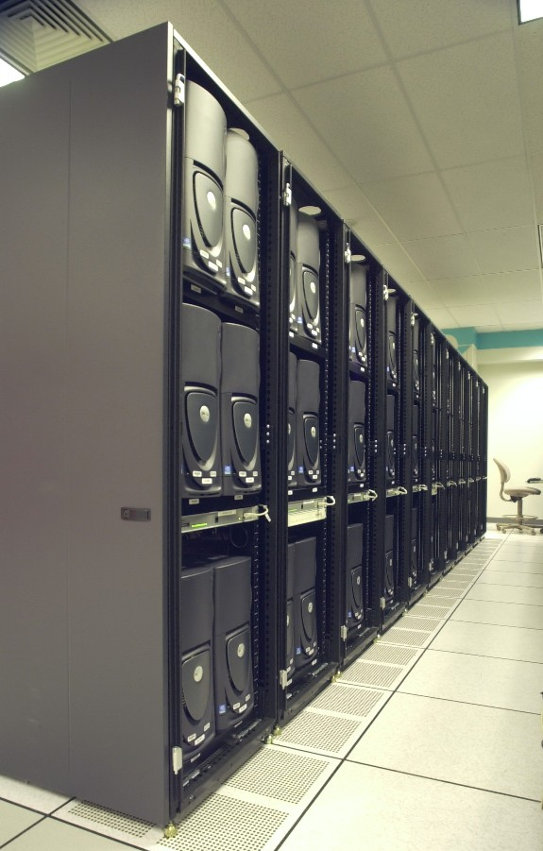
Current Cluster(s)
Wilson
  64 nodes
    800 MHz P3 CPU.
    GeForce3 cards.
  Myrinet 2000 interconnect
Europa
  128 Dell Workstations
    Dual 2.0 GHz P4 Xeon CPU.
    GeForce3 cards.
  Myrinet 2000
  0.5 TFLOP on Linpack.
Wilson
Europa

Slide 5
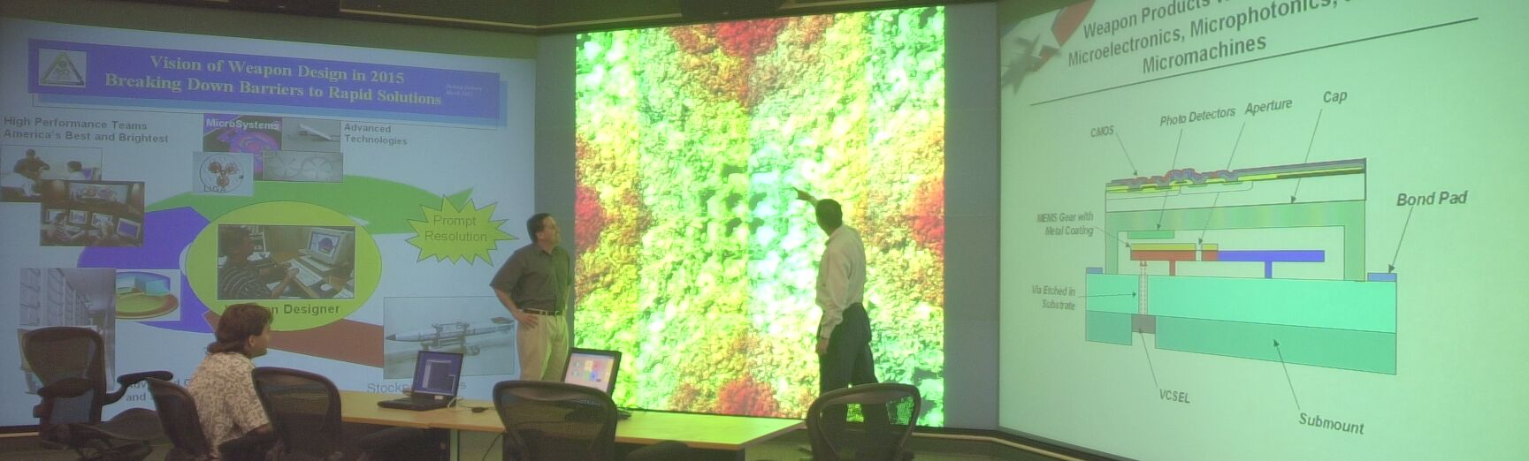
VIEWS Corridor
Three 13’ x 10’ rear projected screens.
48 projectors, each having 1280x1024 pixels.
  60 Megapixels overall.
Provides minute details in large context.
*Image covered by Lawrence Livermore National Laboratories: UCRL-MI-142527 Rev 1

Slide 6
The Graphics Pipeline
Points
Lines
Polygons
Rendering Hardware
Geometric Processing
Translation
Lighting
Clipping
Rasterization
Polygon Filling
Interpolation
Texture Application
Hidden Surface Removal
Frame Buffer
Display

Slide 7
Parallel Graphics Pipelines
Points
Lines
Polygons
Each loaded/calculated individually
Rendering Hardware
Geometric Processing
Translation
Lighting
Clipping
Rasterization
Polygon Filling
Interpolation
Texture Application
Hidden Surface Removal
Frame Buffer
Display

Slide 8
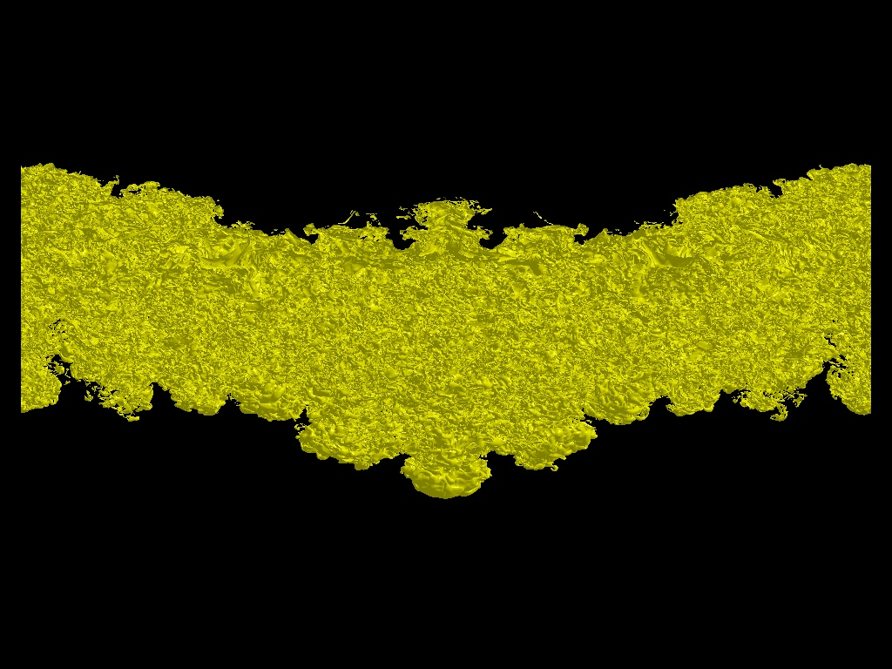
Parallel Graphics Pipelines
FB
G
R
FB
G
R
FB
G
R
FB
G
R

Slide 9
Sort Middle Parallel Rendering
Sorting Network
G
R
FB
FB
G
R
FB
FB
G
R
G
R

Slide 10
Sort First Parallel Rendering
Sorting Network
G
R
FB
FB
G
R
FB
FB
G
R
G
R

Slide 11
Sort Last Parallel Rendering
Sorting Network
G
R
G
R
FB
G
R
G
R

Slide 12
Low Hanging Fruit: Chromium
Chromium replaces the OpenGL dynamic library.
  Intercepts OpenGL stream and filters.
  Provides sort-first and sort-last parallel rendering.
  Can plug in custom stream processing units (SPUs).
Presented at SIGGRAPH 2002.
  Humphreys, et al. “Chromium: A Stream-Processing Framework for Interactive Rendering on Clusters.”
Can plug into unaware applications.
  Example: EnSight from CEI.
  Bottleneck: all geometric primitives still processed by single process.

Slide 13
Sort-First Bottleneck
Polygon Sorter
Renderer
Polygon Sorter
Renderer
Network
Polygon Sorter
Renderer
Polygon Sorter
Renderer

Slide 14
Sort-Last Bottleneck
Renderer
Renderer
Composition Network
Renderer
Renderer

Slide 15
Know Your Limits
Sort First
Sort First (cached)
Sort Last
Sort Last
Sort First
Network Usage
Network Usage
Polygons
Image Size

Slide 16
Circumventing the Bottleneck
Reduce image data processed/frame
  Spatial decomposition
  Image compression
  Custom composition strategies
Image data: 10 GB/frame ⇨ 500 MB/frame
1
1
1
1
2
2
2
1
Notes:
Because we need to handle both very large input geometries and very large displays at the same time, we worked very hard to alleviate the previous bottleneck by drastically reducing the amount of image data that needs to be processed.
We do this by taking advantage of spatial decomposition in the geometry. Spatial decomposition means that the geometry belonging to each processor is clumped together. We find that the geometries we are interested in typically have good spatial decomposition because the parallel simulations that created the data work very hard to group elements within processors for basic efficiency.
When the geometry is spatially decomposed, we find that it is typically drawn on only a small fraction of the display. Thus the images that each processor generates has lots of blank space in it. We can apply some simple image compression techniques to greatly reduce our image data.
We also find that if we split the display into tiled regions, which we have to in order to render images this big, the spatial grouping allows most processors to only render in a fraction of these tiles. We take advantage of this by creating custom composition strategies that can throw away unused tiles while maintaining good load balancing.
Our image data reduction techniques have proven to be very successful. For composing a 20 mega-pixel image for this display, we have reduced the amount of data across our network from 10 GB/frame to about 500 MB/frame.

Slide 17
ICE-T
Reduced Image space composition technologies presented last year at PVG2001.
  Moreland, Wylie, and Pavlakos. “Sort-Last Parallel Rendering for Viewing Extremely Large Data Sets on Tile Displays.”
Implemented API: Image Composition Engine for Tiles (ICE-T).
Challenge: integrate ICE-T with useful tools.
Caveat: really large images can still take on the order of seconds to render.

Slide 18
Life is Compromise
Real Time: 20 – 30 Hz
  Immersive but approximate.
Interactive Time: 5 – 10 Hz
  Responsive but not detailed.
Display Time: 0.5 – 10 sec
  Detailed but not interactive.
Coffee Time: 0.5 – 10 min
  Occasional computation.
Batch Time: > 30 min
  One-time processing.
Interactivity
Detail / Accuracy

Slide 19
ICE-T in Chromium?
Unfortunately, no.
Chromium uses a “push” model.
  Application pushes primitives to Chromium.
  Chromium processes primitives and discards.
ICE-T uses a “pull” model.
  ICE-T pulls images from application.
  Necessary since multiple renders per frame required.
Chromium SPU would have to cache stream.
  Bad news for large data.
  Ultimately, the Chromium application would have to be so tailored to the ICE-T SPU to maintain reasonable performance, it might as well use the ICE-T API directly.

Slide 20
VTK: The Visualization Toolkit
VTK is a comprehensive open-source visualization API.
Completely component based: Expandable.
VTK supports parallel computing and rendering.
  Abstract communication level
    Sockets, threads, MPI implemented.
  “Ghost cells” of arbitrary levels.
  Sort-last image compositing provided.

Slide 21
VTK Pipeline
Uses “pipes and filters” model.
Control is propagated backward
  Each component has its data “pulled” from its downstream component.
Each unit can cache intermediate results.
  Execution propagation only updates changes.
Reader
Filter
Filter
Writer
Data
Control

Slide 22
VTK Rendering
Filter
Mapper
Actor
Renderer
Render
Window

Slide 23
VTK Rendering
Filter
Mapper
Actor
Renderer
Render
Window
Actor

Slide 24
VTK Rendering
Filter
Mapper
Actor
Renderer
Render
Window
Actor
Renderer

Slide 25
VTK Rendering
Interactor
Filter
Mapper
Actor
Renderer
Render
Window
Actor
Renderer

Slide 26
Level of Detail Rendering
Filter
Mapper
LOD
Actor
Renderer
Render
Window
Desired
Update Rate
Mapper

Slide 27
Level of Detail Rendering
Interactor
Desired
Update Rate
Still
Update Rate
Filter
Mapper
LOD
Actor
Renderer
Render
Window
Desired
Update Rate
Mapper

Slide 28
Rendering Parallel Pipelines
F
M
A
R
Render
Window
F
M
A
R
Render
Window
F
M
A
R
Render
Window

Slide 29
Rendering Parallel Pipelines
F
M
A
R
Render
Window
Composite
Manager
Communicator
F
M
A
R
Render
Window
Composite
Manager
F
M
A
R
Render
Window
Composite
Manager

Slide 30
Rendering Parallel Pipelines
F
M
A
R
Render
Window
Composite
Manager
Communicator
F
M
A
R
Render
Window
Composite
Manager
F
M
A
R
Render
Window
Composite
Manager

Slide 31
Rendering Parallel Pipelines
F
M
A
R
Render
Window
Composite
Manager
Communicator
F
M
A
R
Render
Window
Composite
Manager
F
M
A
R
Render
Window
Composite
Manager

Slide 32
Rendering Parallel Pipelines
F
M
A
R
Render
Window
Composite
Manager
Communicator
F
M
A
R
Render
Window
Composite
Manager
F
M
A
R
Render
Window
Composite
Manager

Slide 33
Rendering Parallel Pipelines
Interactor
F
M
A
R
Render
Window
Composite
Manager
Communicator
F
M
A
R
Render
Window
Composite
Manager
F
M
A
R
Render
Window
Composite
Manager

Slide 34
Triggering Parallel Rendering
Interactor
F
M
A
R
Render
Window
Composite
Manager
Communicator
F
M
A
R
Render
Window
Composite
Manager
F
M
A
R
Render
Window
Composite
Manager

Slide 35
Triggering Parallel Rendering
Interactor
F
M
A
R
Render
Window
Composite
Manager
Communicator
F
M
A
R
Render
Window
Composite
Manager
F
M
A
R
Render
Window
Composite
Manager

Slide 36
Image Space Level of Detail
Interactor
Reduction
Factor
F
M
A
R
Render
Window
Composite
Manager
Communicator
F
M
A
R
Render
Window
Composite
Manager
F
M
A
R
Render
Window
Composite
Manager

Slide 37
Image Space Level of Detail
Interactor
Inflated
Image
F
M
A
R
Render
Window
Composite
Manager
Communicator
Low Res
Image
F
M
A
R
Render
Window
Composite
Manager
Low Res
Image
F
M
A
R
Render
Window
Composite
Manager
Low Res
Image

Slide 38
Image Space Level of Detail
Use Desired Rendering Rate and Composite Manager timing metrics to pick reduction factor.
  See ParaView for example.
Geometric and Image LODs are independent.
  Use them both!

Slide 39
ICE-T Parallel Rendering
Interactor
F
M
A
ICE-T
R
Render
Window
ICE-T
Composite
MPI Communicator
F
M
A
ICE-T
R
Render
Window
ICE-T
Composite
F
M
A
ICE-T
R
Render
Window
ICE-T
Composite

Slide 40
Remote Parallel Rendering
Render
Window
DD
Client
Socket
Comm.
DD
Server
F
M
A
ICE-T
R
Render
Window
ICE-T
Composite
MPI Communicator
F
M
A
ICE-T
R
Render
Window
ICE-T
Composite
F
M
A
ICE-T
R
Render
Window
ICE-T
Composite

Slide 41
Remote Parallel Rendering
Interactor
Render
Window
DD
Client
Socket
Comm.
DD
Server
F
M
A
ICE-T
R
Render
Window
ICE-T
Composite
MPI Communicator
F
M
A
ICE-T
R
Render
Window
ICE-T
Composite
F
M
A
ICE-T
R
Render
Window
ICE-T
Composite

Slide 42
Using Chromium for Parallel Rendering
F
M
A
Cr
R
Chromium
RW
F
M
A
Cr
R
Chromium
RW
F
M
A
Cr
R
Chromium
RW

Slide 43
Using Chromium for Parallel Rendering
Interactor
F
M
A
Cr
R
Chromium
RW
Parallel
Render
Manager
F
M
A
Cr
R
Chromium
RW
F
M
A
Cr
R
Chromium
RW

Slide 44
Future Challenges
Remote power wall display.
  VIEWS corridor separated from clusters by ~200m.
Application integration.
  Upcoming Kitware contract to (in part) help integrate ParaView.
Better parallel data handling.
  Find/load multipart files.
  Parallel data transfer from disk.
  Parallel neighborhood / global ID information.
  Repartitioning
    Load balancing / volume visualization.
  Make it easy!

Slide 45
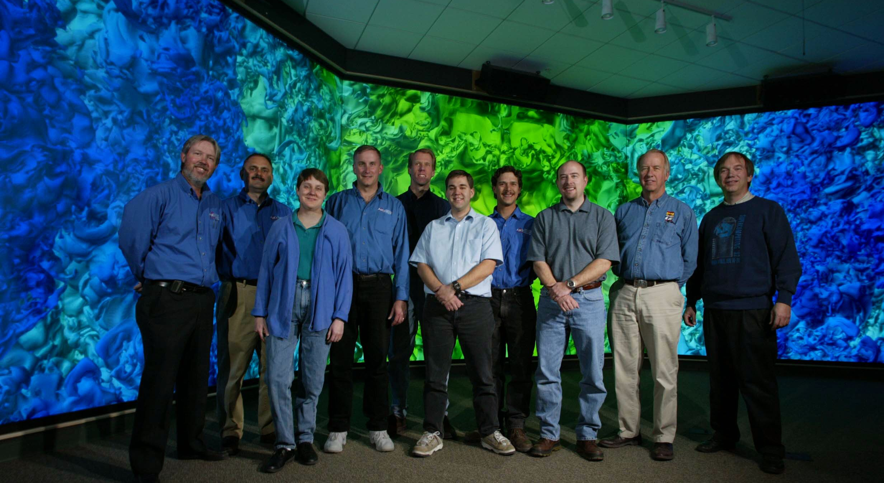
Our Team
Left to right: Carl Leishman, Dino Pavlakos, Lisa Ice, Philip Heermann, David Logstead, Kenneth Moreland, Nathan Rader, Steven Monk, Milton Clauser, Carl Diegert.
Not pictured: Brian Wylie, David Thompson, Vasily Lewis, David Munich, Jeffrey Jortner

