Slide 1

Final Project: Back-End Infrastructure for a Microblogging App
By Kenneth Rodríguez

Slide 2
Project Overview
The main objective of this project is to develop the basic back end infrastructure for a microblogging social media platform called “SmallTalk”. This platform will enable users to create and interact with short-form text content.

Slide 3
Scope
The project will consist of a few key components to provide the necessary infrastructure for a minimum viable product.
User registration and authentication: users should be able to create accounts, log in, and log out securely.
Post creation: Users will be able to publish short text-based posts to the public feed.
Post feed: All users will see the most recent posts published by other users in the platform.
Post liking: Users can like other users’ posts, as well as their own, and the liked content should be persistent.
Real time updates: Users will receive live updates when their content has been liked by other users.
Backup job: A batch job to backup all of the system’s database should run on a scheduled basis.

Slide 4
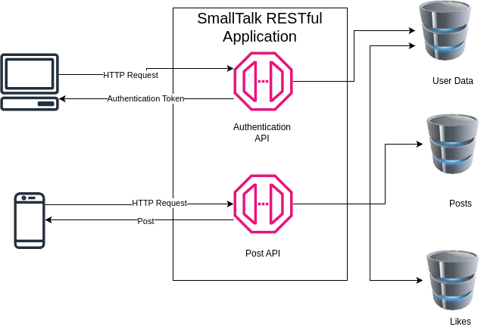
System Architecture

Slide 5
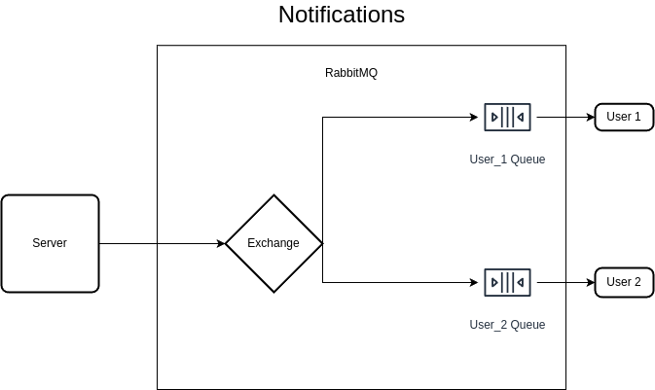
System Architecture

Slide 6
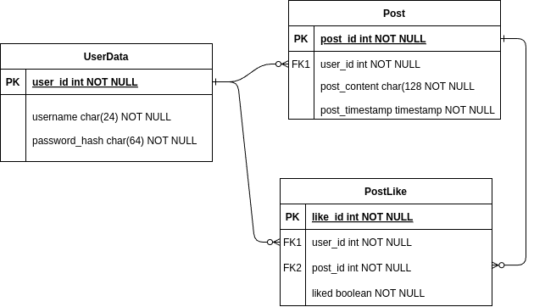
Database

Slide 7
Back-End Services
The back-end infrastructure of the project is the basis of the entire service.
API Gateway: The server provides a REST API entrypoint, which handles all incoming requests and routes them to the appropriate service.
User Service: The user service handles requests for user registration and login.
Post Service: The post service publishes and retrieves posts.
Like Service: The like service updates the likes of a user created post, and triggers the notification service to notify the relevant users.
Notification Service: The notification service sends a notification to a message broker which will route the message to its destination on the client side.
Back Up Job: The backup job creates a daily backup of the existing database, to prevent data loss.

Slide 8
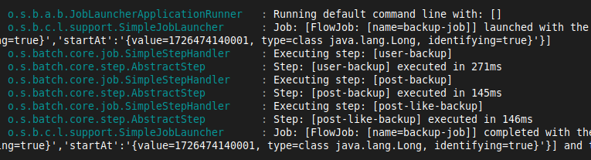
Batch Backup Job
The Backup Job is a scheduled job which runs every day at midnight. When triggered, the service will use the Spring Batch component to backup all of the available databases to .csv files, providing a way of rolling back the database in case of failure or data corruption.
The backup job consists of three steps, where each step is responsible for backing up one of the three different tables in the database.

Slide 9
Message Broker - RabbitMQ
To provide users with real time notifications, it is necessary to use a message-brokering system, which will allow users to receive updates without directly receiving the message from the application.
The RabbitMQ instance will receive messages from the server in an Exchange and send them to the appropriate Queue, where messages wait to be consumed by a client.
The Notification service sends updates to the Exchange named “smalltalk.direct”. This Exchange sends a copy of the message only to the queues where the routing key is an exact match.

Slide 10
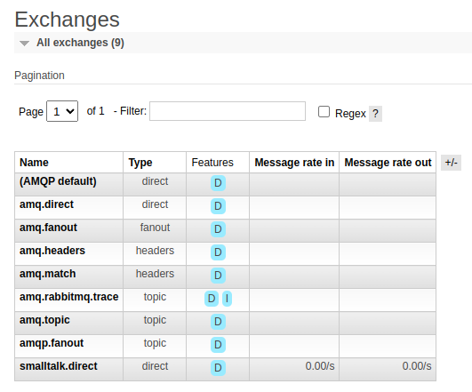

Slide 11
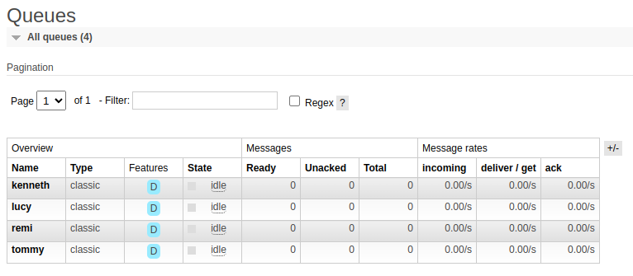

Slide 12
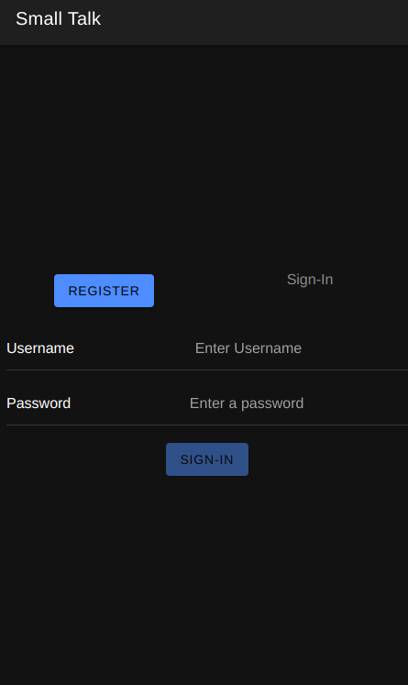
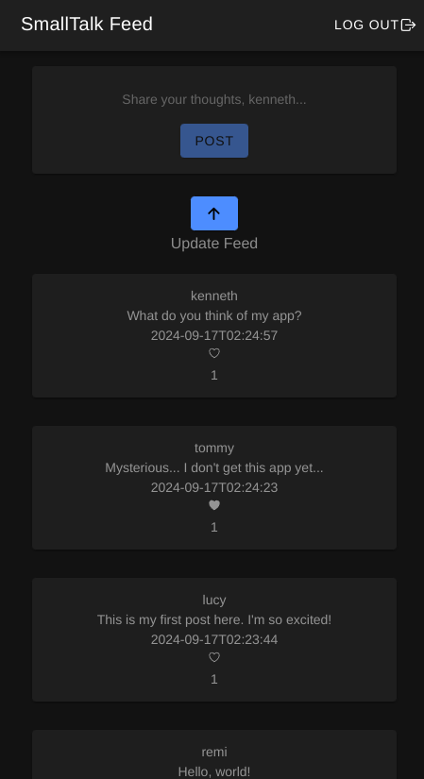
Front-End

Slide 13
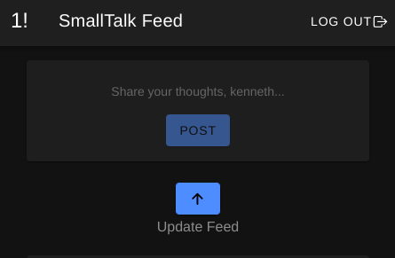
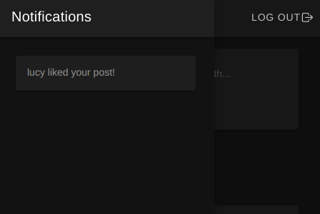
Front-End (Notifications)

Slide 14
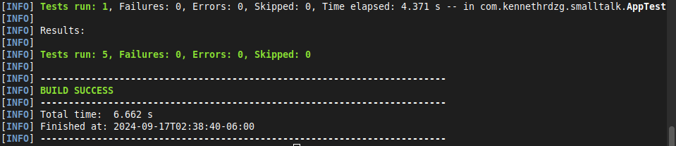
Testing
To ensure that everything works properly, it is necessary to set up a proper testing process that validates the correct execution of the application. To achieve this, Spring Boot provides the tools necessary to test the program.
We can leverage the JUnit 5 and Mockito frameworks to set up appropriate unit tests for the project. These dependencies will allow us to design specific tests that compare the expected behavior of the application against its actual execution.

Slide 15
Deployment
Deployment Environment
As a Java application, the web server can run on virtually any machine that runs the JVM with Java 17.
The environment variables, such as the login credentials for MySQL and RabbitMQ should be in a shell script named “env_variables.sh”.
Deployment Process
The “run.sh” script, found in the project’s files, should be executed in a shell from within the server’s directory. The script will call the environment variables script, and perform the cleaning, compiling, testing and execution process using Maven.

Slide 16
Potential Features
User Following: Users could potentially follow other users and receive notifications when they post new content.
Multimedia User Content: The platform could allow for content upload other than text, such as images, audio, or video.
Password Salting: To increase security, the password salting technique could be implemented on top of the current password hashing.
Technology Considerations
Containerization: By using tools like Docker and Kubernetes, multiple instances of the application could be easily deployed for improved scalability.
Cloud Technologies: The project could eventually be moved from a local server to a virtual machine in a cloud provider.
Future Considerations

Slide 17
The End

