Slide 1

Implementing Bayesian Network using Junction Tree
Team members:
Akarsh M.P.
Kenneth Rithvik
Nagesh
Pavan Kumar A
Under the Guidance of
Prof. Preeti Satish
Assistant Professor, Dept of Computer Science & Engineering
Department of Computer Science & Engineering, DSCE

Slide 2
Introduction
A Bayesian network is a probabilistic graphical model (a type of statistical model) that represents a set of random variables and their conditional dependencies via a directed acyclic graph (DAG).
An extended notion of a BN is a Hybrid BN (HBN), which contains both discrete and continuous variables.
Formally, Bayesian networks are DAGs whose nodes represent random variables in the Bayesian sense: they may be observable quantities, latent variables, unknown parameters or hypotheses.
Department of Computer Science & Engineering, DSCE

Slide 3
Objective and Problem Statement
To build a library package that can model Bayesian Networks and evaluate its Conditional Probability Table (CPT). This package will be implemented through Java. This package accepts Directed Acyclic Graph (DAG) as input and will generate CPTs as output.
Using Junction Tree we increase the efficiency and speed of calculating the CPT by making the CPT table smaller. This reduces the amount of memory required to store these tables.
Department of Computer Science & Engineering, DSCE

Slide 4
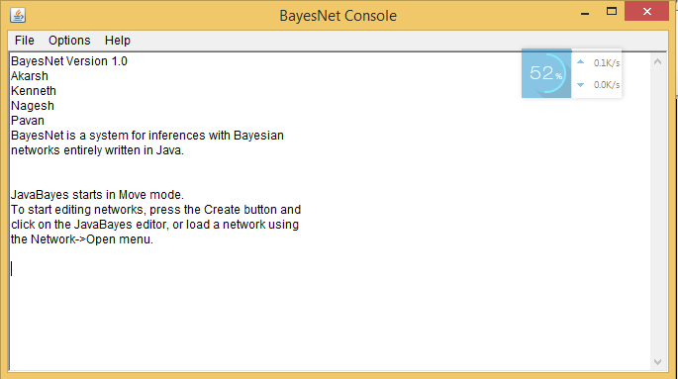
Console Interface
Department of Computer Science & Engineering, DSCE

Slide 5
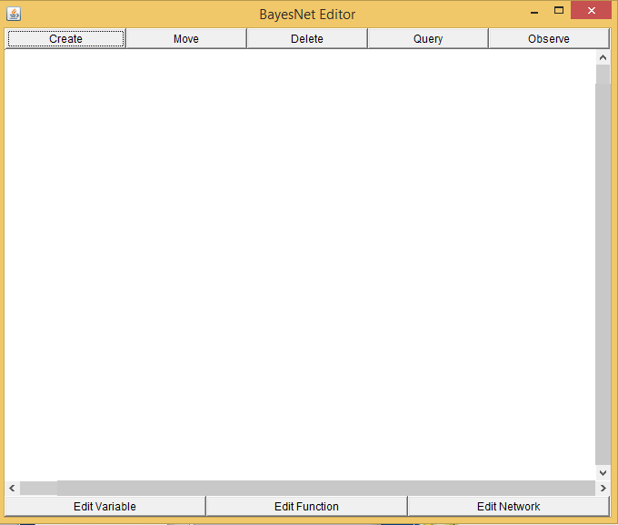
Editor Interface
Department of Computer Science & Engineering, DSCE

Slide 6
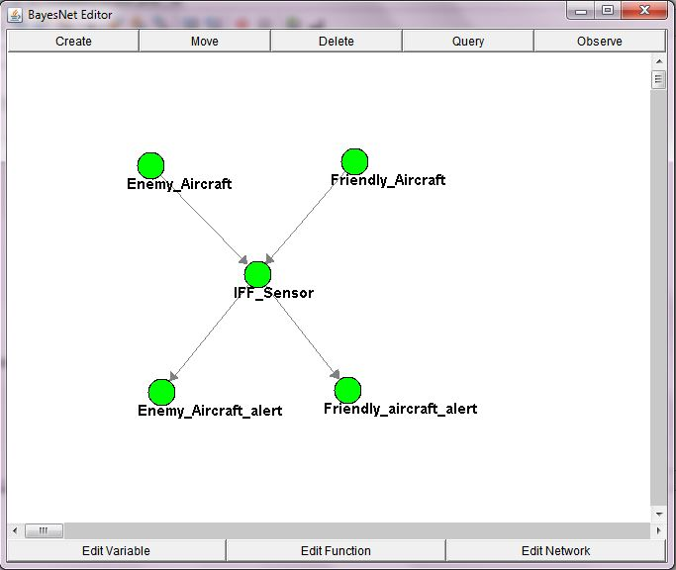
Example
Department of Computer Science & Engineering, DSCE

Slide 7
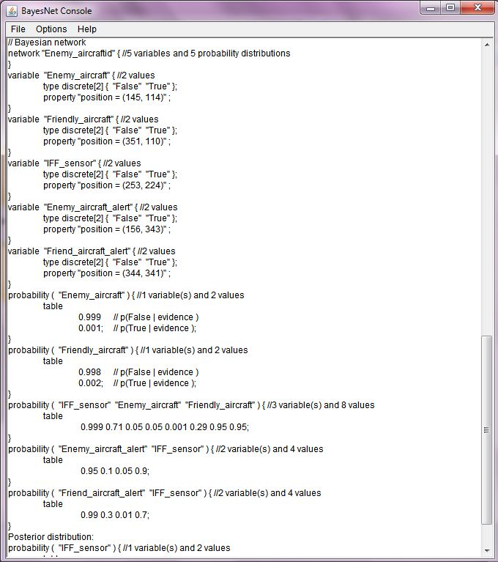
Output

Slide 8
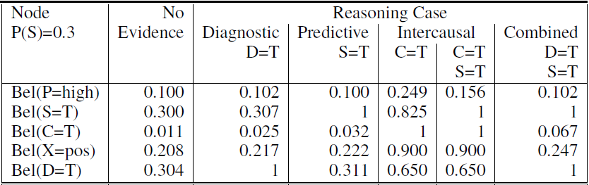
Converting BN to Probability Table (contd)
Department of Computer Science & Engineering, DSCE

Slide 9
Converting BN to Probability Table (contd)
Department of Computer Science & Engineering, DSCE

Slide 10
THANK YOU
Department of Computer Science & Engineering, DSCE

