Slide 1
Why Digital Strategies Fail? Group - 25

Slide 2
Digitalization : Nearly Instant, free and flawless ability to connect Devices, Physical objects and People anywhere -McKinsey&Co

Slide 3
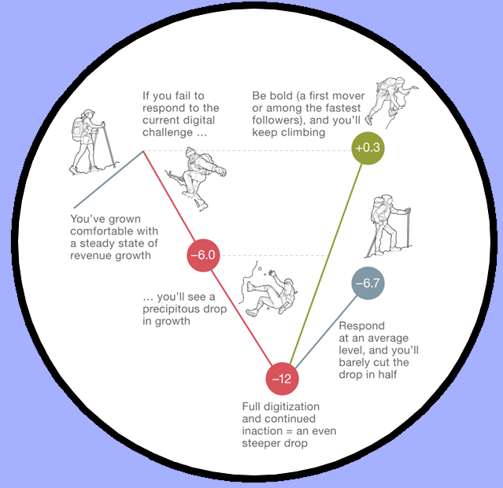
Muddled Understanding of Digital
Revenue Growth
Economical Impact
It radically changes profitability and Scale effects
Operational impact
Improvements in Analytics and Connectivity(IoT) brigs about new business models
Economics of Digital
Digital undoes variable pricing caused due to scarcity by providing choice and transparency
Digital sways the balance completely towards first movers and some superfast followers

Slide 4
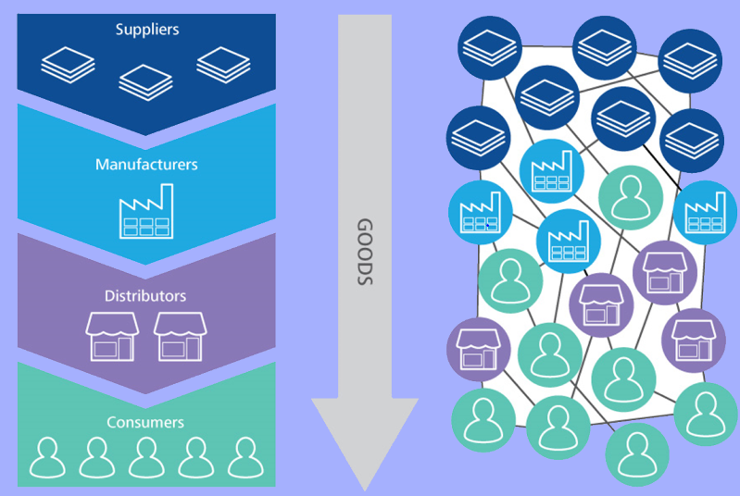
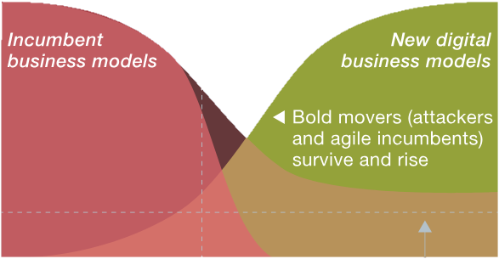
Overlooking Ecosystems
Supply Chain Vs Ecosystems
Digital-platform and ecosystem economics upend the fundamentals of supply and demand
Digital changes value chains into value webs increasing co-creation and collaboration
Overlooking Incumbent's Digital Stride
Digital Adaptation
Incumbents disrupt multiple reaches of the value chain with their reach
For Incumbents digitization goes from being an incremental affair to a headlong rush

Slide 5
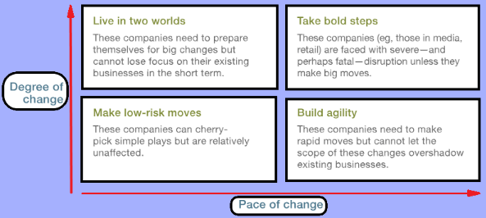
Aspiration VS Adaptability

Slide 6








Critique’s Take
Real-life implications
Brick & Mortar retailers like Walmart
failed to catch up with online retailers
like Amazon
Google has created the perfect
ecosystem which spans across
industries like search, Cloud,
Phones & Software
Amazon an incumbent paperback
re-seller monopolized the e-book
market too by introducing the Kindle
Kodak trying to make low risk moves
failed to keep up with its competitors
shifted to DSLRs
There can be cases where the winner doesn’t take all.
Ex: Apple and Samsung co-exist.
Wait and watch method still works in the digital economy, but the time to wait has become lesser.
The concept that first movers always win is disproved in the example of electric cars.

Slide 7
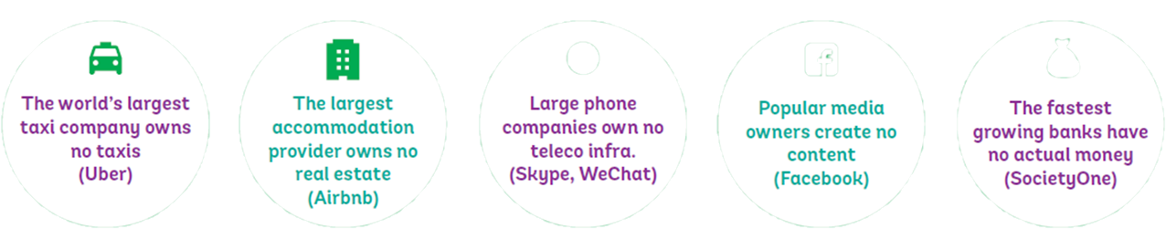
Thank
You

