Slide 1
Master of Technology in Knowledge Engineering
Unit 1
Intelligent Systems & Techniques for Business Analytics
Representation & Reasoning
Sam GU Zhan 顾 瞻
zhan.gu@nus.edu.sg
© 2016 NUS. The contents contained in this document may not be reproduced in any form or by any means,
without the written permission of ISS, NUS other than for the purpose for which it has been supplied.

Slide 2
Objective
To introduce the concepts of knowledge representation and knowledge-based reasoning
To learn formal logic as an important scheme of knowledge representation and reasoning
To briefly introduce semantic networks and frames for representation and reasoning with concepts and associations.

Slide 3
Outline
Knowledge representation in KBS
Propositional logic
Syntax, Inference rules
Predicate logic
Syntax, Establish truth of inference
Representation, reasoning, and search
More representation schemes
Semantic networks, frames

Slide 4
Knowledge Representation & KBS

Slide 5
KBS Tasks: related techniques
Typical KBS tasks
Optimization
Planning, allocation
Decision
Diagnosis
Prediction
Pattern classification, recognition, matching
Representation
Projection
Summary
Learning
Discovery
Representation
Techniques / concepts
Constraint satisfaction
Multi-criteria / object decision
Function mapping / approximation
Dimension reduction
Extraction
Accumulation, convergence

Slide 6
KBS Tasks: from KE point of view
Typical KBS tasks
Optimization
Planning, allocation
Decision
Diagnosis
Prediction
Pattern classification, recognition, matching
Representation
Projection
Summary
Learning
Discovery
Representation
Major KE task category
Search
Representation & reasoning
Representation
Discovery & representation

Slide 7
Knowledge & Intelligent Agent
The first principle of knowledge engineering is that the problem-solving power exhibited by an intelligent agent’s performance is primarily the consequence of its knowledge base, and only secondarily a consequence of the inference method employed. Expert systems must be knowledge-rich even if they are methods-poor. This is an important result and one that has only recently become well understood in AI. For a long time AI has focused its attention almost exclusively on the development of clever inference methods; …… The power resides in the knowledge.
⎯ Edward Feigenbaum (Stanford University)

Slide 8
Agent
An agent is anything that can be viewed as perceiving its environment through sensors and acting upon that environment through actuators
Human agent:
eyes, ears, and other organs for sensors
hands, legs, mouth, and other body parts for actuators
Robotic agent:
cameras and infrared range finders for sensors
various motors for actuators

Slide 9
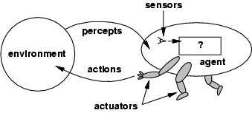
Agents and Environments
The agent function maps from percept histories to actions: [f: P* → A]
The agent program runs on the physical architecture to produce f
Agent = architecture + program
Types of environment
Single agent environment
Multi-agent environment
Competitive environment

Slide 10

Knowledge Bases
Knowledge base = set of sentences in a formal language
Declarative approach to building an agent (or other system):
Tell it what it needs to know.
Then it can Ask what to do ⎯ answers (actions) should follow from the KB

Slide 11
A Simple Knowledge-based Agent
Agents can be viewed
at the knowledge level
what they know, regardless of how implemented
at the implementation level
data structures in KB (representation), and
algorithms that manipulate them (reasoning)
An agent must be able to:
Represent states, actions, etc. Incorporate new percepts
Update internal representations of the world
Deduce hidden properties of the world
Deduce appropriate actions

Slide 12
Knowledge Representation in KBS
A scheme by which to represent knowledge in a computer in a way that allows the system to manipulate it to solve difficult problems
Unlike humans, knowledge must be ‘transplanted” into the KBS
Representation goes hand-in-hand with Reasoning (inference)
Large amount of knowledge is usually needed to solve complex problems
Explicit knowledge representations also allows for knowledge management (KM) and sharing

Slide 13
Knowledge Representation Schemes
Natural Language (not in our scope of discussion)
Formal Logic
Propositional logic
First Order Logic (predicate calculus)
Production Rules
Semantic Nets (to be briefly introduced later)
Frames (to be briefly introduced later)
Relational Database (not to be discussed in this course)

Slide 14

Preparations: Sets, Relations, Functions

Slide 15

Set and Element
A set is an unordered collection of objects.
{a, b, c} = {b, c, a}
The objects in a set are also called the elements, or members, of the set. A set is said to contain its elements.
E.g: ISS-Lecturer = {…, Charles, Sam, …}
Sam is a member of ISS-Lecturer
ISS-Lecturer contains Sam as an element

Slide 16
Description of Membership
Set A and an object a
a ∈ A means
a is an element (a member) of the set A, or
a “belongs” to the set A, or
a is “in” the set A
while a ∉ A means
a is not a member of the set A, or
a “not belong” to the set A, or
a is “out” the set A
A
a
A
a

Slide 17
Universal Set and Subset
Taking the previous example:
U — all people in Singapore
C — all people in the class
G — all girls in the class
U is the universal set, C and G are sets defined on U.
For any a in C, a ∈U
For any g in G, g ∈C, g ∈U
G is a subset of C: G ⊆ C
U
G
C

Slide 18
Relations between Sets
Subset
A ⊆ B A is a subset of B
(Every element of set A is also an element of B)
A ⊂ B A is a proper subset of B
(A is a subset of B, and B contains at least one element that is not a member of A)
A ⊄ B A is not a subset of B
(A contains at least one element that is not a member of B)
A ⊆ A a set is always a subset of itself

Slide 19
What is a Relation
The order of a relation
is_taller(x, y) is said to be a binary relation, or relation of order two, since it requires two objects to make a complete statement.
A relation such as has_two_legs(x) is a unary, or order one, relation.
(*) Our discussion will mainly focus on binary relations. Most concepts applicable to binary relations can be generalized to relations of higher order.

Slide 20
Relations and Sets
Let A and B be sets. A binary relation R from A to B is
a subset of A × B (R ⊆ A × B )
a set of ordered pairs
the first element of each ordered pair comes from A and the second element comes from B
Use the notation a R b to denote (a, b) ∈ R
Use the notation a R b to denote (a, b) ∉ R
When (a, b) ∈ R, a is said to be related to b by R

Slide 21
Composite Relations
A single relation can be built up from two or more relations.
Example 3.8: is_aunt_of(Lisa, Ben) follows
is_sister_of(Lisa, someone), and
is_parent_of(someone, Ben)
Let R₁ be a relation from A to B and R₂ be a relation from B to C.
The composite relation of R₁ and R₂, from A to C, denoted R_{2 °} R₁ is defined as follows:
R_{2 °} R₁ = { (a, c) |
a ∈ A ∧ c ∈ C ∧ ∃b[b ∈ B ∧ (a, b) ∈ R₁ ∧ (b, c) ∈ R₂] }

Slide 22
Composite Relations (cont.)
Example: Let
R₁: is_sister_of = {(Lisa, Mike), (Judy, Kent)}
R₂: is_parent_of = {(Mike, Ben), (Kent, Ray)}
Thus R_{2 °} R₁: is_aunt_of = {(Lisa, Ben), (Judy, Ray)}
(*) If R₁ is a relation from A to B and R₂ is a relation from C to D, then R_{2 °} R₁ is not defined unless B = C.

Slide 23
What is a Function
Let A and B be sets. A function (or map, or transformation) f from A to B, denoted f: A → B, is a relation from A to B such that for every a ∈ A, there exists a unique b ∈ B such that (a, b) ∈ f. If (a, b) ∈ f, then we write f(a) = b.
A function f from A to B is a binary relation from A to B with the special properties:
Every element of A occurs as the first component of an ordered pair of f
If f(a) = b and f(a) = c, then b = c (the value of f(a) must be unique)

Slide 24
Basic Concepts of Function
If f is a function from A to B, we say that A is the domain of f and B is the codomain of f.
If f(a) = b, we say that b is the image of a and a is a pre-image of b.
The range of f is the set of all images of elements of A.
If f is a function from A to B, we say that f maps A to B.

Slide 25
Formal Logic
Logic consists of
a well defined set of syntax and semantics, and
a proof theory
One can deduce valid conclusions from a set of sentences using logical rules of inference
First order logic (FOL) is most commonly used for problem solving in Artificial Intelligence

Slide 26
Logic & Model
Logics are formal languages for representing information such that conclusions can be drawn
Syntax defines the sentences in the language
Semantics defines the "meaning" of sentences
i.e.: truth of each sentence in each possible world
For precision, we use model instead of “world”.
Logicians typically think in terms of models, which are formally structured worlds with respect to which truth can be evaluated
We say m is a model of a sentence α, if α is true in m

Slide 27
Propositional Logic

Slide 28
Propositional Logic
The syntax of propositional logic expression is constructed using propositions and connectives
All propositions must be either true or false (referred to as truth value of the proposition)
The truth value of an expression can be determined using a truth table
The truth value of complex expression depends only on the truth of its individual parts

Slide 29
Propositional Logic: Propositions
Examples of simple proposition
P = “The waves are high”
Q = “The ship is sinking”
? S = “x + y = 5”
(not a proposition, as its truth cannot be defined unless x and y are assigned specific values )

Slide 30
Propositional Logic: Connectives
Connectives:
¬ (negation “not”)
∨ (disjunction “or”)
∧ (conjunction “and”)
→ (implication “if … then”)
↔ (biconditional “if and only if”)
Complex expressions using connectives
P ∧ Q = “The waves are high AND the ship is sinking”
P → Q = “IF the waves are high THEN the ship is sinking”

Slide 31
Propositional Logic: Syntax
Sentences (also called well-formed formulas, wffs)
Atomic sentence
Literal = proposition symbols such as
P₁ positive literal
¬P₂ negative literal
Complex sentence
Constructed from simpler sentences using logical connectives
If S, S₁ and S₂ are sentences, then the following are sentences:
¬S (negation), S₁ ∧ S₂ (conjunction),
S₁ ∨ S₂ (disjunction), S₁ → S₂ (implication),
S₁ ↔ S₂ (biconditional)

Slide 32
Propositional Logic: Semantics
Semantics defines the rules for evaluating the truth of a sentence with respect to a particular model m:
¬S is true iff S is not true (false)
S₁ ∧ S₂ is true iff S₁ is true and S₂ is true
S₁ ∨ S₂ is true iff S₁ is true or S₂ is true
S₁ → S₂ is true iff S₁ implies S₂
(S₁ is false or S₂ is true)
S₁ ↔ S₂ is true iff S₁ → S₂ is true and S₂ → S₁ is true

Slide 33
Propositional Logic: Semantics (cont.)
Each model specifies true/false for a proposition symbol
E.g. P₁ (false) P₂ (true) P₃ (false)
With three symbols, 8 possible models can be enumerated automatically (2³ = 8)
Simple recursive process evaluates an arbitrary sentence, e.g.
¬P₁ ∧ (P₂ ∨ P₃) =
true ∧ (true ∨ false) = true ∧ true = true

Slide 34
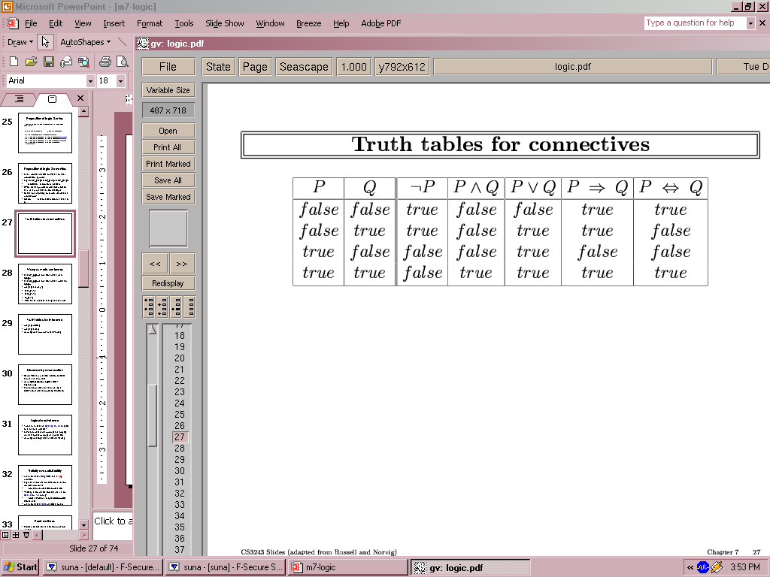
Truth Table
With the two sentences P and Q, we can have a truth table (4 rows indicate 4 possible models) for the possible sentences generated with P, Q and logical connections

Slide 35
Logic & Model: examples
Example 4.1: the language of arithmetic
x + 2 ≥ y is a sentence; x2 + y > {} is not a sentence
x + 2 ≥ y is true iff the number x + 2 is no less than the number y
x + 2 ≥ y is true when x = 7, y = 1
{x = 7, y = 1} is a model of sentence x + 2 ≥ y
x + 2 ≥ y is false when x = 0, y = 6
{x = 0, y = 6} is not a model of sentence x + 2 ≥ y

Slide 36
Entailment
Entailment means that one sentence follows logically from another:
KB ╞ α
Knowledge base KB entails sentence α
iff α is true in all models where KB is true
Example 4.2:
the KB containing “the Giants won” and “the Reds won” entails “Either the Giants won or the Reds won”
x + y = 4 entails 4 = x + y
Entailment is a relationship between sentences (defined by syntax),
which is based on semantics

Slide 37
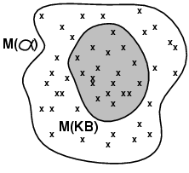
Entailment & Models
M(α) is the set of all models of α
Then KB ╞ α iff M(KB) ⊆ M(α)
Example 4.3:
KB = Giants won and Reds won
α = Giants won
M(KB) ⊆ M(α) KB ╞ α
KB’ = Giants won or Reds won
α = Giants won
M(KB’) ⊇ M(α) KB’ ╞ α
M(KB) ⊆ M(α)

Slide 38
Inference
KB ├_{i} α
sentence α can be derived from KB by procedure i
Soundness:
i is sound if whenever KB ├_{i} α, it is also true that KB╞ α
Completeness:
i is complete if whenever KB╞ α, it is also true that KB ├_{i} α
First-order logic is expressive enough to say almost anything of interest, and for which there exists a sound and complete inference procedure
i.e.: the procedure will answer any question whose answer follows from what is known by the KB.

Slide 39
Inference by Enumeration
Depth-first enumeration of all models is sound and complete
Sound: it implements directly the definition of entailment
Complete:
it works for any KB and α
it always terminates when there are only finite many models to examine
Complexity for n symbols
time complexity is O(2^{n})
space complexity is O(n) (because of depth-first)

Slide 40
Equivalence, Validity, and Satisfiability
Two sentences α and β are logically equivalent if they are true in the same set of models α ⇔ β
α ≡ β if and only if α╞ β and β╞ α
A sentence is valid if it is true in all possible models,
e.g., True, A ∨¬A, A ⇒ A, (A ∧ (A ⇒ B)) ⇒ B
Valid sentences are known as tautologies
Validity is connected to inference via the Deduction Theorem:
KB ╞ α if and only if (KB ⇒ α) is valid

Slide 41
Equivalence, Validity, and Satisfiability (cont.)
A sentence is satisfiable if it is true in some model
e.g., A∨ B, C
If a sentence α is true in a model m, then we say
m satisfies α, or
m is a model of α
A sentence is unsatisfiable if it is true in no models
e.g., A∧¬A
Satisfiability can be checked by enumerating possible models until one is found that satisfies the sentence

Slide 42
Equivalence, Validity, and Satisfiability (cont.)
Satisfiability is connected to inference via the following:
α ╞ β iff (α ∧¬β) is unsatisfiable
Proving β from α by checking the unsatisfiability of (α ∧¬β) corresponds to mathematical proof techniques
Proof by refutation or proof by contradiction
Assumes sentence β to be false and shows that this leads to a contradiction with known axioms α

Slide 43
Proof Methods
Proof methods divide into (roughly) two kinds:
Application of inference rules
Legitimate (sound) generation of new sentences from old ones
Typically require transformation of sentences into a normal form
Model checking
Truth table enumeration (always exponential in n)
Depth-first enumeration
Heuristic search in model space (sound but incomplete)
Why?

Slide 44
Reasoning in Propositional Logic
Patterns of inference are called inference rules
Modus Ponens
α ⇒ β, α
β
And-Elimination
α ∧ β
α
 A proof is a sequence of applications of inference rules
An example in English:
If it’s cloudy then It's going to rain.
Given cloudy, therefore it's going to rain.
An example in English:
It's raining and it's pouring.
Therefore it's raining.

Slide 45
Rules of Inference: Modus Ponens
P Q
P→Q P ∧ (P → Q) [P ∧ (P → Q) ] →Q
Modus ponens
P
P → Q
∴ Q (“∴” denotes “therefore”)
Corresponding tautology
[P ∧ (P → Q) ] → Q
T T
T F
F T
F F
T T T
F F T
T F T
T F T

Slide 46
Rules of Inference: Modus Ponens (cont.)
Suppose the following are true
implication: “if it snows today, then we will go skiing”
hypothesis: “it is snowing today”
Then by Modus ponens, the conclusion of the implication
“we will go skiing” is true.
! If it is not snowing, then we may or may not go to skiing.

Slide 47
Rules of Inference in Propositional Logic
Rules of inference Tautology Name
P P → (P ∨ Q) Addition
P ∨ Q
P ∧ Q (P ∧ Q) → P Simplification
∴ P
P (P ) ∧ (Q) → (P ∧ Q) Conjunction
Q
∴ P ∧ Q

Slide 48
Rules of Inference in Propositional Logic (cont.)
Rules of inference Tautology Name
¬Q ¬Q ∧ (P →Q) → ¬P Modus tollens
P → Q
∴ ¬P
P →Q [(P →Q) ∧ (Q→R)] →(P→R) Hypothetical
Q → R syllogism
∴ P → R
P ∨ Q [(P ∨ Q) ∧ ¬P] → Q Disjunctive
¬P syllogism
∴ Q
 Every rule of inference forms a tautology

Slide 49

Rules of Inference in Propositional Logic (cont.)
Example 4.4 (for exercise)
Hypotheses
If you send me an e-mail, then I will finish writing the program (e → p )
If you do not send me an e-mail, then I will go to sleep early (¬e → s )
If I go to sleep early, then I will wake up feeling refreshed (s → r )
Propositions used
you send me an e-mail, e
I finish writing the program, p
I go to sleep early, s
I wake up feeling refreshed, r

Slide 50
Rules of Inference in Propositional Logic (cont.)
Example 4.4 (for exercise) (cont.)
Conclusion
If I do not finish writing the program, then I will wake up feeling refreshed (¬p → r )
How to establish the argument?
(Homework)
Notes:
(Homework) refer to page 48

Slide 51
Conjunctive Normal Form (CNF)
Conjunctive Normal Form
is conjunction of disjunctions of literals
E.g.: (A ∨ ¬B) ∧ (B ∨ ¬C ∨ ¬D)
 Every sentence of propositional logic is logically equivalent to a conjunction of disjunctions of literals
Clause
A disjunction of literals
E.g.: l₁ ∨ ¬ l₂ ∨ l₃
Unit clause
a disjunction of one literal, e.g.: l₁

Slide 52
Conversion to CNF
Example 4.5: A ⇔ (B ∨ C)
Eliminate ⇔, replacing α ⇔ β with (α ⇒ β) ∧ (β ⇒ α).
(A ⇒ (B ∨ C)) ∧ ((B ∨ C) ⇒ A)
Eliminate ⇒, replacing α ⇒ β with ¬α∨ β.
(¬A ∨ B ∨ C) ∧ (¬(B ∨ C) ∨ A)
Move ¬ inwards using de Morgan's rules:
(¬A ∨ B ∨ C) ∧ ((¬B ∧ ¬C) ∨ A)
Apply distributive law (∨ over ∧):
(¬A ∨ B ∨ C) ∧ (¬B ∨ A) ∧ (¬C ∨ A)

Slide 53
Resolution
Unit resolution
l₁ ∨ … ∨ l_{k} , m
l₁ ∨ … ∨ l_{i-1} ∨ l_{i+1} ∨ … ∨ l_{k}
Where
each l_{i} (i = 1, … k) is a literal
m and l_{i} are complementary literals (i.e., one is the negation of the other: m = ¬l_{i} )
E.g.: Applying Disjunctive syllogism
A ∨ B, ¬B
A

Slide 54
Resolution (cont.)
Full resolution
l₁ ∨ … ∨ l_{i} … ∨ l_{k} , m₁ ∨ … ∨ m_{j} … ∨ m_{n}
l₁ ∨ … ∨ l_{i-1} ∨ l_{i+1} ∨ … ∨ l_{k} ∨ m₁ ∨ … ∨ m_{j-1} ∨ m_{j+1} ∨ … ∨ m_{n}
Where l_{i} and m_{j} are complementary literals
Resolution takes two clauses and produce a new clause containing all the literals of the two original clauses except the two complementary literals
The resulting clause should contain only one copy of each literal
May need factoring to remove multiple copies

Slide 55
Resolution (cont.)
Any complete search algorithm, applying only the resolution rule, can derive any conclusion entailed by any KB in propositional logic
Refutation completeness:
Resolution can always be used to either confirm or refute a sentence, but it cannot be used to enumerate true sentence
Given that A is true, we cannot use resolution to automatically generate the consequence A ∨ B.
However, we can use resolution to answer the question of whether A ∨ B is true

Slide 56
Resolution (cont.)
Resolution is sound and complete for propositional logic
Inference procedures based on resolution
Using the principle of proof by contradiction
To show that KB ╞ α , we show that (KB ∧ ¬α ) is unsatisfiable

Slide 57
Resolution Algorithm
Resolution algorithm
0) Convert the (KB ∧ ¬α ) into CNF
Apply resolution rule to the resulting clauses
1.1) each pair that contains complementary literals is resolved to produce a new clause
1.2) add the resulting clause from 1.1) to the set of clause, if it is not present
Continue the process until one of the following happens:
2.1) there are no new clauses that can be added
KB does not entail α
2.2) an application of the resolution rule derives the empty clause
KB entails α (i.e.: proved)

Slide 58
Resolution Algorithm (cont.)
The empty clause
Means a disjunction of no literals
Is equivalent to False:
a disjunction is true only if at least one of its literal is true
Represents a contradiction
It arises only from resolving two complementary unit clauses such as P and ¬P

Slide 59
Resolution Algorithm (cont.)
Example 4.6:
KB = (A ∨ ¬B) ∧ (B ∨ C) ∧ ¬A
We want to prove α = C (aka. Clause C is true in KB / based on our knowledge)
Convert (KB ∧ ¬α ) into CNF, obtain 4 clauses
Apply resolution rules
Obtain empty clause
¬A
A ∨ ¬B
B ∨ C
¬C
¬B
A ∨ C
B

Slide 60
* Completeness of Resolution
Resolution closure RC(S)
S is a set of clauses
RC(S) is the set of all clauses derivable by repeated application of the resolution rule to clauses in S or their derivatives
Completeness theorem for resolution in propositional logic
Ground resolution theorem :
If a set of clauses is unsatisfiable, then the resolution closure of those clauses contains the empty clause

Slide 61
Definite Clauses
Real-world KB often contain only clauses of a restricted kind
Horn clause: a disjunction of literals of which at most one is positive, e.g.:
l₁ ∨ ¬ l₂ ∨ l₃ is not a Horn clause
l₁ ∨ ¬ l₂ ∨ ¬ l₃ is a Horn clause
¬ l₁ ∨ ¬ l₂ ∨ ¬ l₃ is a Horn clause
Definite clauses
Horn clauses with exactly one positive literal
The positive literal is called the head
The negative literals form the body of the clause
A definite clause with no negative literals is called fact
 l₁ means l₁ is true; ¬ l₁ means l₁ is false

Slide 62
Definite Clauses (cont.)
Why definite clause
Every definite clause can be written as an implication whose premise is a conjunction of positive literals in body, and whose conclusion is the single head literal
Easy to read and write sentences as implication for many domain knowledge
Inference with definite clauses can be done through the forward chaining and backward chaining algorithms, obvious and easy for human to follow
Deciding entailment with definite clauses run in linear time of the size of KB
 Definite clauses form the basis for logic programming
α ⇒ β equals to ¬α ∨ β Then replace: α = L₁ & β = L₃ ∧ L₂
L₃ ∧ L₂ → L₁ = ¬ (L₃ ∧ L₂) ∨ L₁ = ¬ L₃ ∨ ¬ L₂ ∨ L₁

Slide 63
Forward vs. Backward Chaining
FC is data-driven
The focus of attention starts with the known data
e.g., object recognition, routine decisions
May do lots of work that is irrelevant to the goal
BC is goal-driven
Appropriate for problem-solving
e.g., Where are my keys? How do I get into a PhD program?
☺ Complexity of BC can be much less than linear in size of KB

Slide 64
Summary: inference with propositional logic
Resolution is complete for propositional logic
Both forward, backward chaining can be applied with resolution
Multiple strategies have been developed to make the resolution principle more efficient.
These strategies help select clause pairs for application of the resolution rule. e.g.:
Linear resolution is complete
Linear input resolution is complete for Horn clauses

Slide 65
Summary: basic concepts of logic
syntax:
formal structure of sentences
semantics:
truth of sentences with respect to models
entailment:
necessary truth of one sentence given others
inference:
deriving sentences from other sentences
soundness:
derivations produce only entailed (correct) sentences
completeness:
derivations can produce all entailed sentences

Slide 66
Propositional Logic: Pros and Cons
☺ Propositional logic is declarative
☺ Allows partial / disjunctive / negated information
(unlike most data structures and databases)
☺ Is compositional
meaning of A ∧ B is derived from meaning of A and of B
☺ Meaning in propositional logic is context-independent
(unlike natural language, where meaning depends on context)
☹ Has very limited expressive power
(unlike natural language)
E.g., cannot say “every one has parents”
except by writing one sentence for each person

Slide 67
First Order (Predicate) Logic

Slide 68
First Order Logic (FOL)
Propositional logic assumes the world contains facts
First-order logic (also called first-order predicate calculus, or predicate logic) assumes the world contains
Objects: people, houses, numbers, colors, baseball games, wars, …
Relations: bigger than, part of, red, round, prime, comes between , one more than, …
Functions: father of, best friend, plus, …

Slide 69
Syntax of FOL: basic elements
Constants KingJohn, 2, AI, π, NUS,...
Predicates IsStudent, Eats, HasLeg,...
Functions Sqrt, LeftLegOf,...
Variables x, y, a, b, ...
Connectives ¬, ⇒, ∧, ∨, ⇔
Equality =
Quantifiers ∀, ∃

Slide 70
Sentences in FOL
Term Is an expression that refers to an object.
Example 4.7:
MotherOf(Anne): “mother of Anne”
MotherOf(x): “someone’s mother”
John, Anne, Kevin
x, y, z (variable)
Ground term: a term with no variables
Atomic sentence Is formed from a predicate symbol followed by a parenthesized list of terms
Example 4.8:
sister(Anne, Dora)
sister(Mary, motherOf(x) )
function
predicate

Slide 71
Sentences in FOL (cont.)
Predicate
Example 4.9:
friend(Anne, MotherOf(X))
Anne has someone’s mother as friend
Complex sentences are made from atomic sentences using logical connectives
Example 4.10:
brother(Kevin, John) ∧ friend(Kevin, Dan) ⇒ friend(John, Dan)

Slide 72
Establish Truth of Predicate
A predicate does not have truth value unless is propositionalized
Reasoning can only be carried out on true sentences
Predicates need to be propositionalized for use in reasoning
Propositionalization can be done in two ways
Assigning specific value from world/model to variable in predicate (similar to instantiation)
Using quantifiers

Slide 73
Universal Quantification
Universal quantifier
∀x P is true in a model m iff P is true with x being each possible object in the model
“Every holiday is a happy day”
∀x Holiday(x) ⇒ happy(x)
Main connective with ∀ is ⇒

Slide 74
Universal Quantification (cont.)
Example 4.11:
We want to say “Everyone at NUS is smart.”
∀x At(x, NUS) ⇒ Smart(x)
“For everyone, if the person is at NUS then the person is smart” (For those are out of NUS, we don’t know.)
× ∀x At(x, NUS) ∧ Smart(x)
“Everyone is at NUS and this person is smart.”

Slide 75
Existential Quantification
Existential quantifier
∃x P is true in a model m iff P is true with x being some possible objects in the model
“Someone working in NUS is my friend.”
∃x Work(x, NUS) ∧ MyFriend(x)
The main connective with ∃ is ∧

Slide 76
Existential Quantification (cont.)
Example 4.12:
we want to say “Someone in NUS is smart.”
√ ∃x At(x, NUS) ∧ Smart(x)
“Someone is at NUS and this person is smart.”
× ∃x At(x, NUS) ⇒ Smart(x)
“For someone, if the person is at NUS then this person is smart.” (If the same person is out of NUS, then he may not be smart.)

Slide 77
Properties of Quantifiers
∀x ∀y is the same as ∀y ∀x
∃x ∃y is the same as ∃y ∃x
∃x ∀y is not the same as ∀y ∃x
Example 4.13:
∃x ∀y Loves(x, y)
“There is some person who loves everyone in the world.”
∀y ∃x Loves(x, y)
“Everyone in the world is loved by some person.”

Slide 78
Properties of Quantifiers (cont.)
Connections between ∀ and ∃
∀x P ≡ ¬∃x ¬P
∃x P ≡ ¬∀x ¬P
Example 4.14:
∀x Likes(x, praise)
¬∃x ¬Likes(x, praise)
∃x Likes(x, homework)
¬∀x ¬Likes(x, homework)

Slide 79
Exercise: FOL
Express the following descriptions using FOL sentences
Any person who is smart buys insurance
Some people invested in stock lost money
Everyone has only one best friend except him/herself
(homework)

Slide 80
Important Inference Rules for Quantifiers
Universal instantiation
We can infer any sentence obtained by substituting a ground term (a term without variable) for the variable
Every instantiation of a universally quantified sentence α is entailed by it
∀v α Subst({v/g}, α)
for any variable v and ground term g

Slide 81
Important Inference Rules for Quantifiers (cont.)
Example 4.15:
∀x At(x, ISS) ⇒ Smart(x)
With substitutions:
{x / Sam}
{x / Student_of (Sam)}
we obtain
At(Sam, ISS) ⇒ Smart(Sam)
At(Student_of (Sam), ISS) ⇒ Smart(Student_of (Sam))

Slide 82
Important Inference Rules for Quantifiers (cont.)
Existential instantiation
For any sentence α, variable v, and constant symbol k that does not appear elsewhere in the knowledge base
∃v α
Subst({v/k}, α)
The existential sentence says there is some object satisfying a condition, and the instantiation process is just giving a name to that object
That name must not already belong to another object in KB

Slide 83
Important Inference Rules for Quantifiers (cont.)
Example 4.16:
∃x Crown(x) ∧ OnHead(x, John)
With substitution
{x / C₁}
Yield:
Crown(C₁) ∧ OnHead(C₁,John)
provided C₁ is a new constant symbol, called a Skolem constant

Slide 84
Important Inference Rules for Quantifiers (cont.)
More explanation for existential instantiation
A Mathematical example
Suppose we discover that there is a number that is little bigger than 2. 71828 and that satisfies the equation d(x^{y})/dy = x^{y} for x
We can give this number a name, such as e, but it would be a mistake to give it the name of existing object, such as π

Slide 85
Reduction to Propositional Inference
Example 4.17:
Suppose the KB contains just the following:
∀x King(x) ∧ Greedy(x) ⇒ Evil(x)
King(John)
Greedy(John)
Brother(Richard,John)
Instantiating the universal sentence in all possible ways, we have:
King(John) ∧ Greedy(John) ⇒ Evil(John)
King(Richard) ∧ Greedy(Richard) ⇒ Evil(Richard)
King(John)
Greedy(John)
Brother(Richard,John)

Slide 86
Reduction to Propositional Inference (cont.)
The new KB is propositionalized
proposition symbols are
King(John), Greedy(John), Evil(John)
King(Richard), Greedy(Richard), Evil(Richard)
Brother(Richard,John)
Every FOL (first order logic) KB can be propositionalized so as to preserve entailment

Slide 87
Problems with Propositionalization
Propositionalization may generate lots of irrelevant sentences.
In example 4.17:
it seems obvious that Evil(John)
but propositionalization produces lots of facts such as Greedy(Richard) that are irrelevant
 With p predicates, each is k-ary predicate(x1…xk), and n constants, there are p·n^{k} instantiations.

Slide 88
Finding Substitution
The inference in example 4.17 can be done in such a way
Find some x such that x is a king and x is greedy, and then infer that x is evil
If there is some substitution θ that makes the premise of the implication identical to sentences already in the KB, then we can assert the conclusion of the implication, applying θ
Such a substitution is θ = {x / John}

Slide 89
Unification
Unification is a process of finding substitutions that make different logical expressions look identical
In the previous example
We can get the inference immediately if we can find a substitution θ = {x / John} such that
King(x)∧Greedy(x) matches King(John)∧Greedy(John)
A substitution θ that makes two sentences identical is called a unifier for them
Unify(α, β) = θ if αθ = βθ

Slide 90
Unification (cont.)
Example 4.18:
Suppose we have a query Knows(John, x) (whom does John know?)
We have KB containing the following sentences:
Knows(John, Jane)
Knows(y, Bill) (i.e., everyone knows Bill)
Knows(y, Mother(y)) (i.e., everyone knows own mother)
Knows(x, Elizabeth) (i.e., everyone knows Elizabeth)
With θ = {x/Jane}
Knows(John, x) matches Knows(John, Jane)
With θ = {x/Bill, y/John}
Knows(John, x) matches Knows(y, Bill)

Slide 91
Unification (cont.)
Example 4.18 (cont.)
With θ = {y/John, x/Mother(John)}
Knows(John, x) matches Knows(y, Mother(y))
1) find {y/John} for Knows(John, x) and Knows(y, Mother(y))
2) substitute y in Knows(y, Mother(y)) by John, and get
Knows(John, Mother(John))
3) find {x/Mother(John)} for
Knows(John, x) and Knows(John, Mother(John))

Slide 92
Unification (cont.)
Not the same variable
Example 4.18 (cont.)
Find a match for Knows(John, x ) and Knows( x, Elizabeth)
Not as obvious as the previous cases
?! If use {x/John}, then cannot use {x/Elizabeth} at the same time
☺ Can solve the problem by renaming
E.g.: rename x in Knows(x, Elizabeth) by $x1 (new name)
Then can get θ = {x/Elizabeth, $x1/John}

Slide 93
First-Order Definite Clauses
First-order literals
Predicates that can include variables
variables are assumed to be universally quantified
First-order definite clauses
Are disjunctions of literals, with exactly one is positive
Can be either atomic definite clause, or an implication whose antecedent is a conjunction of positive literal and whose consequent is a single positive literal
Example 4.19: some first-order definite clauses
King(x) ∧ Greedy(x) ⇒ Evil(x)
King(John)
Greedy(y)

Slide 94
Forward Chaining in FOL
Basic idea
Start with the atomic sentences in the KB and apply Modus Ponens in the forward direction, adding new atomic sentence, until no further inference can be made
FC is sound and complete for first-order definite clauses
A simple algorithm
Starting from known facts
Triggers all the rules whose premises are satisfied, adding their conclusions to the known facts
Repeat the process until the query is answered, or no new facts are added

Slide 95
Forward Chaining in FOL: example
Example 4.20:
The law says that it is a crime for an American to sell weapon to hostile nations. The country Nono, an enemy of America, has missiles, and all of its missiles were sold to it by Colonel West, who is American.
American(x) ∧ Weapon(y) ∧ Sells(x, y, z) ∧ Hostile(z)
⇒ Criminal(x)
Owns(Nono, M1)
Missile(M1)
Missile(x) ∧ Owns(Nono, x) ⇒ Sells(West, x, Nono)
Missile(x) ⇒ Weapon(x)
Enemy(x, America) ⇒ Hostile(x)
American(West)
Enemy(Nono, America)

Slide 96
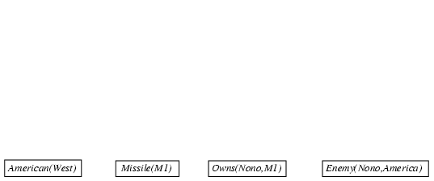
Forward Chaining in FOL: example (cont.)

Slide 97
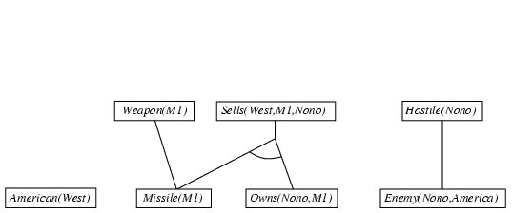
Forward Chaining in FOL: example (cont.)

Slide 98
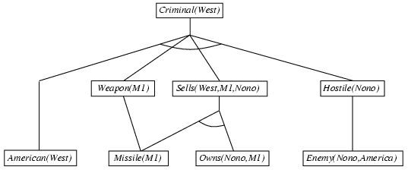
Forward Chaining in FOL: example (cont.)

Slide 99
Forward Chaining in FOL (cont.)
Forward chaining is widely used in deductive databases
Production system (Rule based system, i.e. CLIPS)
Were among the earliest forward chaining systems
Production: a condition-action rule

Slide 100
Backward Chaining in FOL
Basic idea:
Work backward from the goal, chaining through rules to find known facts that support the proof
It is used in logic programming, which is the most widely used form of automated reasoning
A simple algorithm: a brief description
It is called by the original query
A list of goals, each containing a single element
It returns the set of all substitutions that satisfy the query.
If all of the goals can be satisfied, then current branch of the proof succeeds.

Slide 101
Backward Chaining in FOL (cont.)
A simple algorithm: more details of the steps
The list of goals is in a “stack” waiting to be worked
Takes the first goal in the list and finds every clause in the KB whose positive literal (head) unifies with the goal
Each such clause creates a new recursive call in which
The premise (body) of the clause is added to the goal stack
Facts are clauses with a head but no body, so when a goal unifies with a known fact, no new sub-goals are added to the “stack” and the goal is solved (so removed from the “stack”)
…Sounds familiar? Search alike?

Slide 102
Backward Chaining in FOL (cont.)
A simple algorithm: further understanding
Given query q,
if there is a rule: p₁, p₂, …, p_{n} → q, then
If we can get all the subgoals p₁, p₂, …, p_{n} proved, then the original goal q is proved.
The same idea is applied recursively to all the goals in the “stack”
where p₁, p₂, …, p_{n} and q are literals in FOL
For each such step, unification is applied
A query q here is actually treated as ¬q (negation of q), so proof by refutation

Slide 103
Backward Chaining in FOL: example
Example 4.21:
The proof of Criminal(West) from the sentences given in Example 4.20:
Criminal(West)
{x/West, y/M1, z/Nono}
American(West)
Weapon(M1)
Sells(West,M1,Nono)
Hostile(Nono)
{ }
Missile(M1)
Missile(M1)
Owns(Nono,M1)
Enemy(Nono,America)
{ }
{ }
{ }
{ }

Slide 104
Resolution: brief summary
Resolution rule requests two complementary literals
In propositional logic:
If one is the negation of the other
In first-order (predicate) logic:
If one unifies with the negation of the other
l₁ ∨ ··· ∨ l_{k}, m₁ ∨ ··· ∨ m_{n}
(l₁ ∨ ··· ∨ l_{i-1} ∨ l_{i+1} ∨ ··· ∨ l_{k} ∨ m₁ ∨ ··· ∨ m_{j-1} ∨ m_{j+1} ∨ ··· ∨ m_{n})θ
where Unify(l_{i}, ¬m_{j}) = θ

Slide 105
Resolution: brief summary (cont.)
Example 4.22:
DoHomework(x) → Headache(x)
≡ ¬DoHomework(x) ∨ Headache(x)
¬DoHomework(x) ∨ Headache(x)
DoHomework(Donald Duck)
Headache(Donald Duck)
with θ = {x/Donald Duck}
Application of resolution to KB
Conversion to CNF (KB ∧ ¬α)
Apply resolution steps to CNF

Slide 106
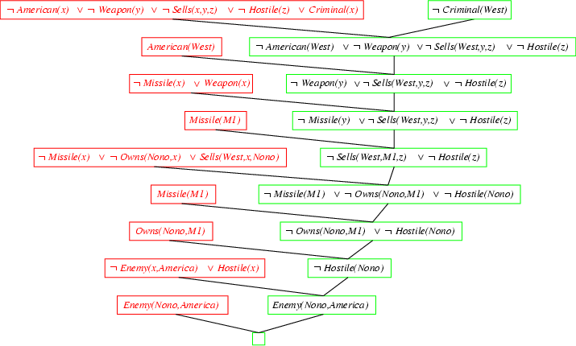
Resolution Proof: simple example
Example 4.23 (using linear input resolution algorithm):
¬ Enemy(Nono, America)

Slide 107
Semantic Networks, Frame, and Ontology

Slide 108
Semantic Networks
Semantic networks originally developed by M. R. Quillian as a model for word concepts in human memory, consist of nodes, links and labels
Nodes represent objects, concepts, or situations
can be instances (individual objects) or classes (generic objects)
Link between nodes represent a relationship
Labels
Labels on nodes indicate the name of the object, concept, etc
Labels on links describe the type of relationship between nodes
Nodes, links and labels form a directed graph

Slide 109
Semantic Networks: features
Offer graphical aids for visualizing a knowledge base by representing
individual objects
categories of objects, and
relations among objects
Semantic networks are a form of logic
Provide more convenient notation for certain kinds of sentences
Provide efficient algorithms to perform inheritance reasoning for inferring properties of an object on the basis of its category membership

Slide 110
Semantic Network Example: representation
Animal is a Class; Birds & Mammals are Subclass;
Pepe and Garfield are Instances
feathers
Animals
fur
has
kind_of
kind_of
has
two
has_legs
Birds
has_legs
Mammals
four
has
kind_of
Wings
can
kind_of
kind_of
Cats
Dogs
fly
isa
isa
caanary
isa
GARFIELD
ODIE
isa
PEPE
SYLVESTER

Slide 111
Semantic Network Example: inference
Inferencing is by
inheritance
“Does Sylvester have fur ?”
“Do dogs have 4 legs ?”
To answer those queries, you need to traverse the tree via the inheritance links
Is it possible to answer:
“What is the relationship between Garfield & Sylvester?”
Animals
fur
kind_of
has
Mammals
has_legs
four
kind_of
kind_of
Cats
Dogs
isa
isa
isa
GARFIELD
ODIE
SYLVESTER

Slide 112
Semantic Networks: Pros & Cons
Advantages
A powerful, flexible and graphical way of representing knowledge
Often used as a communication tool between knowledge engineer and expert during the knowledge acquisition phase
Good for representing declarative knowledge
Disadvantages
No formal definition of what arcs and nodes represent
Hard to represent negation (“cats don’t like water”)
Hard to represent disjunction (“Garfield eats Twitty-bird or catfish”)
The only kind of inferring is based on inheritance
Diagrams can become very complex and too large to display

Slide 113
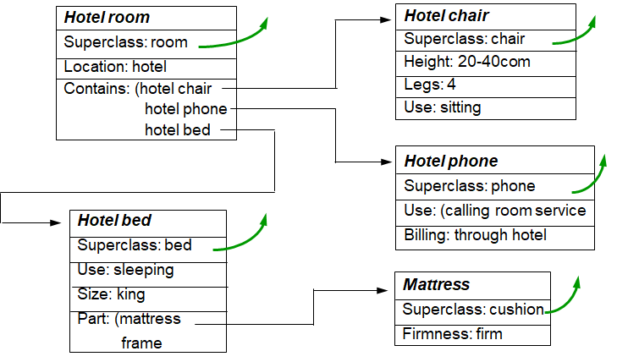
Frames
Frames (Marvin Minsky, 1975) are a version of semantic networks (similar to class, or entity relationship diagram (ERD))
A frame is representation of an object or a category with attributes and relations to other objects or categories
People consider
frames extended semantic
networks in a number of
important ways

Slide 114
Frames (cont.)
Frames make it easier to organize our knowledge hierarchically
In a network, every concept is represented by nodes and links at the same level of specification
Very often, we like to think of an object as a single entity for some purpose and only consider details of its internal structure when necessary
Allow procedural attachment
Support the linking of specific pieces of code to appropriate entities in the frame representation

Slide 115
Frames (cont.)
Support class inheritance
The slot and default values of a class frame are inherited across the class/subclass and class/member hierarchy
Recognize that different views of an object actually represent the same object
provide the use in default reasoning
E.g.: different perspectives of a cube can be very different but they actually represent the same single cube. Inferring the hidden side as default assumption.
Allow complex objects to be represented as a single frame (rather than as a large network structure)
add to the power of semantic nets

Slide 116
Frames (cont.)
Example 4.24: Part of a frame description of a hotel-room (from G.F. Luger in “Artificial Intelligence: Structures and Strategies for Complex Problem
Solving” with minor
modifications)
Hotel room
Superclass: room
Location: hotel
Contains: (hotel chair
hotel phone
hotel bed
Hotel chair
Superclass: chair
Height: 20-40com
Legs: 4
Use: sitting
Hotel phone
Superclass: phone
Use: (calling room service
Billing: through hotel
Hotel bed
Superclass: bed
Use: sleeping
Size: king
Part: (mattress
frame
Mattress
Superclass: cushion
Firmness: firm

Slide 117
From Semantic Nets to Frames
Animals
BIRDS
Kind_of | ANIMAL
Feathers | yes
Wings | yes
Fly | yes
Legs | 2
Color* | Brown
feathers
has
kind_of
has_legs
two
Birds
has
Wings
can
kind_of
CANARIES
Kind_of | BIRD
Feathers | yes
Wings | yes
Fly | yes
Legs | 2
Color | white
fly
canary
isa
PEPE

Slide 118
Frames: Example
A Frame:
Frame Name “BIRDS”
BIRDS
Kind_of | ANIMAL
Feathers | yes
Wings | yes
Fly | yes
Legs | 2
Color* | Brown
Slots
Frame Attributes each slot describes an attribute
Slot Name
Slot Value

Slide 119
Frames: Slot Values
The default slot values becomes true when no other values are present, otherwise the default value will be over-written.
Slot can have restrictions on the range and type of value it can take (e.g. numeric, text, {0-10}, {Yes, No}, etc)
Slots can contain program code which is executed if the slot value is changed or to compute some value

Slide 120
Frames: Classes and Instances
Class is a group of objects
that share similar characteristics
all objects in the class have
similar descriptions
Classes may have
subclasses which represent
further refinement of a class
Subclasses inherit all attributes
of the parent
It can also have additional attributes
Instances of a class/subclass are specific objects or members of the class
They inherit attributes of all parent classes
CARS
PASSENGER
COMMERCIAL
SEDAN
MPV
VANS
JAPANESE
…
…
…
TOYOTA
MAZDA
SGX 11 Y
…
…
…

Slide 121
Frames: Inheritance
Class=ATHLETES Subclass_of: SPORTS_PEOPLE
Name [txt]: Runs_km [num]: Freq_wk [int]:3 Wt [num]: Ht [num]: BMI: IF Ht or Wt change THEN BMI=Wt/(Ht*Ht)
Class=MALE Subclass_of: ATHLETES
Name [txt]: Runs_km [num]: Freq_wk [int]:3 Wt [num]: Ht [num]: BMI: IF Ht or Wt change THEN BMI=Wt/(Ht*Ht)
Class=FEMALE Subclass_of: ATHLETES
Name [txt]: Runs_km [num]: Freq_wk [int]:3 Wt [num]: Ht [num]: BMI: IF Ht or Wt change THEN BMI=Wt/(Ht*Ht) Children[Yes/No]:No
Instance_name: Charles Instance_of: MALE
Name [txt]:Charles Runs_km [num]:10 Freq_wk [int]:5 Wt [num]:66 Ht [num]:1.7 BMI:22.8
Instance_name:Jane Instance_of: FEMALE
Name [txt]: Jane Runs_km [num]:12 Freq_wk [int]:4 Wt [num]: 51 Ht [num]:1.64 BMI: 18.9 Children[Yes/No]:No

Slide 122
Frames: Pros & Cons
Advantages
Provide a natural way for the structured and concise representation of knowledge
Make programming easier by grouping related knowledge
Easy to set up slots for new properties and relations
Easy to include default information and detect missing values
Disadvantages of Frames
No standards for slots and filler values
More of a general methodology than a specific representation
No associated reasoning/inference mechanisms

Slide 123
Ontology for Distributed AI
Ontology has attracted more and more attentions in the areas where knowledge/information sharing is critical and necessary (modern name: knowledge graph)
Enterprise knowledge management,
Automatic translation,
Information/knowledge extraction,
Google / Baidu brain
… …
Techniques of natural language processing are helpful for ontology:
Lexical and syntactical analysis, semantic analysis, topic model, text mining techniques.

Slide 124
What an Ontology Offers
An ontology identifies and properly defines
a set of relevant concepts that characterize a given application domain, e.g.: travel agents, medical practitioners.
The construction of its unifying conceptual framework
fosters communication and cooperation among agents (human or machine), better enterprise organization, and system interoperability.
It provides system-engineering benefits
such as reusability, reliability, and specification.
Single view/copy of master knowledge graph/database

Slide 125
Ontology: levels of formality
A domain ontology seeks to
reduce or eliminate conceptual and terminological confusion among the members of a user community who need to share various kinds of electric documents and information.
Ontology can have different levels of formality
Types of ontology
Foundational ontology (i.e. Nothing → Thing)
is domain independent, supports a model’s generality to ensure reusability across different domains
Core ontology (i.e. Virtual vs. Real)
includes application-domain concepts
Specific domain ontology
with specific domain concepts (i.e. Education vs. Oil Exploration)

Slide 126
Further Discussion: Representation, Reasoning and Search

Slide 127
Knowledge Representation: What is Best
In the 1960s and 1970s, students frequently asked, "Which kind of representation is best?" and I usually replied that we'd need more research. . . But now I would reply: To solve really hard problems, we'll have to use several different representations. This is because each particular kind of data structure has its own virtues and deficiencies, and none by itself would seem adequate for all the different functions involved with what we call common sense.
⎯ Marvin Minsky

Slide 128
Properties of Knowledge Representation
A good representation scheme for complex structured knowledge should possess the following properties:
representational adequacy
ability to represent all knowledge in the domain problem
inferential adequacy
ability to draw (new) inferences from the knowledge base
inferential efficiency
ability to direct inferencing to more productive directions
well-defined syntax & semantics
with correct grammar and precise meaning
naturalness
natural, readable and understandable
Ref:
“Artificial Intelligence” by Elaine Rich

Slide 129


Representation, Reasoning and Search
Knowledge Based AI System
Reasoning capability is jointly
enabled by knowledge base
representation and search strategy.
Inference Engine
Reasoning
Searching
Representation
Knowledge Base

Slide 130
Inference and Search
If the successor function in search is defined to generate all possible applications of inference rules, then the search algorithms (uninformed, heuristic) can be applied to find proofs.
Can use inference rules as operators in a standard search algorithm
 Searching for proofs is an alternative to enumerating models
Inference rules and search
The search can go forward from the initial KB, applying inference rules/operators to derive the goal sentences, or
Can go backward from the goal sentence, trying to find a chain of inference rules/states from initial KB: known facts.

Slide 131
Inference and Search (cont.)
Inference in propositional logic is NP-complete
?! In the worst case, searching for proofs is going to be no more efficient than enumerating models
☺ However, finding a proof can be highly efficient
Because it can ignore irrelevant propositions, no matter how many of them there are
Monotonicity: if β ╞ α then β ∧ γ ╞ α
Inference rules can be applied whenever suitable premises are found in the KB ⎯ the conclusion of the rule must follow regardless of what else is in the KB

Slide 132
Inference and Search (cont.)
Search algorithms are complete ⇒ they will find any reachable goal
If the available inference rules/operators are inadequate, then the goal is not reachable.
i.e.: No proof exists, using only those inference rules.
Resolution is an important inference rule
Yields a complete inference algorithm, when coupled with any complete search algorithm
 Complete inference algorithm =
adequate inference rules + complete search algorithm

Slide 133
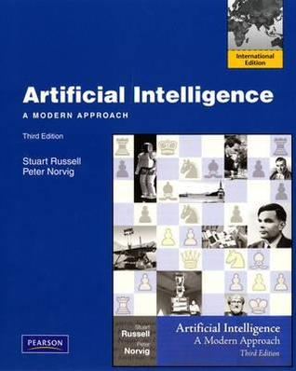
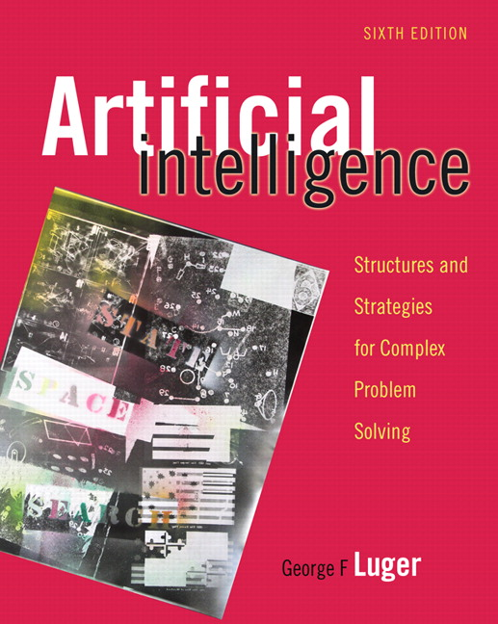
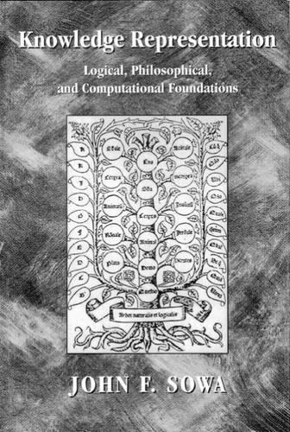
References
Russell, S. & P. Norvig, “Artificial Intelligence: A Modern Approach”, Prentice Hall, 2009
Luger, G. F., “Artificial Intelligence, Structures and Strategies for Complex Problem Solving” Addison-Wesley, 2008
Sowa, J. F., “Knowledge Representation, Logical Philosophical, and Computational Foundations”, Brooks, 2000

