Slide 1
Web Services Term Project Main Points and Operations
Kenneth Silvere
UIN:662516116

Slide 2
My web services term project is the one given in option 2.
Here, one doctor element is assigned three patients. Each patients has a name and an insurance number.
A doctor along with his/her patients can be deleted, names of both the doctor and the patients can be updated , a new doctor with his patients can be added, in this service.
This powerpoint presentation will show the execution and features of this project in detailed steps.

Slide 3
First we have to turn on the tomcat server and select the project directory in the command prompt.
Then using ant , we run the Jersey Client.
Next, we deploy the service using the command ‘ ant deploy –Dwar.name = drpatients ‘
The service will not be deployed if the server is not turned on.
After that, we call the service from the web browser, and we can see the output.
The following 3 slides will show these steps in real time execution.

Slide 4
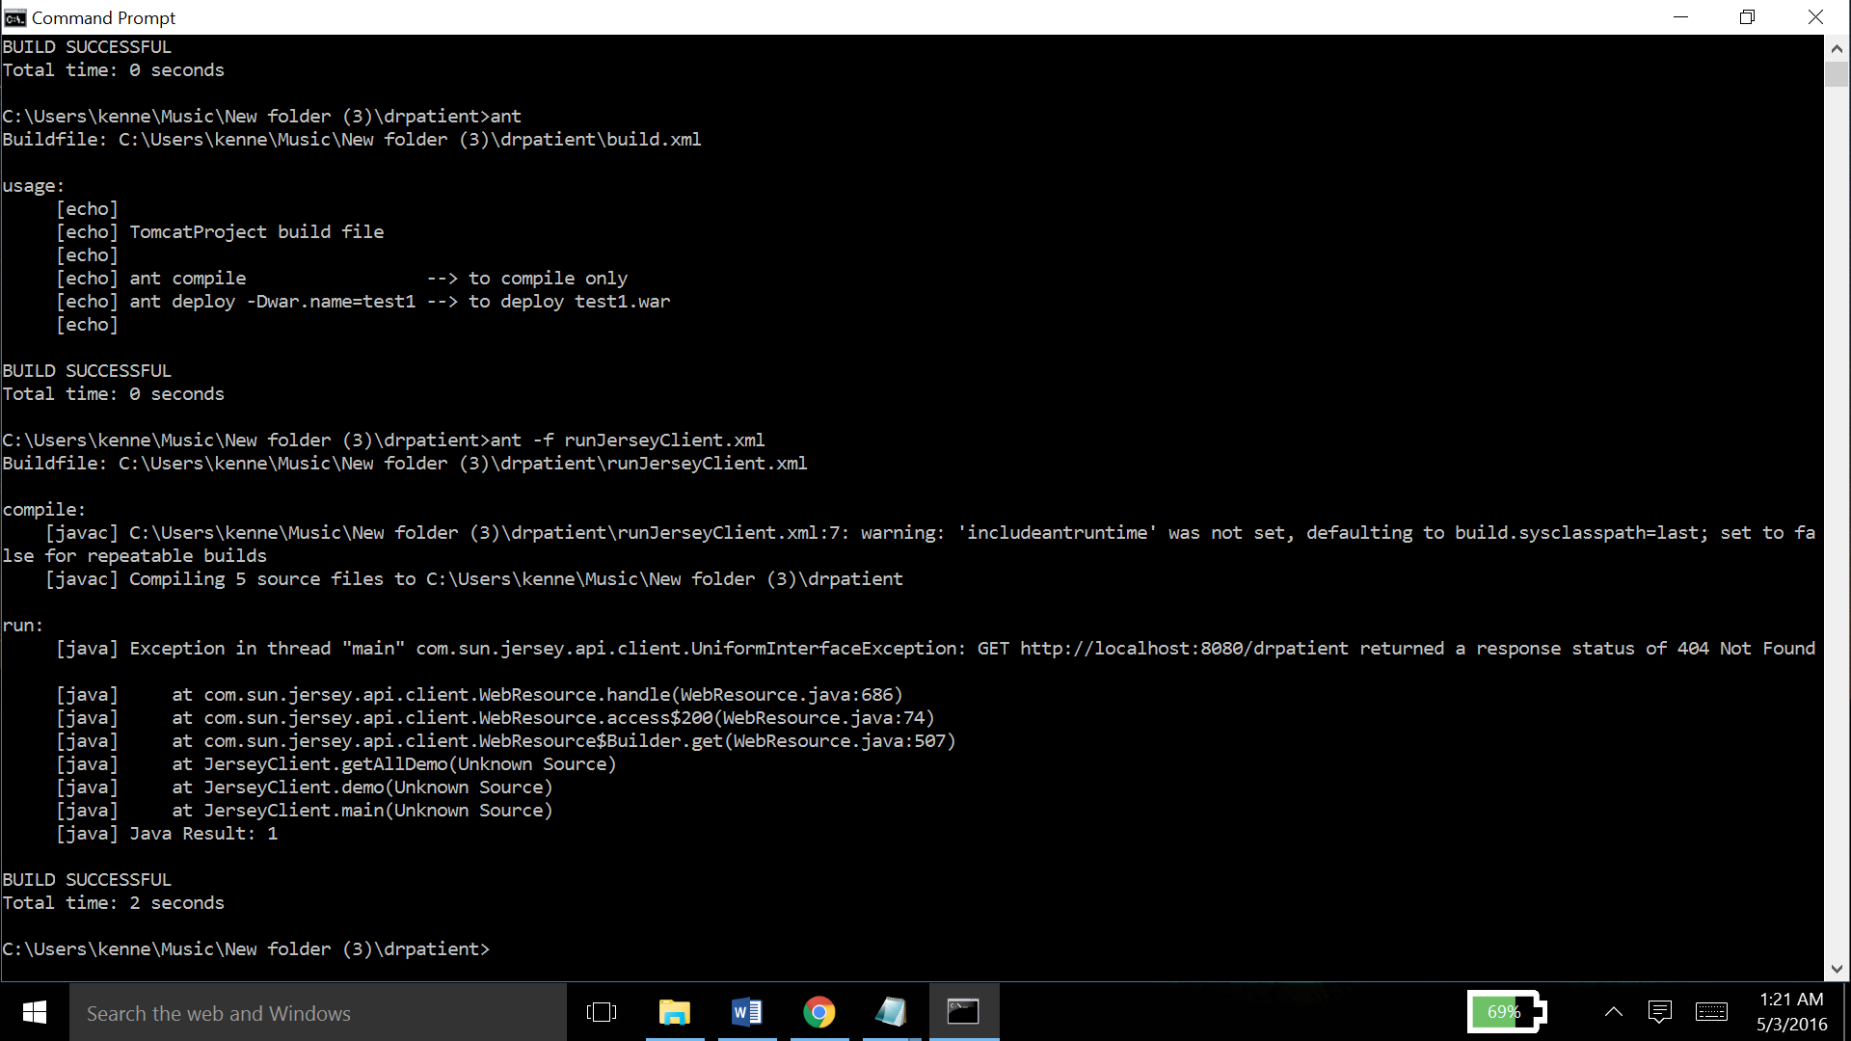

Slide 5
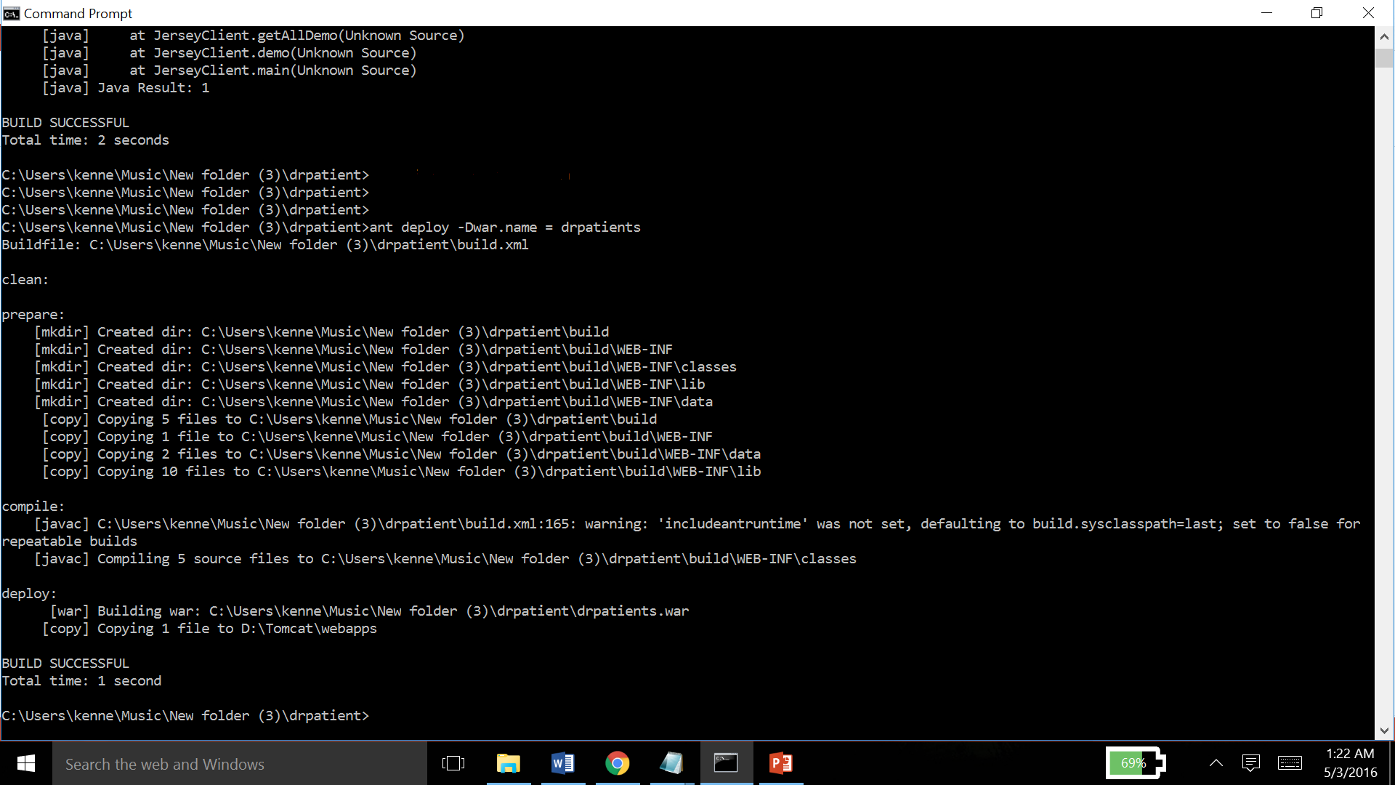

Slide 6
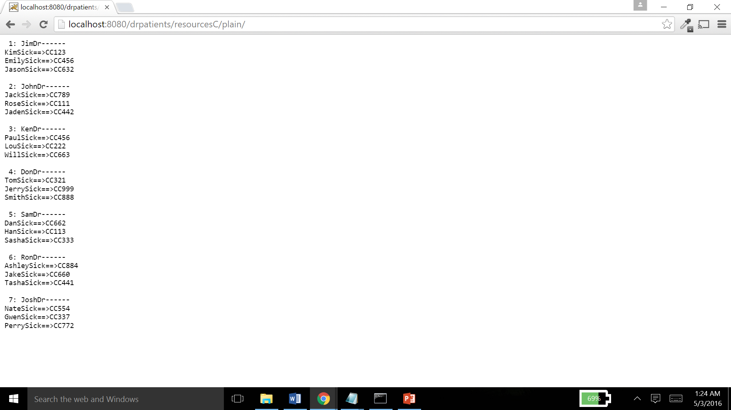

Slide 7
We got lists of all the doctors and their patients in plain text. Now we want them in xml format
In order to do this,
We have to modify the url
Instead of localhost:8080/drpatient/resourcesC/plain/ we give the url : localhost:8080/drpatient/resourcesC/xml/
We just remove ‘plain’ at the end of the url and append ‘xml’.
We now get the lists of doctors and their patients in xml
This output is show in the next slide.

Slide 8
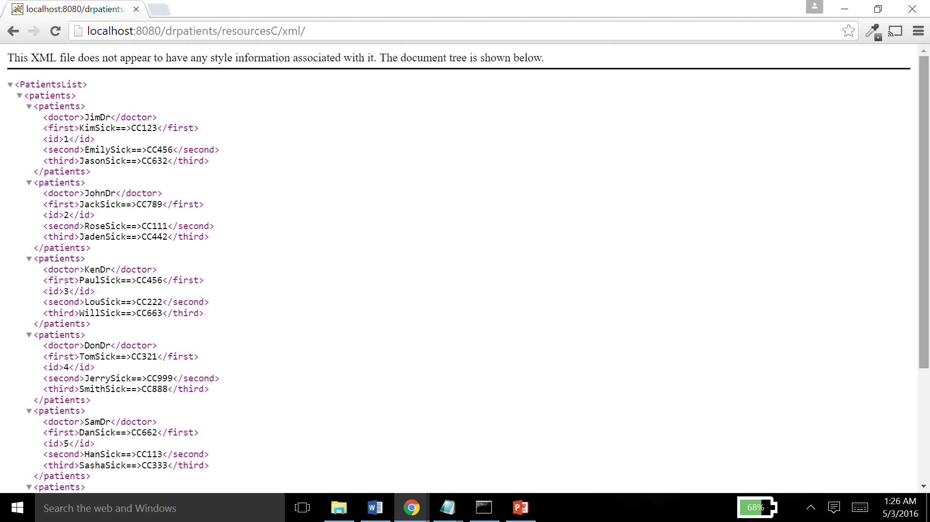

Slide 9
We can also get a list of only one doctor with his/her patients in both plain text and xml
To do this,
We just append the id of the doctor whose list we want to the url. So for xml we give
localhost:8080/drpatient/resourcesC/xml/5
and for plain text , we give
localhost:8080/drpatient/resourcesC/plain/5
to get the list of the doctor whose id = 5
This is shown in the following two slides.

Slide 10
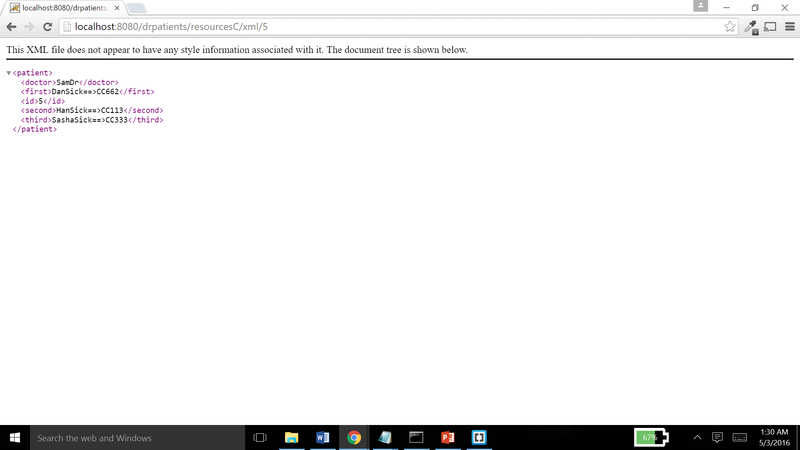

Slide 11
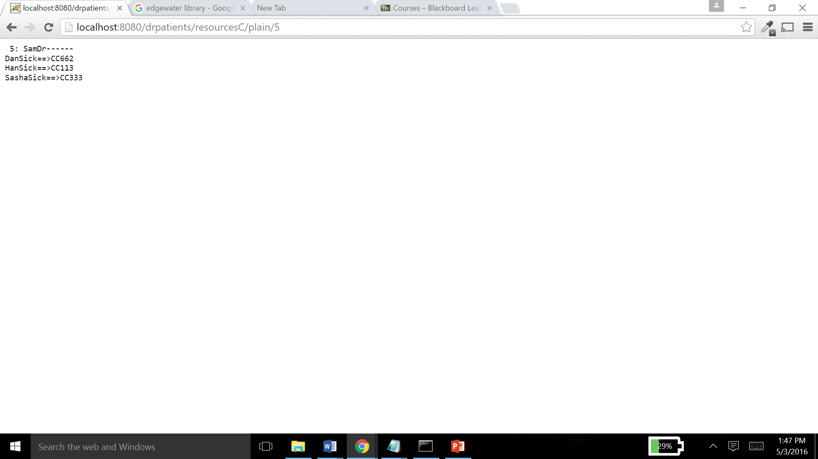

Slide 12
Next, we want to add a new doctor along with his three patients. We use the CURL utility to do this.
We use the POST request to to do this. The syntax for this command is
curl --request POST --data "doctor=Evelyn Silvere" --data "first=Anita" --data "second=Van Jake" --data "third=Derrick" localhost:8080/drpatient/resourcesC/create
This adds a new doctor with patients in the service .
This operation is shown in the following two slides

Slide 13
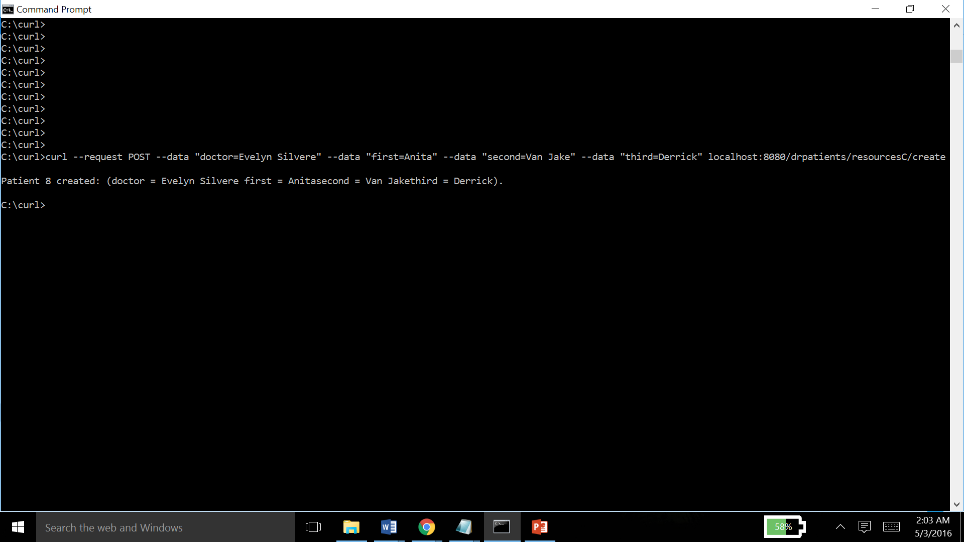

Slide 14
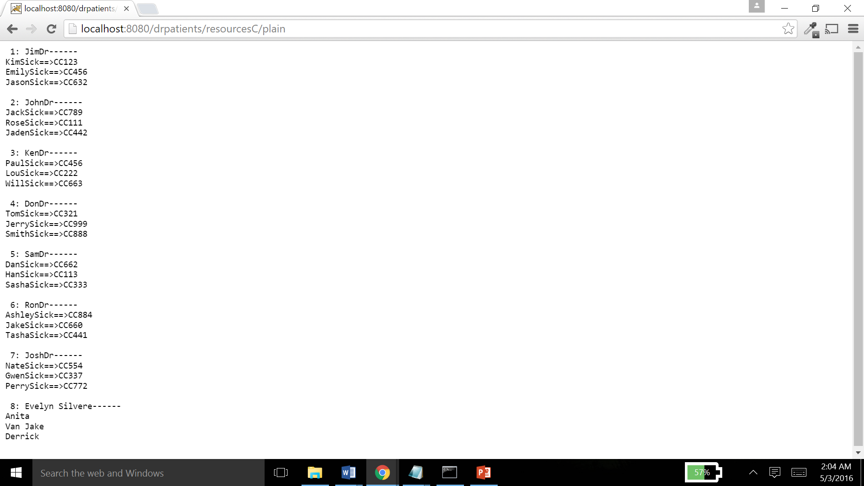

Slide 15
We use the same CURL utility to update a doctor’s name or patient’s details
The PUT request is used to perform this function.
We give the id of the doctor whose details we want to update and we give the element name along with the new value to be updated.
The syntax for this command is
curl --request PUT --data "id=8" --data "doctor=Dr.Silvere" localhost:8080/drpatient/resourcesC/update
This operation is shown in the next two slides

Slide 16
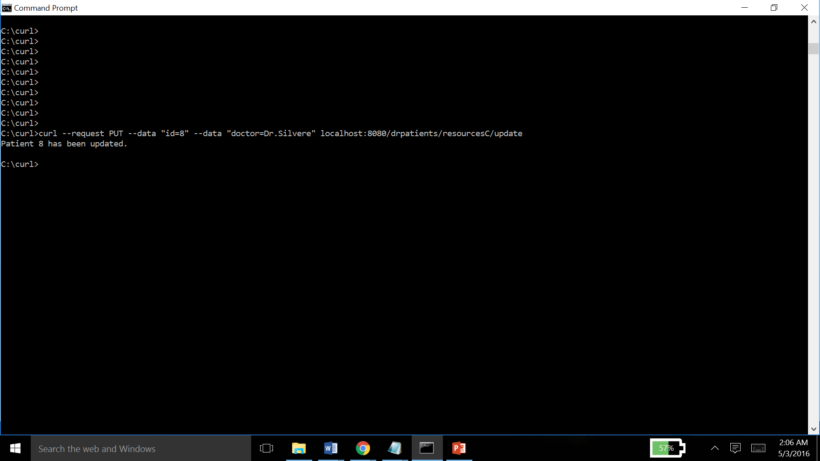

Slide 17


Slide 18
Next, we look at deleting a doctor and his patients using CURL
This is a simple command that we pass to curl with the id of the doctor who we want to delete from our web service .
The syntax for this command is
curl --request DELETE localhost:8080/drpatient/resourcesC/delete/7
This operation is shown in the next 2 slides.

Slide 19
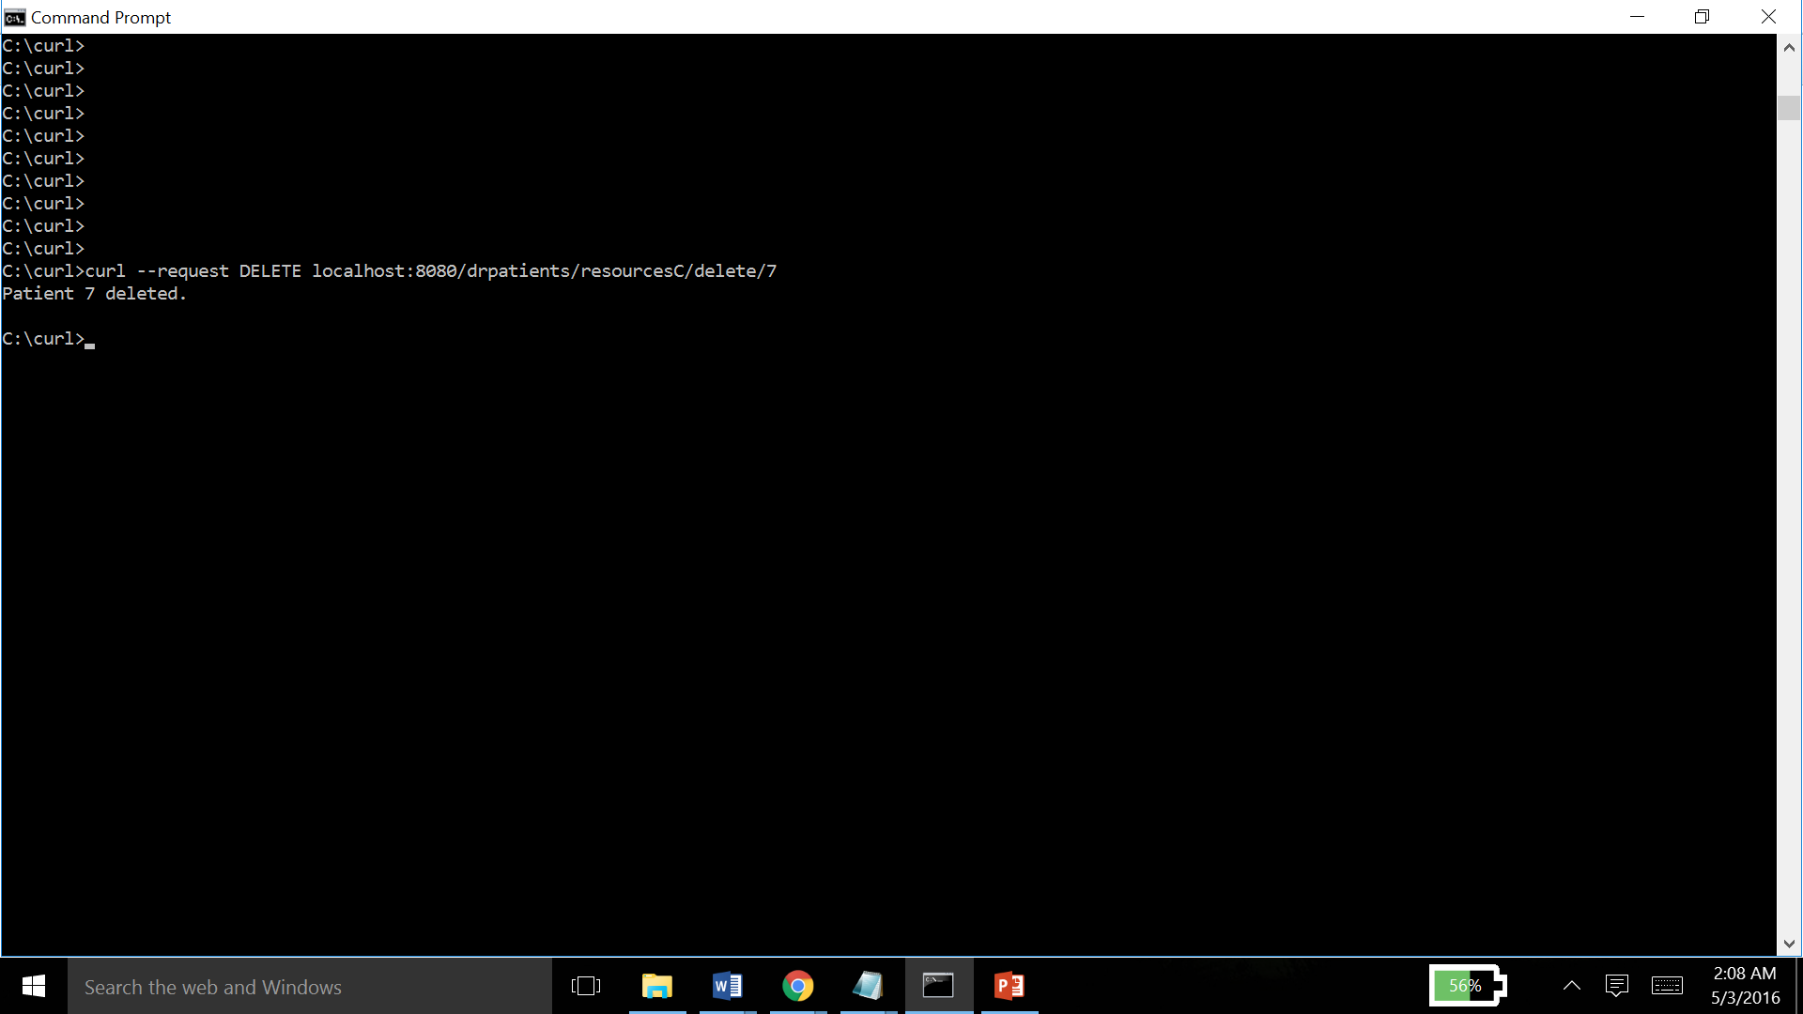

Slide 20
