Slide 1
An investigation of the impact of earthquakes in iceland
KU Data analytics bootcamp 2020
Brett, Angie, cj, kenn

Slide 2
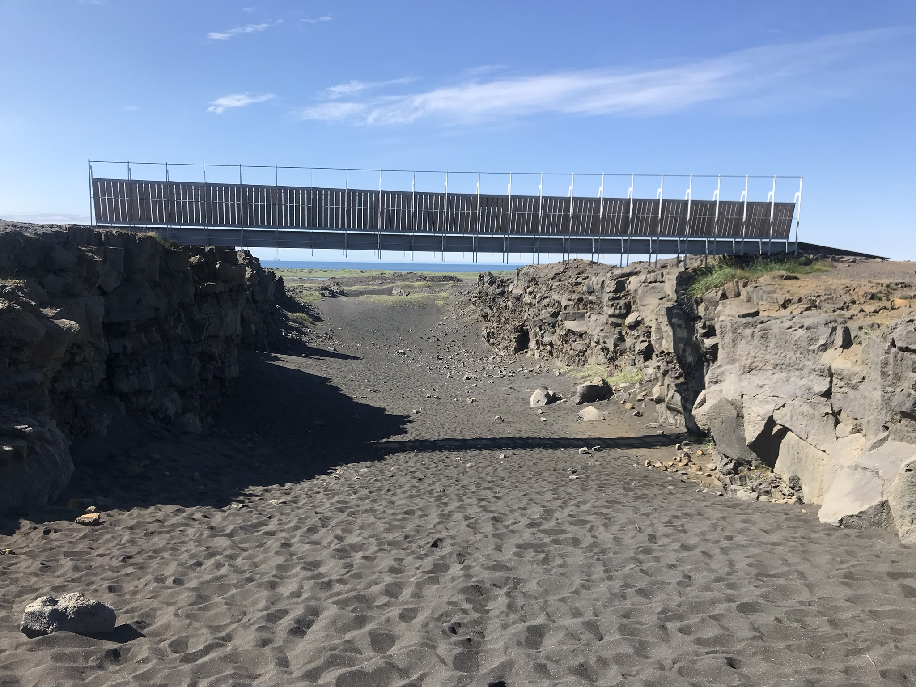
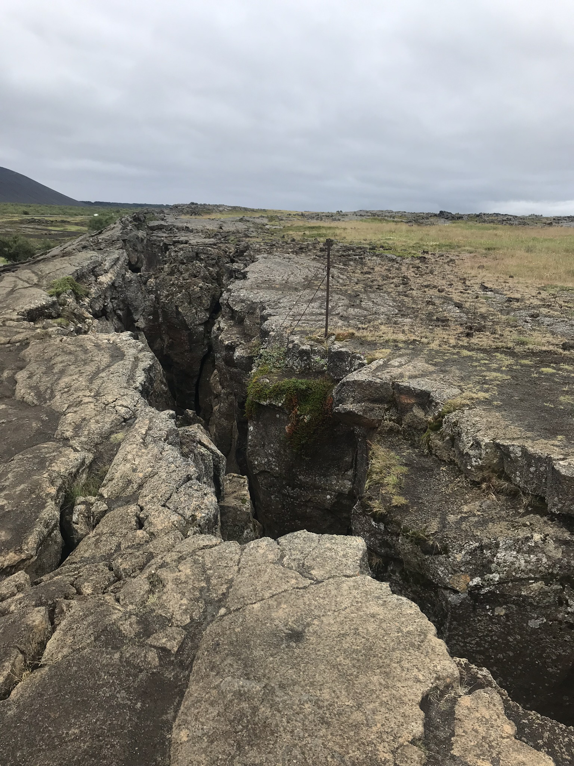
Euroasian and N. American tectonic plates

Slide 3
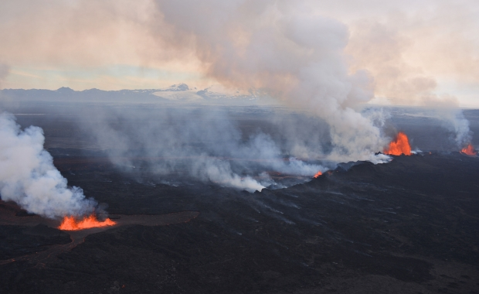
So many earthquakes
Iceland experiences approximately 500 earthquakes every week.
Why so many? Iceland is located on top of the Atlantic ridge, where the Eurasian and N. American tectonic plates meet.
The two plates are separating at about an inch per year!
Don’t get too scared, it will take about a million years for them to be over 15 feet apart!
Source: https://icelandmag.is/article/why-constant-earthquakes-iceland-slowly-being-torn-apart

Slide 4
Alternative hypothesis:
Null hypothesis:
If earthquakes are not related to economic outcomes, then earthquakes over 6.1 magnitude would not have an effect on:
Gross Domestic Product
Trade
Manufactures exports
Earthquakes of magnitude 6.1or higher have greater than 3% impact on the following economic areas:
Gross Domestic Product
Trade
Manufactures exports

Slide 5
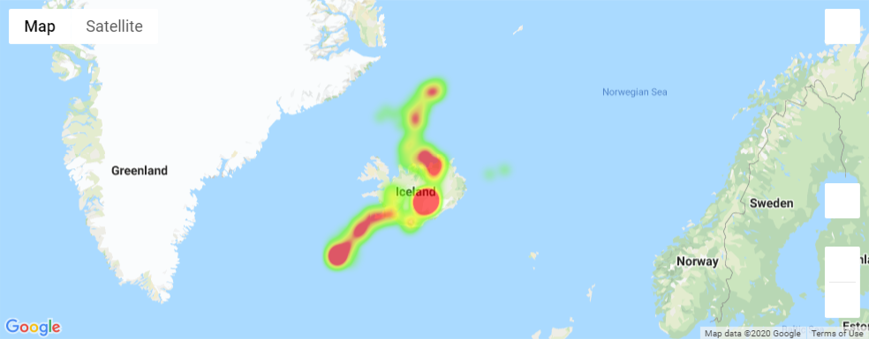
Iceland with overlay of earthquake severity heat map

Slide 6

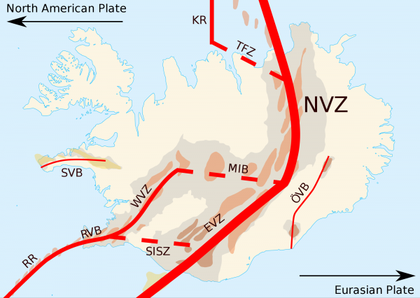
Our map agrees with the current understanding of seismic activity:

Slide 7
Economic background
Averages since 1960
Overview of the economy, main three points
Mean and st dev

Slide 8
Plots of each distinct category
Most meaningful plots only

Slide 9
Conclusions
Implications of findings and what they mean.
ANOVA and t-test

Slide 10
Clean up

