Slide 1
An investigation of the impact of earthquakes in iceland
KU Data analytics bootcamp 2020
Project 1
Brett, Angie, cj, kenn
Notes:
https://www.usgs.gov/faqs/which-country-has-most-earthquakes?qt-news_science_products=0#qt-news_science_products

Slide 2
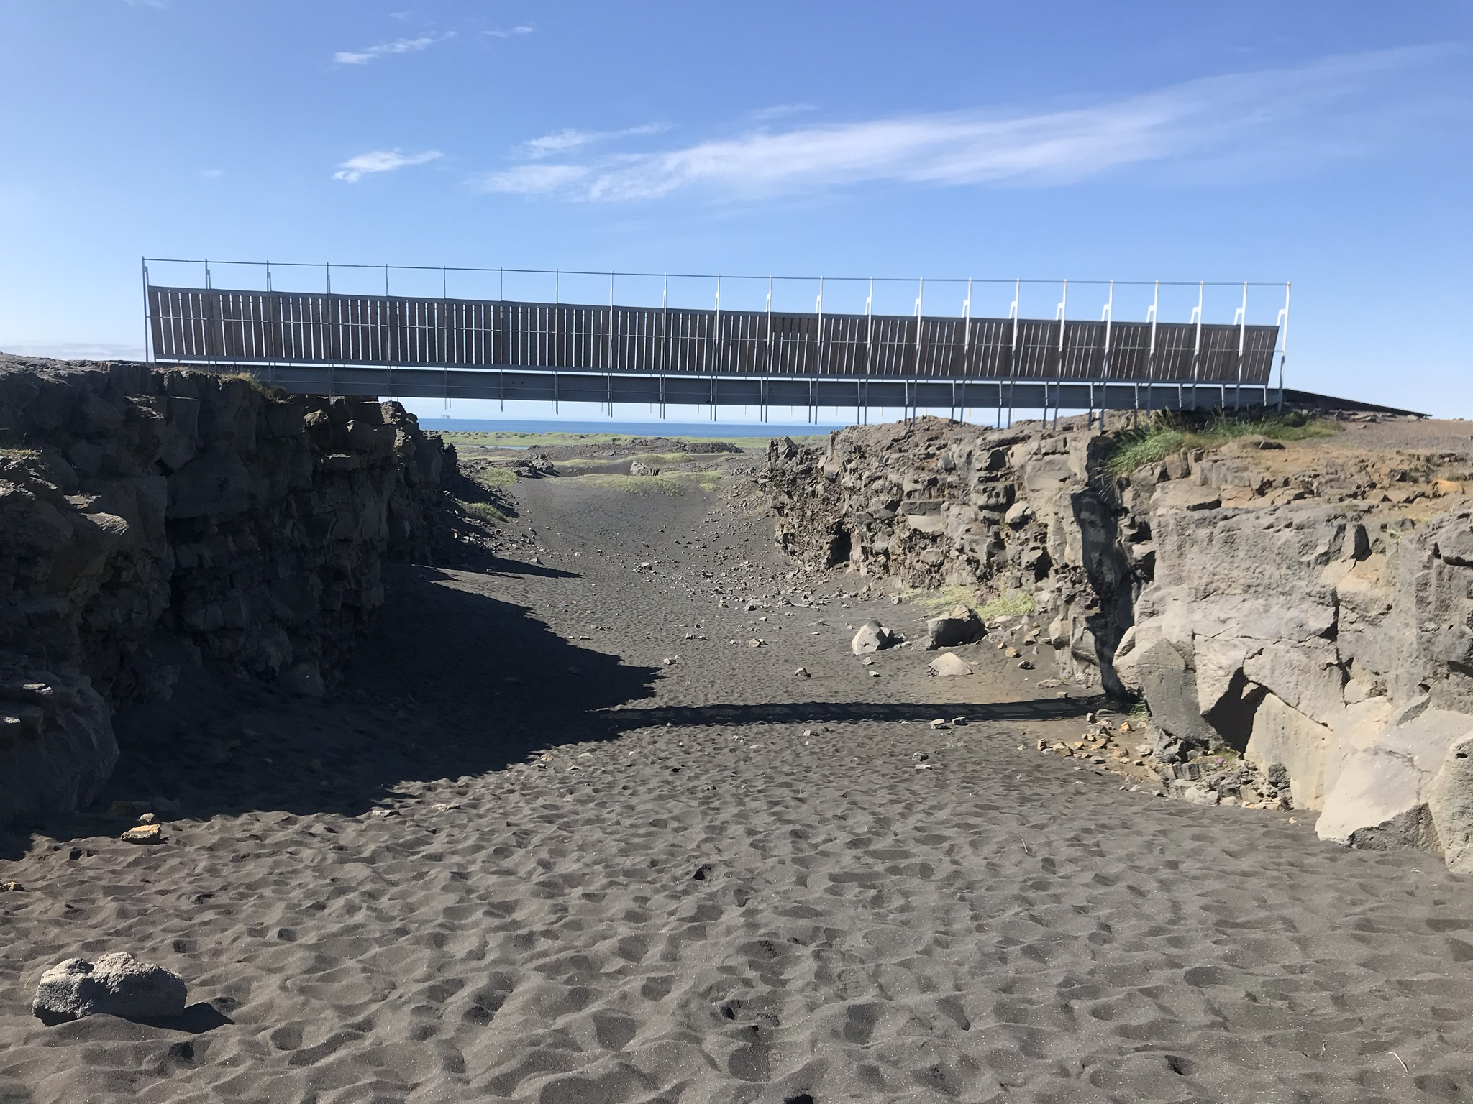
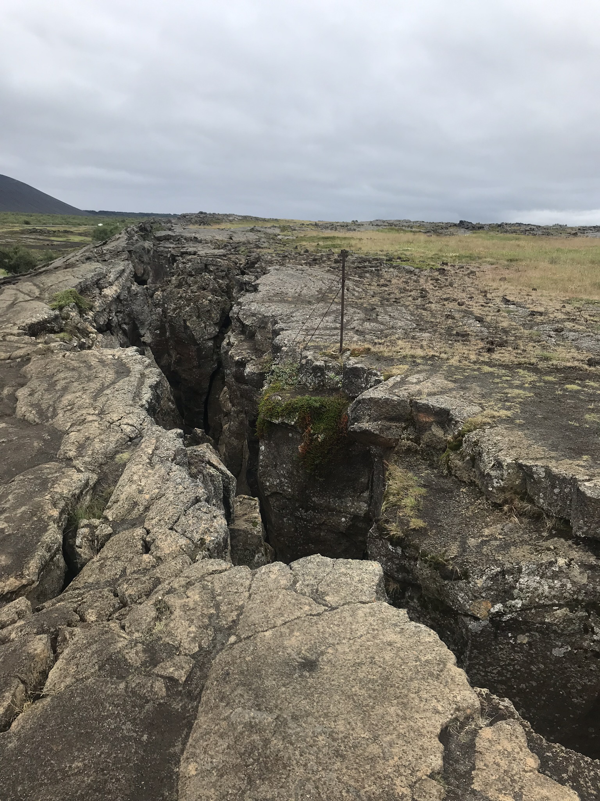
Euroasian and N. American tectonic plates
Iceland experiences approximately 500 earthquakes every week.
Why so many?
Iceland is located on top of
the Atlantic ridge, where the
Eurasian and N. American
tectonic plates meet.
The two plates are separating
at about an inch per year.
Don’t get too scared, it will
take about one thousand
years for them to reach 0.15
miles apart!
Source: https://icelandmag.is/article/why-constant-earthquakes-iceland-slowly-being-torn-apart

Slide 3
hypothesis:
Earthquakes of magnitude 6.1or higher reduce the normal growth rate of 3.9% on the following economic areas:
Gross Domestic Product
Trade
Manufactures exports

Slide 4
Sources
World Bank – Iceland CSV
US Geological Survey - Earthquake API
Google Maps API

Slide 5
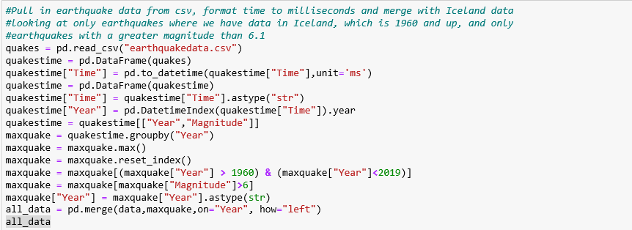
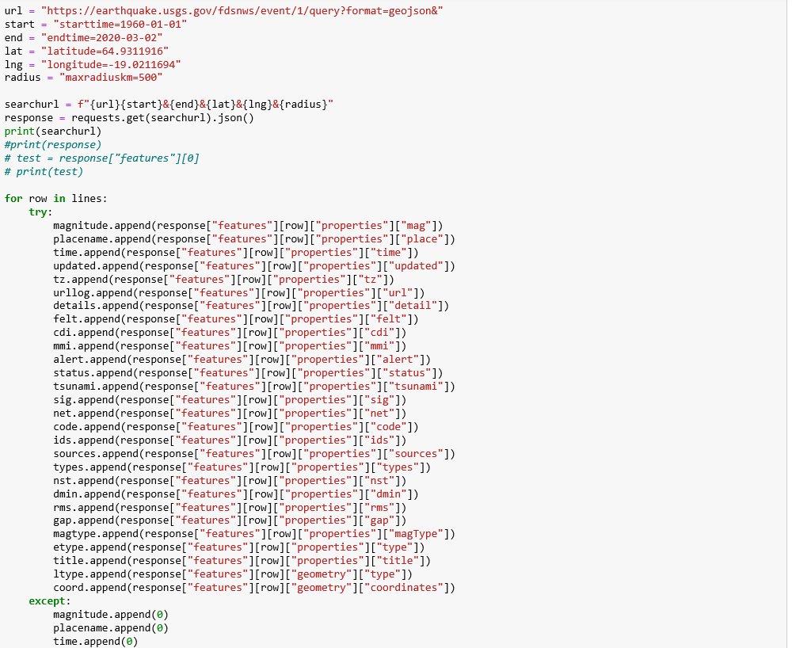
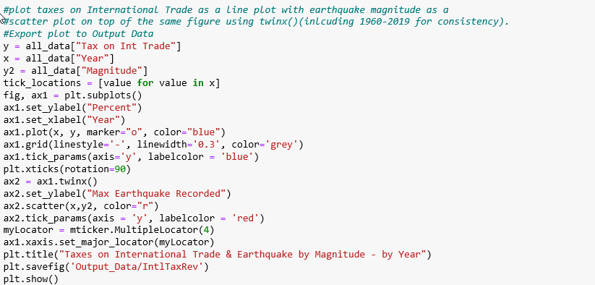
Clean up

Slide 6
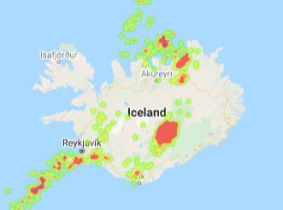
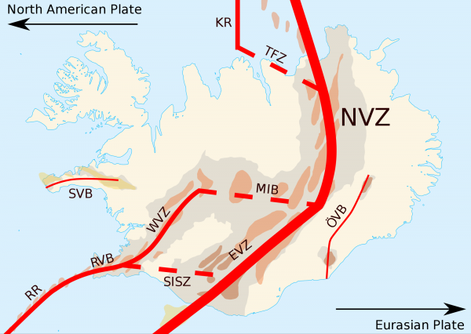
Our map agrees with the current trends of seismic activity:

Slide 7
Economic background
A long history of natural disasters dating back to a volcano in 1875 that destroyed Iceland's economy.
The economy flourished during the last half of the twentieth century due to a thriving fish industry.
The economy was devastated again in the market crash of 2008.
The market has been improving since 2008 due to tourism and construction.
https://www.cia.gov/library/publications/the-world-factbook/geos/print_ic.html

Slide 8
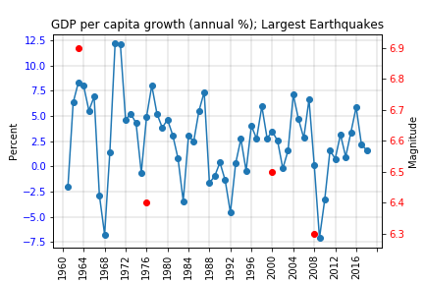

Slide 9
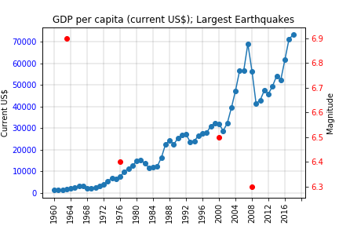

Slide 10
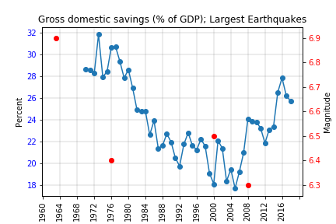

Slide 11
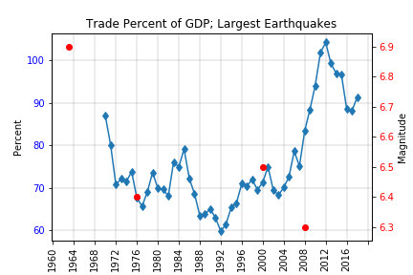

Slide 12
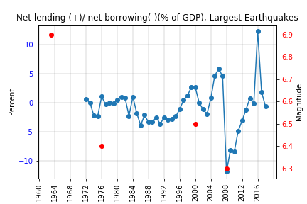

Slide 13
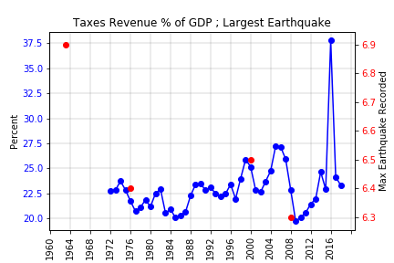

Slide 14
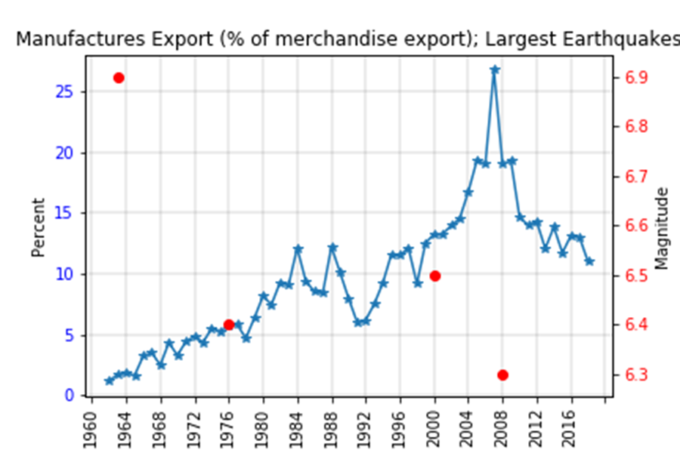

Slide 15
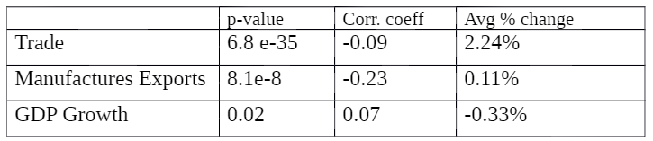
Conclusions
We reject the null hypothesis (type 1 error)

