Slide 1
An investigation of the impact of earthquakes in iceland
KU Data analytics bootcamp 2020
Brett, Angie, cj, kenn

Slide 2
Main hypothesis:
Is there a specific earthquake severity that impacts the following areas:
Economic impact
CO₂ Emmissions
Life expectancy
Population

Slide 3
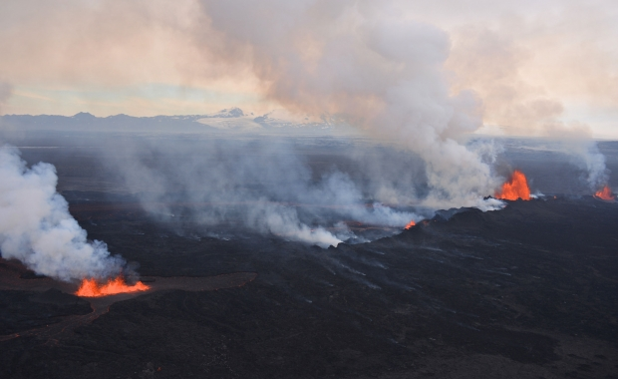
So many earthquakes
Iceland experiences approximately 500 earthquakes every week.
Why so many? Iceland is located on top of the Atlantic ridge, where the Eurasian and N. American tectonic plates meet.
The two plates are separating at about an inch per year!
Don’t get too scared, it will take about a million years for them to be over 15 feet apart!
Source: https://icelandmag.is/article/why-constant-earthquakes-iceland-slowly-being-torn-apart

Slide 4
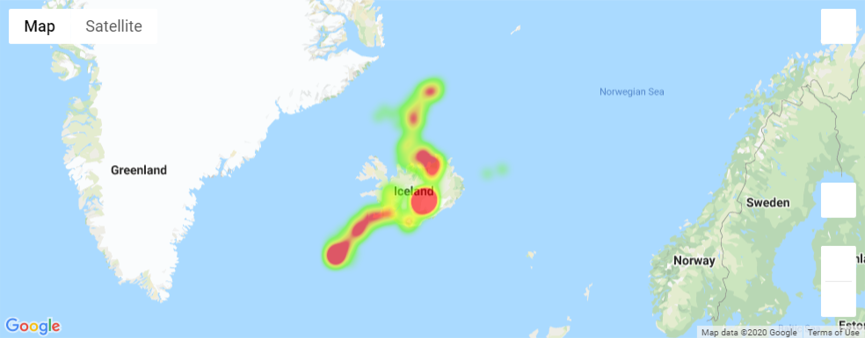
Iceland with overlay of earthquake severity heat map

Slide 5

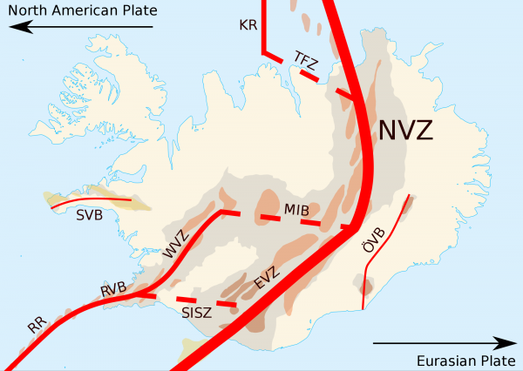
Our map agrees with the current understanding of seismic activity:

