Slide 1
An investigation of the impact of earthquakes in iceland
KU Data analytics bootcamp 2020
Project 1
Brett, Angie, cj, kenn

Slide 2
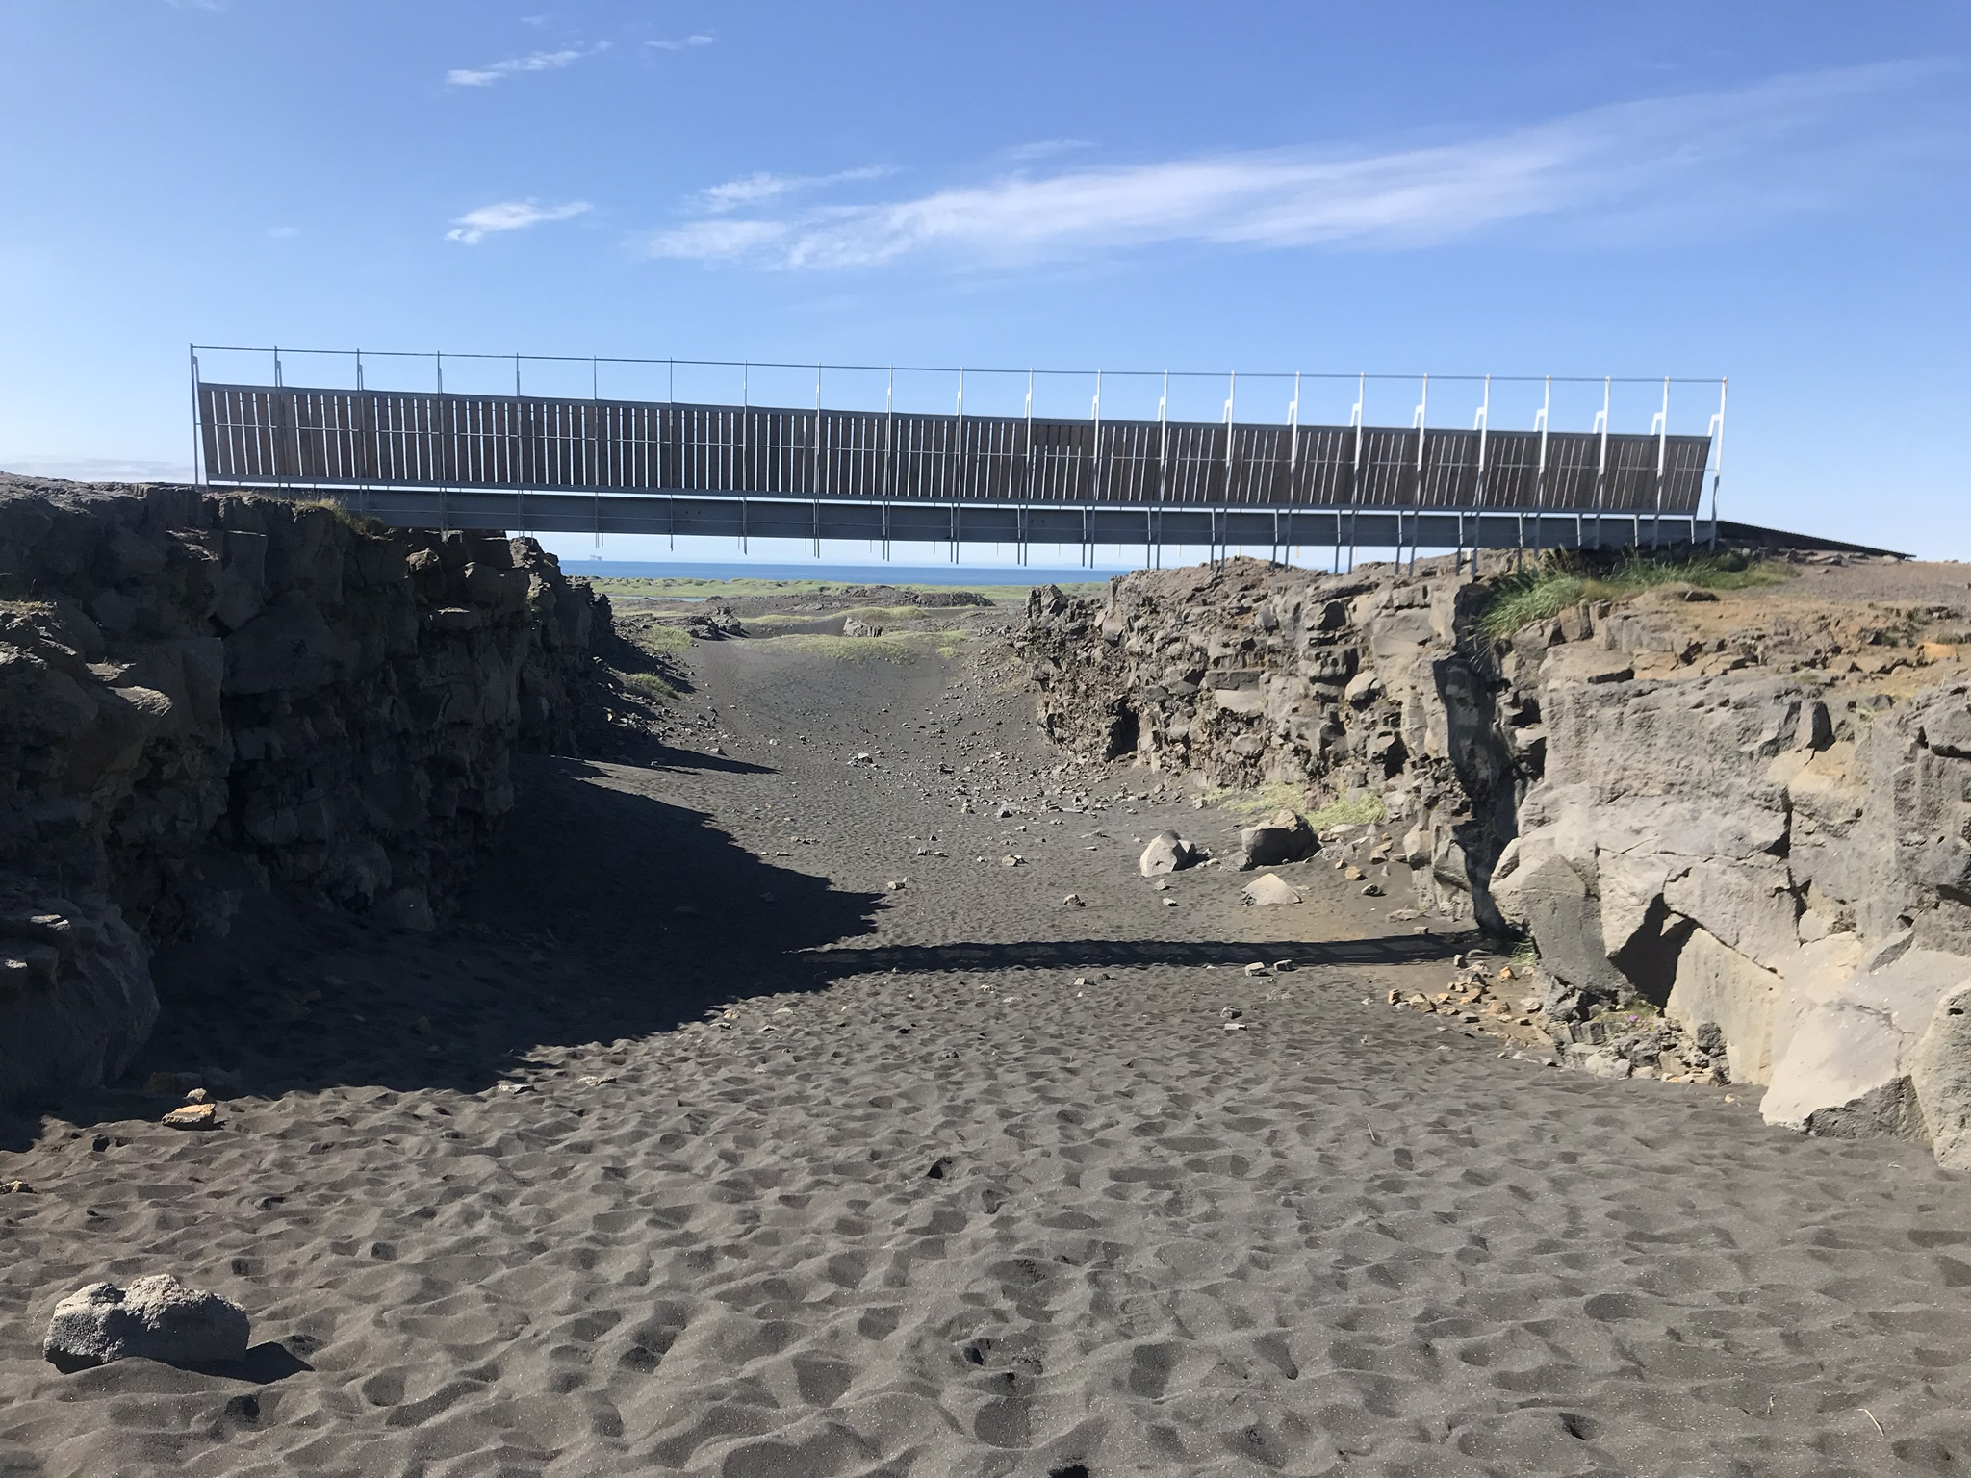
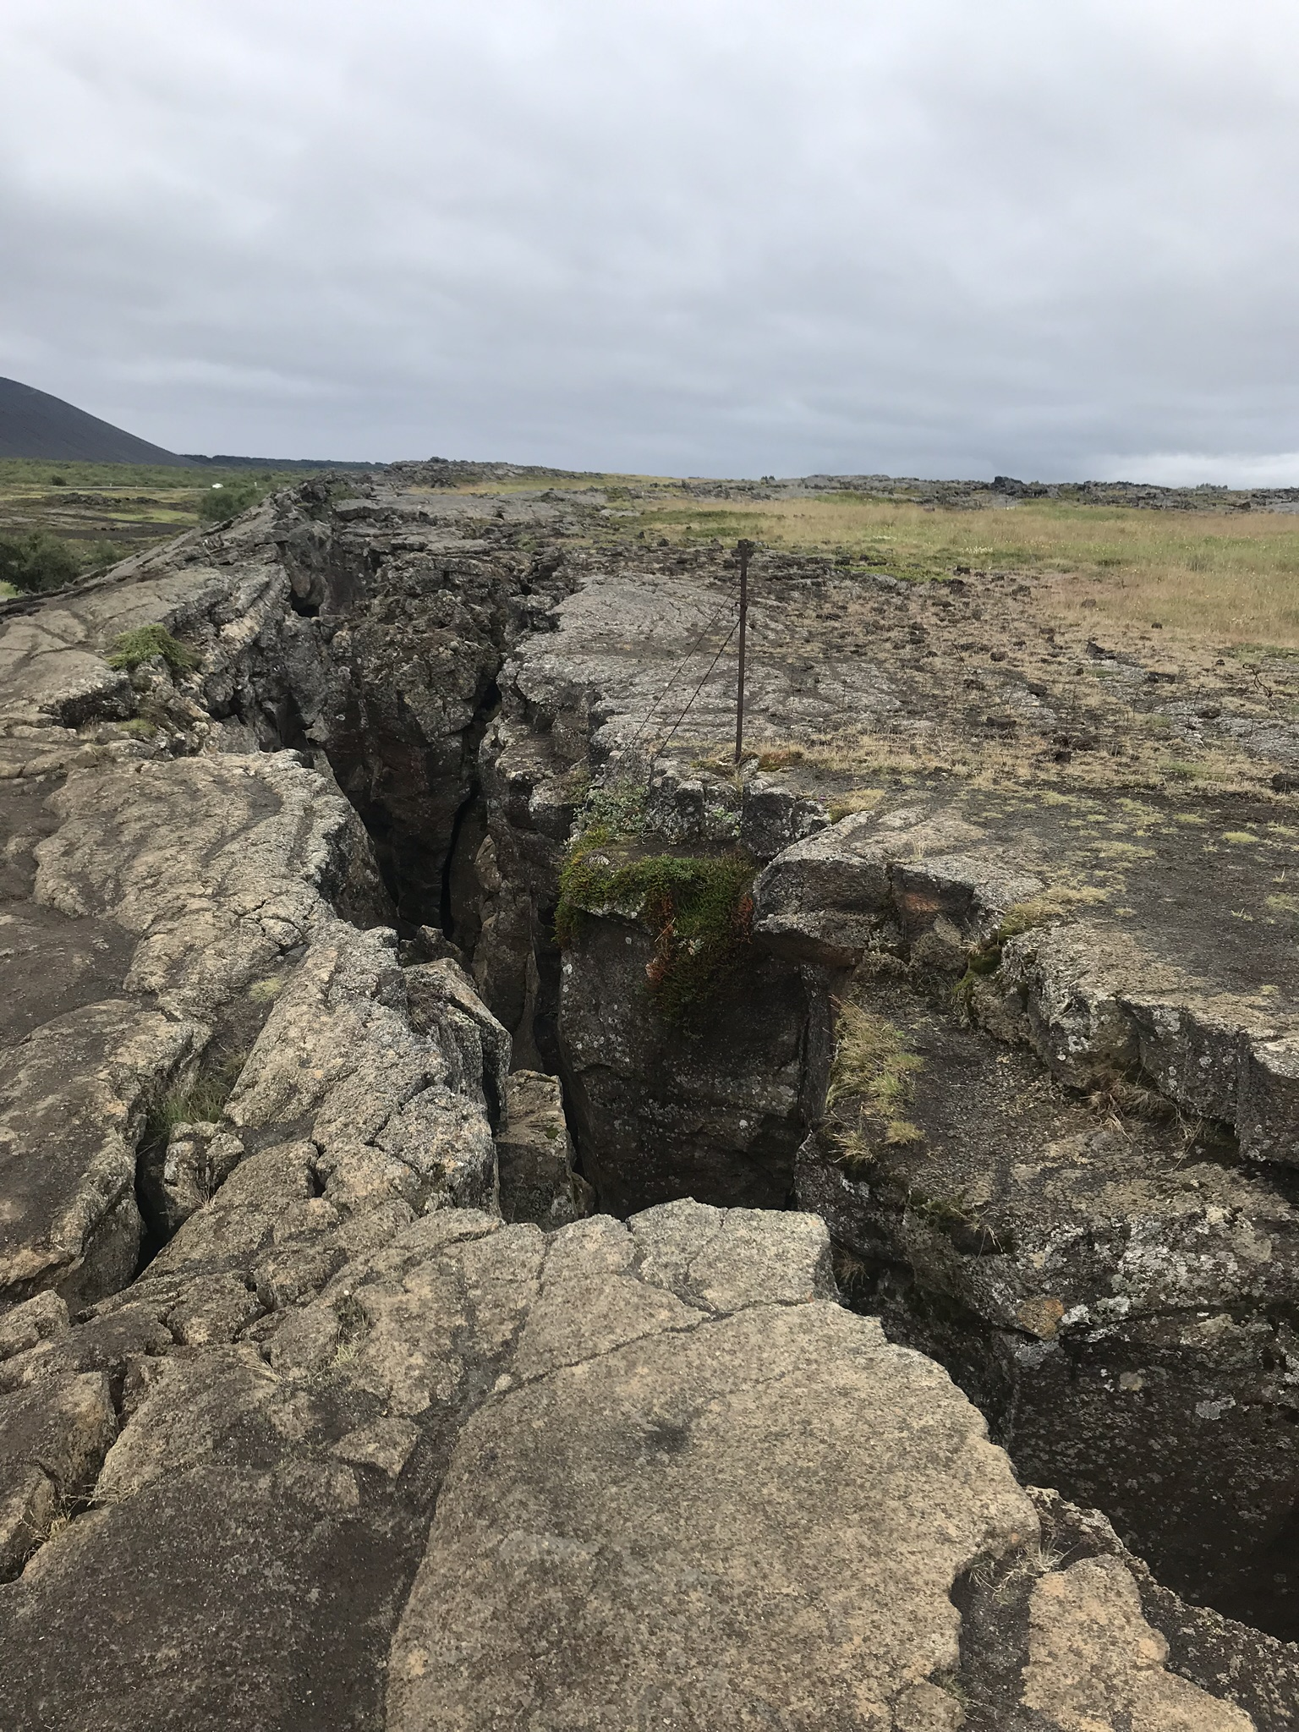
Euroasian and N. American tectonic plates
Iceland experiences approximately 500 earthquakes every week.
Why so many? Iceland is located on top of the Atlantic ridge, where the Eurasian and N. American tectonic plates meet.

Slide 3
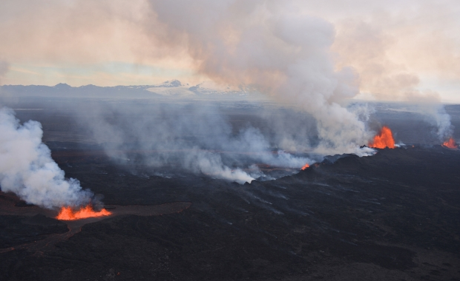
So many earthquakes
The two plates are separating at about an inch per year.
Don’t get too scared, it will take about one thousand years for them to reach 0.15 miles apart!
Source: https://icelandmag.is/article/why-constant-earthquakes-iceland-slowly-being-torn-apart

Slide 4
Alternative hypothesis:
Null hypothesis:
If earthquakes are not related to economic outcomes, then earthquakes over 6.1 magnitude would not have an effect on:
Gross Domestic Product
Trade
Manufactures exports
Earthquakes of magnitude 6.1or higher have greater than 3.9% impact on the following economic areas:
Gross Domestic Product
Trade
Manufactures exports

Slide 5
Sources
World Bank – Iceland CSV
US Geological Survey - Earthquake API
Google Maps API

Slide 6
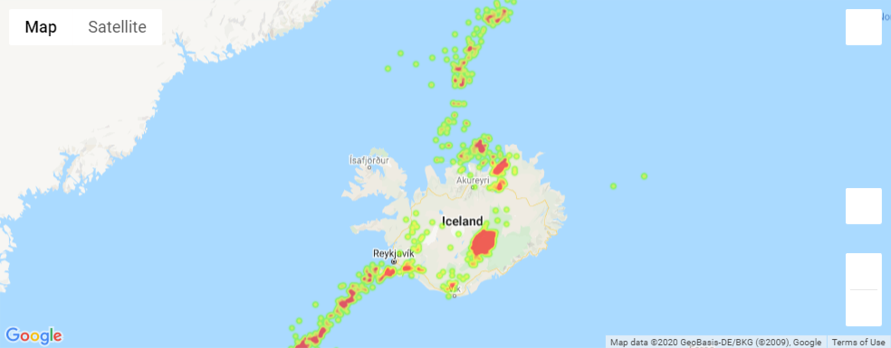
Iceland with overlay of earthquake severity heat map

Slide 7
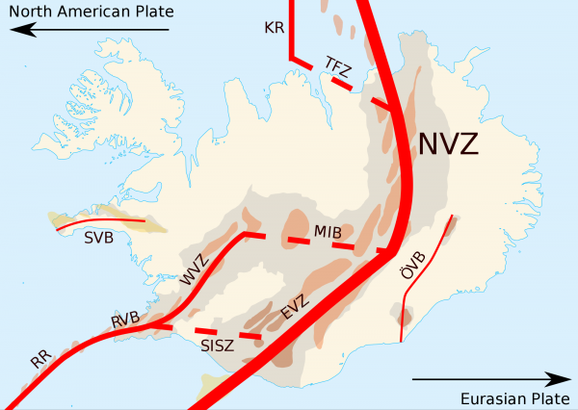
Our map agrees with the current trends of seismic activity:

Slide 8
Economic background
A long history of natural disasters dating back to a volcano in 1875 that destroyed Iceland's economy.
The economy flourished during the last half of the twentieth century due to a thriving fish industry.
The economy was devastated again in the market crash of 2008.
The market has been improving since 2008 due to tourism and construction.
https://www.cia.gov/library/publications/the-world-factbook/geos/print_ic.html

Slide 9
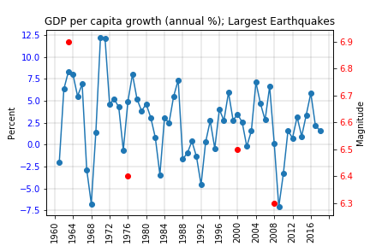

Slide 10
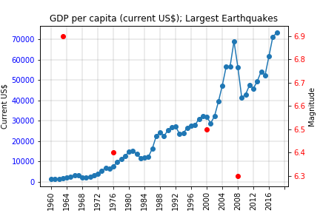

Slide 11
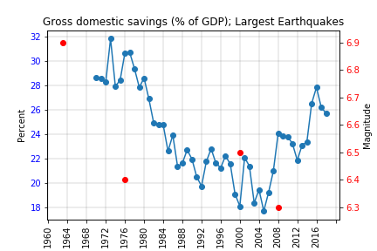

Slide 12
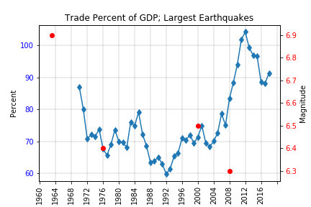

Slide 13
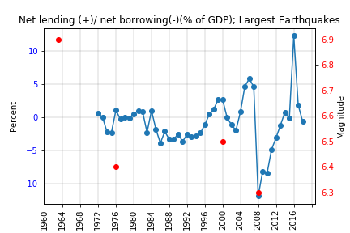

Slide 14
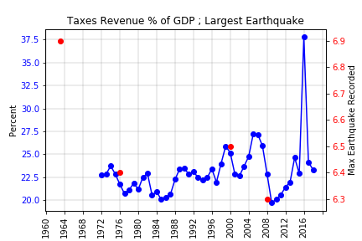

Slide 15
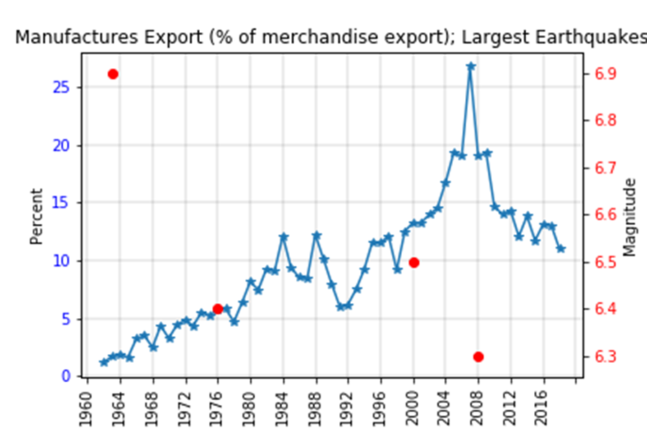

Slide 16
Conclusions
Implications of findings and what they mean.
t-test

Slide 17
Clean up

