Slide 1

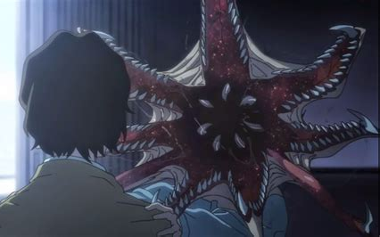
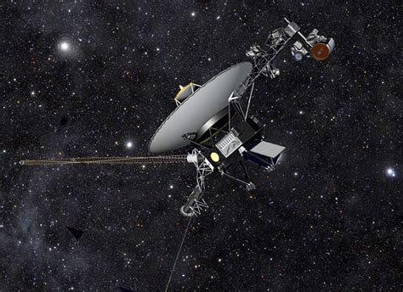
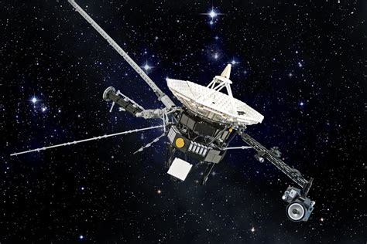
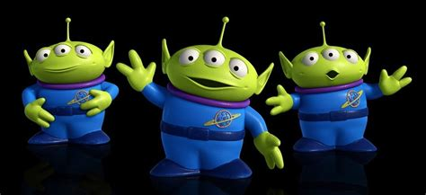
SPROUT F25: How to Talk to Aliens
DAY 1: Where are the Aliens?
Astrobiology, Planetary Science, the Drake Equation, the Fermi Paradox
Astronomy basics: spectroscopy (prisms), photometry (cameras)
Communication & Social Impact
DAY 2: Mission Design
Kenny Phan (he/any), Yale College '27

Slide 2

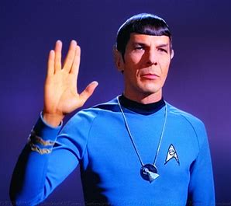
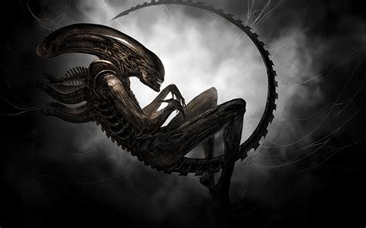
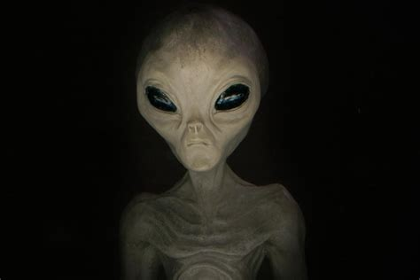
DAY 1: Where are the Aliens?

Slide 3
Q: What is Astrobiology?

Slide 4
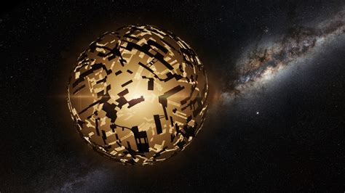
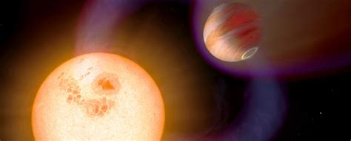
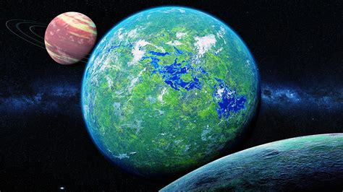
Q: What is Astrobiology?
A: the most interesting subject ever!

Slide 5
e.g. a star and a planet

Slide 6
e.g. a star and a planet
think! pair! share!
if we were space explorers, what would be good to know about this system?

Slide 7
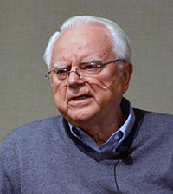
The (Frank) Drake Equation, 1965
N = R * fp * ne * fl * fi * fc * L

Slide 8
The Drake Equation
Number of contactable civilizations =
Rate of star formation *
frac. of stars with planets *
# of planets per star w/ planet(s) *
frac. of those planets w/ life *
frac. of those planets w/ intelligent life *
frac. of those planets with communicative life *
length of time life has been communicating (beyond their planet)

Slide 9
The Drake Equation
N << 1 OR N >> 1
Depending on the values and uncertainties you use
Ridiculously unhelpful!

Slide 10
The Drake Equation
N << 1 OR N >> 1 <-- assume this, N ~ L
Depending on the values and uncertainties you use
Ridiculously unhelpful!

Slide 11

The (Enrico) Fermi Paradox, 1950ish
If we assume N >> 1 (as many astronomers do)
WHERE ARE THE ALIENS?

Slide 12
The (Enrico) Fermi Paradox, 1950ish
help me out!
think pair share:
WHERE ARE THE ALIENS?

Slide 13
The (Enrico) Fermi Paradox, 1950ish
Possible answers:
We are the first
Life is dies too much (the great filter)
We are in a simulation
Everyone is quiet (dark forest theory)
Space is too big

Slide 14
Biosignatures (fl in Drake eqn.)
How did life form? What does it need?

Slide 15
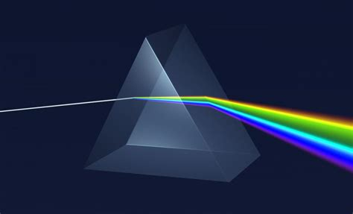

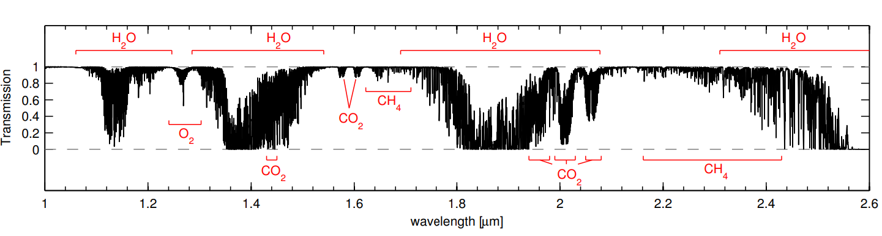
Biosignatures: e.g. w/ spectroscopy
Smette+ 2015

Slide 16

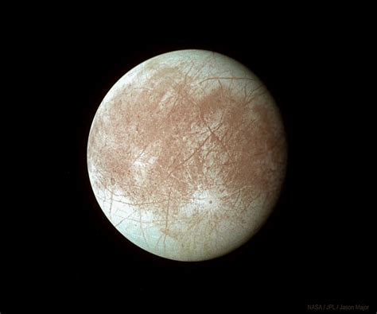
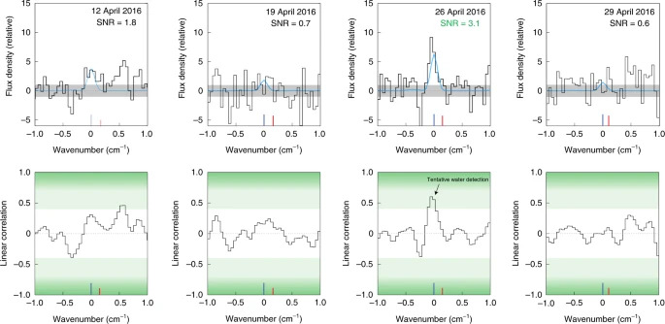
Biosignatures: e.g. w/ spectroscopy
Paganini+ 2019

Slide 17
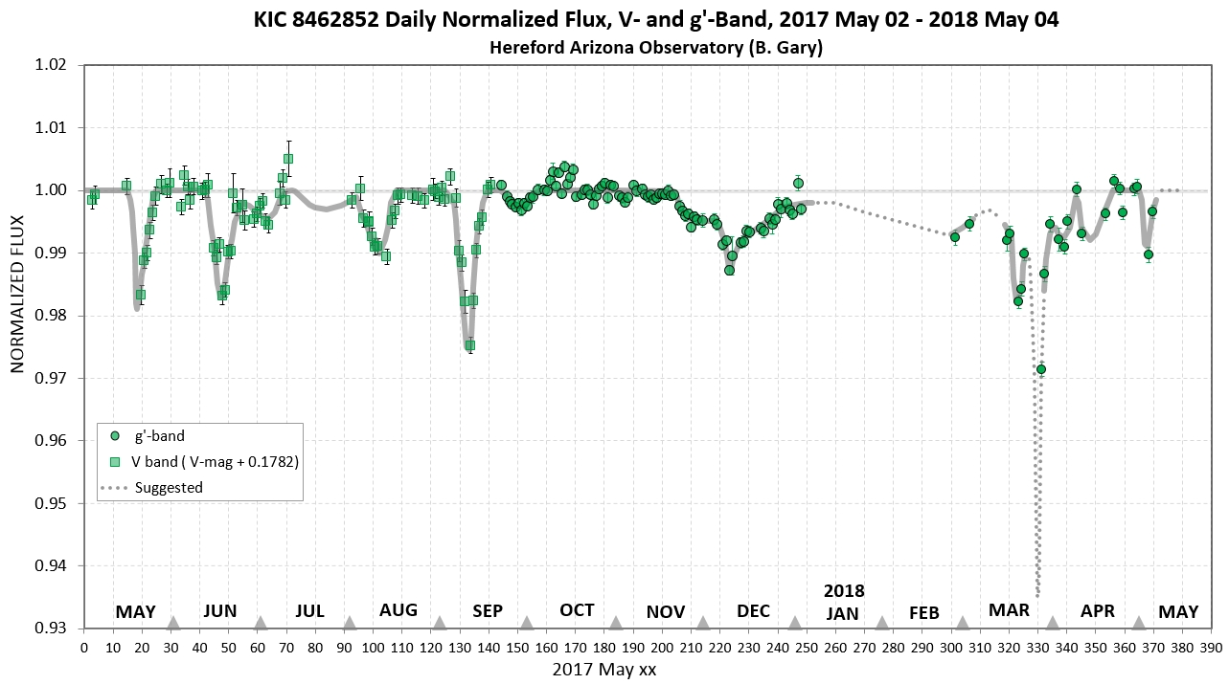
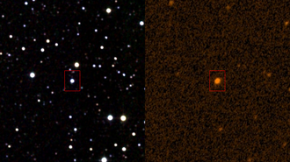
Technosignatures: e.g. w/ photometry

Slide 18
Technosignatures: e.g. w/ photometry

Slide 19
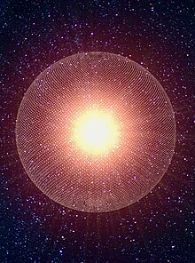
Technosignatures: e.g. w/ photometry

Slide 20
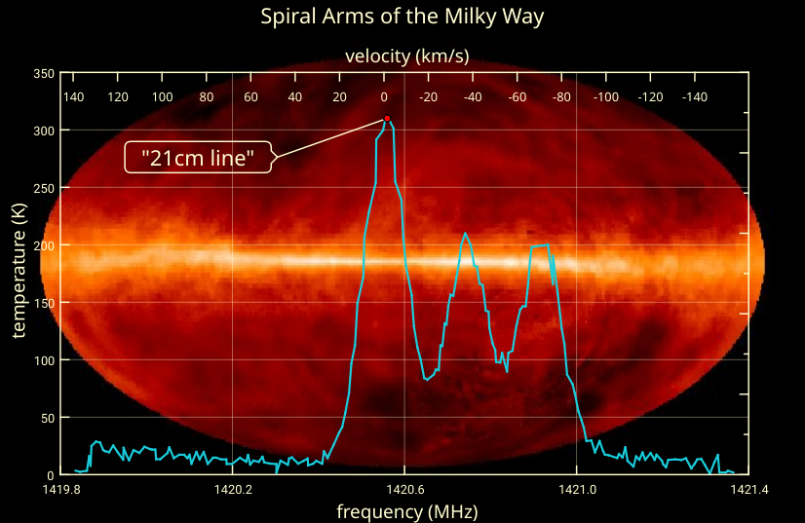
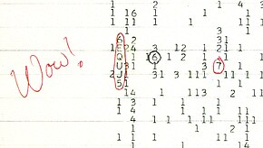
How might we communicate?

Slide 21
How might we communicate?
1420.4556±0.005 MHz

Slide 22
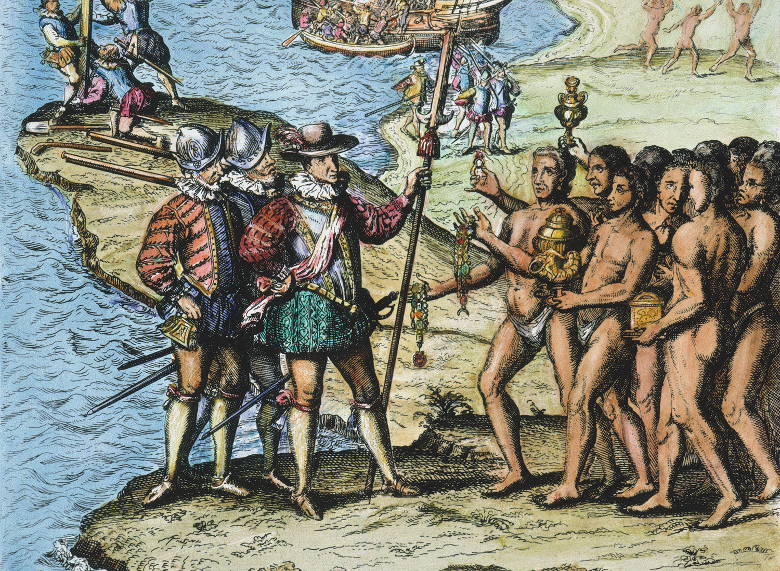
The problem of first contact
Taino population, 1492: 8 million; ~1550: “0”
Mass torture, enslavement
Spread of illness
Led to colonization of the Americas and genocide of indigenous populations

Slide 23
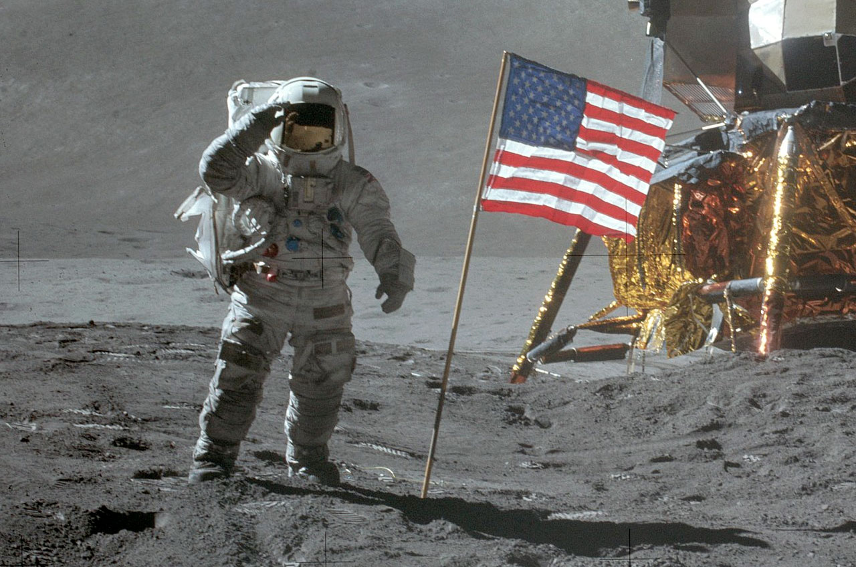
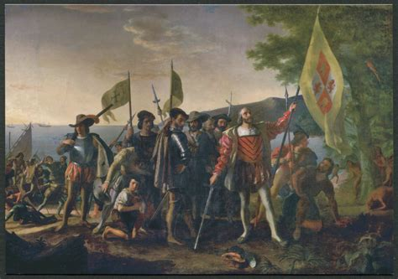
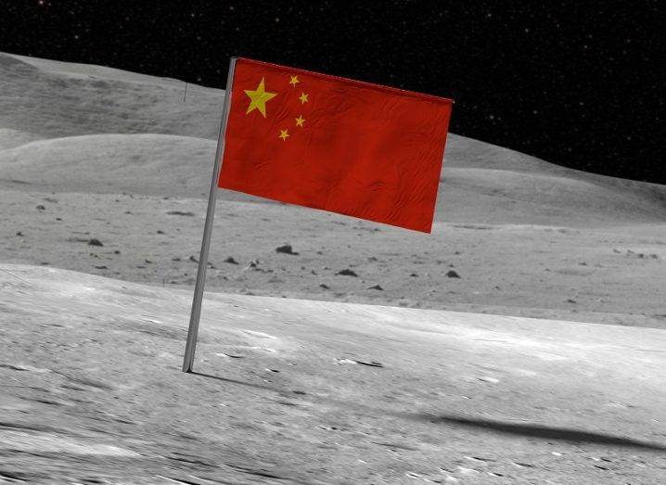

Slide 24
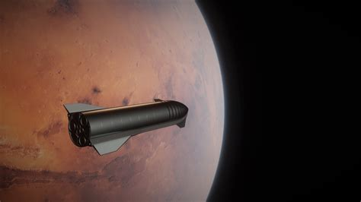

Slide 25
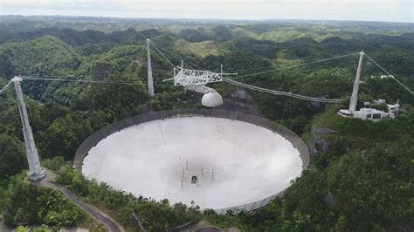
DAY 2: Mission Design
Voyager 1 Probe
Arecibo Observatory
Voyager 2 Probe

Slide 26
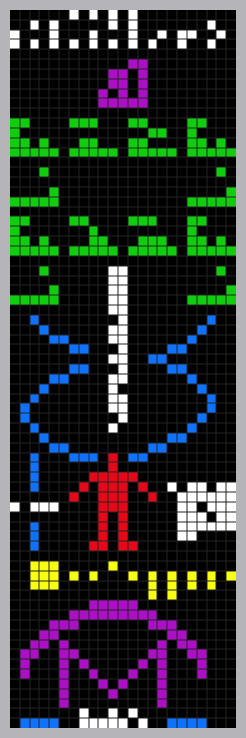
The Arecibo Message (1974)
White – 1 to 10 in binary
Purple – DNA! Atomic numbers of hydrogen, carbon, nitrogen, oxygen, phosphorous
Green – DNA! Nucleotides (molecules that make up DNA)
Blue & White – DNA! Double Helix and number of base pairs
Red, Blue & White – Humans, Average male height (blue, white), human population (white)
Yellow – Planets, highlighting Earth
Purple blue, white – Arecibo Telescope

Slide 27
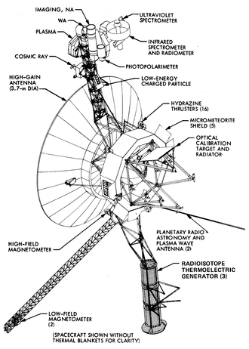
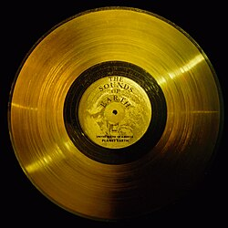
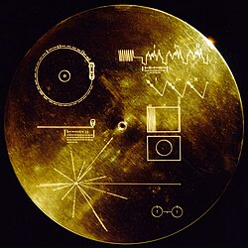
The Voyager Probes (1977)
Only human objects that have escaped the solar system
The Golden Record

Slide 28
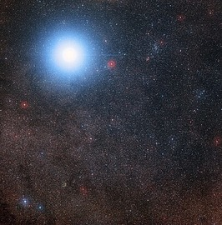
The Mission
Scientists have just received word of mysterious signals from the Alpha Centauri system, 4.3 light years away. It is possible they intercepted the Arecibo Message of 1974. You are tasked with a designing a probe from Earth to our potential interstellar companions. Expect the probe to arrive within ~20 years of launch. Remember, light (aka any communication) takes 1 year to travel 1 light year.

Slide 29
Mission Summary
Breakout groups of ~4
~20 years for a probe to arrive, 4.3 years for comms
What do you want to share? Our knowledge of math and science? Our society? Our music? How do you want to share it? Vinyl? Mp3? An IPhone?
What instruments might you want on the probe? Cameras? Spectrographs? Thermometers?
SHARE OUT at 1:45 (each group has ~2 mins to present)

Slide 30
How did I do? Is astrobiology fascinating?

Slide 31
EXTRA SLIDES

Slide 32
Dark Forest Theory (“cosmic sociology”)
TPS! What are the holes in the dark forest?
3 Axioms
Suppose a vast number of civilizations distributed throughout the universe, on the order of the number of observable stars.
Suppose that survival is the primary need of a civilization.
Suppose that civilizations continuously expand over time, but the total matter in the universe remains constant.
2 Assumptions
Chain of Suspicion: How do we know other intelligent life is friendly? How do they know we are?
Technological explosion: there's no telling when a civilization will "leapfrog" another.

Slide 33
Happy Forest Theory: throughout the universe there is an inexplicable goodwill towards others and everyone lives in harmony forever Chiller Forest Theory: throughout the universe the law of live and let live rules

Slide 34

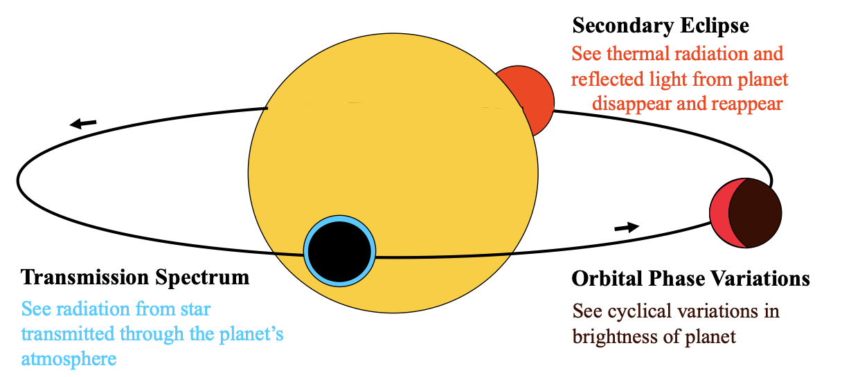
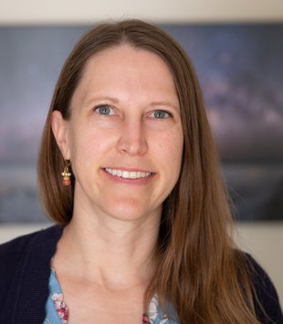
Biosignatures: e.g. w/ spectroscopy
Kempton & Knutson 2024

Slide 35
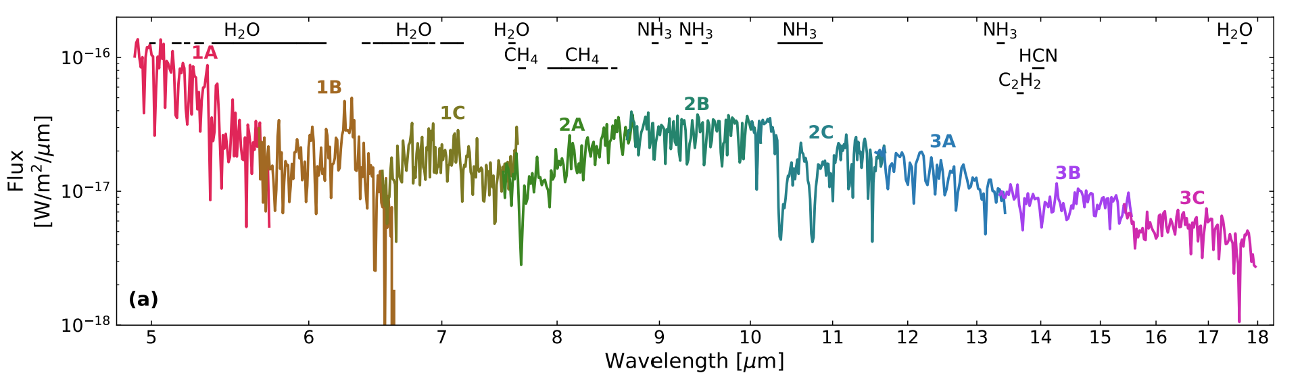
Biosignatures: e.g. w/ spectroscopy
TPS! What kind of planet is this?
Matthews+ 2025

Slide 36
Biosignatures: e.g. w/ spectroscopy
WISE-0458! A Brown Dwarf
Matthews+ 2025

Slide 37
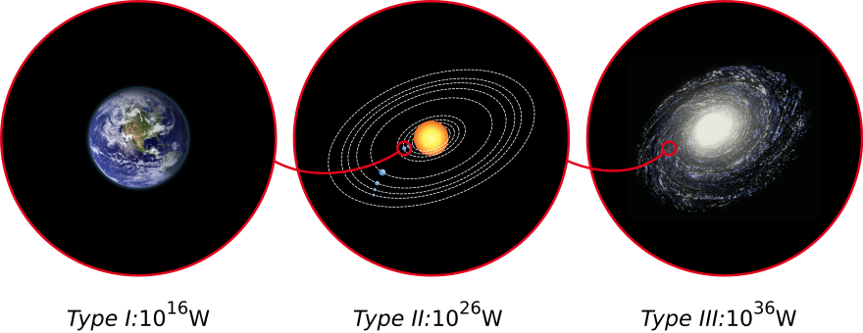
Civilization types (the Kardashev scale)

