Slide 1

RoboHire
AI-Powered Recruiting
for Modern Teams
From role brief to final shortlist, hiring moves on autopilot.
PARTNER SALES KIT
90%
3 Days
7
24/7
Time Saved
Avg. Time-to-Hire
Languages
Availability

Slide 2




The Hiring Problem
Startups are competing for talent with 10x the disadvantage
42 Days Average
$15-25K Per Hire
Time-to-hire while competitors close in 2 weeks
Agency fees that drain startup runway
No Dedicated Recruiter
Inconsistent Interviews
Founders screening resumes at midnight
Engineers pulled off product work to interview

Slide 3

What is RoboHire?
An AI recruiting platform that runs the first 80% of hiring autonomously
From role definition to candidate shortlist — your team only focuses on the final decision.
Hiring Stage | Traditional | RoboHire
Screen 200 Resumes | 3–5 days | Minutes
Interview Scheduling | 2 weeks | 48 hours
Evaluation Consistency | Varies by interviewer | Unified AI standard
Availability | Business hours | 24/7, 7 languages
Cost per Hire (Agency) | $15,000–25,000 | From $29/month

Slide 4



How It Works
6 steps to your next great hire
01
Clarify the Role
AI asks the right questions and produces a structured hiring brief in ~10 minutes.
02
Generate Job Description
STEPS 1–3
Auto-drafts polished JD with responsibilities, requirements, and benefits.
03
Screen Resumes
Semantic matching ranks all candidates with scores, grades, and clear reasoning.

Slide 5



How It Works
6 steps to your next great hire
04
Invite Candidates
Auto-send interview invitations with private links. Candidates self-serve scheduling.
05
AI Video Interviews
STEPS 4–6
24/7 structured conversations with intelligent follow-ups. 7 languages supported.
06
Review & Decide
Structured scorecards with skill fit, experience depth, risk signals, and recommendations.

Slide 6


Why Startups Choose RoboHire
AI Recruiting Team
Semantic Intelligence
Not another dashboard. RoboHire executes work — role definition, screening, interviews, evaluations move forward autonomously.
Reads context, not keywords. Connects 3 years of ML projects with TensorFlow expertise. Intelligent follow-ups during interviews.
Consistent & Defensible
Enterprise Quality, Startup Price
Same questions. Same rubric. Same scoring. No interviewer bias, no mood-dependent variation. Clear audit trail.
No recruiter salary. No agency fees. Professional hiring operations starting at $29/month. Scale without adding HR headcount.

Slide 7
Real-World: Campus Recruiting
150 applicants → 4 finalists in 3 days
Day 1 AM
Brief the role to AI. Upload 150 resumes. Receive ranked top 15 with reasoning.
Day 1 PM
All 15 candidates invited to AI interview. Self-serve scheduling — zero coordination.
Day 2–3
12 candidates complete interviews on their own schedule (evenings, weekends).
Day 3 PM
4 finalists with structured scorecards. Ready for founder final interviews.
“During campus hiring, volume is brutal. With RoboHire, every candidate gets the same core questions, scoring is consistent, and our team gets a much clearer read on intent and soft skills.”
— Head of HR, Consumer Internet Company

Slide 8
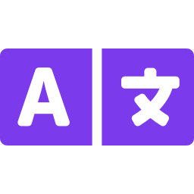
Built for Global Teams
7 Languages
24/7 Availability
Unified Standards
Chinese, English, Japanese,
Spanish, French, Portuguese,
German
Candidates interview on their
schedule — across every
time zone.
Same rubric whether hiring in
Tokyo, Berlin, or San Francisco.
Fair cross-region comparison.

Slide 9


Platform Features
Agent Alex
Smart Matching
AI Interviews
AI recruiting consultant with text chat & live voice
Semantic resume scoring across multiple dimensions
24/7 structured video conversations in 7 languages
Talent Hub
Analytics
ATS Integration
Centralized candidate database with smart tagging
Pipeline metrics, conversion rates, score distributions
Webhook support and API access for custom workflows

Slide 10
Simple, Transparent Pricing
14-day free trial • No credit card required
MOST POPULAR
Starter
Growth
Business
Enterprise
¥179/month
¥1,232/month
¥2,474/month
Custom
1 seat, 3 jobs
15 interviews, 30 matches
Unlimited seats
120 interviews, 240 matches
Unlimited seats
300 interviews, 1000 matches
Everything unlimited
45+ ATS integrations
All plans: 14-day free trial • AI screening • AI interviews • Evaluation reports • Multi-language • Talent pool

Slide 11
ROI: The Numbers Speak
For a 20-person startup hiring 10 people/year
Cost Category | Without RoboHire | With RoboHire
Recruiter salary (part-time) | $30,000/yr | $0
Agency fees (3 hires) | $45,000/yr | $0
Founder time (200 hrs) | $50,000 | $5,000 (20 hrs)
RoboHire subscription | — | $2,388/yr
Total | $125,000+ | $7,388
$117,000+ annual savings
Growth plan at $199/month • Founder time at $250/hr

Slide 12

Security & Compliance
Data encryption at rest and in transit (AES-256, TLS 1.3)
GDPR-ready data handling and candidate consent workflows
SOC 2 aligned security practices
Data residency options for enterprise customers
Automatic data retention policies with candidate purging
No candidate data used for AI training — your data stays yours

Slide 13
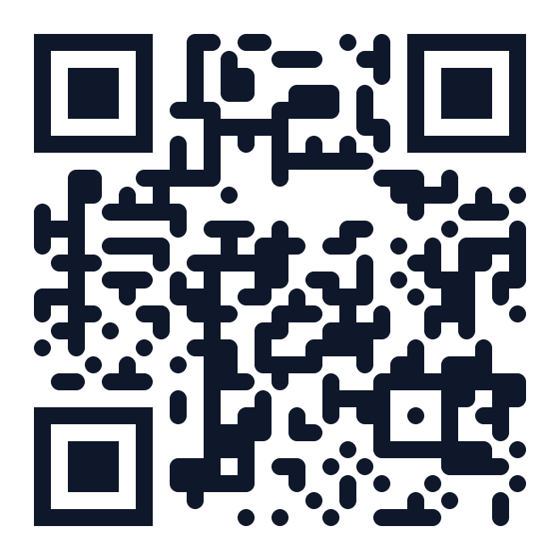
Start Hiring Smarter Today
Let AI handle the repetitive 80%.
Keep your team focused on what humans do best.
14-Day Free Trial → robohire.io
support@robohire.io
Scan to visit
RoboHire — AI-Powered Recruiting for Modern Teams

