Slide 1
IoT CONTROLLED SpY robot
Ece4180 design project
Marcus bolden
Chidiebere okoli
Kehinde aina
Sulemana moro
December 2016

Slide 2
purpose
Create an online GUI
GUI sends commands to mbed via Wi-fi
Commands include:
Move iRobot Create forward, backward, left, and right
Capture picture and record audio/speech
Pictures and recordings are stored on a microSD card

Slide 3
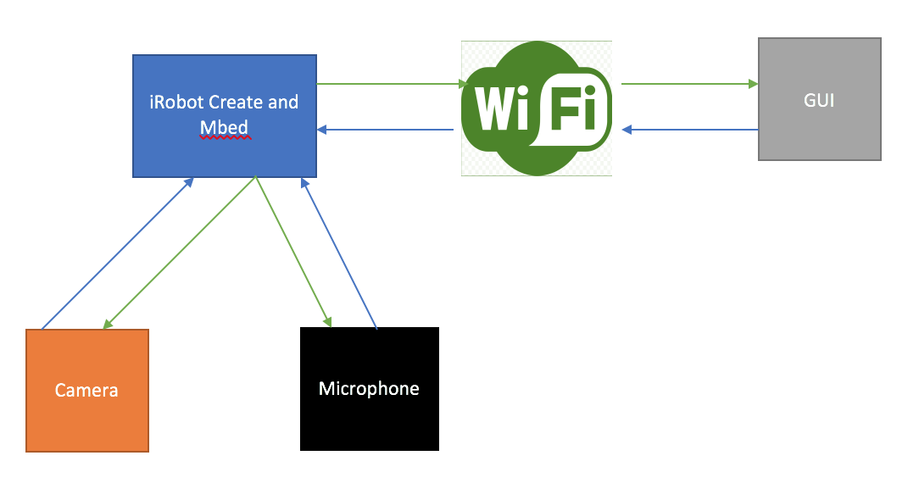
Spy robot block diagram

Slide 4
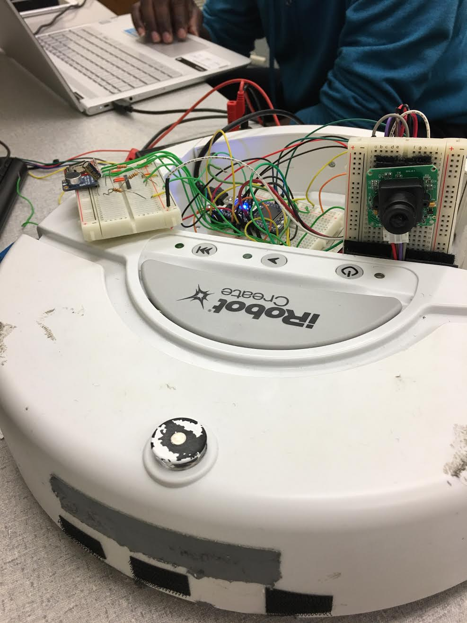
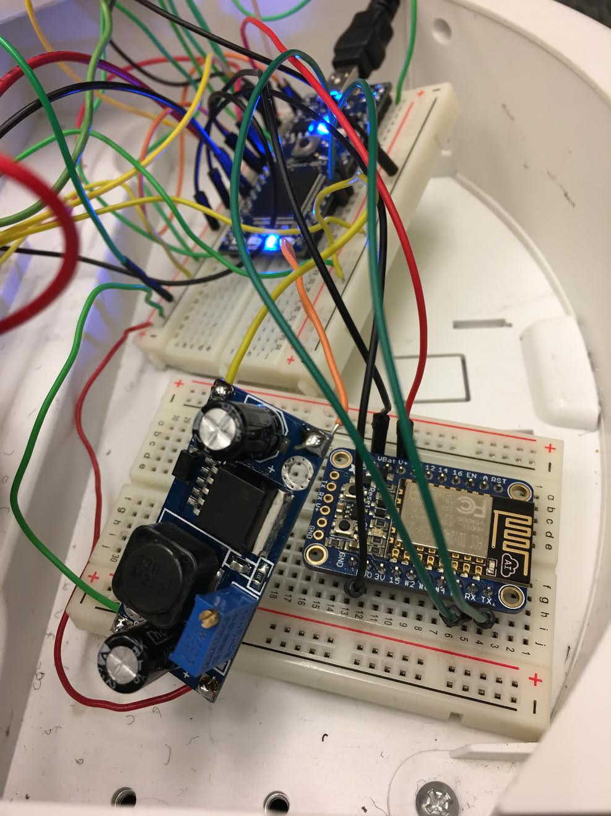
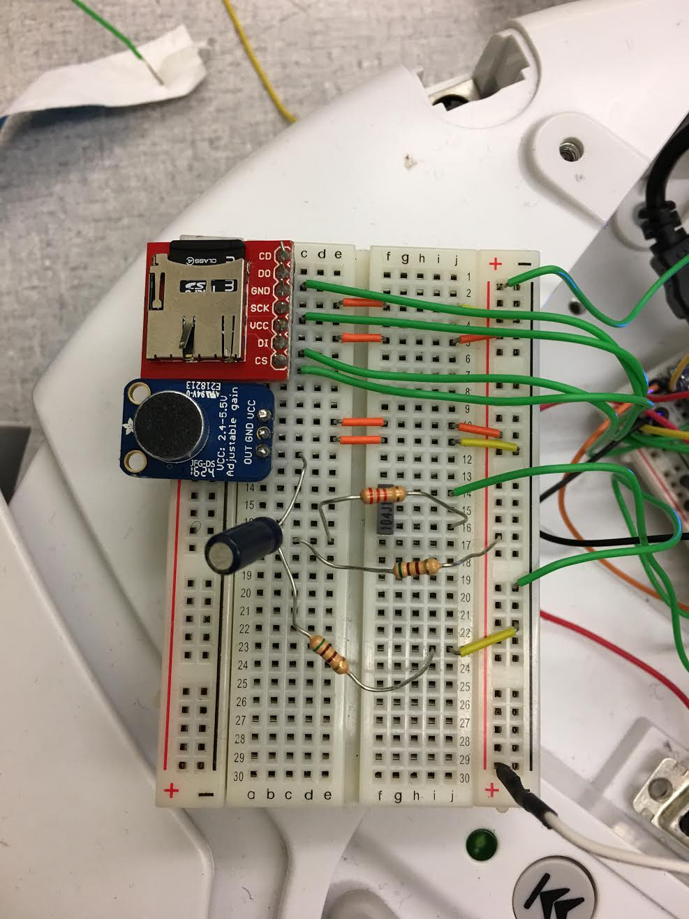
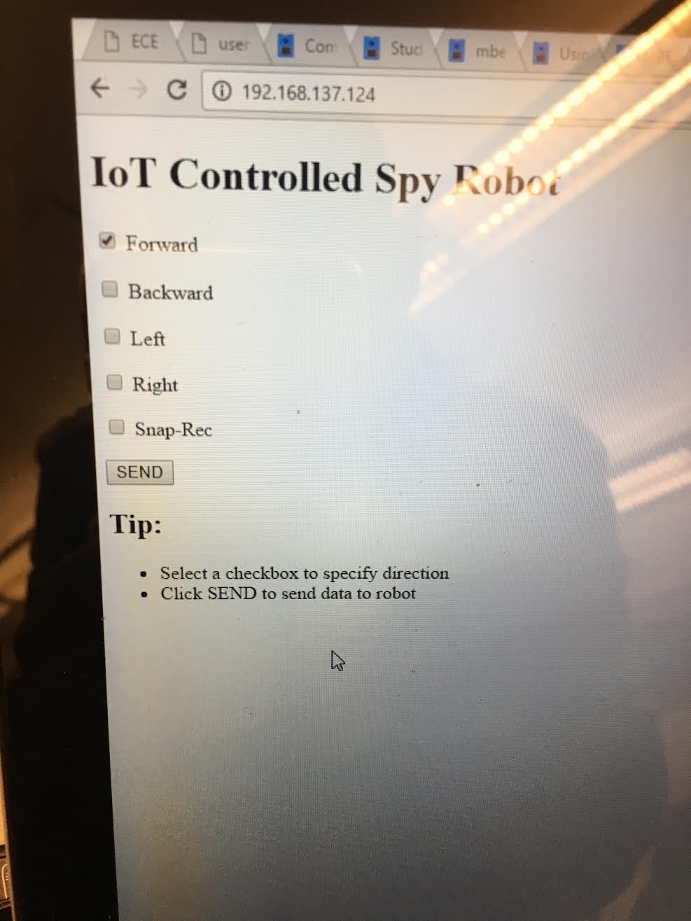
Pictures of spy robot

Slide 5

Some test results and video demo

Slide 6
Challenges
Codes integration
Difficult to have camera and microphone codes work with main code
Limited time
Not enough time to implement wireless transmission of pictures and recordings to a standalone mbed

Slide 7
Future considerations
A display of the online GUI to show captured pictures and if possible live video stream
A smartphone app for the online GUI
Robot location shown on app or GUI
Robot's ability to autonomously detect unusual activities or potential threats

