Slide 1
Advanced
Operating Systems
Part 1: Process

Slide 2
Introduction
System Calls - how a program requests a service from an operating system's kernel
may include:
hardware-related services (e.g. accessing a hard disk drive)
creation and execution of new processes
communication with integral kernel services such as process scheduling
System calls provide an essential interface between a process and the operating system

Slide 3
Introduction
Operating System
Manages computer hardware and provides environment for application programs to run.
Mode
User mode
Kernel mode
System Calls
Provide an interface to the services made
available by the OS

Slide 4
Introduction
System calls provide an essential interface between a process and the operating system
For example, UNIX has about 60 system calls that are at the heart of the operating system

Slide 5
Creating, Compiling and Running a C/C++ program
Creating a C/C++ Program
Editor on a PC machine such as Notepad, Text Pad
Editor on a UNIX machine such as vi editor, Pico
Compiling a C/C++ Program
GNU Compiler (g++), g++ myFile.C
also can use -o and filename in the compilation:
g++ -o myFile myFile.C
Running the program
a.out or myFile

Slide 6
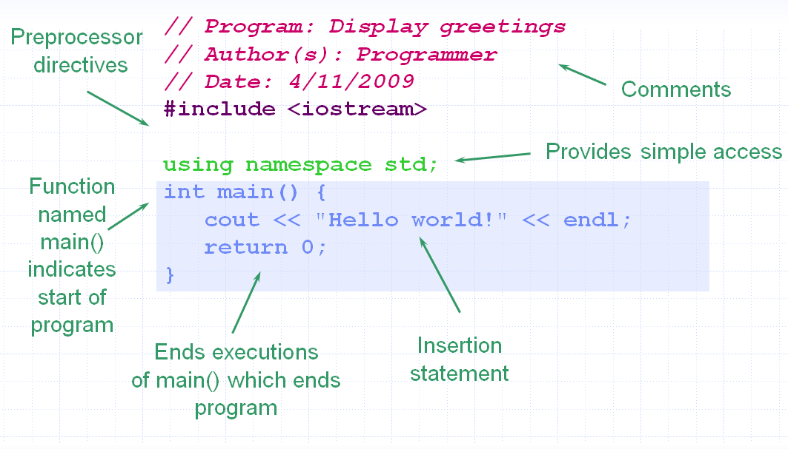
Simple C++ Program
C/C++ program

Slide 7
Where to start
Available UNIX/Linux: cs1.calstatela.edu in CSULA campus
Use telnet to login. There are several different kind of telnet.

Slide 8
Vi Editor
modal editor (two mode)
command mode
The initial mode where most of the keys perform vi commands
insert mode
The mode where what you type is inserted into your document
command line mode transitions
command mode to insert mode Several commands/keys put you into insert mode
i a I A o O
insert mode to command mode Hit the escape key

Slide 9
Vi editor commands
To create a file
Vi filename.c
To save a file
:wq write any changes and quit
:q Quit( will only do so if no changes)
:q! quit without saving changes
To delete
x -- delete a character
dd – delete the entire line
d$ -- delete from the current position to the end of
the line

Slide 10
Time Functions
We can access the clock time with Operating System calls.
Uses of time functions include:
Telling the time
Timing programs and functions
Setting number seeds

Slide 11
Time Functions
DateTime is a predefined class in C++ from the System library
accesses system date & time with DateTime.Today

Slide 12
Time in C++ on UNIX
time_t is typedefed to a long (int) in <sys/types.h> and <sys/time.h>
time_t time(time_t *tloc) -- returns the time since 00:00:00 GMT, Jan. 1, 1970, measured in seconds.
If tloc is not NULL, the return value is also stored in the location to which tloc points. On failure, it returns (time_t) -1.
char *ctime(time_t *clock) -- ctime() converts a long integer, pointed to by clock, to a 26-character string

Slide 13
Time in C++ on UNIX
#include <iostream>
#include <stdio.h>
#include <stdlib.h>
#include <sys/types.h>
#include <unistd.h>
#include <time.h>
using namespace std;
main()
{
int i;
time_t time_local;
for (int i = 0; i < 10; i++)
{
time(&time_local);
cout << ctime(&time_local) << endl;
sleep(1);
}
}

Slide 14
Time in Java
import java.util.Date;
public class My_Time
{
public static void main(String[] args)
{
long currentTime;
Date date;
for (int i = 0; i < 10; i++)
{
currentTime = System.currentTimeMillis();
date = new Date(currentTime);
System.out.println(date.toString());
System.out.println(currentTime);
try
{
Thread.sleep(1000);
} catch (Exception e) {}
}
}
}

Slide 15
Time in C#
DateTime is a predefined class in C# from the System library
accesses system date & time with DateTime.Today
Visual Studio 2010,
Project -> Console Applicayion

Slide 16
using System;
namespace MyTime
{
class Program
{
static void Main(string[] args)
{
Console.WriteLine("Today is : {0}", DateTime.Today);
DateTime yesterday = DateTime.Today.AddDays(-1);
Console.WriteLine("Today is : {0}", yesterday);
}
}
}

Slide 17
Process Control
A process is a single running program.
Process ID: pid
Process Status: UNIX command ps
System call: getpid()
A program usually runs as a single process.
Programs run as several separate communicating processes.

Slide 18
Process(C/C++)
Every process has a parent process(except init)
Think of processes on a Linux system as if they form a tree, with init at it’s root
The parent process ID, “ppid”, is simply the process ID of the process’s parent
When referring to process ID’s in C/C++ code, always use pid_t typedef

Slide 19
Process(C/C++)
The command “ps”, gives us a list of processes and some info on them such as their process ids
Take a try on Linux machine

Slide 20
Process(C/C++)
We can easily and separately access that information by getpid() and getppid()
We definitely need <stdlib.h> and <unistd.h>
#include <iostream>
#include <string>
#include <sys/types.h>
#include <unistd.h>
#include <stdlib.h>
using namespace std;

Slide 21
Process(C/C++)
There are two ways to create a new process:
(1) Using the system function can run a program easy. System call system(char *string) – where string can be the name of a UNIX utility, an executable shell script or a user program. System returns the exit status of the shell. system is prototyped in <stdlib.h>.
#include <stdlib.h>
using namespace std;
int main ()
{
int return_value;
return_value = system (“ls -l /”);
return return_value;
}

Slide 22
Process(C/C++)
(2) Using fork() system call to create a subprocess, hands the command to the Bourne shell for execution
~~~~~~~~~~~~~~~~~~~~~~~~~~~~~~~~~
#include <sys/types.h>
#include <sys/wait.h>
#include <iostream>
#include <unistd.h>
#include <cstdlib>
using namespace std;

Slide 23
Process(C/C++)
int main()
{
int pid;
pid = fork();
if (pid == 0) // This is child process
{
cout << "This is Child Process. pid = " << getpid() << endl;
}
else // This is parent process
{
cout << "This is Parent Process. pid = " << getpid() << endl;
wait(NULL);
cout << "This is Parent Process. Finished " << endl;
}
}

Slide 24
Process(C/C++)
Although using system is relatively simple but it’s inefficient and has security risk. Using fork and exec methods are preferred for creating new processes
Linux’s fork function makes a child process that is an exact copy of it’s parent process
If you want the process to be the instance of another program, use exec
To create a new process, use fork and then exec to make a copy of the current process and then change the process to be an instance of a program

Slide 25
Process(C/C++)
When fork is called, a duplicate of the process is created
Referred to as the “child” of the “parent” process
Executes the same program from the same place
Has it’s own unique process ID
Fork function provides different return values to the parent and the child
one process(parent) goes in to fork and two(parent and child) come out
Child ID is returned zero while parent ID is returned with the child ID

Slide 26
Process(C/C++)
exec functions replace the program running with another program
When exec is called by a program, the process stops executing that program and starts a new one
When using an exec function in programs, the name of the function should be passed as the first element of the argument list
Since exec replaces the program with another one, it never returns unless an error occurs

Slide 27
Process(C/C++)
execl stands for execute and leave
execl(char *path, char *arg0,...,char *argn, 0);
The last parameter must always be 0.
It is a NULL terminator.
Where path points to the name of a file holding a command that is to be executed,
arg0 points to a string that is the same as path (or at least its last component).
arg1 ... argn are pointers to arguments for the command and
0 simply marks the end of the (variable) list of arguments.

Slide 28
Process(C/C++)
execl example
main()
{
cout << ``Files in Directory are: n'';
execl(`/bin/ls'',``ls'', ``-l'',0);
}

Slide 29
Process(C/C++)
Using execvp and execlp, a program name is used to search for a program in the current path
Using execv and execve, an argument list for the new program as a NULL-terminated array of pointers to strings is used

Slide 30
Process(C/C++)
When a program is invoked from the shell, the shell sets the first element of the argument list to the name of the program, the second element of the argument list to the first command-line argument and so on.

Slide 31
Process(C/C++)
int global=2;
pid_t process_ID = 0;
main(){
string process_type;
int iStack=50;
pid_t pID = fork();
if (pID==0) {
process_type = "Child Process: ";
global++;
iStack++;
process_ID = (int) getpid();
execlp("ls", "ls", "-l", "/", NULL);
cout<<"Main program is over"<<endl;
}

Slide 32
Process(C/C++)
else if (pID > 0) {
process_type = "Parent Process: ";
process_ID = (int) getppid();
}
cout<<process_type;
cout<<" Global variable: "<<global;
cout<<" Stack Variable: "<<iStack<<endl;
cout<<" Process ID is "<<process_ID<<endl;
}

Slide 33
Process(C/C++) - wait(int *)
int wait (int *status_location)
Force a parent process to wait for a child process to stop or terminate.
wait() return the pid of the child or -1 for an error.
The exit status of the child is returned to status_location.

Slide 34
Process(C/C++) - exit(int)
void exit(int status)
terminates the process which calls this function and returns the exit status value.
Both UNIX and C++ (forked) programs can read the status value (from wait(), echo $? For bash).
By convention, a status of 0 means normal termination any other value indicates an error or unusual occurrence.

Slide 35
#include <iostream>
#include <cstdlib>
#include <unistd.h>
#include <sys/wait.h>
using namespace std;
int main()
{
int pid;
int child_exit_value;
pid = fork();
if (pid == 0) // child process
{
cout << "Child process pid = " << getpid() << endl;
sleep(1);
exit(8);
}
else // parent process
{
child_exit_value = 0;
wait(&child_exit_value);
cout << "Parent process pid = " << getpid() << endl;
cout << "The exit system call in Child process return value : " << endl;
cout << WEXITSTATUS(child_exit_value) << endl;
}
}

Slide 36
Process(C/C++) – Multi Children
int wait (int *status_location)
If the calling process has multiple child processes, the function returns when one returns.
To wait for one child: wait(NULL).
To wait for many children: waitpid(pid[i], NULL, 0);

Slide 37
#include <iostream>
#include <sys/types.h>
#include <sys/wait.h>
#include <unistd.h>
#include <cstdlib>
using namespace std;
int main()
{
int pid[3];
pid[0] = fork();
if (pid[0] > 0)
{
cout << "[parent] 1 pid = " << getpid() << endl;
pid[1] = fork();
if (pid[1] > 0)
{
cout << "[parent] 2 pid = " << getpid() << endl;
pid[2] = fork();
if (pid[2] > 0)
{
cout << "[parent] 3 pid = " << getpid() << endl;
}
else if (pid[2] == 0)
{
cout << "[child 3] pid = " << getpid() << endl;
exit(3);
}
}
else if (pid[1] == 0)
{
cout << "[child 2] pid = " << getpid() << endl;
exit(2);
}
for(int i = 0; i < 3; i++)
{
waitpid(pid[i],NULL,0);
}
cout << "[parent] 1 finished " << endl;
}
else if (pid[0] == 0)
{
cout << "[child 1] pid = " << getpid() << endl;
exit(1);
}
}

Slide 38
Process(Java)
Before JDK 5.0, the only way to fork off and execute a process was to use the exec() method of the java.lang.Runtime class.
The java.lang.Runtime.exec(String command) method executes the "command" in a separate process.
public class CreateProcess
{
public static void main(String[] args)
{
try
{
System.out.println("Create a process to execute notepad.exe");
Process process = Runtime.getRuntime().exec("notepad.exe");
System.out.println("Notepad is now open in other window.");
} catch (Exception ex) {}
}
}
New ways of executing a command in a separate process involves a class called ProcessBuilder.

Slide 39
Process(Java)
Before calling the exec()
Specify the command and it’s arguments
Environment variable settings
Working directory
All versions of the method return a java.lang.Process object for managing the created process
After this, we can get the input/output stream of the subprocess and other information

Slide 40
Java Process Exec()
import java.util.*;
import java.io.*;
public class J_Process
{
public static void main(String[] args) {
try {
Process myProcess = Runtime.getRuntime().exec("/bin/ls");
InputStreamReader myProReader = new InputStreamReader(myProcess.getInputStream());
BufferedReader myProInput = new BufferedReader(myProReader);
String line;
while ((line = (myProInput.readLine())) != null)
{
System.out.println(line);
}
} catch (Exception e)
{ }
}
}

Slide 41
Process(Java)
The ProcessBuilder class has two constructors
public ProcessBuilder(List command)
Accepts a List for the command and it’s argument
public ProcessBuilder(String… command)
Accepts a variable number of String arguments
Call start() to execute the command

Slide 42
Process(Java) - Windwos
import java.io.*;
import java.util.*;
public class Build_Process_Windows {
public static void main(String[] args) throws Exception
{
String[] proCommands = {"cmd", "/c", "dir"};
ProcessBuilder processBuilder = new ProcessBuilder(proCommands);
processBuilder.directory(new File("c:\\temp"));
Process myProcess = processBuilder.start();
BufferedReader readOutputCMD = new BufferedReader(new InputStreamReader(
myProcess.getInputStream()));
String outputLine;
System.out.println("Output of " + Arrays.toString(proCommands));
while ((outputLine = readOutputCMD.readLine()) != null)
{
System.out.println(outputLine);
}
int processExitValue = myProcess.waitFor();
System.out.println("Process Exit Value is: " + processExitValue);
}
}

Slide 43
Process (Java) - LINUX
import java.io.*;
import java.util.*;
public class Build_Process
{
public static String getProcessID() throws Exception
{
List<String> proCommands = new ArrayList<String>();
proCommands.add("/bin/bash");
proCommands.add("-c");
proCommands.add("echo $PPID");
ProcessBuilder processBuilder = new ProcessBuilder(proCommands);
Process myProcess = processBuilder.start();
myProcess.waitFor();
if(myProcess.exitValue() == 0)
{
BufferedReader outReader = new BufferedReader(new InputStreamReader(myProcess.getInputStream()));
return outReader.readLine().trim();
}
else
{
System.out.println("Error while getting PID");
return "";
}
}
public static void main(String[] args) throws Exception
{
System.out.println("Process ID is" + getProcessID());
}
}

Slide 44
Process(Java) – a little complex one
combine with threads

Slide 45
Process (C#)
In order to access system calls from C#, we must include the following namespaces (collections of classes):
using System;
using System.Diagnostics;
“using” is a keyword that imports a namespace

Slide 46
Process (C#)
Creating a new process in C# (use Process class)
Process myProcess = new Process();
Retrieving Process ID
Console.WriteLine(myProcess.Id);
//prints process Id
Start process
myProcess.Start()
//starts specified process (arguements optional)

Slide 47
Process (C#)
Executing a process
using System.Diagnostics;
namespace MyProcess_1
{
class Program
{
static void Main(string[] args)
{
Process.Start("notepad.exe");
}
}
}

Slide 48
Process (C#)
Accessing process name
myProcess.ProcessName()
//returns String of process name
Accessing process status
myProcess.Responding
//returns boolean true if running, false if
//idle

Slide 49
Process (C#)
Accessing Process Information
using System;
using System.Diagnostics;
namespace MyProcess_2
{
class Program
{
static void Main(string[] args)
{
Process[] myProcesses = Process.GetProcesses();
Console.WriteLine("Number of Processes: {0}", myProcesses.Length);
foreach (Process tmpProcess in myProcesses)
{
Console.WriteLine(tmpProcess.Id);
}
}
}
}

Slide 50
Process (C#)
Accessing Process Information
using System;
using System.Diagnostics;
namespace MyProcess_3
{
class Program
{
static void Main(string[] args)
{
Process[] myProcesses = Process.GetProcesses();
Console.WriteLine("Number of Processes: {0}", myProcesses.Length);
Console.WriteLine("{0, -8} {1, -30} {2, -10}", "PID", "Process Name", "Status");
foreach (Process tmpProcess in myProcesses)
{
Console.WriteLine("{0, -8} {1, -30} {2, -10}",
tmpProcess.Id, tmpProcess.ProcessName, tmpProcess.Responding ? "Running" : "Idle");
}
}
}
}

Slide 51
Process (C#)
Waiting for a process to end
Process waitProcess = myProcess.Start();
waitProcess.WaitForExit();
//exits after myProcess is complete
Process Exit Code
myProcess.ExitCode
//returns 0 if normal termination occurs
// any other value indicates an error or unusual
//occurrence

Slide 52
Process
Forcing a process to end
myProcess.Kill();
//forcess the process to terminate immediately
using System;
using System.Diagnostics;
using System.Threading;
namespace MyProcess_4
{
class Program
{
static void Main(string[] args)
{
Process myProcess = Process.Start("notepad.exe");
Thread.Sleep(3000);
myProcess.Kill();
}
}
}

