Slide 1

First Period
Who is f3

Slide 2
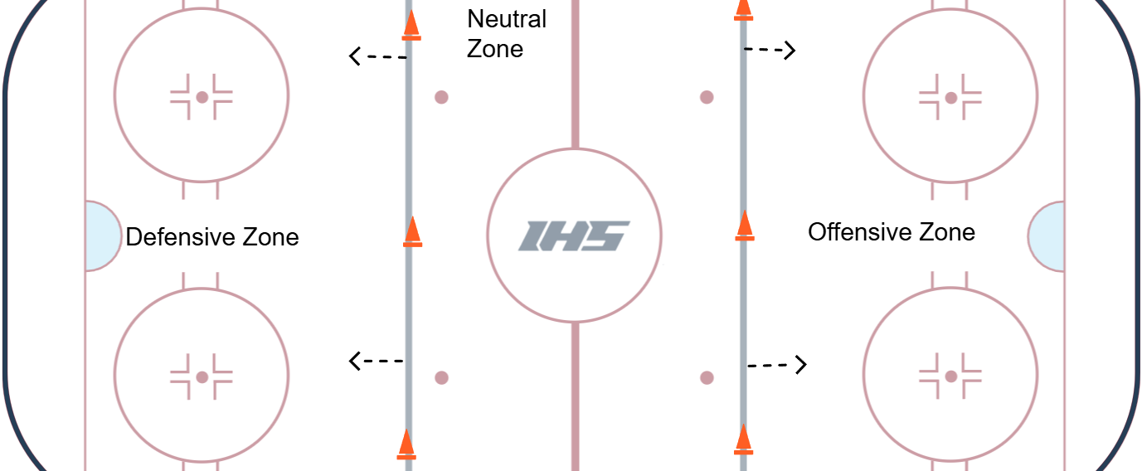
Zones
The defensive zone is the end that your goalie is in and you are defending. The offensive zone is the end that we are trying to score on.

Slide 3
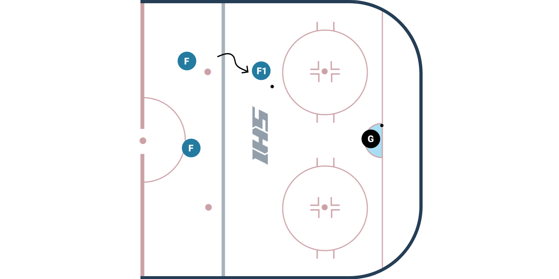
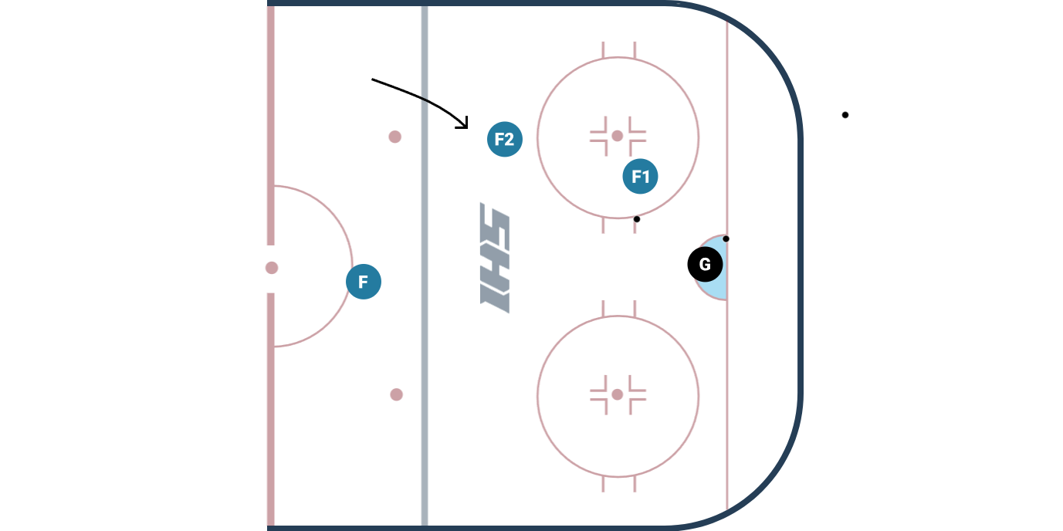
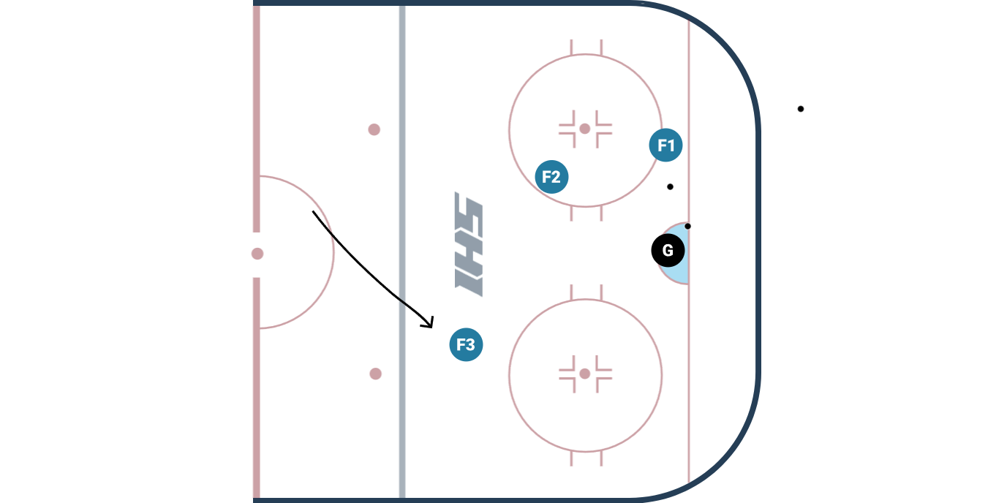
When you are in the offensive zone. The first three skaters will be:
F1
F2
F3
The first player to go over the other teams blue line
The 2nd player to go over the other teams blue line
The 3 player to skate over the other teams blue line

Slide 4
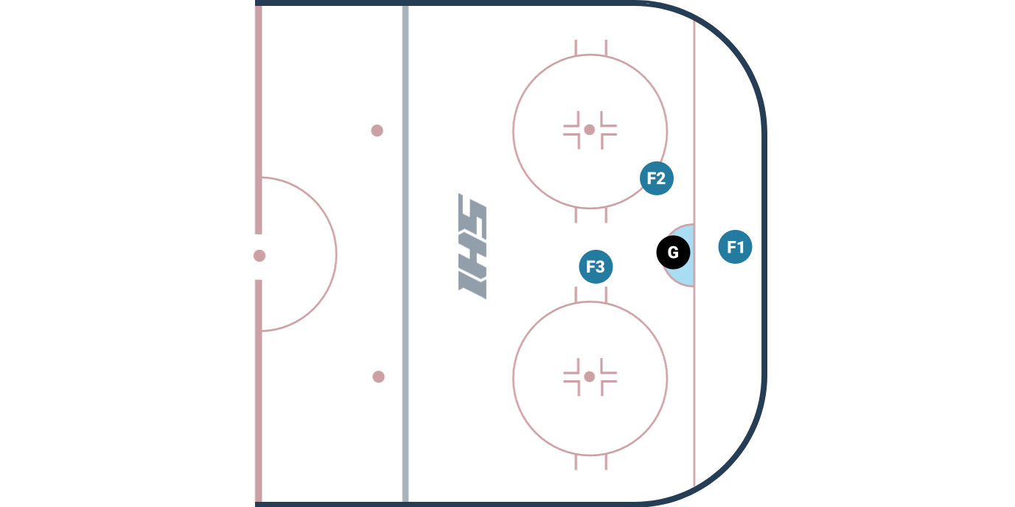
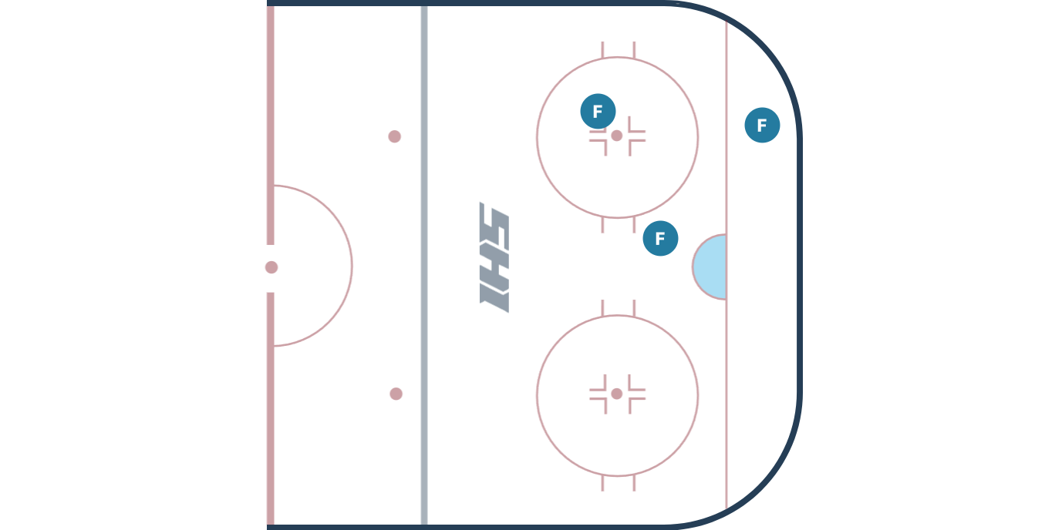
In the offensive zone. F1 is the farthest in, F2 is 2nd, and F3 is 3rd.
Find the F2

Slide 5
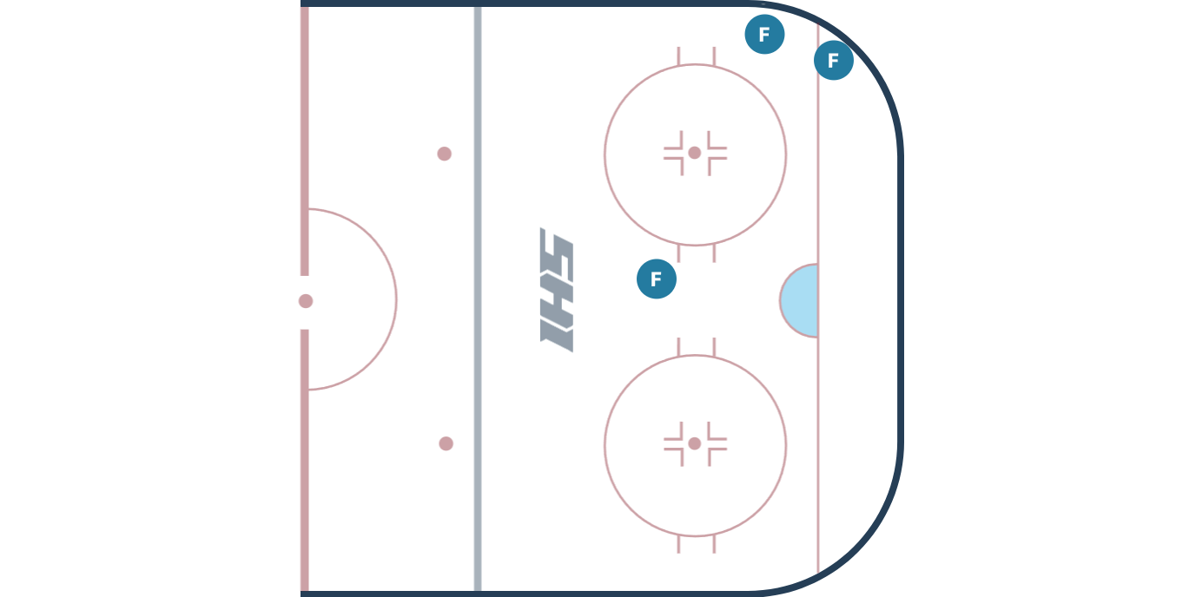
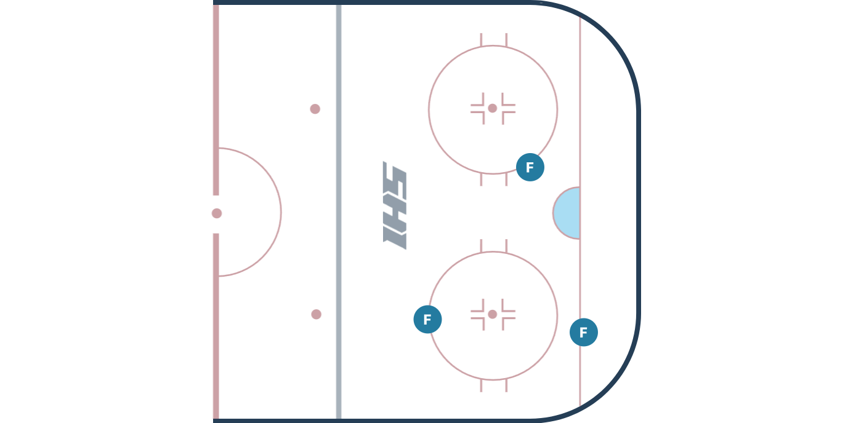
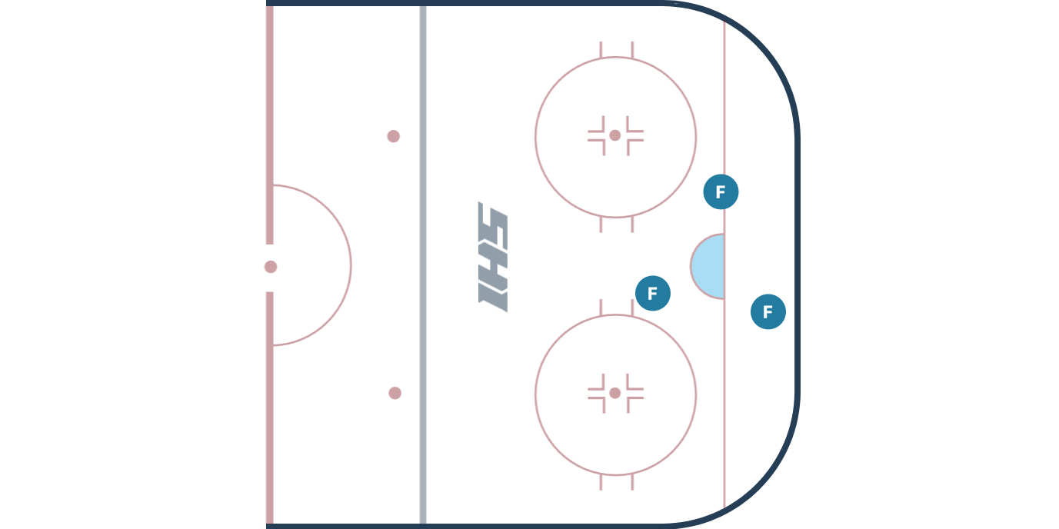
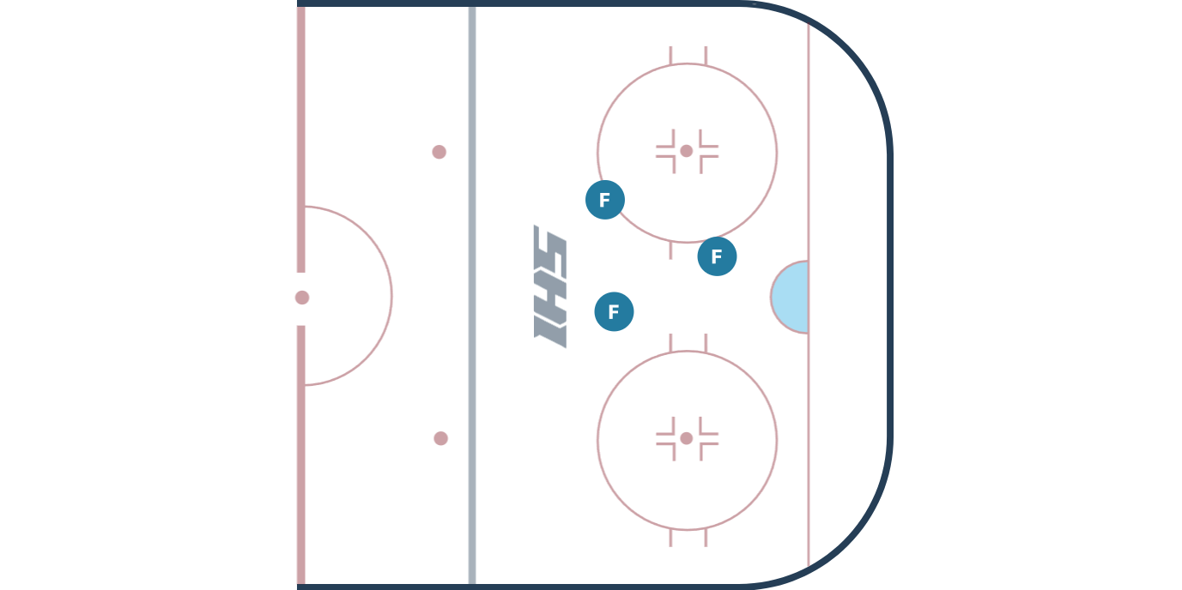
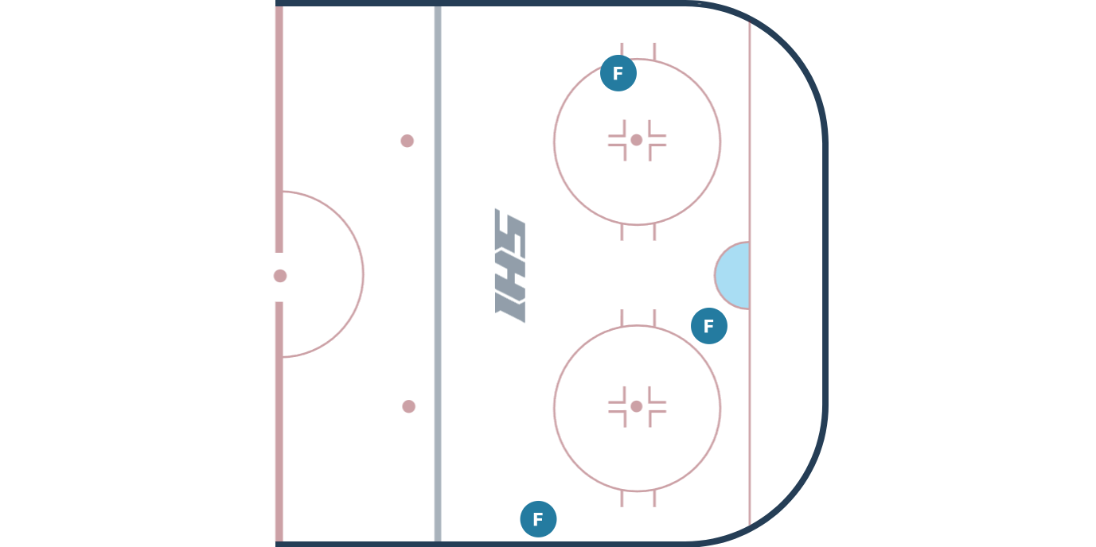
Find the F1 in every picture

Slide 6
Find the F2 in every picture

Slide 7
Find the F3 in every picture

Slide 8
Did you find them all
THE END

